Slide 1
Vive Trackers for Unity3D

Slide 2
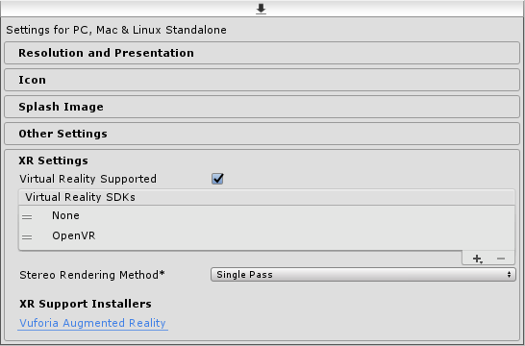
Unity3D Configuration
Import the SteamVR plugin for Unity in your project:
https://assetstore.unity.com/packages/tools/integration/steamvr-plugin-32647
If applicable (depends on SteamVR plugin version), uncheck :
Preferences -> SteamVR -> Automatically Enable VR
Check : Project Settings -> Player -> XR Settings > Virtual Reality Supported
Add VR SDK None
Add VR SDK OpenVR
*ViveTrackersManager script automatically initializes OpenVR,
so we need to set the primary VR SDK to None
to prevent Unity3D to initialize OpenVR.
NB: The SteamVR application should always run in the background while the Unity3D application (either the UnityEditor or an executable) is running. If not, you should expect Vive Trackers connections issues !!!

Slide 3
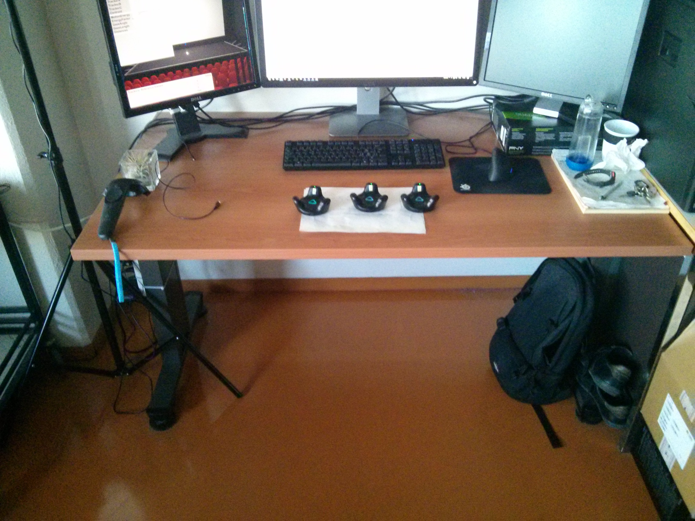
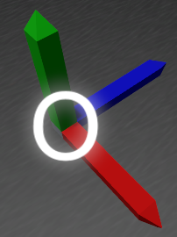
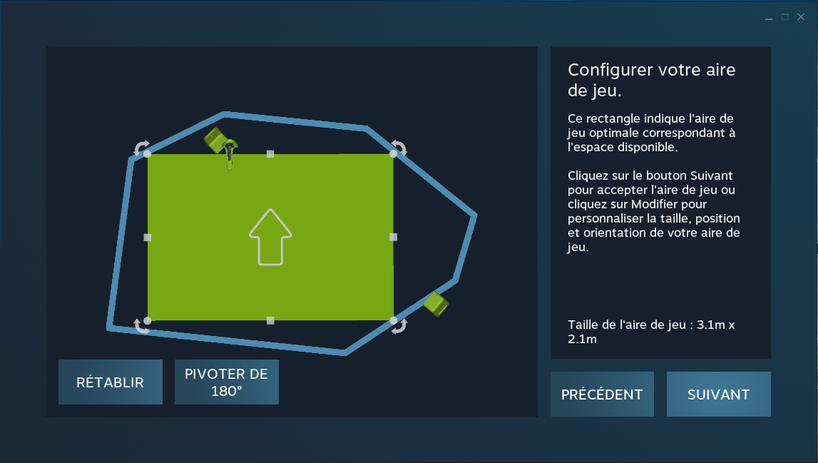
Understanding SteamVR calibration and Vive Trackers calibration
1. Vive Trackers calibration in Unity3D
In Unity3D, ViveTracker objects can be calibrated. The origin reference frame is used as the default transformation for their calibration.
*during runtime,
the origin reference frame
can also be used to apply an offset
(3D Position & Rotation) to all the trackers.
SteamVR reference frame in the real space
SteamVR reference frame
2. SteamVR Room calibration
If you need to get a perfect match between your virtual world and your real world (e.g. going towards a direction in the real world applies the same direction in the virtual world), you should make the SteamVR reference frame aligned with the desired forward axis in your real space.
*each time a SteamVR calibration is done, the application using the Vive Trackers must be restarted (e.g: UnityEditor).

Slide 4
SteamVR configuration

Slide 5
Running SteamVR with Vive Trackers only (no HMD)
Modify these SteamVR configuration files:
SteamFolder/steamapps/common/SteamVR/drivers/null/resources/settings/default.vrsettings
> set enable to true
SteamFolder/steamapps/common/SteamVR/resources/settings/default.vrsettings
> set requireHmd to false
> set forcedDriver to null
> set activateMultipleDrivers to true
More informations:
http://help.triadsemi.com/en/articles/836917-steamvr-tracking-without-an-hmd

Slide 6
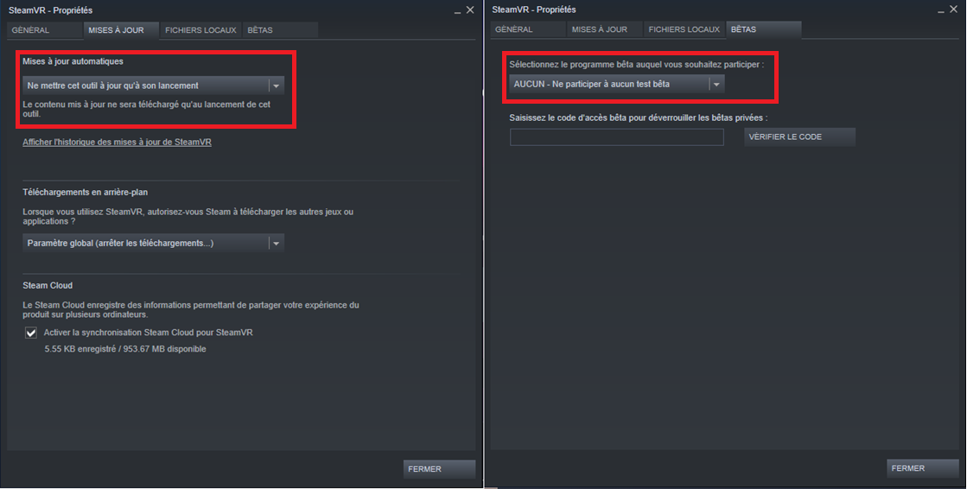
Set SteamVR properties in Steam
Force SteamVR to update itself only when Steam is launched
Recent versions of SteamVR have good support for Vive Trackers. So, you can avoid beta versions.
NB : Be careful when Steam performs a SteamVR update :
default.vrsettings files could be overridden with new ones !!!

Slide 7
Optimize Vive Trackers connection reliability

Slide 8
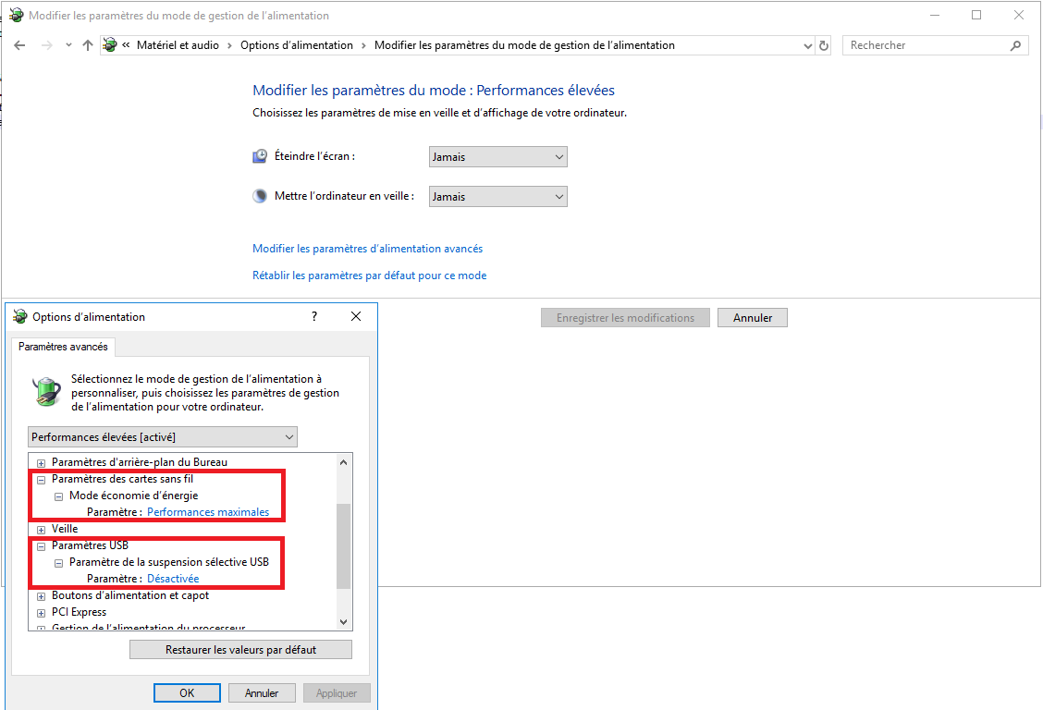
Configure Windows Power Options

Slide 9
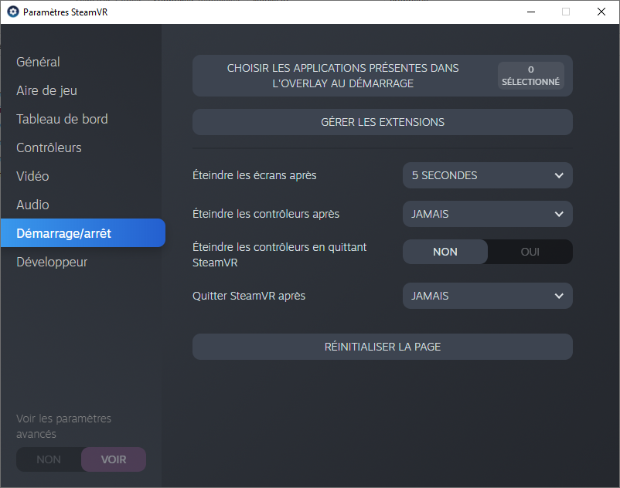
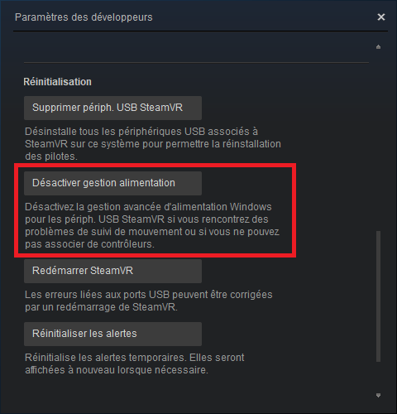
Set SteamVR settings
SteamVR will update itself only if Steam is executed !

