Slide 1
Vive Trackers for Unity3D
1. Unity3D plugin usage
2. SteamVR configuration
3. Optimize tracking reliability

Slide 2
1. Unity3D plugin usage

Slide 3
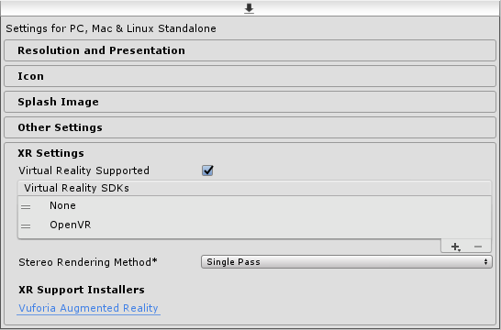
Unity3D Configuration
Import the SteamVR plugin for Unity in your project:
https://assetstore.unity.com/packages/tools/integration/steamvr-plugin-32647
If applicable (depends on SteamVR plugin version), uncheck :
Preferences -> SteamVR -> Automatically Enable VR
Check : Project Settings -> Player -> XR Settings > Virtual Reality Supported
Add VR SDK None
Add VR SDK OpenVR
*ViveTrackersManager script automatically initializes OpenVR,
so we need to set the primary VR SDK to None
to prevent Unity3D to initialize OpenVR.
*Please look at ViveTrackersTest script for an example usage.
NB: the SteamVR application should always run in the background while the Unity3D application (either the UnityEditor or an executable) is running. If not, you should expect Vive Trackers disconnections issues !!!

Slide 4
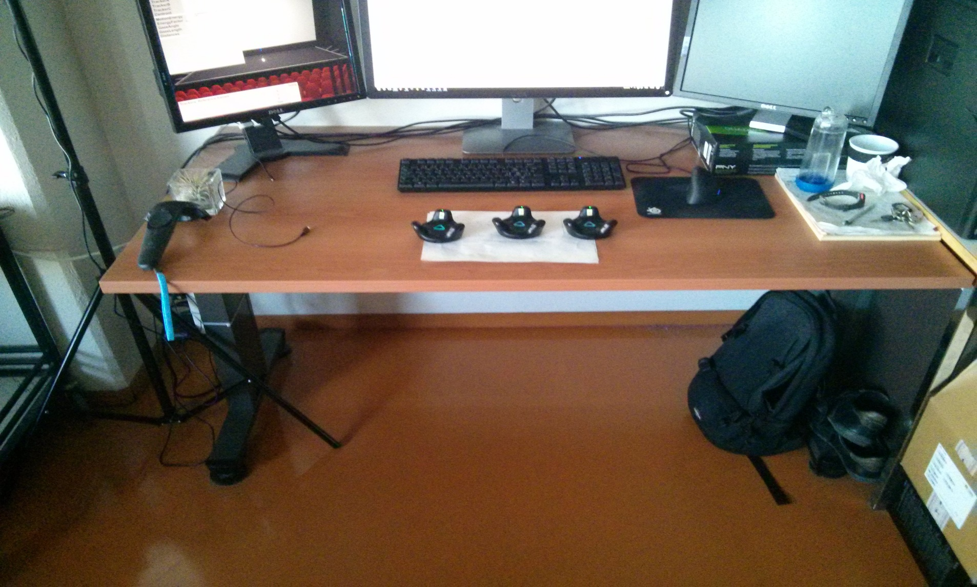
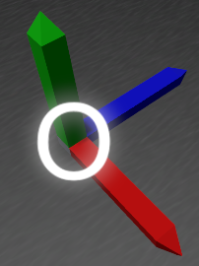
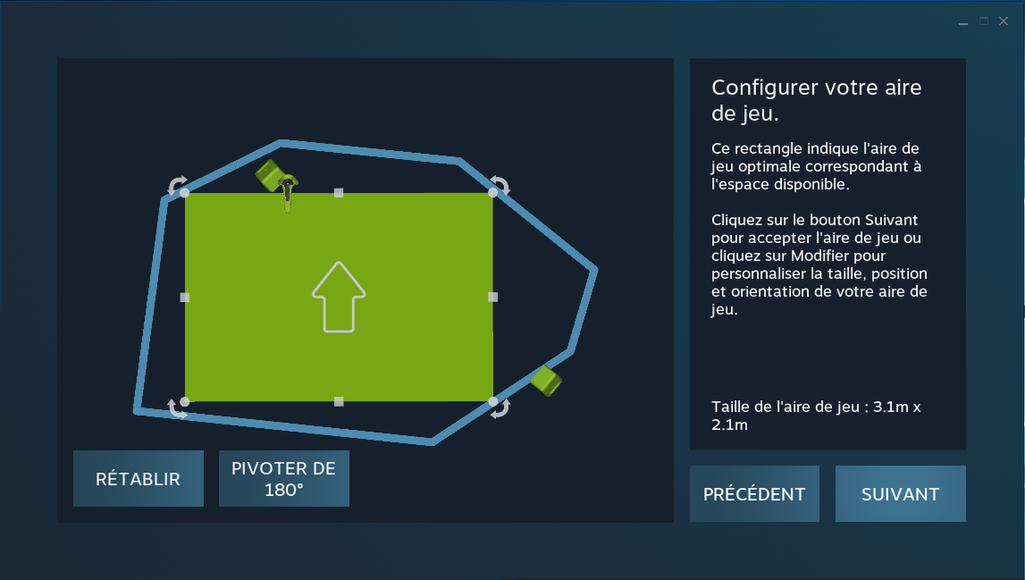
SteamVR Room calibration Vs Vive Trackers calibration
1. Vive Trackers calibration in Unity3D
In Unity3D, ViveTracker objects can be calibrated. The origin reference frame is used as the default
rotation for their calibration.
*during runtime,
the origin reference frame
can also be used to apply an offset
(3D Position & Rotation) to all the trackers.
SteamVR reference frame in the real space
2. SteamVR Room calibration
If you need to get a perfect match between your virtual world and your real world (e.g. going towards a direction in the real world applies the exact same direction in the virtual world), you should make the SteamVR reference frame aligned with the desired forward axis in your real space.
SteamVR reference frame
NB : each time a SteamVR Room calibration is done, the application using the Vive Trackers should be restarted (e.g: UnityEditor).

Slide 5
Keep Vive Trackers identification consistent during runtime
When using Vive Trackers, one problem is to guarantee that a given Vive Tracker device is always associated to the same Vive Tracker virtual object (e.g. a GameObject with a ViveTracker script on it), no matter what are the wireless connections issues during runtime (e.g. in the worst case, a given Vive Tracker device can be disconnected and connected again multiple times).
To guarantee a consistent identification of Vive Tracker devices and no duplicates of the corresponding Vive Tracker virtual objects, we use a configuration file (see ViveTrackers.csv) which allows you to define the association between a Vive Tracker device (using its unique serial number) and a unique label that you can freely define (e.g. « A », « B », « C », …).
The ViveTrackersManager script can use this configuration file to always associate a Vive Tracker device with the same unique Vive Tracker virtual object.
To build your own configuration file, you first need to:
add your Vive Tracker devices’ serial numbers to it : set logTrackersDetection field to true
allow the use of all available connected devices in SteamVR : set createDeclaredTrackersOnly field to false
This way, all the connected Vive Tracker devices will get their serial numbers printed in the Unity3D Console, and you can just copy these serial numbers to fill your own configuration file.
Once your configuration file is built, you can use it by:
setting your configuration file path : set configFilePath field
enabling the automatic association defined in your configuration file : set createDeclaredTrackersOnly field to true

Slide 6
2. SteamVR configuration

Slide 7
Running SteamVR with Vive Trackers only (no HMD)
Modify these SteamVR configuration files:
SteamFolder/steamapps/common/SteamVR/drivers/null/resources/settings/default.vrsettings
> set enable to true
SteamFolder/steamapps/common/SteamVR/resources/settings/default.vrsettings
> set requireHmd to false
> set forcedDriver to null
> set activateMultipleDrivers to true
More informations:
http://help.triadsemi.com/en/articles/836917-steamvr-tracking-without-an-hmd

Slide 8
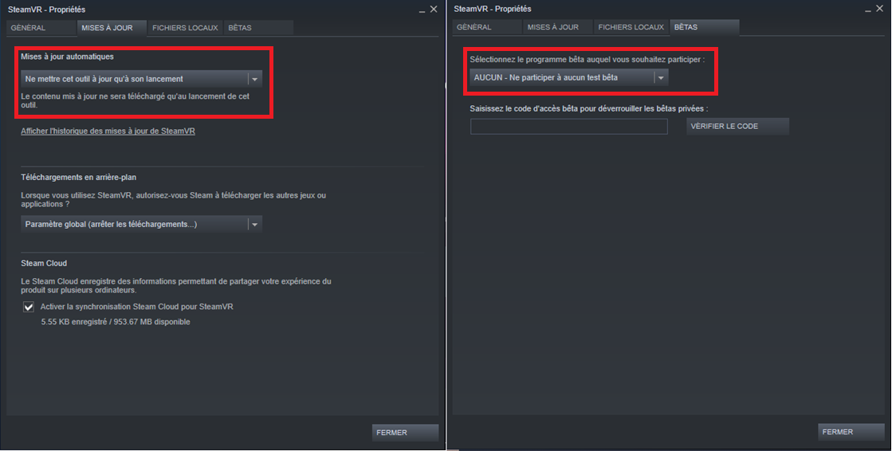
Set SteamVR properties in Steam
Force SteamVR to update itself only when Steam is launched
Recent versions of SteamVR have good support for Vive Trackers. So, you can avoid beta versions.
NB : Be careful when Steam performs a SteamVR update :
default.vrsettings files could be overridden with new ones !!!

Slide 9
3. Optimize tracking reliability

Slide 10
Tracking Setup
1. Bluetooth dongles should be setup the farthest away from each others. This is the most influencing parameter to get good tracking results. We advise to use usb cables with 2m as minimum length, to avoid radio interferences between your Bluetooth dongles.
2. Remove light reflection sources as possible in your tracking area (e.g : windows, mirrors, and other reflective surfaces). Lighthouse tracking is really sensible to reflections (more information : https://xinreality.com/wiki/Lighthouse).
3. Base stations should be setup not to far away from each others.
When using 2x Base stations, use HTC recommendations : https://www.vive.com/fr/support/vive/category_howto/tips-for-setting-up-the-base-stations.html
When using 4x Base stations, use this process to place your base stations to get a good tracking quality :
- Physically place your Base stations as a rectangle shape (e.g the 4 corners of a room)
- do the SteamVR Room calibration using the 4 corners technic
- mark each Room’s corner taking care to physically place your Vive Controller just below each Base station (the Vive controller position and the Base station position should be the same 2D position on the SteamVR calibration 2D view).
- when the 4 corners are defined, SteamVR calibration should produce a rectangle with every angles corresponding exactly to the base stations’ positions (as you defined previously). If one of the rectangle’s angle is not located at its corresponding Base station position, it means the corresponding Base Station is too far away from the others Base stations : you have to physically move it closer.

Slide 11
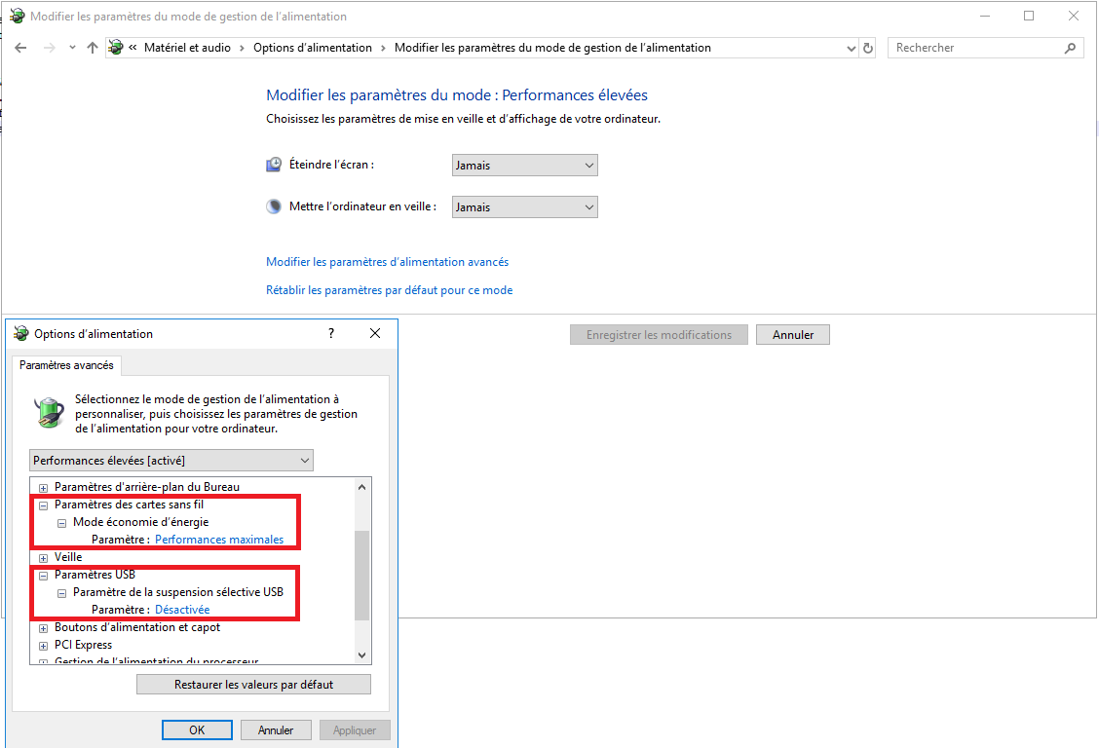
Configure Windows Power Options

Slide 12
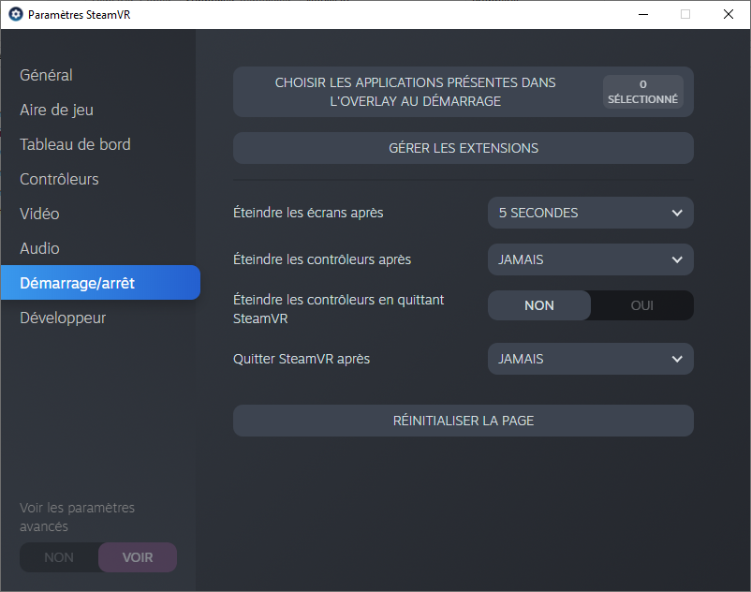
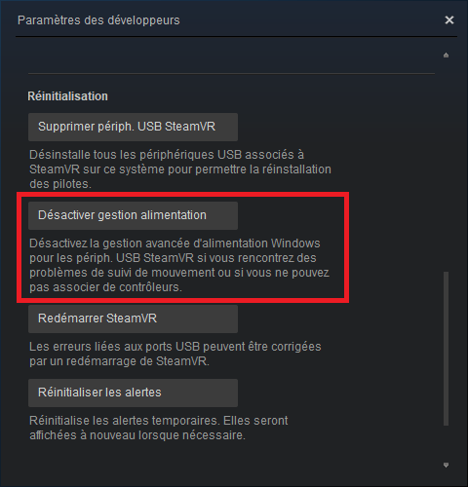
Set SteamVR settings
SteamVR will update itself only if Steam is executed !

