Slide 1

IPMACC: Open-Source Implementation of OpenACC API
Ahmad Lashgar
IPM

Slide 2
Outline
OpenACC
IPMACC
Results
Proposed Software-Managed Cache clause

Slide 3
OpenACC 2.0
Compiler directives and API to offload computation to the system’s accelerator
Matrix multiplication example:
#pragma acc data copy(a[0:SIZE],b[0:SIZE],c[0:SIZE])
{
#pragma acc kernels
{
#pragma acc loop independent
for (i = 0; i < LEN; ++i) {
#pragma acc loop independent
for(j=0; j < LEN; j++){
float sum=0;
for(l=0; l < LEN; l++){
sum += a[i*LEN+l]*b[l*LEN+j];
}
c[i*LEN+j]=sum;
}
}
}
}
for (i = 0; i < LEN; ++i) {
for(j=0; j < LEN; j++){
float sum=0;
for(l=0; l$ltLEN; l++){
sum += a[i*LEN+l]*b[l*LEN+j];
}
c[i*LEN+j]=sum;
}
}

Slide 4
OpenACC 2.0 (continued)
Directives
data
copy, copyin, copyout, create, present
kernels
loop
independent, reduction
cache
API
acc_init, acc_free, acc_create, acc_copyin

Slide 5
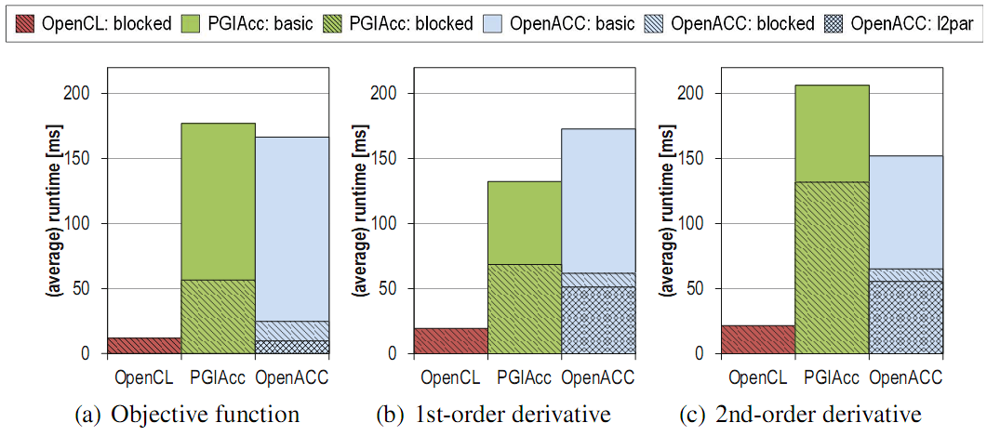
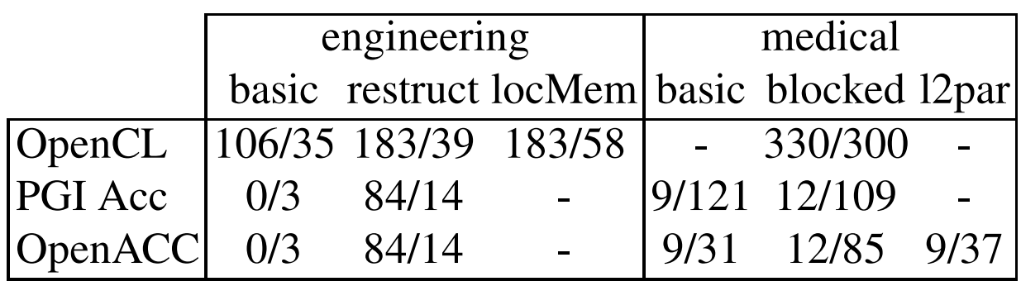
Pros and Cons
Up to 6.5X lower effort
Up to 2.5X lower performance
Key bottlenecks:
In ability to perform sophisticated reductions
Transparent multi-accelerator computation
In flexibility to utilize software-managed cache like CUDA/OpenCL
Medical application
[WIENKE’2012]

Slide 6
IPMACC
Open source implementation of OpenACC 2.0
Implemented:
data, kernels, loop, function call, user-defined types,
Unimplemented:
parallel, cache, multi-accelerator
Target accelerators:
CUDA capable devices
OpenCL capable devices
Can be used to generate:
CUDA/OpenCL source code equivalent to OpenACC source
Intermediate objects
Final binary
$ ipmacc source.c -c -o binary

Slide 7
Infrastructure
Four major steps:
System compile defaults:
g++ for OpenCL targets
nvcc for CUDA targets
Validated through Rodinia benchmark suite and various test cases

Slide 8
Experimental Results
Microbenchmarks
Accelerator: NVIDIA GeForce 280

Slide 9
Experimental Results (2)
Rodinia Benchmark Suite
Accelerator: NVIDIA GeForce 480
Comparing CUDA automatic generated code against native CUDA in NW and Pathfinder:
native CUDA uses shared memory to reduce global memory traffic.

Slide 10
References
[WIENKE’2012] Wienke, S., Springer, P., Terboven, C., & an Mey, D. (2012). OpenACC—First Experiences with Real-World Applications. In Euro-Par 2012 Parallel Processing (pp. 859-870). Springer Berlin Heidelberg.

