Slide 1
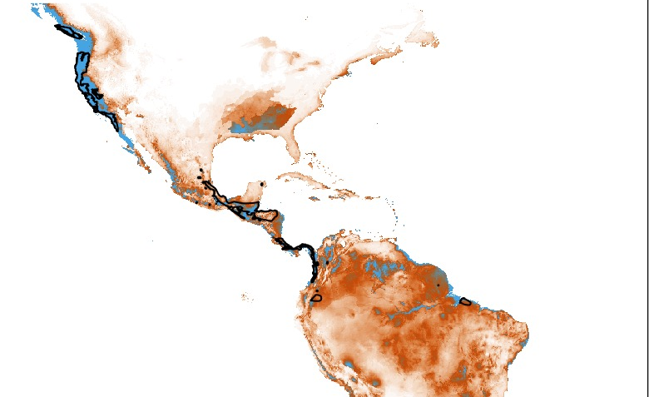
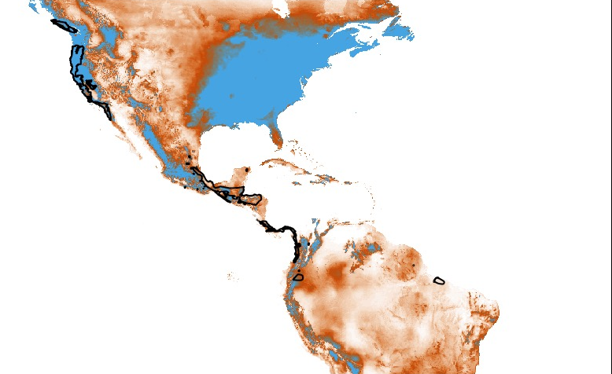
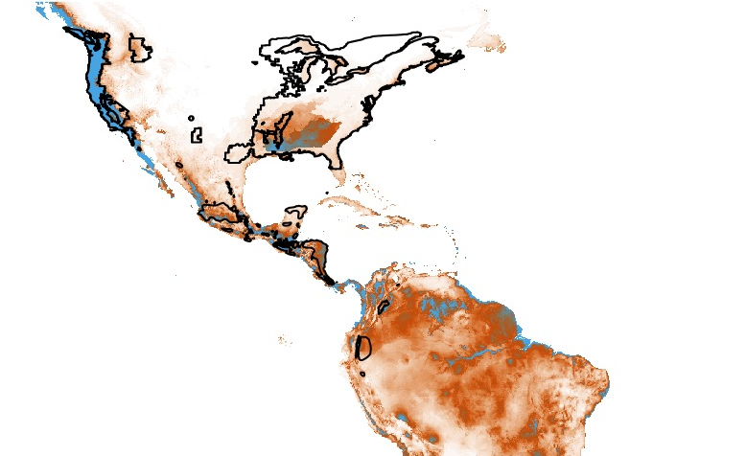
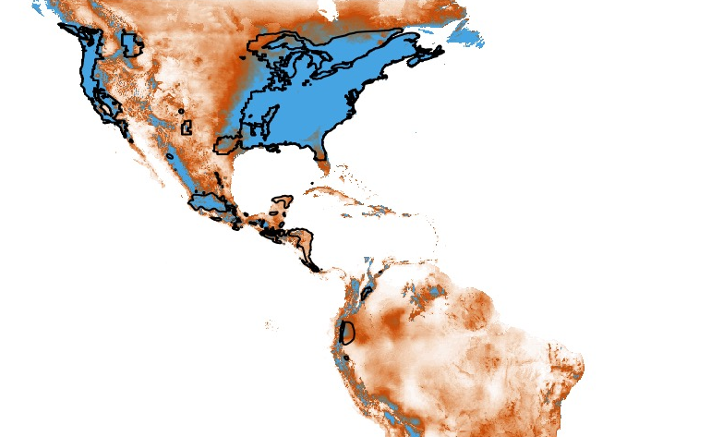
Arboreal
Suitability Model
Terrestrial
Suitability Model
MAXENT Suitability
Arboreal
Distribution
59.3% Overlap
4.2%
Overlap
Terrestrial
Distribution
35.0% Overlap
84.4% Overlap

