Slide 1
Do Large Language Models Have Style?
A Stylometric Analysis of LLM Authorship
Erdem Bakir | Text Mining & Sentiment Analysis | Università degli Studi di Milano | May 2026

Slide 2
Research Question
Do Large Language Models exhibit distinctive and identifiable stylistic fingerprints that persist across different discourse genres?
1. Can a classifier trained on stylometric features reliably attribute texts to their generating model? 2. Which stylistic features are most discriminative across models? 3. How robust are stylistic signatures across different discourse genres?
Sub-questions

Slide 3
Experimental Setup
Models Compared
Generation Parameters
Closed-source
Temperature
0.7 (all models)
• GPT-4o-mini (OpenAI)
Max tokens
300 (≈150 words)
• Claude Haiku 4.5 (Anthropic)
Format
No markdown / headers / bullets
• Gemini 2.5 Flash (Google)
Gemini extra
Thinking budget = 0
Open-source
• Qwen2.5-7B-Instruct (HuggingFace)
• LLaMA 3.1-8B-Instruct (HuggingFace)
APIs used: OpenAI API, Anthropic API, Google Generative AI API, HuggingFace Inference API

Slide 4
Corpus & Feature Extraction
600
5
6
120
14
Total texts
LLMs
Discourse genres
Prompts per model
Stylometric features
Discourse Genres
Feature Sources
• Explanation
• Opinion
• Comparison
• Narration
• Argumentation
• Dialogue
spaCy (en_core_web_sm) Avg. sentence length, punctuation frequency, POS ratios: noun, verb, adj, adverb
StyloMetrix Lemma type-token ratio, active/passive voice,
present/past tense, 1st-person pronoun,
discourse markers (contradiction, agreement)
No feature pair exceeded r = 0.70 correlation.

Slide 5
Classification Approach
Hyperparameter Tuning
Balanced Score
Model
Random Forest
balanced_score = CV accuracy − 0.5 × overfit_gap
overfit_gap = train accuracy − CV accuracy
Grid Search Space
Validation
5-fold stratified
Parameter | Values tested | Best
max_depth | 3, 5, 7, 10 | 3
min_samples_leaf | 3, 5, 10 | 5
n_estimators | 5, 10, 20, 30, 50 | 50
Tuning
Grid search with
balanced score
Accuracy | Train Accuracy | Overfit Gap
0.54 | 0.67 | 0.13

Slide 6
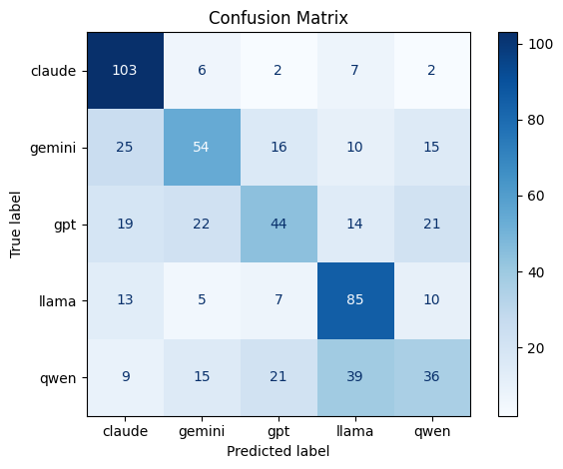
Classification Results
54%
20%
0.52
0.13
Overall Accuracy
Random Baseline
Macro F1-score
Overfit Gap
Per-Model Performance
Confusion Matrix
Model | Precision | Recall | F1-score
Claude | 0.61 | 0.86 | 0.71
LLaMA | 0.55 | 0.71 | 0.62
Gemini | 0.53 | 0.45 | 0.49
GPT | 0.49 | 0.37 | 0.42
Qwen | 0.43 | 0.30 | 0.35
Macro avg | 0.52 | 0.54 | 0.52

Slide 7
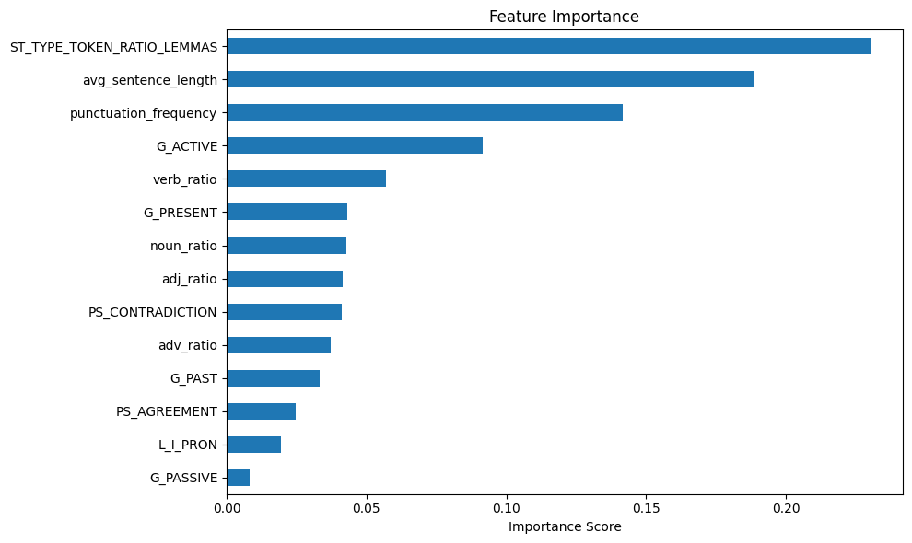
Feature Importance
Key Findings
Lexical diversity (0.23)
Most discriminative feature, vocabulary richness differs most between models
Sentence length (0.19)
Second-most important, reflects structural tendencies of each model
Punctuation frequency (0.14)
Some models' higher punctuation frequency stands out clearly

Slide 8
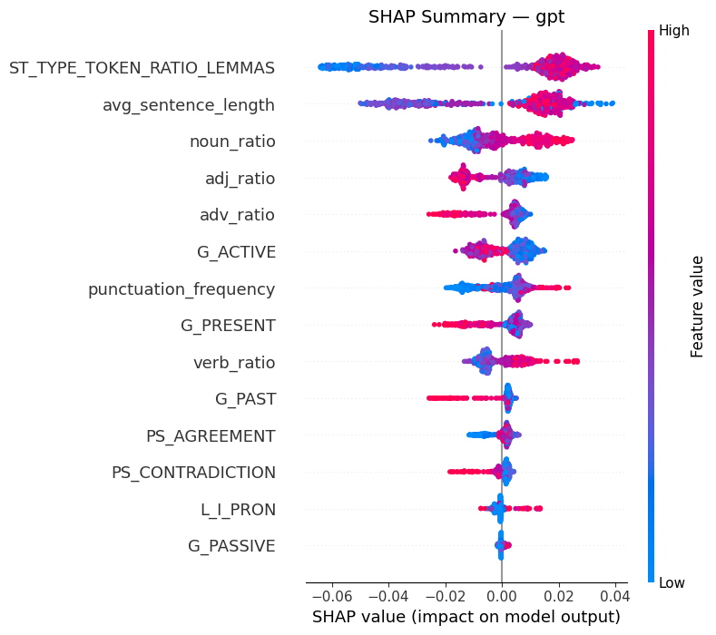
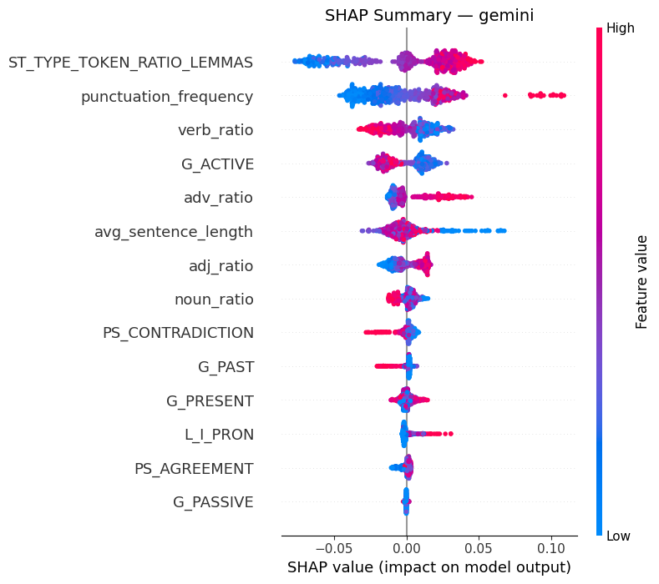
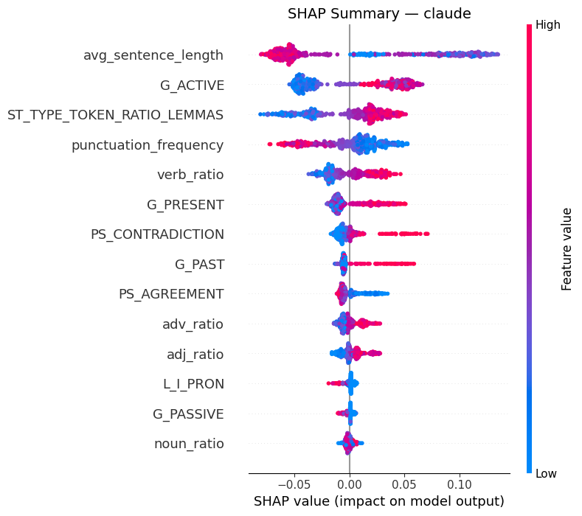
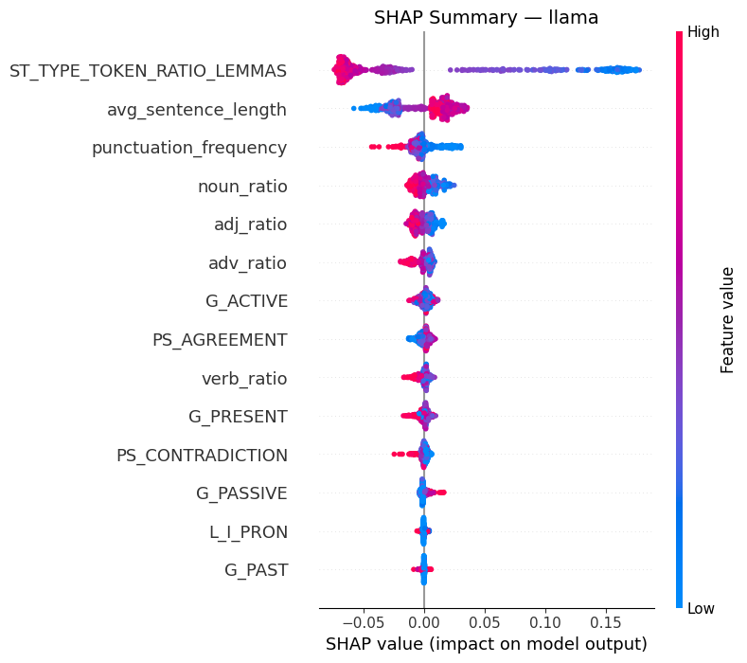
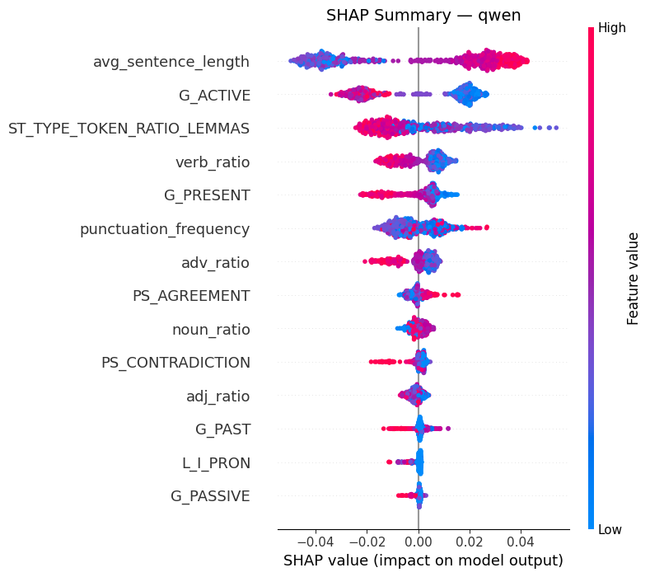
SHAP Analysis — Per-Model Stylistic Signatures
Claude: Short sentences, high active voice, contradiction markers | Gemini: Rich vocabulary, high punctuation frequency | GPT: High lexical diversity, longer sentences, heavy noun usage | LLaMA: Low lexical diversity, long sentences | Qwen: Long sentences, lower active voice

Slide 9
Genre Analysis
Results by Genre
Genre | Accuracy | vs. avg
Explanation | 0.44 | −0.10
Narration | 0.52 | −0.02
Opinion | 0.54 | 0.00
Dialogue | 0.56 | +0.02
Argumentation | 0.57 | +0.03
Comparison | 0.59 | +0.05
Overall (avg) | 0.54 | —
Explanation shows the lowest accuracy, technical writing converges across models.
Comparison is the highest, discourse markers create distinctive per-model patterns.

Slide 10
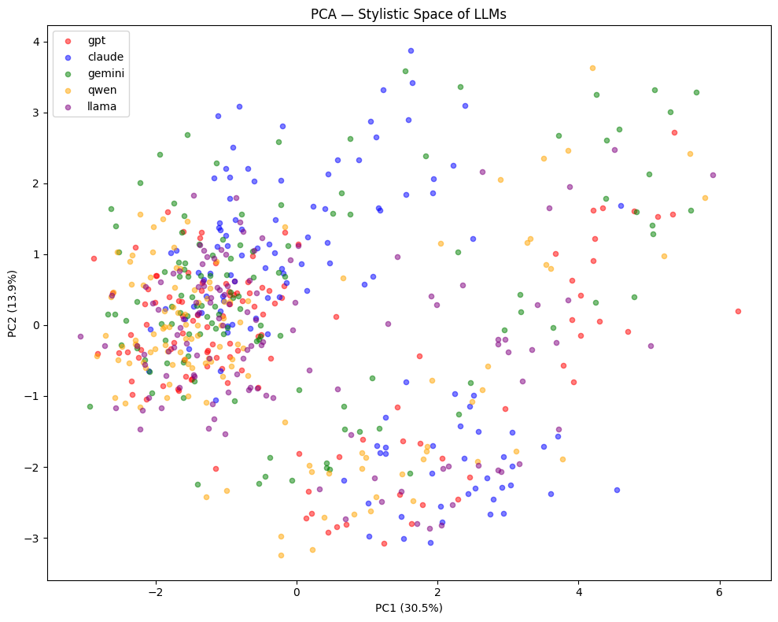
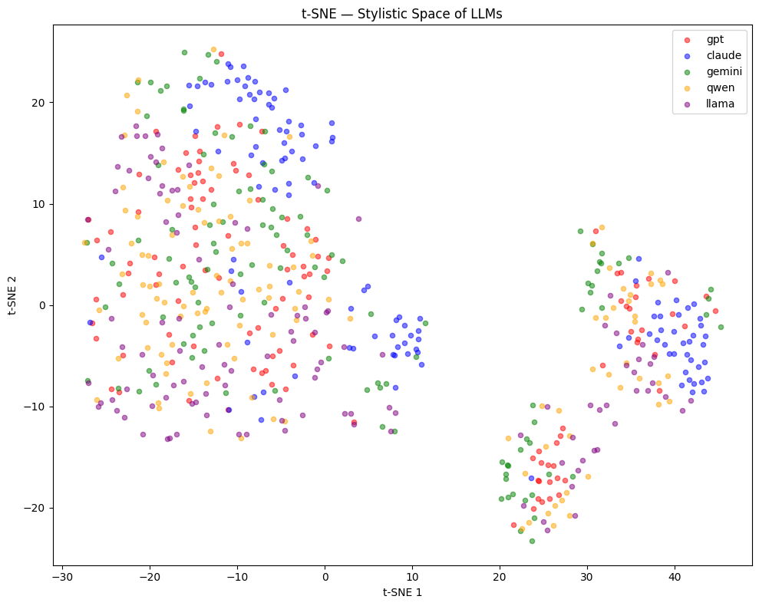
Stylistic Space Visualization
PCA — by Model
t-SNE — by Model
PCA: 30.5% + 13.9% = 44.4% variance explained. Neither PCA nor t-SNE show clearly separated model clusters — consistent with 54% classifier accuracy.

Slide 11
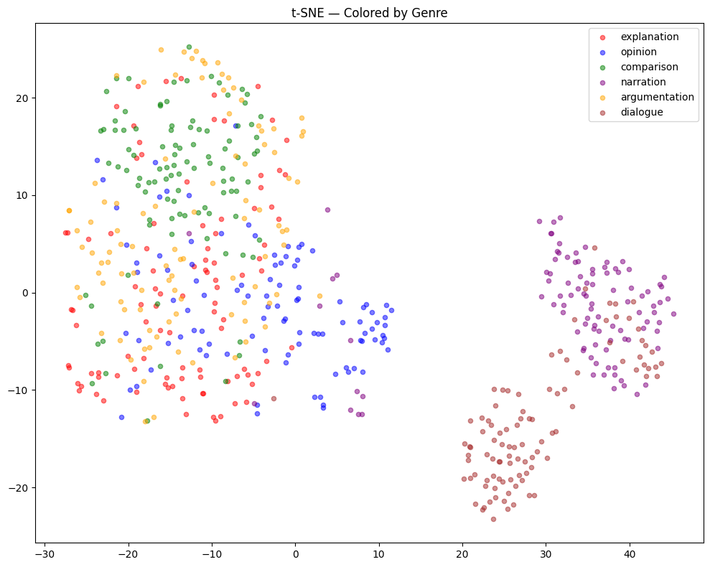
Genre Effect on Stylistic Space
t-SNE — Colored by Genre
Key Finding
Genre drives stylistic space more strongly than model identity.
• Dialogue and Narration form clearly separate clusters regardless of which model generated them.
• Explanation, Opinion, Comparison, Argumentation genres overlap significantly in stylistic space.
• Genre-driven variation partially masks model-level stylistic differences.

Slide 12
Concluding Remarks
LLMs do have style
Claude most distinctive
Random Forest on 14 stylometric features → 54% accuracy vs. 20% baseline. Statistically meaningful authorship attribution across models.
F1 = 0.71. Short sentences, high active voice, frequent contradiction markers. LLaMA second (F1 = 0.62). Qwen hardest to distinguish (F1 = 0.35).
Genre > Model in stylistic space
Future work & limitations
Dialogue and Narration form clear clusters regardless of model. Genre variation partially masks model-level differences.
Larger corpus, stylistic robustness under human-mimicry prompting, expanded feature set, larger number of stylistic attributes.

