Slide 1
Programming Workshop Interest Meeting

Slide 2
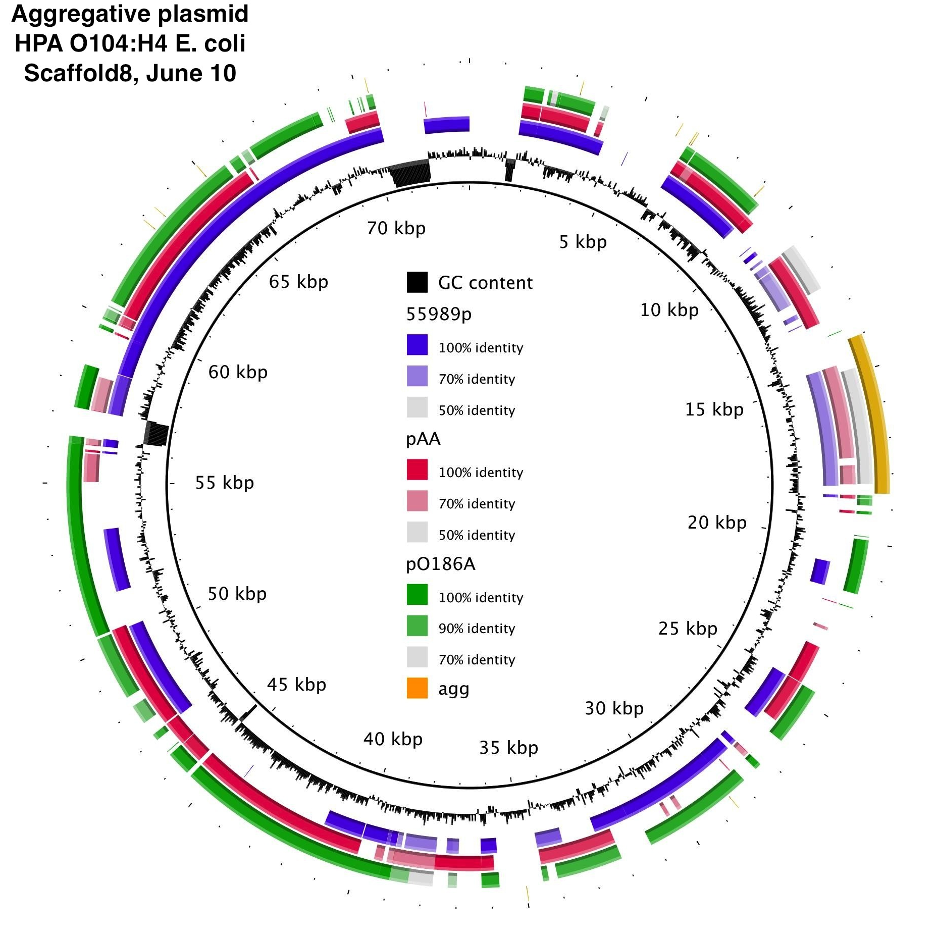
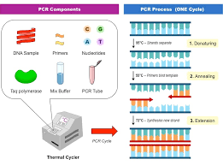



Caveat
What this is: a streamlined introduction to programming; foundations to help you pick up your own skills
What this is not: “cookbook programming”

Slide 3
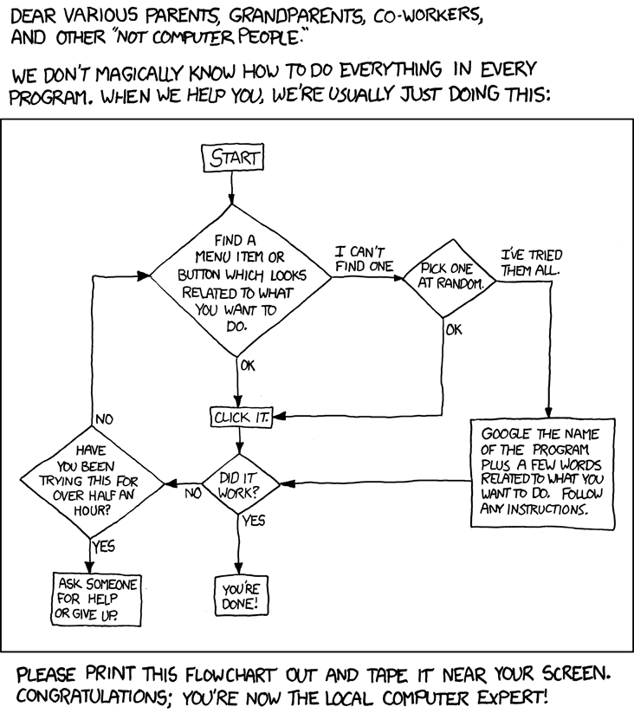
Notes:
https://xkcd.com/627/

Slide 4
Logistics
1 hour, one day per week:
20 minutes “lecture”
10 minutes guided programming
30 minutes pair programming
Possible short assignments

Slide 5
Overview
Phase 1:
Introduction to command line, source control, Python, coding style/etiquette
Phase 2:
Intermediate Python, command line
Phase 3:
Introduction to R, bioinformatics, servers

Slide 6
Phase 1 Topics
Command line: navigating directories, calling functions
Source control: GitHub code storage
Python & foundational CS concepts:
data types formal logic
loops sorting algorithms
functions
Etiquette: pair programming, commenting, syntax, troubleshooting

Slide 7
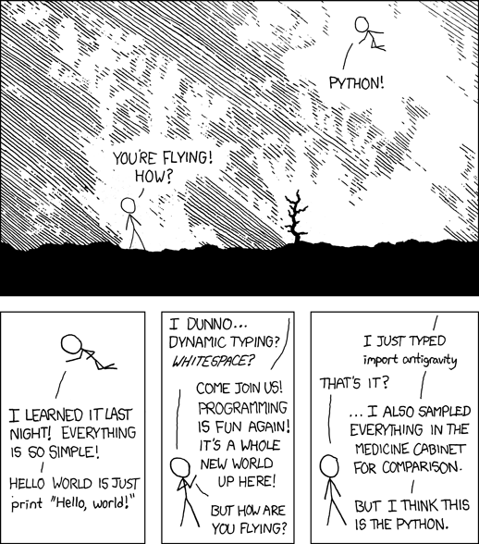
Phase 2 Topics
Intermediate Python:
classes
libraries
data structures
interfaces
algorithms
Notes:
https://xkcd.com/353/

Slide 8
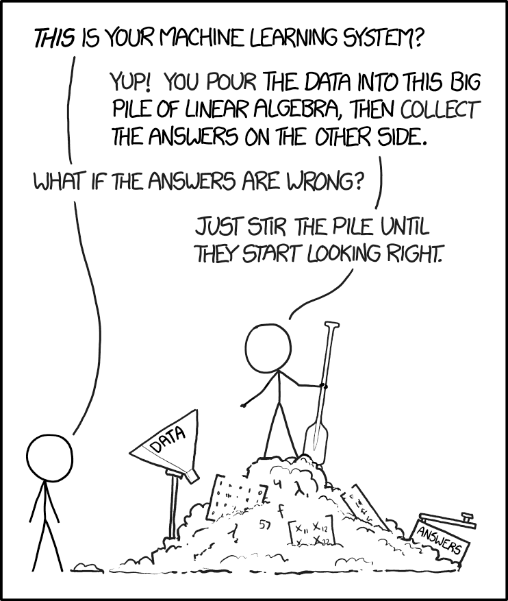
Phase 3 Topics
R:
working with experimental data
statistical tests
data visualization
Bioinformatics:
sequencing data
machine learning
algorithms
Mayo’s servers:
parallel computing
Notes:
xkcd.com/1838/

Slide 9
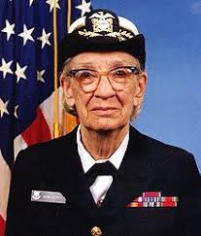
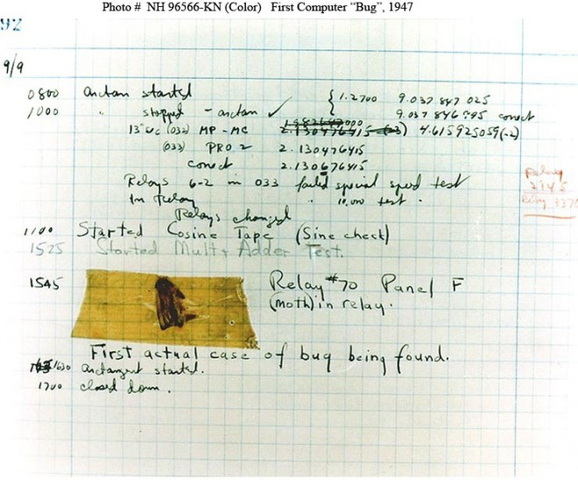
Grace Hopper
Notes:
First compiler
Debugging
Rear admiral (lower half)
Yale renaming Calhoun college after her

Slide 10
Feedback? Other questions?

Slide 11
Activity?
Goal: sort the cards (ascending or descending is fine)
4 rules:

