Slide 1
Workshop 2: Python
8 June 2017

Slide 2
Topics Covered
Bash Review
Installing Python + Sublime
Variables
Functions

Slide 3
Download
Sublime
http://www.sublimetext.com/3
Python
Let’s use Python 3
Mac: python --version
PC: python -V
https://www.python.org/downloads/

Slide 4
Refresh Bash
What are my 3 get out of jail free cards?
What are the arguments to functions with the form -[letter] called?
What is special about files with a . in from of the name? How do I see them?
How do I delete a directory?
How do I make a new file? (2 ways)
…other lingering confusions?

Slide 5
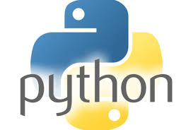
Why Python?
Readable
Flexible
Reasonable typing
Active community
Fast (enough) ->
interpreted, not
compiled
TABBBBBS

Slide 6
Python on Command Line
Use Python interactively…
Type python into command line
>> print(“Hello world”)

Slide 7
Variables
Just like in math, you can store stuff in variables.
In python, = is the assignment operator. Other languages are different (<- in R)
>> x = 5
>> print(x)

Slide 8
Python…not on command line
Remember when we ran a file with bash in it? We called it on command line with ./file.sh or bash file.sh or sh file.sh.
We are going to do the same thing with python.

Slide 9
Python
All programs should have a start point. In Python, this is the Main function.
The canonical way of doing this is:
def main():
#code goes here
if __name__ == “__main__”:
main()

Slide 10
Functions
>> def function(argument1, arg2):
# stuff
return
In main, call:
>> function(“foo”, “bar”)
You can return something, or not (and the system will return None for you)

