Slide 1
Workshop 8: Sorting, Intro to Algorithms
13 July 2017

Slide 2
Why Sorting?
Algorithmic strategy:
Recursion
Divide-and-conquer
Efficiency:
Run time, big O notation
Memory
Coding

Slide 3
Activity
In front of you, you have a few cards. Shuffle them so they are in random order.
Sort the cards. To do so, you are only allowed these actions:
You can pick up a card in each/either of your two hands.
If you have a card in your hand, you can put it down.
If you have cards in both hands, you can compare them and know which one is bigger/smaller.
If a card is not in your hand, you don’t remember its value (turn them over if this is hard for you).

Slide 4
Evaluation of Sorting Strategy
How many times did you iterate through all of your cards? (Roughly)
How many times did you look at each card? (Roughly)
How much does the sorted-ness of the list impact the quickness of your algorithm?
Do you think you could have done it more efficiently?

Slide 5
Bubble Sort
Notes:
By Swfung8 - Own work, CC BY-SA 3.0, https://commons.wikimedia.org/w/index.php?curid=14953478

Slide 6
Bubble Sort
Start at the beginning of the list.
Compare the n=0,1 items, swap if out of order.
Move on to n=1,2 items, repeat until finished the list.
After each run through the list, only need to compare n=0->n-1 items (because the last one will be the biggest).
If no swaps through a run of the list = sorted.

Slide 7
Bubble Sort Evaluation
Most efficient: list already sorted
Do n operations (check everything in the list once)
Least efficient: list in reverse order
Do n + (n – 1) + (n – 2) + (n – 2) + … + 1 operations → n (n - 1 ) / 2
Two for loops!

Slide 8
Insertion Sort

Slide 9
Insertion Sort
Insertion sort iterates, consuming one input element each repetition, and growing a sorted output list. At each iteration, insertion sort removes one element from the input data, finds the location it belongs within the sorted list, and inserts it there. It repeats until no input elements remain.

Slide 10
Selection Sort

Slide 11
Selection Sort
The algorithm divides the input list into two parts: 1)sorted and 2) unsorted sublists.
The algorithm proceeds by finding the smallest (or largest, depending on sorting order) element in the unsorted sublist, exchanging (swapping) it with the leftmost unsorted element (putting it in sorted order), and moving the sublist boundaries one element to the right.

Slide 12
Merge Sort

Slide 13
Merge Sort
Divide-and-conquer
n(log n) best AND worst case
Three steps:
1)The divide step computes the midpoint of each of the sub-arrays. Each of this step just takes O(1) time.
2) The conquer step recursively sorts two subarrays of n/2 (for even n) elements each.
3)The merge step merges n elements which takes O(n) time.

Slide 14
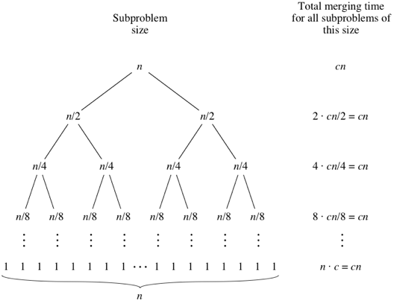
Merge Sort

Slide 15
Bogosort
Randomly permute the list
Check if it is sorted
Unbounded worst case!
Aka stupid sort, slowsort, monkey sort

Slide 16
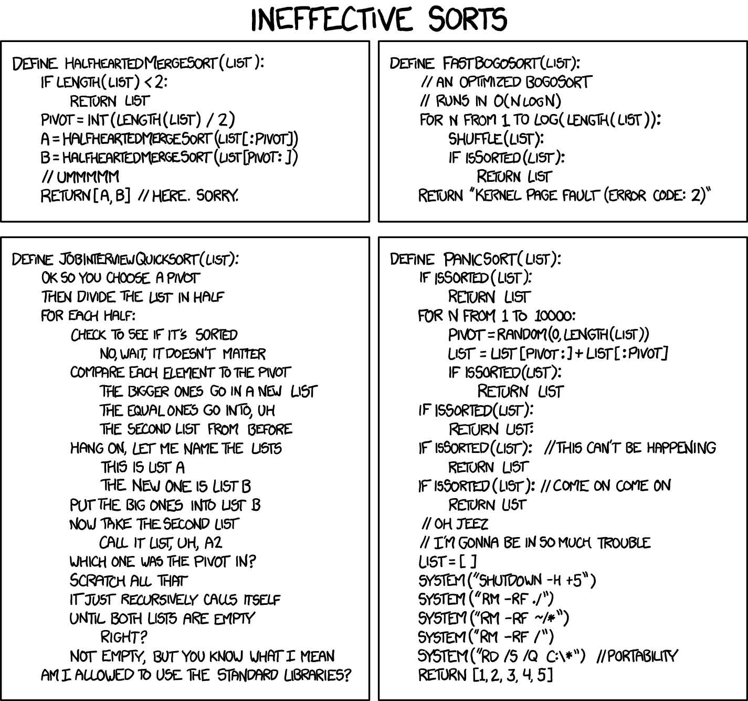
https://xkcd.com/1185/
StackSort: http://gkoberger.github.io/stacksort/

