Slide 1
Workshop 9: Sorting Cont. & searching
13 July 2017

Slide 2
Review
O(unbounded):
Bogosort
O(n²):
Bubble
Insertion
Selection
O(n log n):
Merge
Quick

Slide 3
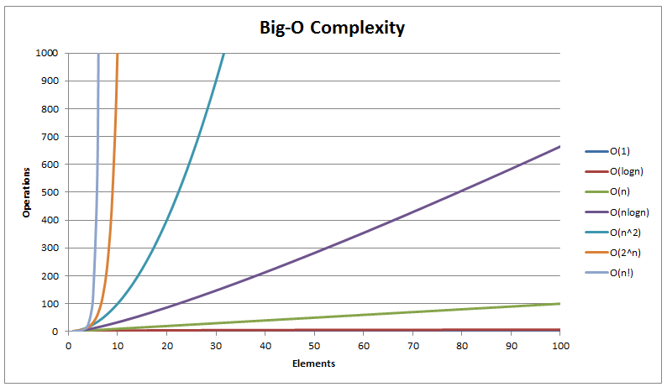
Big-O

Slide 4
Why Sorting?
Algorithmic strategy:
Recursion
Divide-and-conquer
Efficiency:
Run time, big O notation
Memory
Coding

Slide 5
Evaluation of Sorting Strategy
How many times did you iterate through all of your cards? (Roughly)
How many times did you look at each card? (Roughly)
How much does the sorted-ness of the list impact the quickness of your algorithm?
Do you think you could have done it more efficiently?

Slide 6
Bubble Sort
Notes:
By Swfung8 - Own work, CC BY-SA 3.0, https://commons.wikimedia.org/w/index.php?curid=14953478

Slide 7
Insertion Sort

Slide 8
Selection Sort

Slide 9
Merge Sort

Slide 10
Why Sorting?
Pick one of your cards. This is the card you want to find.
Flip over your cards and shuffle them so they are in random order.
Find your card.
Flip over all your cards. Sort them. Flip them back over.
Find your card.

Slide 11
Searching
What strategy did you use to find your card when your cards were unordered? Ordered?
Were they the same strategy? Which one is easier to look for your card in?

Slide 12
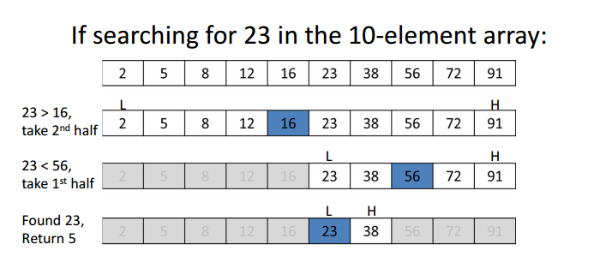
Binary Search
Notes:
http://www.geeksforgeeks.org/binary-search/

Slide 13
Binary Search Complexity
O(log n)
What algorithm does this remind you of?

Slide 14
Code Binary Search
What are we going to store our data in?
What is the input?
What is the output?
What building blocks will we need?

Slide 15


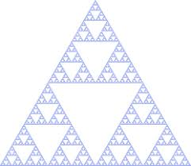
Recursion

Slide 16
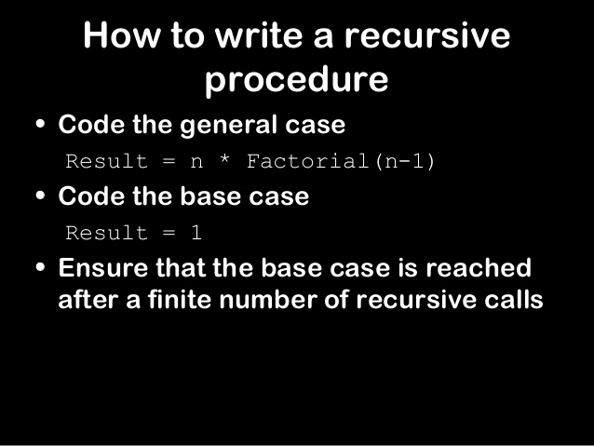
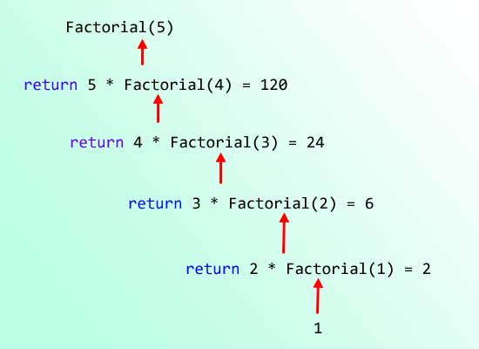
(Serious) Recursion

