Slide 1
Distributed Summarization of Dynamic Data
Emma Alexander and Eric Balkanski
CS 262 Project Presentation
April 25th, 2016
Notes:
\max_S\ & f(S) \\
\notag \text{s.t. } &\sum_{i \in S} p_i \leq B, \\
\notag & p_i \geq c_i \text{ for all } i \in S.

Slide 2
Summarizing Crime Data
Dataset
Summary
City | Type | Time | Arrest
NY | Assault | Night | Yes
NY | Theft | Night | Yes
NY | Assault | Night | No
LA | Theft | Morning | Yes
LA | Theft | Evening | No
NY | Assault | Night | Yes
LA | Theft | Morning | Yes

Slide 3
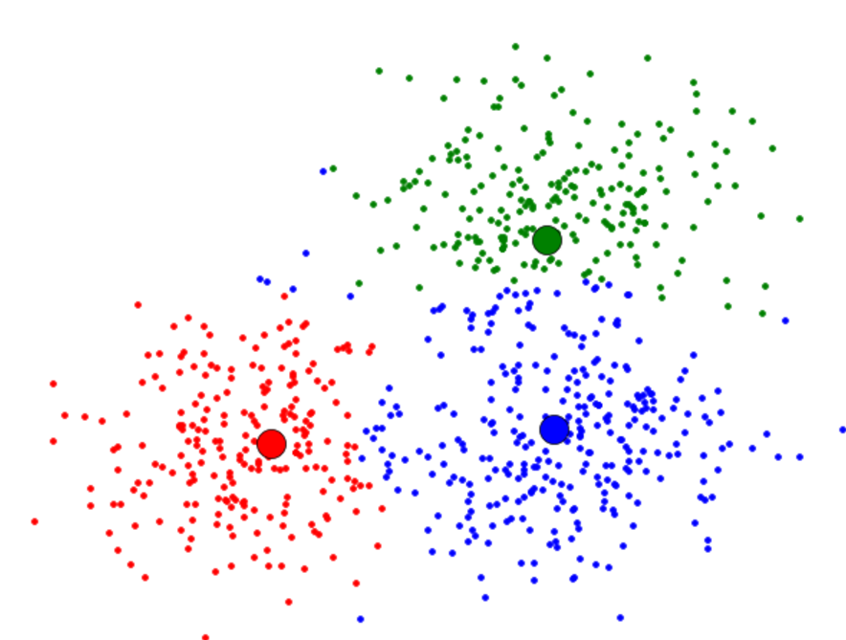
Data Summarization as Optimization
Input:
set of elements V (e.g., set of crimes)
function f(S) measures how well S summarizes V
via clustering
Optimization problem:

Slide 4
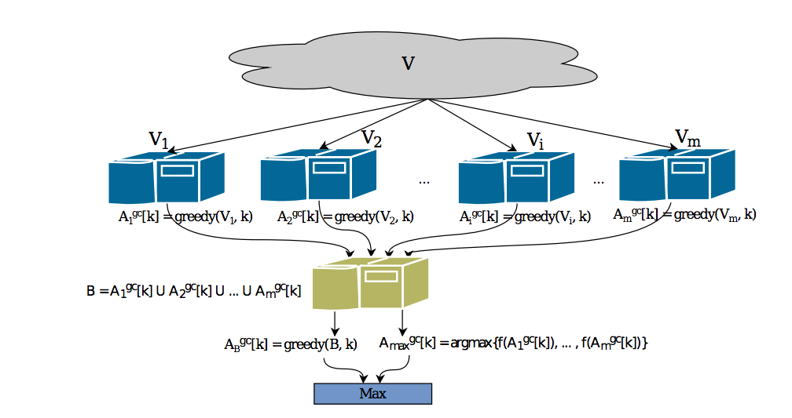
Distributed Data Summarization
What if V is too large to: to efficiently compute summary? fit on single machine?
Distributed approach: [Mirzasoleiman et al. ’13 and ‘15]

Slide 5
Tradeoffs
As number of machines m …
Runtime
Memory per machine
Approximation ratio α = f(A*) / f(A)
(quality of A compared to optimal solution A*)
Communication complexity

Slide 6
Our Contribution
Real world datasets are dynamic with
Insertions (e.g., new crimes happen everyday)
Deletions (e.g., erroneous or outdated records)
Naïve solution: rerun entire algorithm for every insertion and deletion
We can achieve better communication complexity …

Slide 7
Our Solution
Insertion or deletion for V_{i}
A_{i}^{old} := last set sent from machine i
Update local solution A_{i}
If d(A_{i}, A_{i}^{old}) ≥ t:
Send A_{i} to central machine
Update central solution A when receive updated A_{i}

Slide 8
Tradeoffs
Trigger for sending a new local solution: d(A_{i}, A_{i}^{old}) ≥ t
As threshold t :
Approximation ratio
Communication complexity

Slide 9
Failure
On local machine, either
central machine waits for m – T local solutions A_{i}
T fault tolerance
Approximation ratio
T+1 replicas of each element on different machines
T fault tolerance
Memory per machine
On central machine, either
leader election
T+1 replicas of central machine

Slide 10
Implementation…

Slide 11
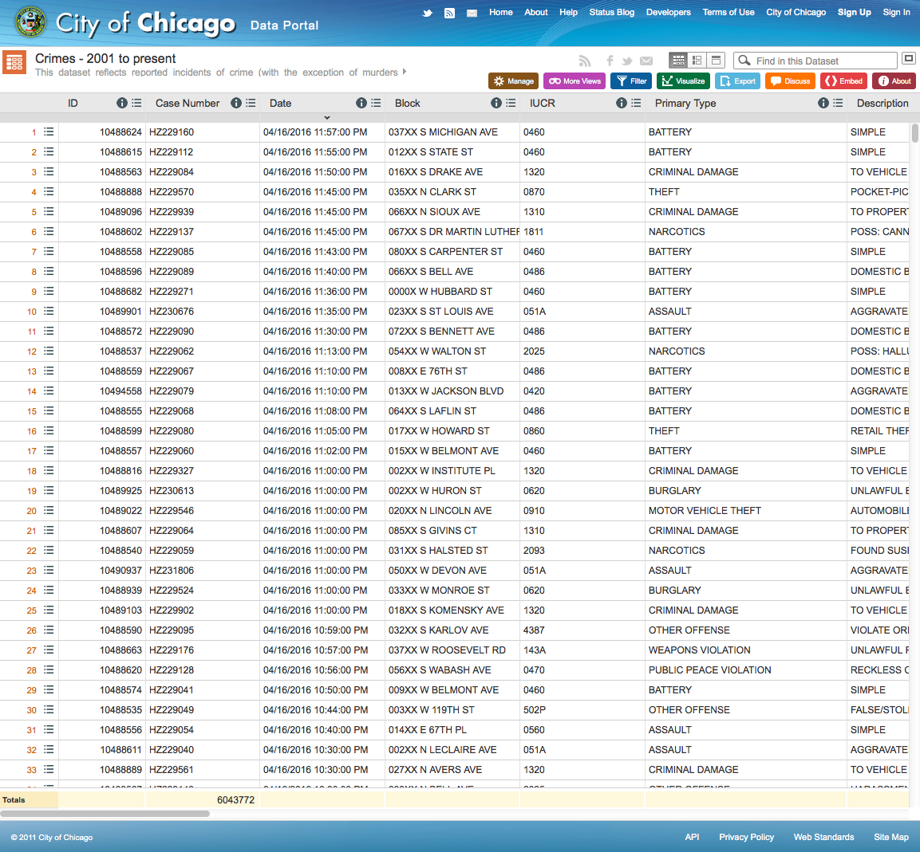
Dataset
City of Chicago data portal
6 million+ crimes, 22 features
We keep 6:
time of day
crime description
location description
arrest (boolean)
domestic (boolean)
district
Ex.) NIGHT,BURGLARY,"RESIDENCE",false,false,006

Slide 12
Simulation
…
Crimes
Crimes
Crimes
Crimes
datamanager.py
Chicago Crimes

Slide 13
Simulation
reps
reps
reps
…
reps
local.py
local.py
local.py
local.py
Crimes
Crimes
Crimes
Crimes
datamanager.py
Chicago Crimes

Slide 14
Simulation
central.py
reps
Crimes
reps
reps
reps
…
reps
local.py
local.py
local.py
local.py
Crimes
Crimes
Crimes
Crimes
datamanager.py
Chicago Crimes

Slide 15
Simulation
central.py
reps
Crimes
reps
reps
reps
…
reps
local.py
local.py
local.py
local.py
Crimes
Crimes
Crimes
Crimes
datamanager.py
Chicago Crimes

Slide 16
Simulation
central.py
reps
Crimes
reps
reps
reps
…
reps
local.py
local.py
local.py
local.py
Crimes
Crimes
Crimes
Crimes
datamanager.py
(oracle)
reps
score
Chicago Crimes

Slide 17
Simulation
central.py
reps
Crimes
Sample Results:
NIGHT,THEFT,"STREET",false,false,004
EVENING,BATTERY,"SIDEWALK",true,false,011
MORNING,BURGLARY,"APARTMENT",false,false,014
EVENING,BATTERY,"RESIDENCE",false,true,004
NIGHT,NARCOTICS,"STREET",true,false,011
reps
reps
reps
…
reps
local.py
local.py
local.py
local.py
Crimes
Crimes
Crimes
Crimes
datamanager.py
(oracle)
reps
score
Chicago Crimes

Slide 18
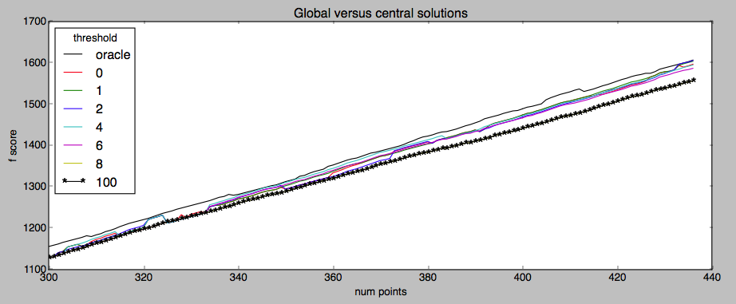
Preliminary Results
Parameters: 2 local processes, 300 to 435 datapoints, 10 representatives
2 local processes, 10 representatives, 300 to 500 points

Slide 19
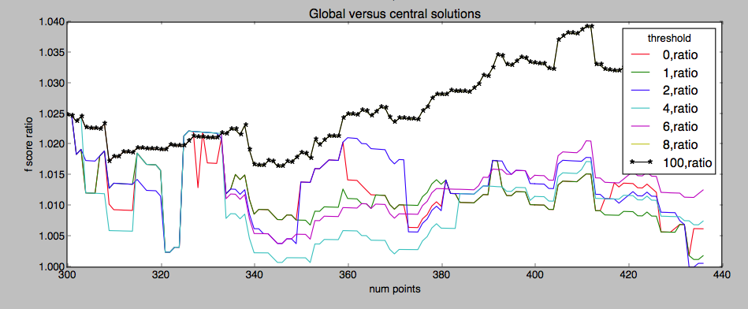
Preliminary Results
Parameters: 2 local processes, 300 to 435 datapoints, 10 representatives

Slide 20
Next Steps
Immediate:
Characterize tradeoff
Simulate failures
General:
Theoretical bounds
Civic applications
[Boston v Somerville crimes]

