Slide 1

Final Report
Customer Segmentation for XYZ Bank
December 2, 2022

Slide 2

Team Member Details
Group Name: Elizabeth’s Analytics
Name: Elizabeth Banning
Email: estall@hotmail.com
Country: USA
College: Western Governors University
Specialization: Data Science

Slide 3
Agenda
Executive Summary
Problem Statement
Approach
Correlations
EDA Summary
Customer Segments
Recommendations

Slide 4
Executive Summary
Purpose: Segment customers into 2-5 groups for marketing campaign
Methods: Clean data, then use k-means clustering analysis
Timeline: Final results by December 30, 2022
Results of EDA: Dataset cleaned, correlations and distributions explored
Results of Clustering: 4 distinct customer groups identified

Slide 5
Problem Description
In order to develop its promotional campaign, XYZ Bank needs to know the answers to the following questions:
What is the best number of groups to divide customers into?
What are the primary characteristics of each group?
To answer these questions, the k-means clustering algorithm will be used to segment the customers, and the inertia metric will be used to determine the optimal number of groups (k). Finally, the characteristics of each group will be summarized so that XYZ Bank can determine which offers to develop and target to each group.

Slide 6
Problem Statement
XYZ is a bank that wants to do a promotion
1,000,000 customers: need to tailor different promotions to different types of customers
Maximum 5 groups
How can customers be grouped?
What are the characteristics of each group?

Slide 7
Approach
1 file used
1,000,000 customers (rows)
48 features (columns)
Clean the data:
Check for duplicates and remove
Check for missing values (treatment depends on type of data)
Check for impossible/nonsense data and correct if necessary
Drop irrelevant features (ID number, etc.)
Cluster:
Determine ideal number of clusters (up to 5)
List characteristics of each group

Slide 8
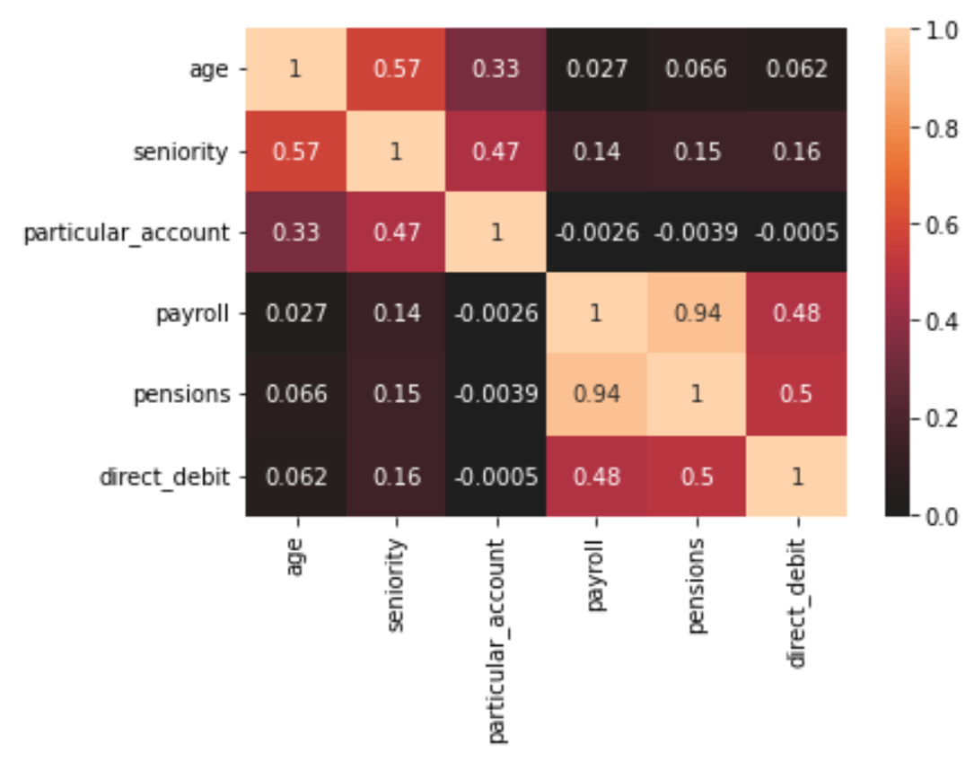
Correlations
Age, seniority, and particular account were correlated. These may be important together in grouping customers.
Payroll, pensions, and direct debit accounts were also correlated.
These groups may help distinguish different customer groups. For example, older customers are more likely to have a particular account.

Slide 9
EDA Summary
Dataset was cleaned: no more missing or nonsensical values
Customer age, seniority, and income were all positively skewed and could help distinguish customer groups
Some categories could also distinguish customer groups, such as gender, active level, and various accounts held
Age, seniority, and particular account are correlated with each other
Payroll, pensions, and direct debit are correlated with each other

Slide 10
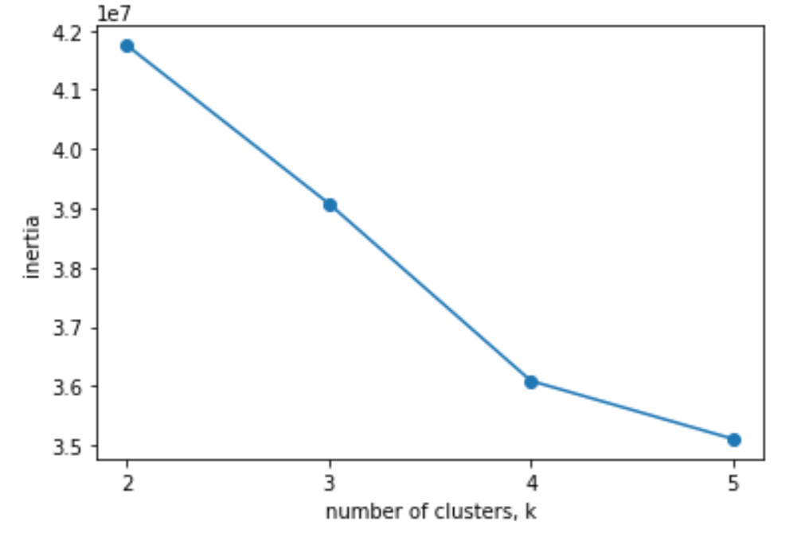
Ideal number of customer segments (clusters)
Ideal number of clusters is where adding more doesn’t result in additional information gain
The “bend” in the graph
Here ideal number is 4 groups

Slide 11
Group 1: Current, long-time personal accounts
459,759 customers (the largest group)
Median age: 45 years old
Median seniority: 108 months (9 years)
Median income: 106,651.90
Typical customer in this group:
Is active user
Has current account
Is primary account holder

Slide 12
Group 2: Inactive personal accounts
441,071 customers
Median age: 37 years old
Median seniority: 63 months (5 years 3 months)
Median income: 106,651.90
Typical customer in this group:
Is NOT active user
Has current account
Is primary account holder

Slide 13
Group 3: Current, long-time business accounts
88,347 customers
Median age: 46 years old
Median seniority: 147 months (12 years 3 months: the longest-term customer group)
Median income: 111,303.20
Typical customer in this group:
Is active user
Has payroll, pensions, and direct debit services
Is primary account holder

Slide 14
Group 4: Former customers
41 customers (the smallest group)
Median age: 33 years old
Median seniority: 0 (no longer with company)
Median income: 125,137.50
Typical customer in this group:
Is not active user
Is a former customer
Is NOT primary account holder

Slide 15
What all 4 groups have in common
More males than females in all groups
Resident, not foreigner
Not employee or spouse of employee
Typical customer does NOT have:
Savings account or credit card
Guarantees
Derivative account or securities account
Junior account
Other account
Particular account
Plus account
Short/medium/long-term deposit
E-account
Funds
Mortgage, loan, or home account
Tax account

Slide 16
Recommendations
Group 1 (current, long-time personal accounts): Offer promotions on accounts individuals typically don’t have but might want to use such as savings, credit card, and loans
Group 2 (inactive personal accounts): Offer promotions to encourage activity using incentives
Group 3 (current, long-time business accounts): Offer promotions on business services such as tax account or loans
Group 4 (former customers): Offer promotions such as incentive for opening account to encourage customers to return

Slide 17
Thank You
GitHub repository link:
https://github.com/ebanning/DataGlacierProject

