Slide 1
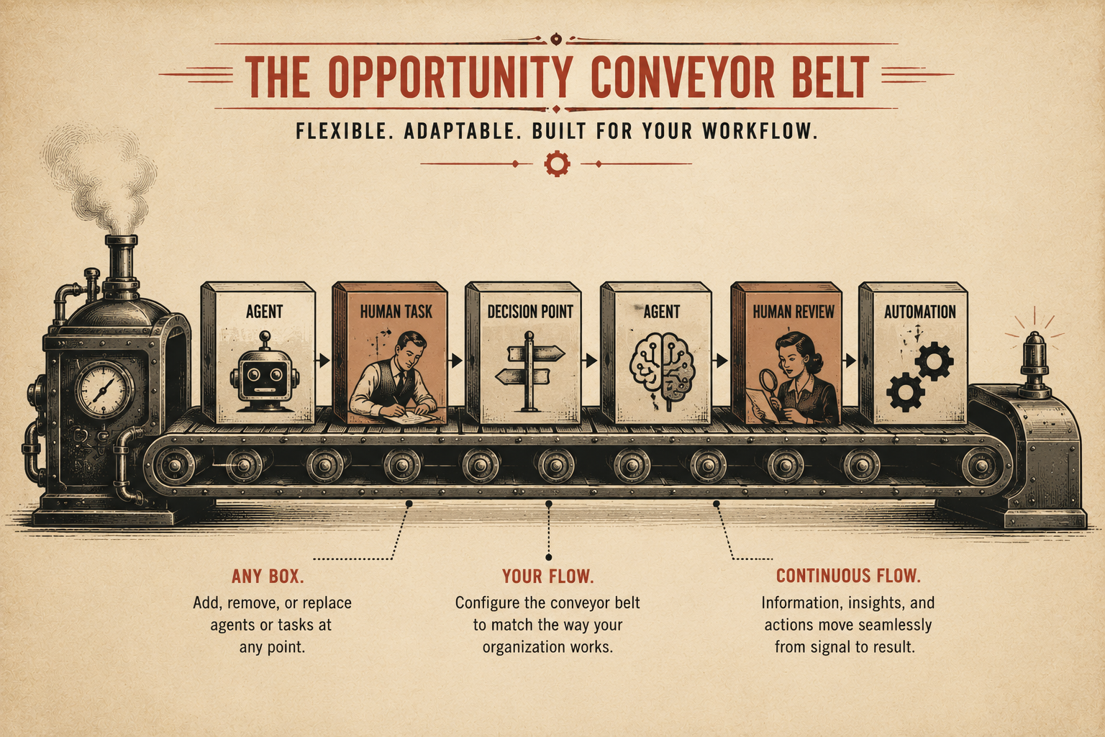
Page 4
VOL. I · THE BAND IT LAYER
THE OPPORTUNITY CONVEYOR BELT
Imagine a conveyor belt running through your organization.
Along this conveyor belt are different boxes.
Some boxes are human tasks. Some boxes are AI agents. Some boxes are decision points. Some boxes are automated processes.
Each box performs a specific function and passes the result to the next stage.
Boxes can be added, removed, rearranged, or upgraded at any time.
The system adapts to the way your organization already works.
No rigid workflows. No forced process changes.
Just a flexible path from signal to action.

