Slide 1
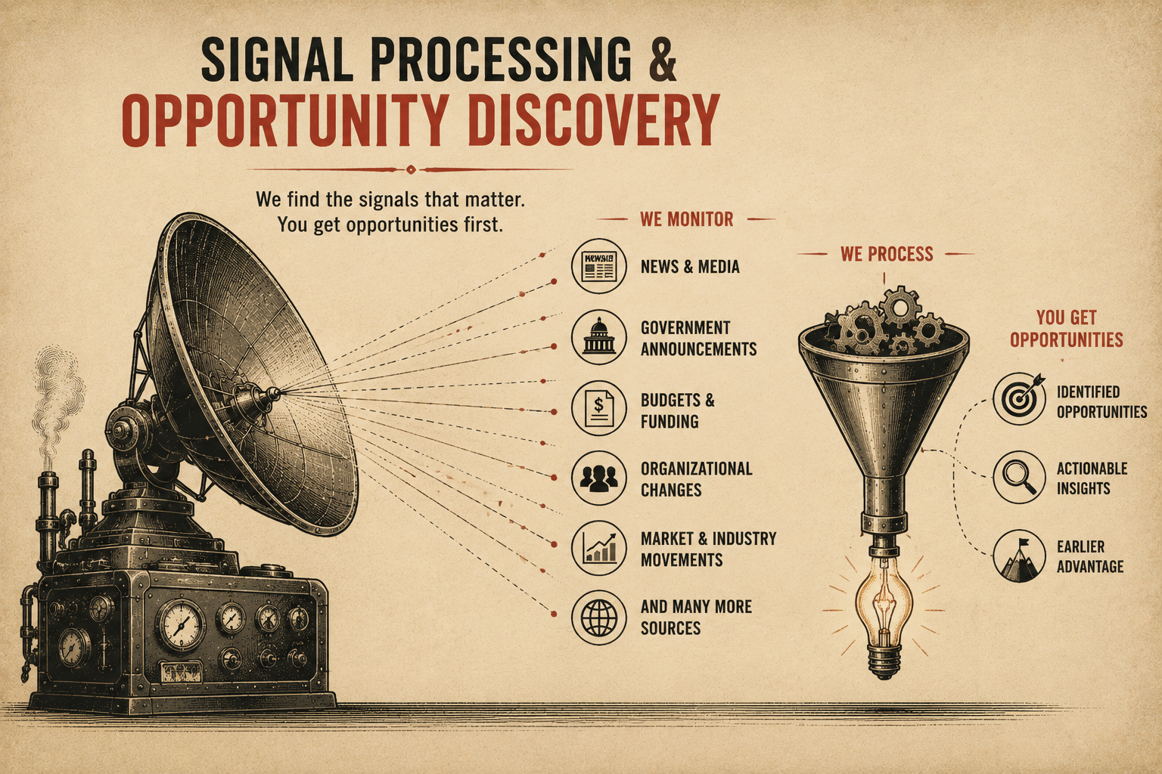
Page 5
VOL. I · THE BAND IT LAYER
SIGNAL PROCESSING & OPPORTUNITY DISCOVERY
Band It continuously monitors information sources and identifies signals that may indicate opportunities.
Examples:
Weak signals often become major opportunities.
The earlier you detect them, the greater the advantage.
— Market changes
— Funding announcements
— New programs
— Procurement activity
— Industry events
— Organizational changes
— Competitive movement

