Slide 1
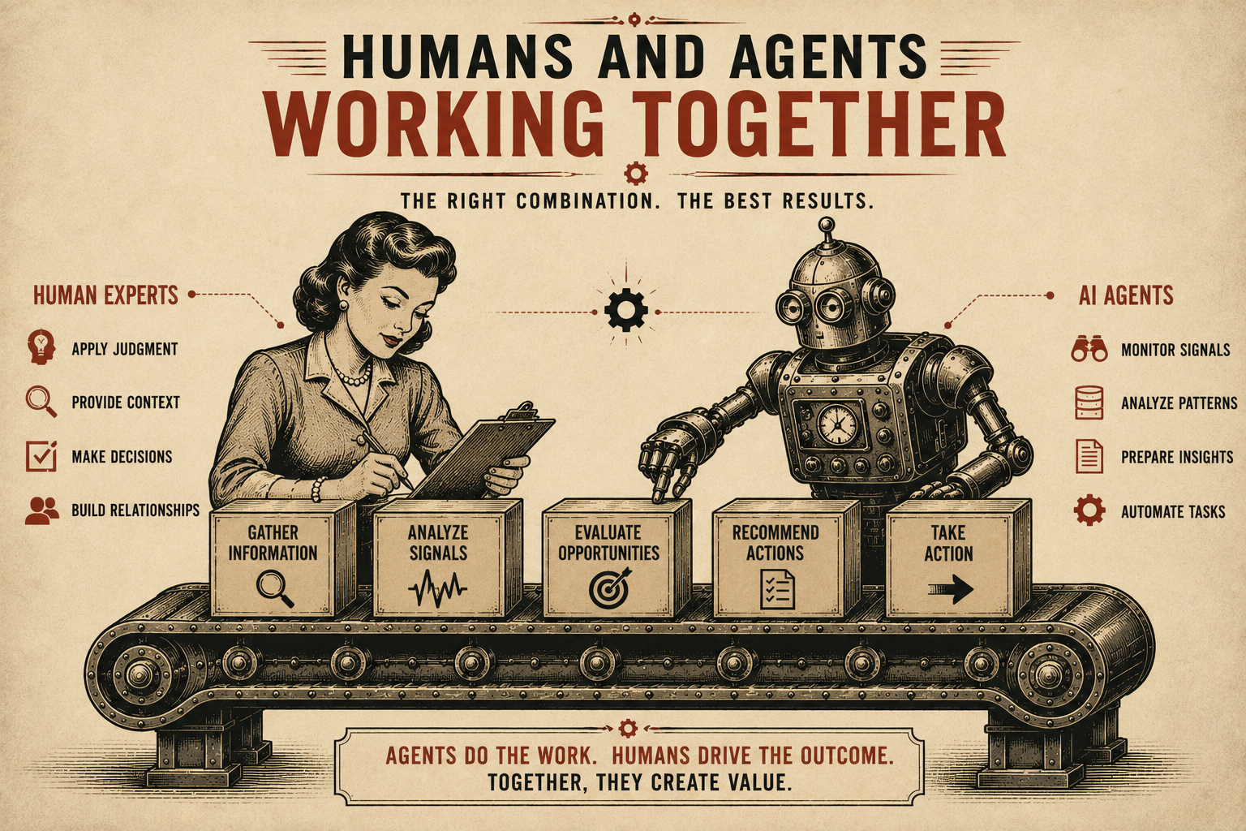
Page 6
VOL. I · THE BAND IT LAYER
HUMANS AND AGENTS WORKING TOGETHER
Band It combines human expertise with AI capabilities.
AI agents:
Human experts:
The goal is not to replace people.
The goal is to amplify their effectiveness.
— Gather information
— Monitor signals
— Analyze patterns
— Prepare recommendations
— Apply judgment
— Make decisions
— Provide context
— Validate results

