Slide 1
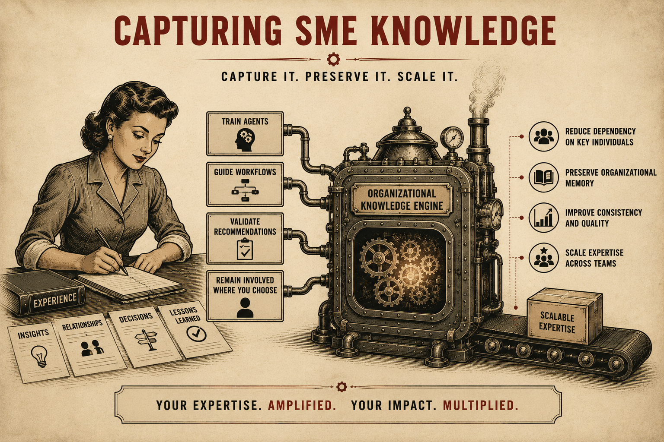
Page 7
VOL. I · THE BAND IT LAYER
CAPTURING SME KNOWLEDGE
Many organizations depend on a small number of key people.
Those individuals hold years of experience, relationships, and decision-making knowledge.
Band It helps capture and preserve that expertise.
Subject Matter Experts can:
The result is organizational knowledge that scales beyond any one individual.
— Train agents
— Guide workflows
— Validate recommendations
— Remain involved wherever they choose

