Slide 1
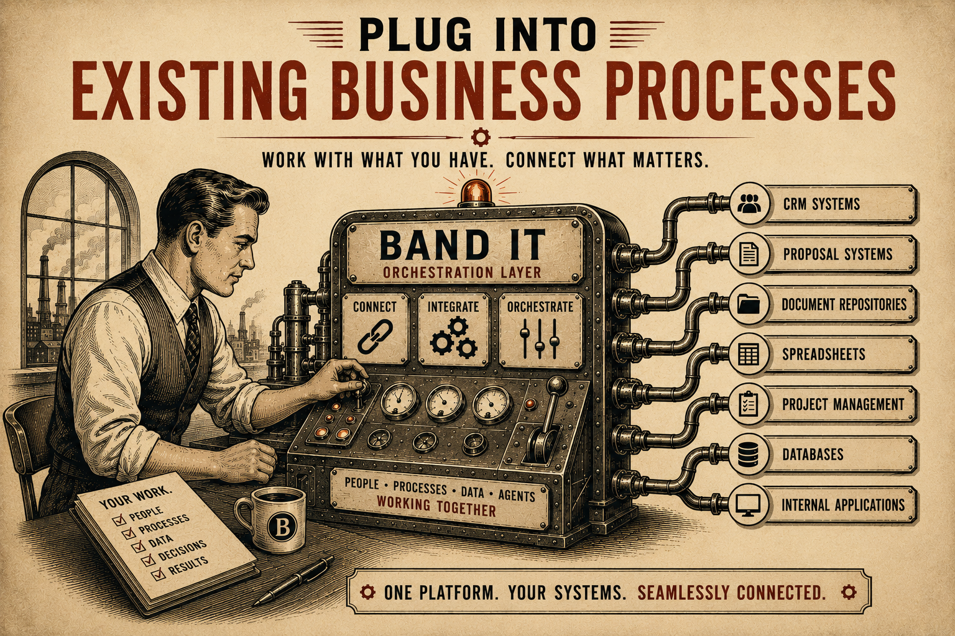
Page 8
VOL. I · THE BAND IT LAYER
PLUG INTO EXISTING BUSINESS PROCESSES
Organizations already have systems and workflows in place.
Band It is designed to work with them.
Examples:
Band It becomes an orchestration layer that connects people, processes, and AI agents.
— CRM systems
— Proposal systems
— Document repositories
— Spreadsheets
— Project management tools
— Databases
— Internal applications

