Slide 1
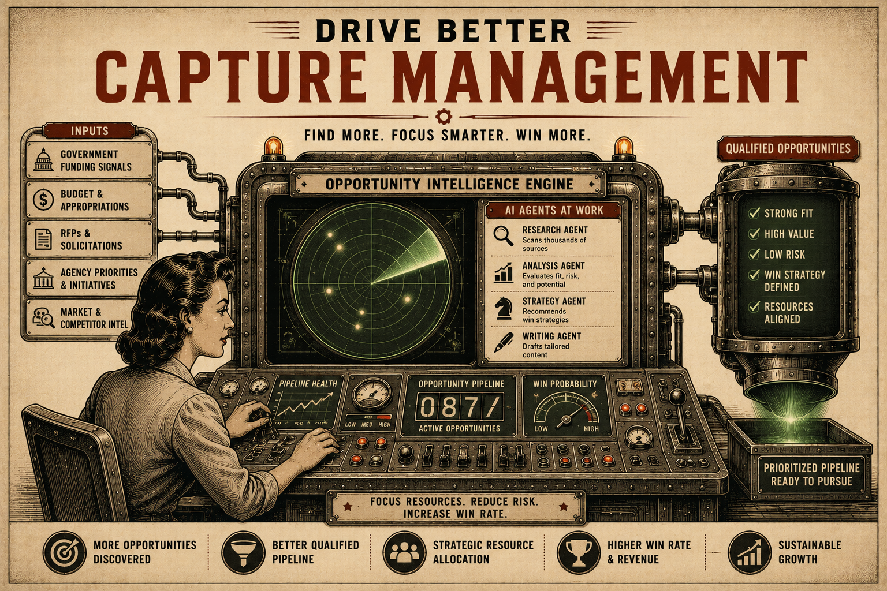
Page 9
VOL. I · THE BAND IT LAYER
EXAMPLE: CAPTURE MANAGEMENT
Every successful contract pursuit begins with signals.
Band It continuously monitors these signals and identifies opportunities before they become obvious to everyone else.
Signal Detection ↓
Opportunity Identification ↓
Research & Qualification ↓
Capture Planning ↓
Proposal Development ↓
Submission & Follow Through
Human experts and AI agents work together throughout the process.
The result is earlier visibility, faster response times, and more opportunities entering the pipeline.
— A new program is funded.
— A budget is approved.
— A procurement notice appears.
— A competitor exits a market.
— A key decision maker changes roles.

