Slide 1
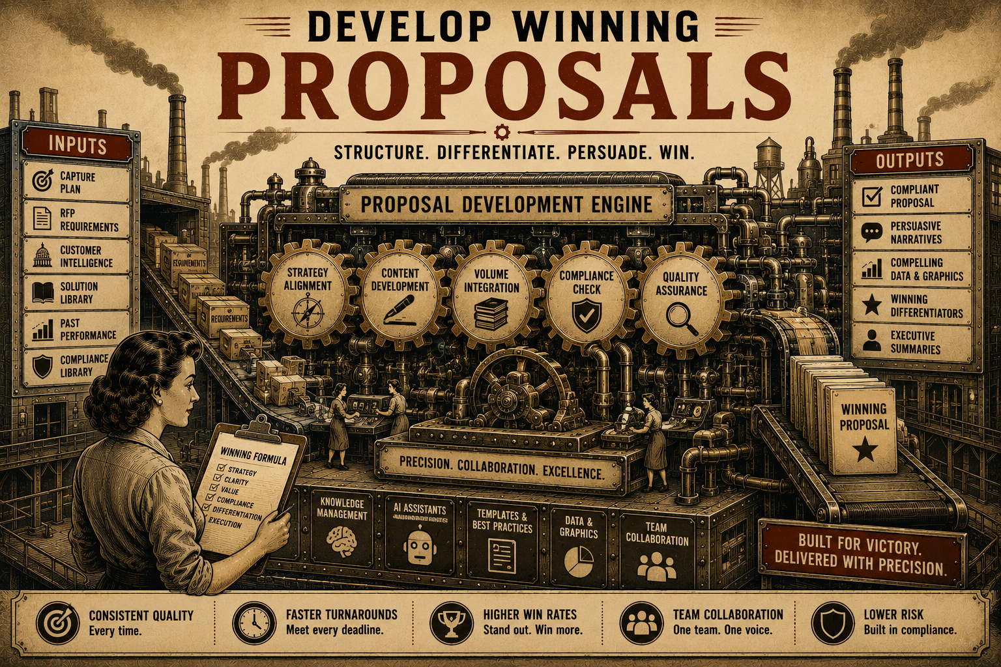
Page 10
VOL. I · THE BAND IT LAYER
THE AGENT FACTORY
Every organization has unique processes and expertise.
Band It enables organizations to create agents that reflect their specific knowledge and workflows.
Agents can be built to:
Over time, organizations build a growing library of reusable capabilities.
Each new agent makes the organization more effective.
— Monitor signals
— Perform research
— Analyze opportunities
— Generate reports
— Support decision-making
— Execute repetitive tasks

