Slide 1
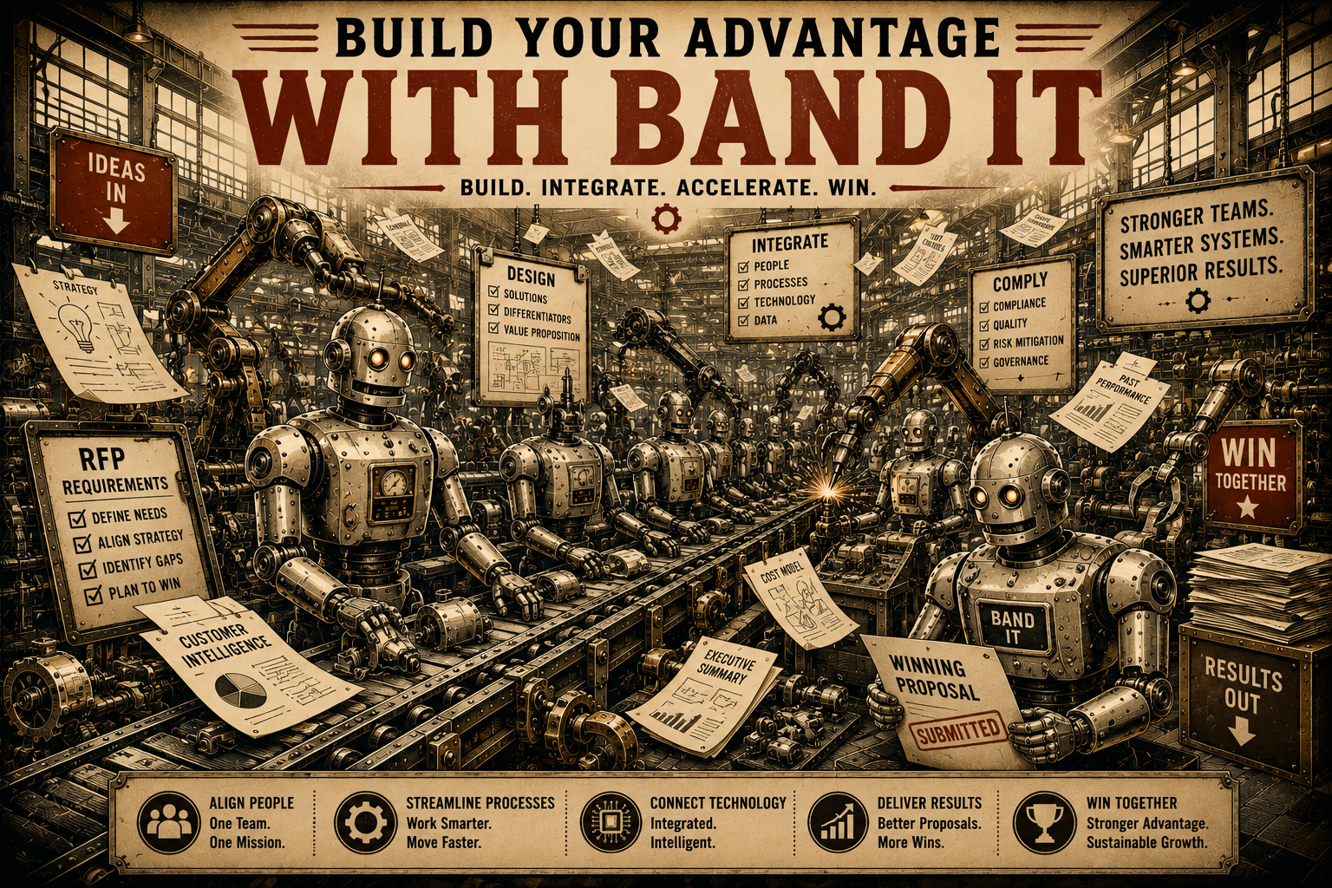
Page 11
VOL. I · THE BAND IT LAYER
THE FUTURE OF WORK
Technology is becoming a utility.
Organizations will increasingly combine people, expertise, and AI agents into flexible systems that continuously adapt to changing conditions.
The future belongs to organizations that can:
Band It helps organizations build that future today.
— Detect opportunities faster
— Learn continuously
— Scale expertise
— Adapt rapidly
— Focus human effort where it creates the most value

