Slide 1
Meeting with Lindsay 4/6/2020

Slide 2
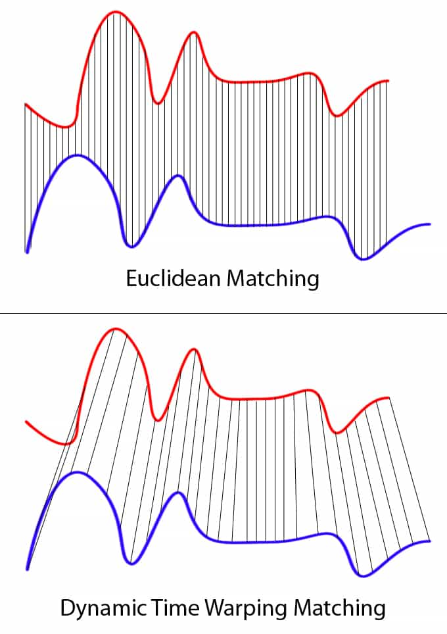
Premise: Dynamic Time Warping Hierarchical Clustering to assign compounds to groups of similar temporal variation
DTW Hierarchical clustering basics: Tree based splitting algorithm where each split is optimized to increase the difference between the branches while minimizing the differences within a single branch
Dynamic Time Warping specifically prioritizes similarities in the temporal profiles over absolute similarities at each time point, to optimize clustering in situations with the potential for slight temporal lags
Number of appropriate clusters selected by optimizing cluster statistics comparing the similarity within clusters to the differences between clusters

Slide 3
Premise: Dynamic Time Warping Hierarchical Clustering to assign compounds to groups of similar temporal variation
Unsupervised splitting, post-split analysis of correlations between mean factor profiles and tracers (specifically urban (phthalic acid) tracers and biomass burning (levoglucosan)) and AMS-PMF factors
Factorization based upon optimized clustering of the top 100 compounds (more not selected due to s/n issues)
All additional (smaller) compounds assigned to the factor whose profile they correlate with best

Slide 4
Wet Season Clustering
Unsupervised clustering optimized at 9 factors- however, both BB and urban influence tracers were in the same cluster and this cluster made up a disproportionate fraction of volume
Solution: extract the “anthropogenic influence” factor and factorize this
Result: factorization of factor 2 optimized at 4 factors, yielding 12 factors overall
(this is why the numbering scheme for IOP1 is off- factor 2 was split into factors 10, 11, 12, and 13 and therefore no longer exists)

Slide 5
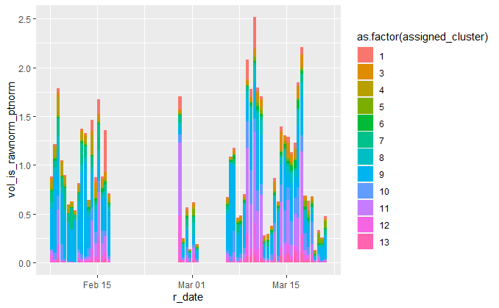
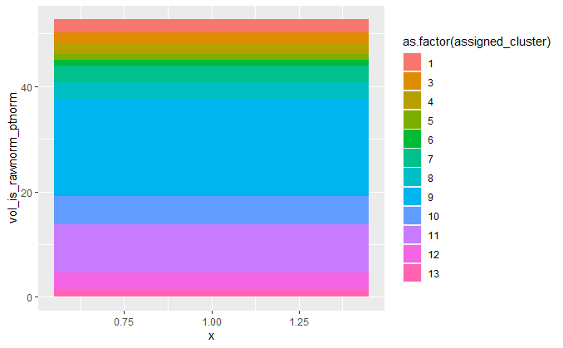
Wet Season

Slide 6
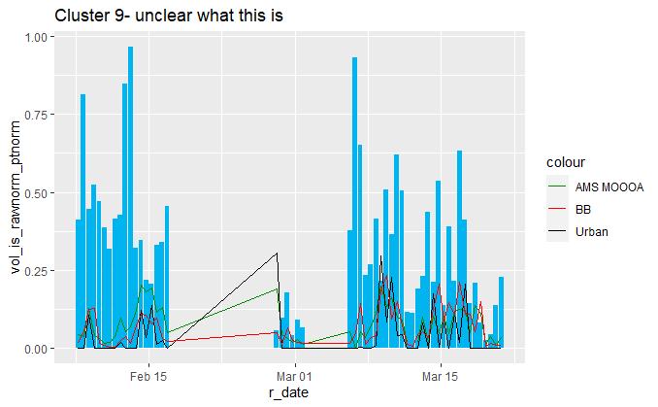
Wet Season- factor by factor
35% cumulative season signal
Factor contains lots of phthalic acid esters
No correlations above .22 with anything

Slide 7
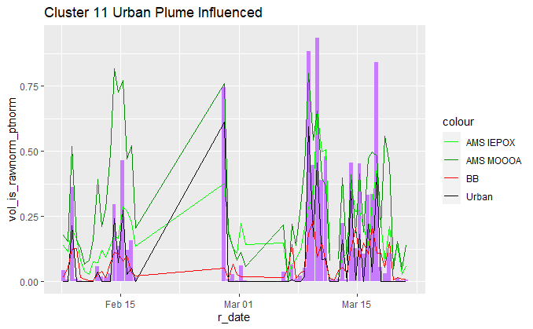
Wet Season- factor by factor
17% cumulative season signal
Factor contains Phthalic acid
Phthalic acid r = .92
AMS IEPOX r = .82
AMS MOOOA r = .73

Slide 8
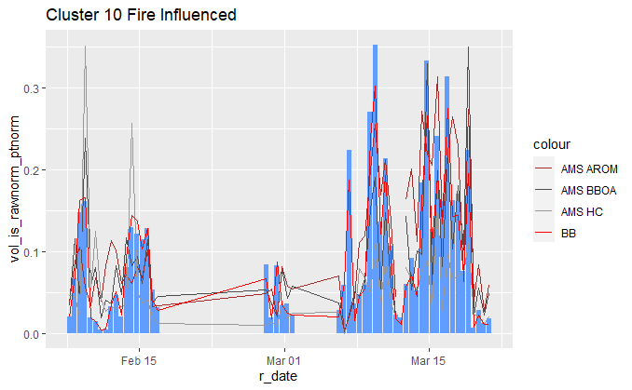
Wet Season- factor by factor
10% cumulative season signal
Factor contains levoglucosan
lev r = .99
AMS BBOA r = .71
AMS AROM r = .71

Slide 9
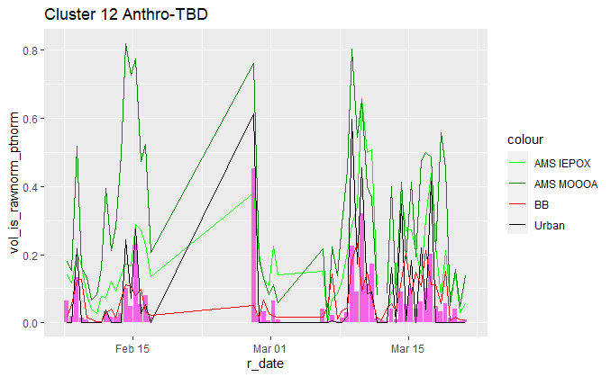
Wet Season- factor by factor
6% cumulative season signal
Levoglucosan R = .41
Phthalic acid R = .83
AMS IEPOX R = .86
AMs MOOOA R = .69

Slide 10
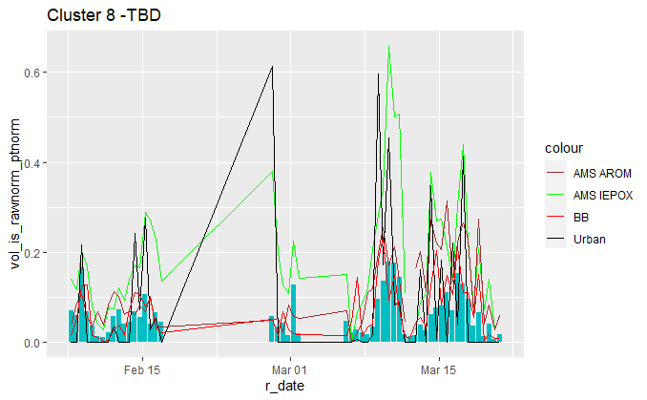
Wet Season- factor by factor
6% cumulative season signal
Levoglucosan R = .65
Phthalic acid R = .45
AMS IEPOX R = .79
AMs Arom R = .55

Slide 11
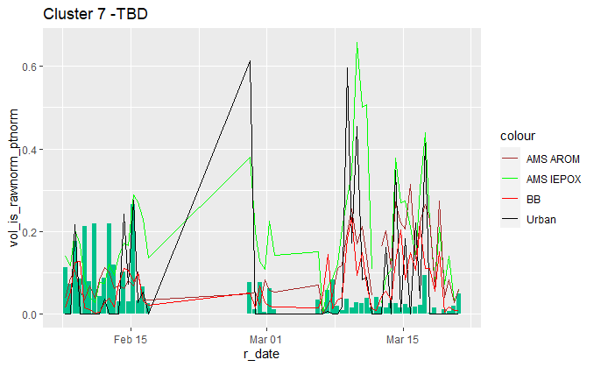
Wet Season- factor by factor
5% cumulative season signal
No cor above .15 with anything. A wacky factor.
Note: strong anticorrelation between many species and biomass burning. Possibly indicative of “low nox” pathway alternatives to some biomass burning associated biogenic products?

Slide 12
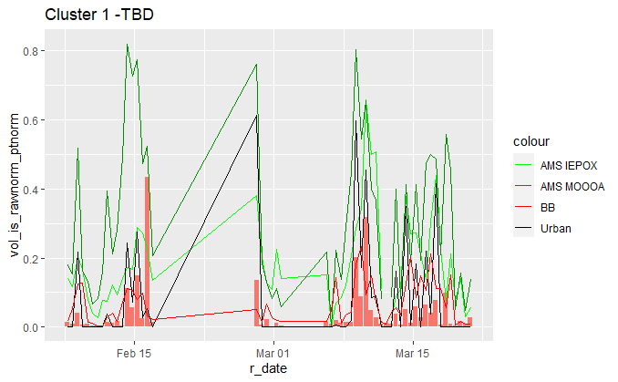
Wet Season- factor by factor
5% cumulative season signal

Slide 13
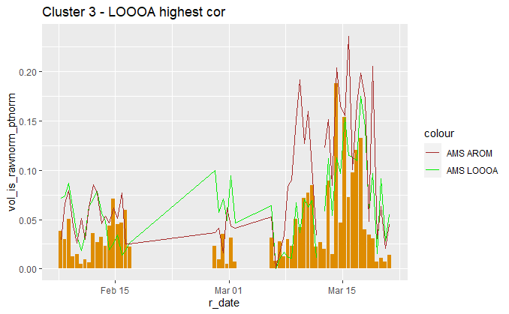
Wet Season- factor by factor
4% cumulative season signal

Slide 14
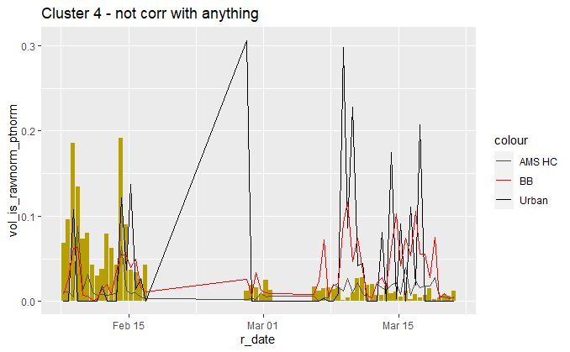
Wet Season- factor by factor
3% cumulative season signal

Slide 15
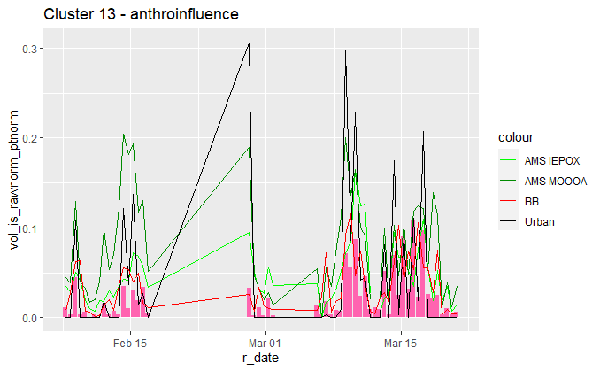
Wet Season- factor by factor
2% cumulative season signal

Slide 16
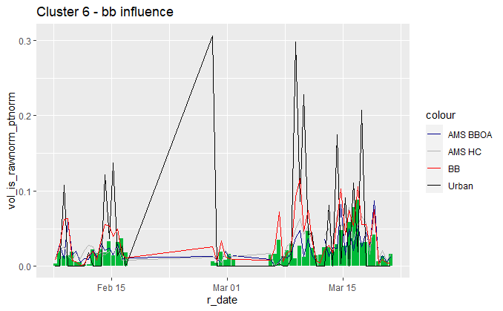
Wet Season- factor by factor
2% cumulative season signal

Slide 17
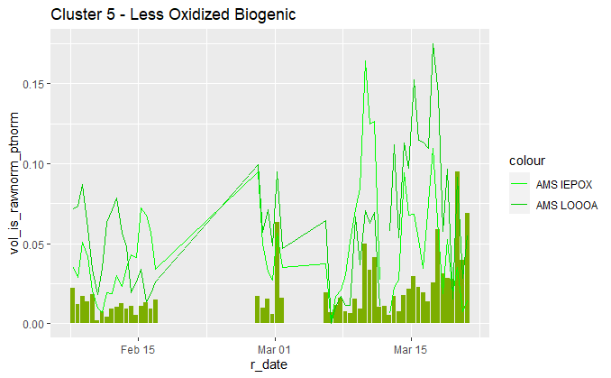
Wet Season- factor by factor
2% cumulative season signal

Slide 18
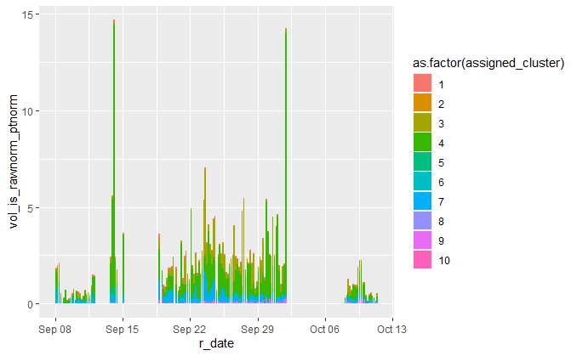
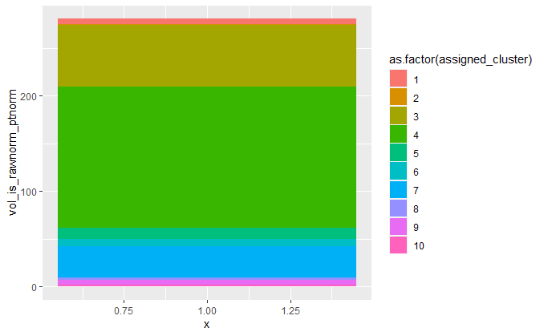
Dry Season

Slide 19
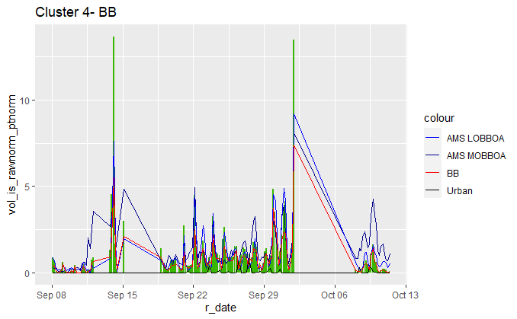
Dry Season- factor by factor
55% cumulative season signal
Levoglucosan r = .98
AMS MOBBOA R = .75
AMS LOBBOA R = .95

Slide 20
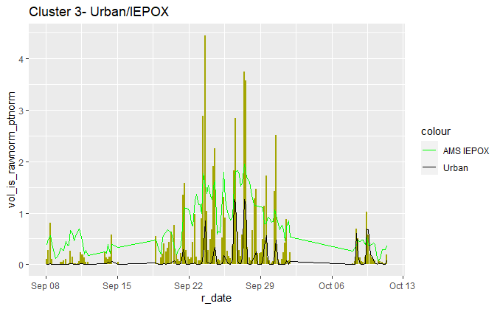
Dry Season- factor by factor
23% cumulative season signal
Contains phthalic acid
Phthalic acid r = .79
AMS IEPOX r = .6

Slide 21
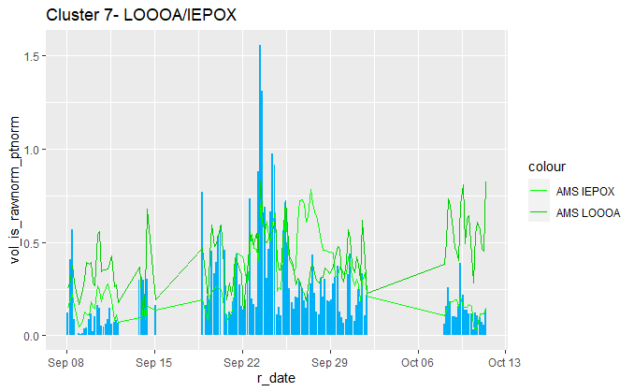
Dry Season- factor by factor
12% cumulative season signal
AMS IEPOX R = .50
AMS LOOOA R = .47

Slide 22
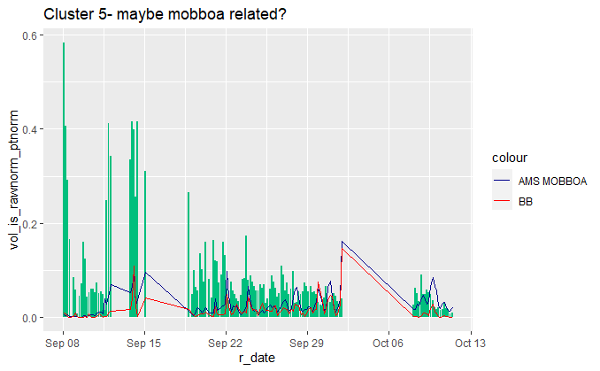
Dry Season- factor by factor
But really not strongly associated with anything
4% cumulative season signal
AMS MOBBOA r = .13

Slide 23
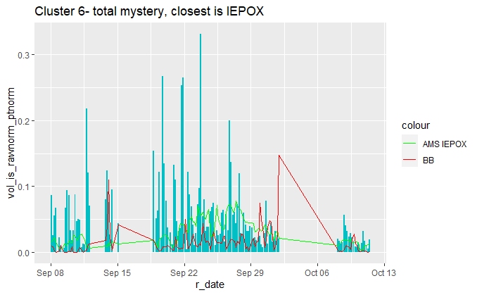
Dry Season- factor by factor
3% cumulative season signal
AMS IEPOX r = .12

Slide 24
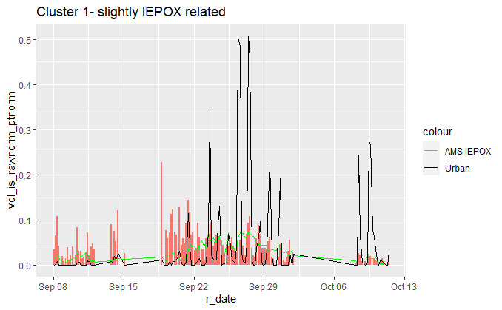
Dry Season- factor by factor
2% cumulative season signal
AME IEPOX r = .29
Phthalic acid r = .25

Slide 25
Dry Season- factor by factor
Everything else dry season is < 1.5% signal, moving on

Slide 26
Anthropogenic Influence Overlap Analysis
Factors with strong association with biomass burning or urban influenced tracers indicated-
Note: UP indictes urban plume, BB indicates biomass burning

Slide 27
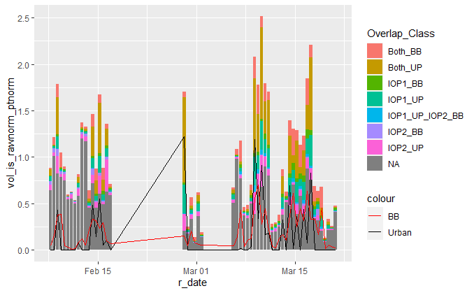
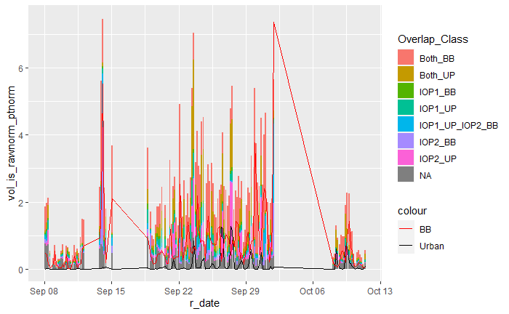
Anthropogenic Influence and Overlap Analysis
Both BB = Strongly associated with biomass burning both seasons; Both_UP = Strongly associated with urban plume both seasons, IOP1_BB = associated strongly with biomass burning wet season only, not associated with any pollution tracers in dry season; IOP1_UP_IOP2_BB = strongly associated with urban pollution in wet season and biomass burning in dry season (I find this really interesting btw- plays into the theory that wet season urban dominates nox and dry season fires dominate nox and these species are Nox dependent formed), NA = not strongly associated with an anthropogenic pollution tracer in either season

Slide 28
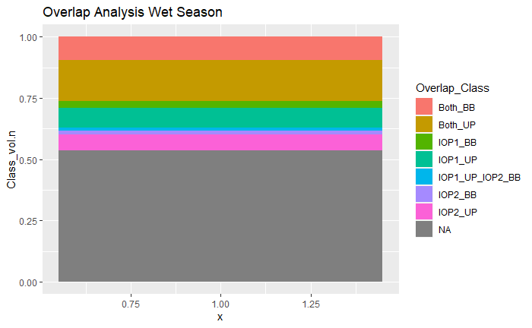
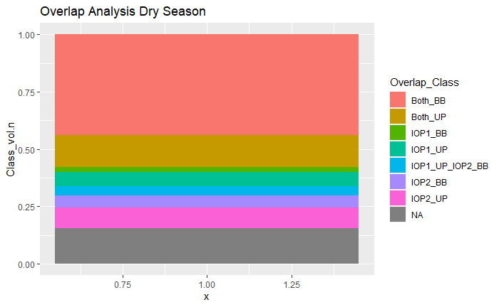
Anthropogenic Influence and Overlap Analysis
Both BB = Strongly associated with biomass burning both seasons; Both_UP = Strongly associated with urban plume both seasons, IOP1_BB = associated strongly with biomass burning wet season only, not associated with any pollution tracers in dry season; IOP1_UP_IOP2_BB = strongly associated with urban pollution in wet season and biomass burning in dry season (I find this really interesting btw- plays into the theory that wet season urban dominates nox and dry season fires dominate nox and these species are Nox dependent formed), NA = not strongly associated with an anthropogenic pollution tracer in either season

Slide 29
Anthropogenic Influence and Overlap Analysis
Wet Season Anthropogenic Influenced Compound Signal
Dry Season Anthropogenic Influenced Compound Signal
Wet Season Anthropogenic Influence Independent Signal
Dry Season Anthropogenic Influenced Compound Signal
Dry Season Anthropogenic Influence Independent Signal
Both BB = Strongly associated with biomass burning both seasons; Both_UP = Strongly associated with urban plume both seasons, IOP1_BB = associated strongly with biomass burning wet season only, not associated with any pollution tracers in dry season; IOP1_UP_IOP2_BB = strongly associated with urban pollution in wet season and biomass burning in dry season (I find this really interesting btw- plays into the theory that wet season urban dominates nox and dry season fires dominate nox and these species are Nox dependent formed)
“Anthropogenic Influenced” = compounds with temporal variability strongly associated with tracers of anthropogenic influence, e.g. urban plume tracers and biomass burning tracers. Screened for association independent of general diurnal variability, but this connection could be more exhaustively probed by changing the clustering algorithm- should discuss. “Anthropogenic Influenced” is assumed to include both direct emissions and species whose formation is influenced by alterations in oxidative conditions caused by fire and urban related oxidant emissions.
“Anthropogenic Influence Independent” assumed to include biogenic products NOT strongly influenced by the presence of
Preliminary conclusion: Wet season ~ 40% of OA (in GCxGC detection region) is influenced by human activity In some way, in dry season ~75% OA influenced by human activity

Slide 30
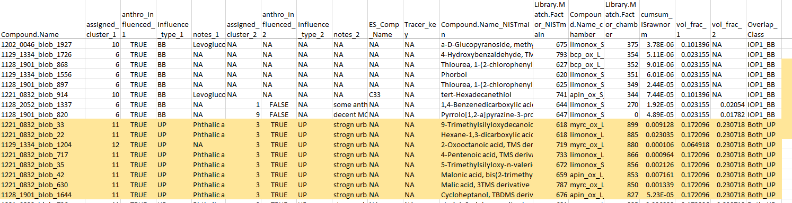
Snapshot of the masterlist
Example: extracting compounds that are strongly associated with urban influence (UP) in both seasons that were identified in monoterpene oxidation filters- possible candidates for tracers of NOx influenced monoterpene oxidation chemistry?

Slide 31
Next Steps
Ensure that I have all of the available chamber data integrated and compared- do we have high Nox specific filters?
Mass spectral library matching to check against past campaigns?
Add in any additional indicators we may have access to- back trajectory analysis for air masses (esp. urban)? Sulfur chemistry indicators? Cloud cover data? Would love to look at correlations btw all clusters and indicators to see if any can explain the factors that don’t correlate with anything
Go back to the unique compound analysis and see what factor the compounds fall into- follow up on the finding of anthropogenic perturbation of oxidation chemistry?
What kinds of preliminary results from this analysis could I include in an abstract?

