Slide 1
Meeting with Allen 4/15/2020

Slide 2
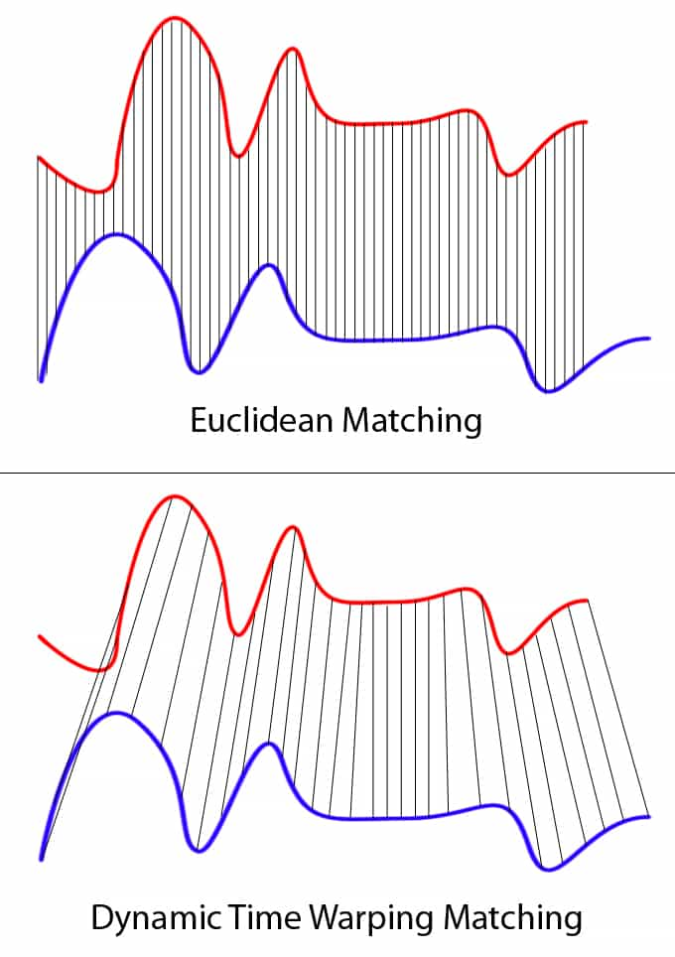
Premise: Dynamic Time Warping Hierarchical Clustering to assign compounds to groups of similar temporal variation
DTW Hierarchical clustering basics: Tree based splitting algorithm where each split is optimized to increase the difference between the branches while minimizing the differences within a single branch
Dynamic Time Warping specifically prioritizes similarities in the temporal profiles over absolute similarities at each time point, to optimize clustering in situations with the potential for slight temporal lags
Number of appropriate clusters selected by optimizing cluster statistics comparing the similarity within clusters to the differences between clusters

Slide 3
Premise: Dynamic Time Warping Hierarchical Clustering to assign compounds to groups of similar temporal variation
Unsupervised splitting, post-split analysis of correlations between mean factor profiles and tracers (specifically urban (phthalic acid) tracers and biomass burning (levoglucosan)) and AMS-PMF factors
Factorization based upon optimized clustering of the top 100 compounds (more not selected due to s/n issues)
All additional (smaller) compounds assigned to the factor whose profile they correlate with best

Slide 4
Wet Season Clustering
Unsupervised clustering optimized at 9 factors- however, both BB and urban influence tracers were in the same cluster and this cluster made up a disproportionate fraction of volume
Solution: extract the “anthropogenic influence” factor and factorize this
Result: factorization of factor 2 optimized at 4 factors, yielding 12 factors overall
(this is why the numbering scheme for IOP1 is off- factor 2 was split into factors 10, 11, 12, and 13 and therefore no longer exists)

Slide 5
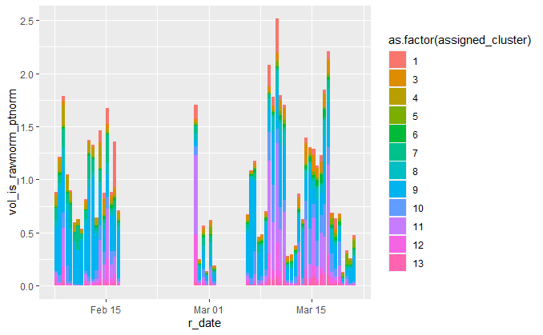
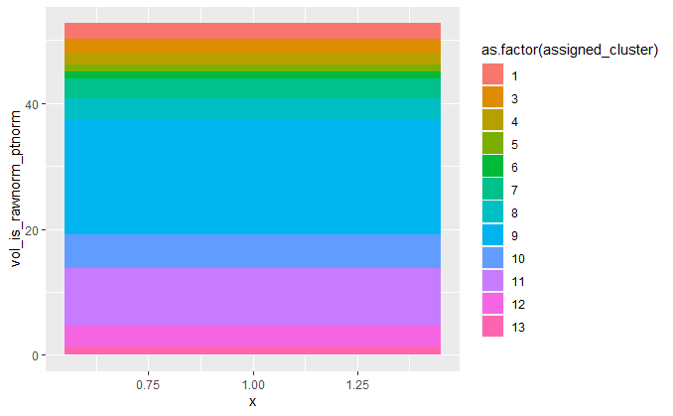
Wet Season

Slide 6
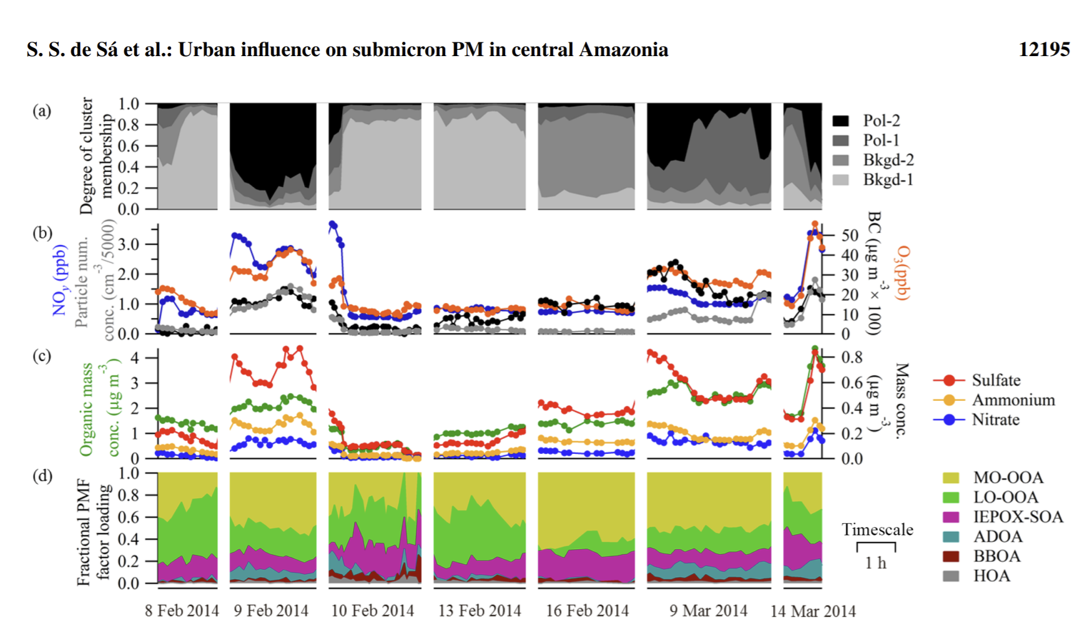
Wet Season- Suzane’s paper
Note: early feb period (excepting on the 9th) is background biogenic period.
This matches my factors- with urban pulse on the 9th but mostly bio factors in this time. Note- I have a few factors that are only high in the feb period. Matching with the Bkgd-1 factor?
Question: how do I get ahold of all of these other indicators? All the rest of the AMS (not just the PMF), the O3, etc… would be super cool to look at with my factors

Slide 7


Wet Season clusters
IOP1 clustering by numbers- top 100 compounds
IOP1 clustering by numbers- all compounds

Slide 8
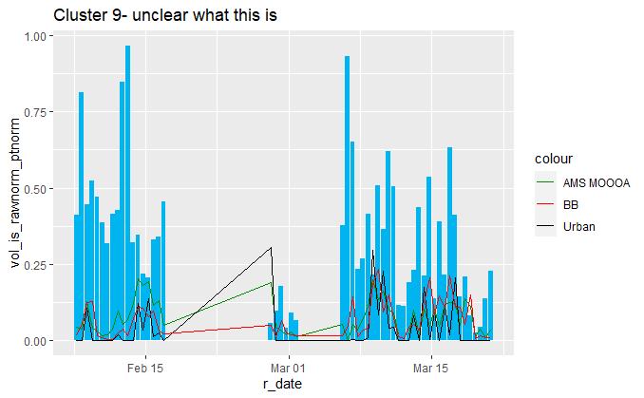
Wet Season- factor by factor
35% cumulative season signal
Night abundant, 31 compounds
Factor contains lots of phthalic acid esters
No correlations above .22 with anything

Slide 9
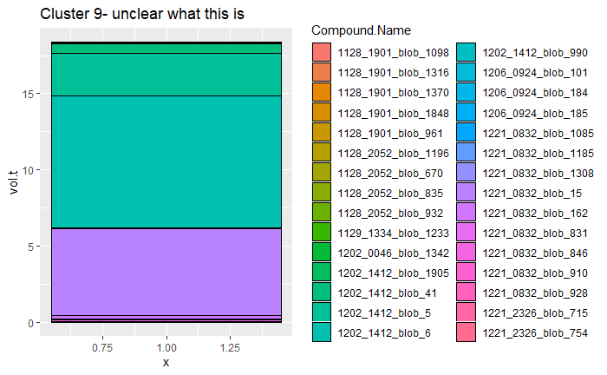
Wet Season- factor by factor
35% cumulative season signal
31 compounds
Factor contains lots of phthalic acid esters
No correlations above .22 with anything
Phthalic acid, butyl isohexyl ester
Phthalic acid, butyl 3-methylbutyl ester
Phthalic acid, butyl 3-methylbutyl pentyl ester

Slide 10
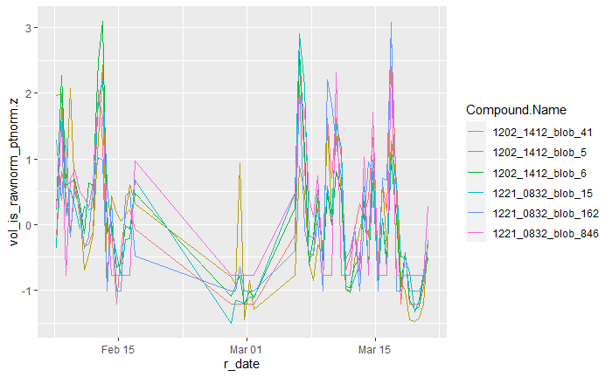
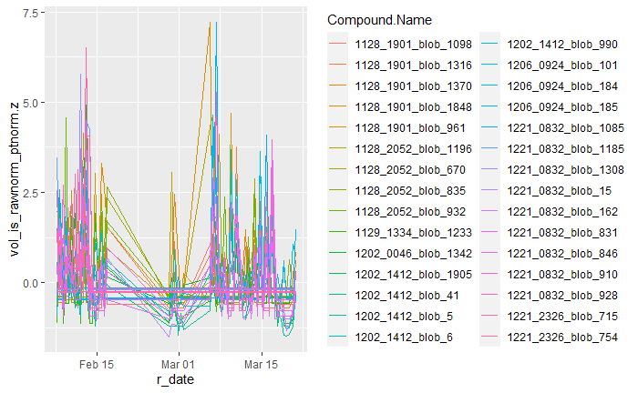
More on factor 9
Just compounds in the top 100 (the ones that determined the mean cluster profile)- note that the flat sections mean that many of the species were below detection limits in several samples
All of the compounds from this factor

Slide 11
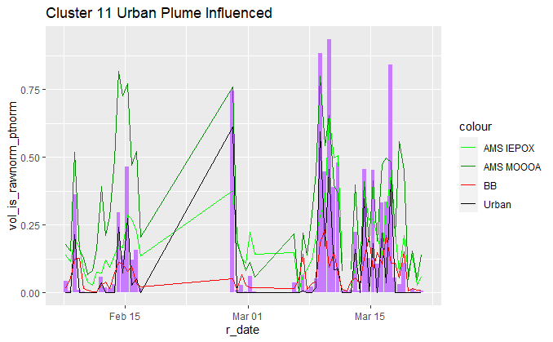
Wet Season- factor by factor
17% cumulative season signal
Day abundant (strong)
Factor contains Phthalic acid
Phthalic acid r = .92
AMS IEPOX r = .82
AMS MOOOA r = .73

Slide 12
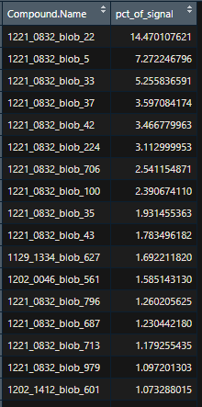
Wet Season- factor by factor
17% cumulative season signal
233 compounds
Factor contains Phthalic acid
Phthalic acid r = .92
AMS IEPOX r = .82
AMS MOOOA r = .73
Limonene ox product
MBTCA
myrcene ox product
A-pinene ox product
Phthalic acid
Note- also includes methylglutaric acid, but <1% mass

Slide 13
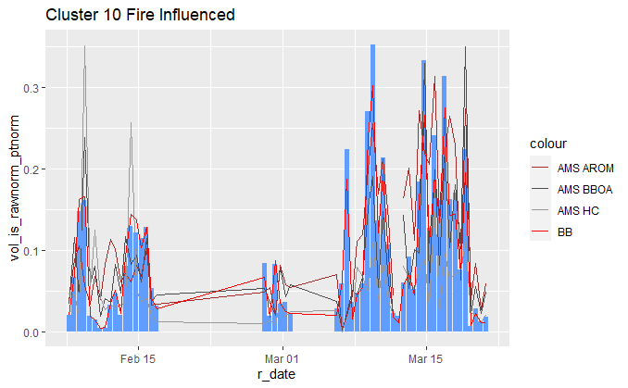
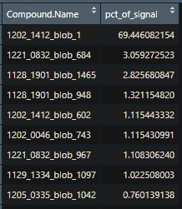
Wet Season- factor by factor
10% cumulative season signal
97 compounds
Factor slightly day abundant, levoglucosan slightly night abundant
Factor contains levoglucosan
lev r = .99
AMS BBOA r = .71
AMS AROM r = .71
levoglucosan
Methyl arabinofuranoside
Pentanedioic acid
4-hydroxybenzoic acid
Other compounds in this factor:
Vanillic acid, a-amyrin, galactosan, beta-sitosterol, C28 acid, vanillin

Slide 14
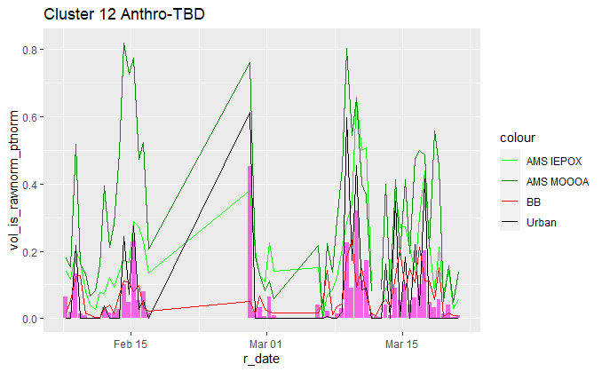
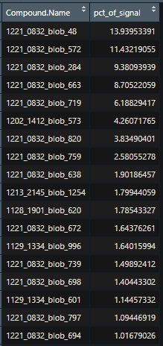
Wet Season- factor by factor
6% cumulative season signal
98 compounds
Strongly day abundant
Levoglucosan R = .41
Phthalic acid R = .83
AMS IEPOX R = .86
AMS MOOOA R = .69
2-methyl tetrol (1)
3-butanoic acid, 3 TMS ester
2-methyl tetrol (2)
Gamma dodecalactone

Slide 15
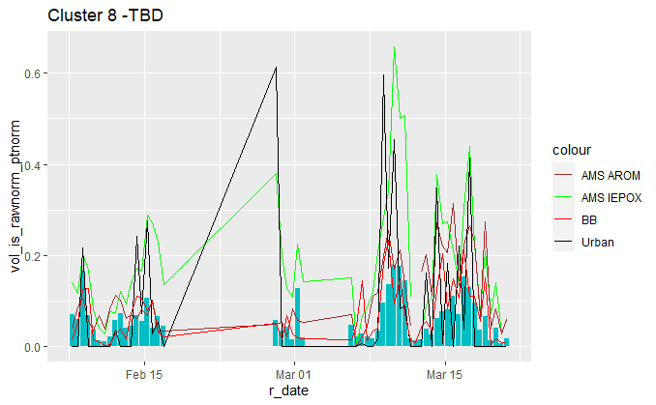
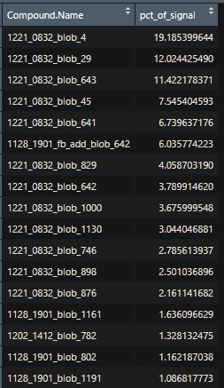
Wet Season- factor by factor
6% cumulative season signal
54 compounds, slightly day abundant
Levoglucosan R = .65
Phthalic acid R = .45
AMS IEPOX R = .79
AMs Arom R = .55
6-methyl-2-tridecanone
Pinic acid

Slide 16
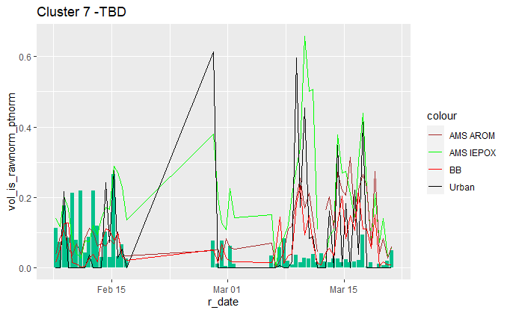
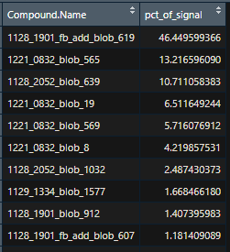
Wet Season- factor by factor
5% cumulative season signal
62 compounds, day abundant
No cor above .15 with anything. A wacky factor.
Note: strong anticorrelation between many species and biomass burning
DEET
Beta-caryophyllene aldehyde
octadecanol

Slide 17
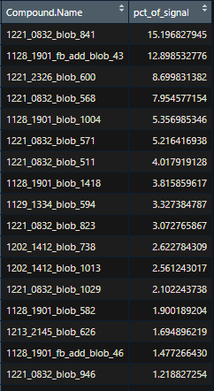
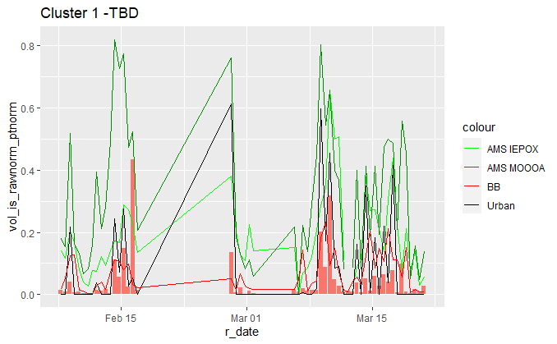
Wet Season- factor by factor
5% cumulative season signal
147 compounds, day abundant
Hexamethyl disiloxane
Methyl palmitate
squalene

Slide 18
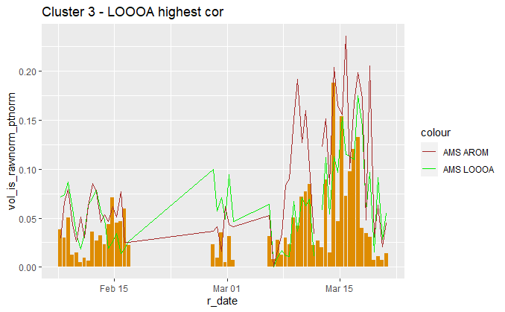
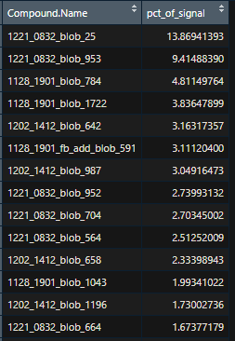
Wet Season- factor by factor
4% cumulative season signal
107 compounds
Slightly day abundant
Beta nocaryophyllonic acid
C13 acid

Slide 19
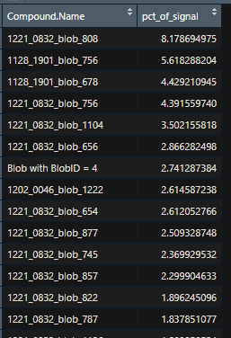
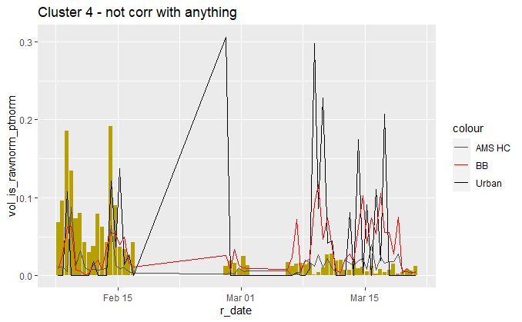
Wet Season- factor by factor
3% cumulative season signal
111 compounds
Slightly night abundant
Dodecyldihydro furanone
Beta caryophyllene ox product
C26 alkane

Slide 20
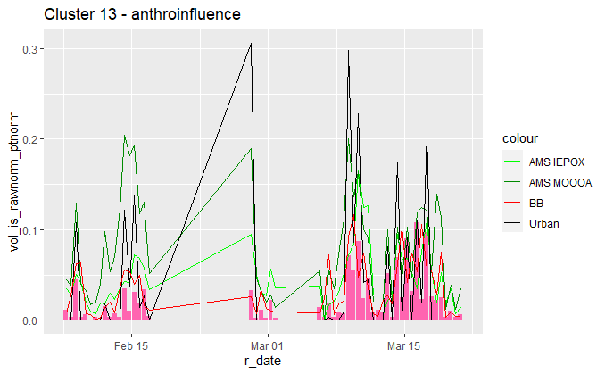
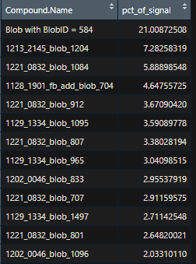
Wet Season- factor by factor
2% cumulative season signal
59 compounds
Day abundant (very strong)
Azelaic acid
Limonene ox product
Note- beta nocaryophyllinic acid in this factor

Slide 21
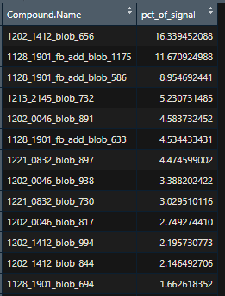
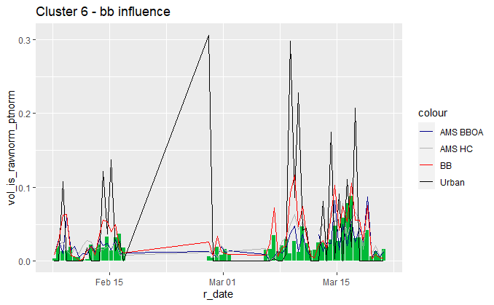
Wet Season- factor by factor
2% cumulative season signal
72 compounds
Slightly night abundant
C9 acid
C24 acid
C26 acid
C22 acid

Slide 22
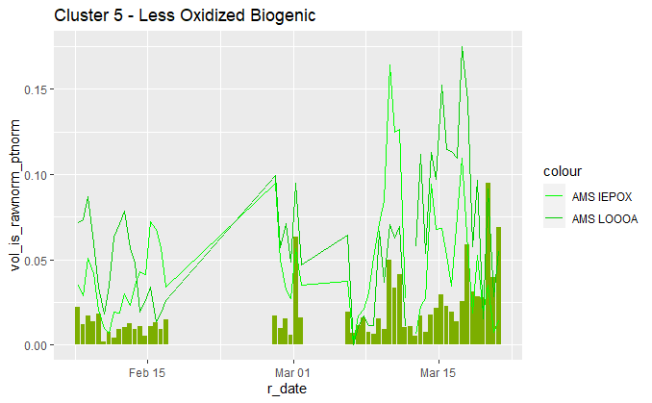
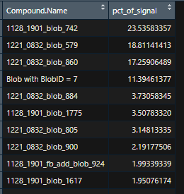
Wet Season- factor by factor
2% cumulative season signal
33 compounds
Slightly day abundant
C10 acid

Slide 23
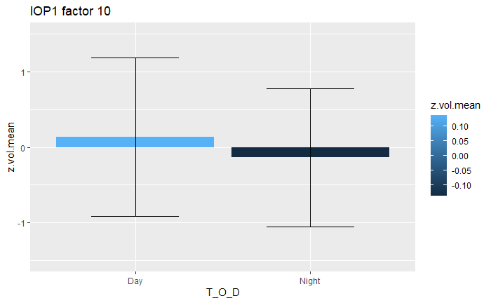
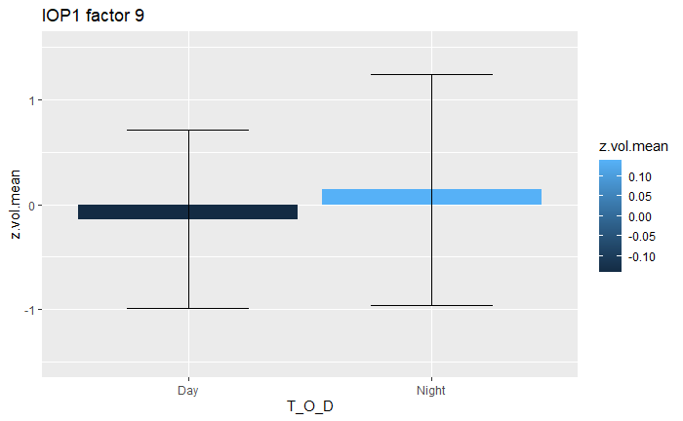
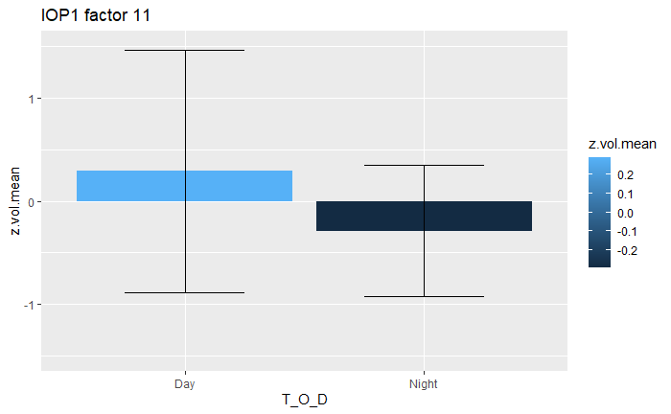
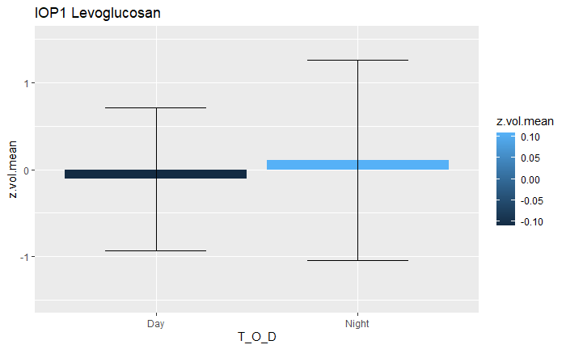

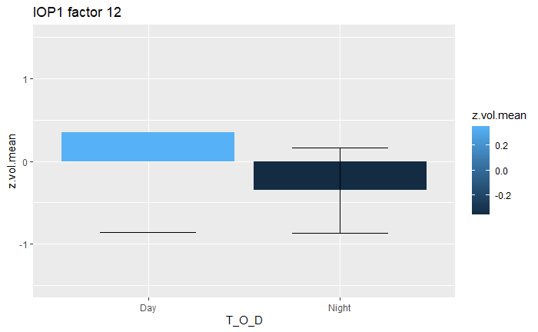
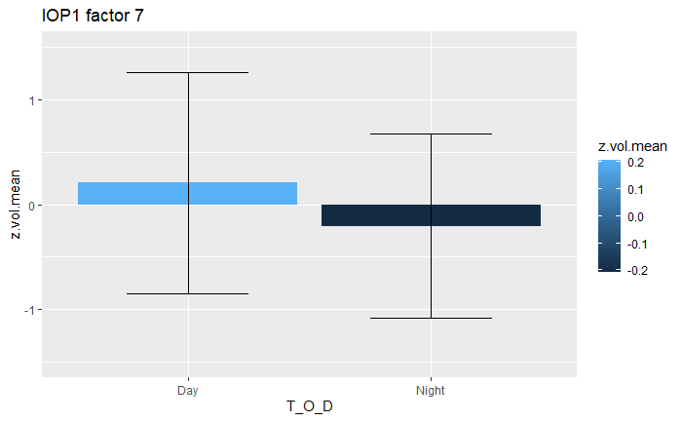
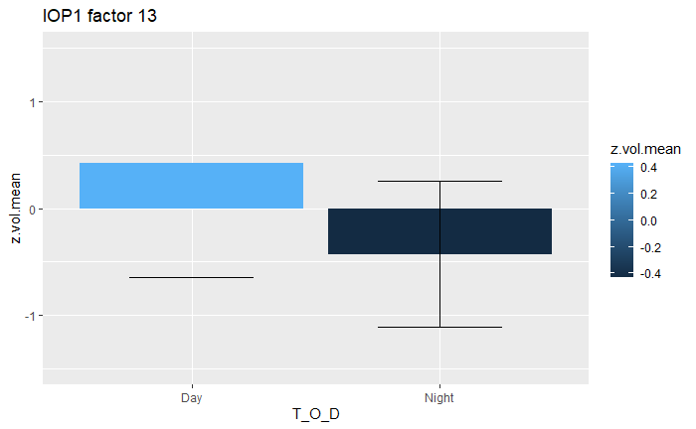
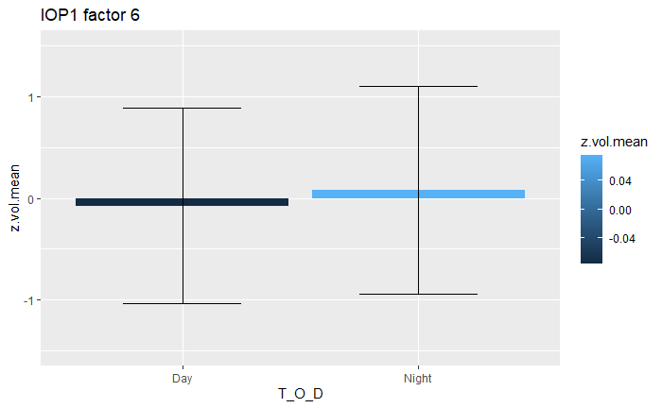
Diurnal Comparisons
Biomass Influenced
Baseline Bio?
Urban Influenced

Slide 24
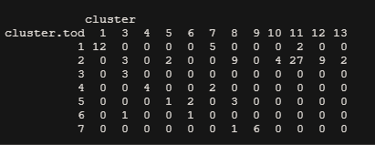
Time Of Day Normalized Clustering

Slide 25
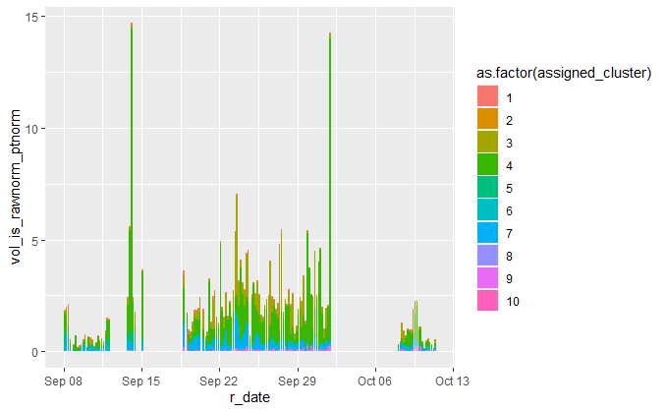
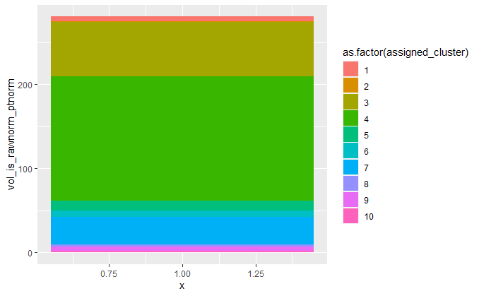
Dry Season

Slide 26
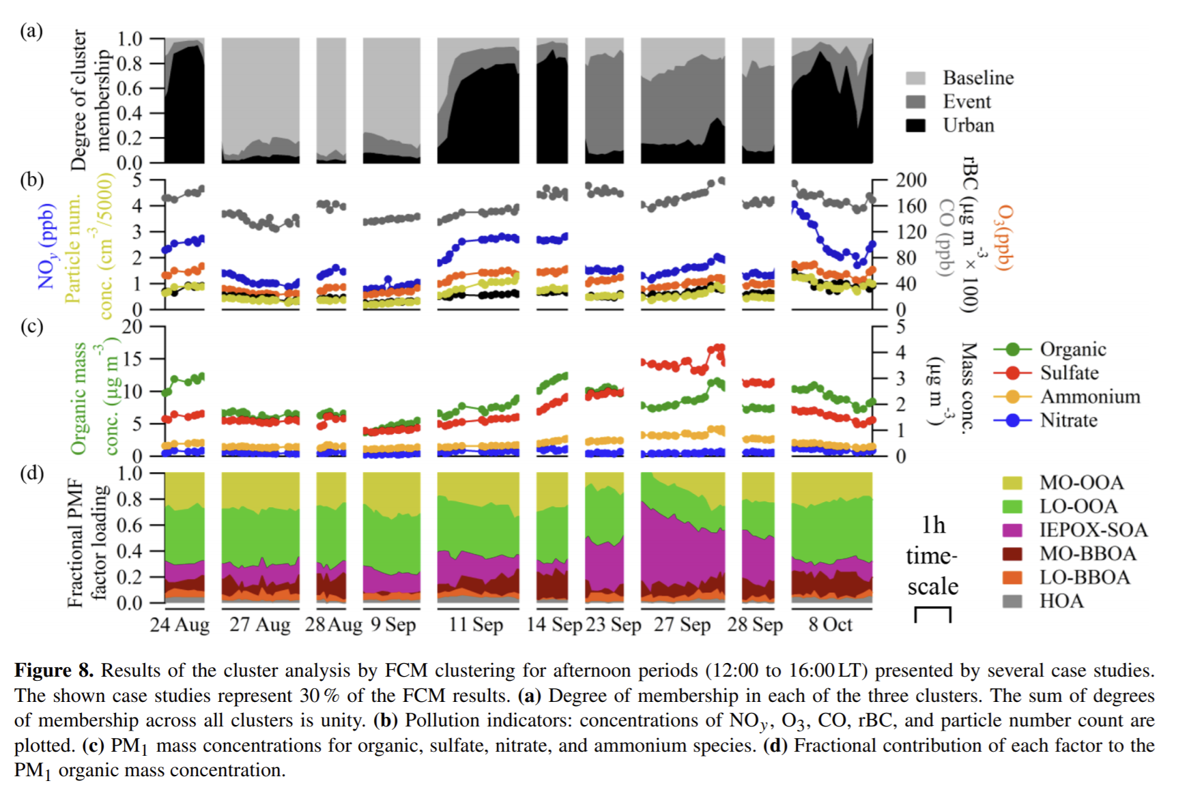
Dry season- Suzane

Slide 27

Dry Season Clusters
IOP2 clustering by numbers- top 100 compounds
IOP2 clustering by numbers- all compounds

Slide 28
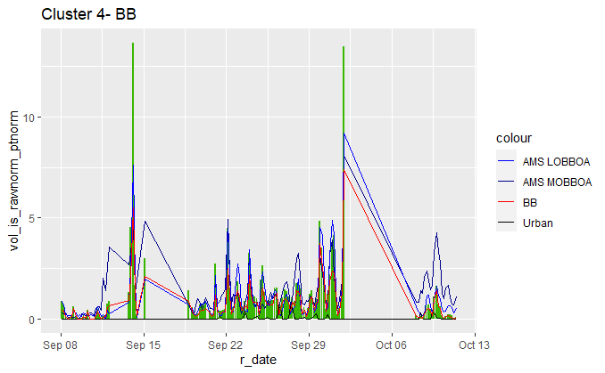
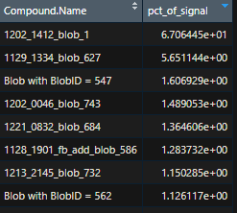
Dry Season- factor by factor
55% cumulative season signal
247 compounds, night abundant (strong)
Levoglucosan r = .98
AMS MOBBOA R = .75
AMS LOBBOA R = .95
Levoglucosan
C24 acid
C26 acid
Also in this factor: vanillic acid, mannosan, a-amyrin, galactosan, sinapinaldehyde

Slide 29
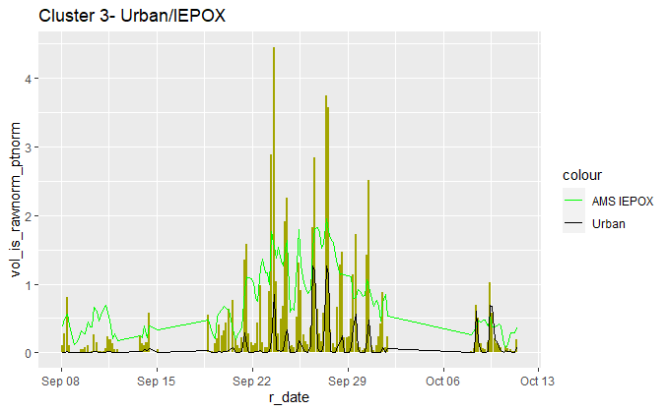
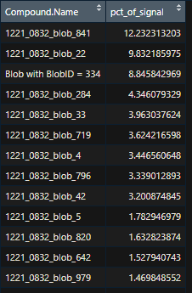
Dry Season- factor by factor
23% cumulative season signal
292 compounds, day abundant (strong)
Contains phthalic acid
Phthalic acid r = .79
AMS IEPOX r = .6
Limonene ox product
MBTCA
Also in this factor: phthalic acid, beta-nocaryophyllonic acid TMS, 2-methylglyceric acid

Slide 30
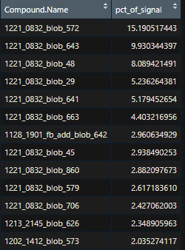
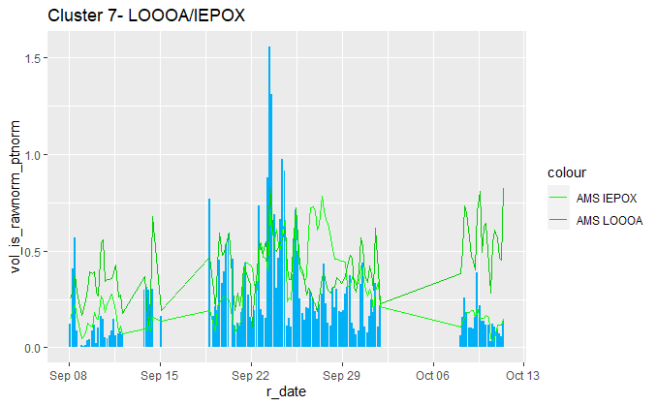
Dry Season- factor by factor
12% cumulative season signal
194 compounds, day abundant (strong)
AMS IEPOX R = .50
AMS LOOOA R = .47
Limonene ox product
2-methyl tetrol (1)
Limonene ox product
Limonene ox product
Pinic acid
Myrcene ox product
Limonene ox product
2-methyl tetrol (2)

Slide 31
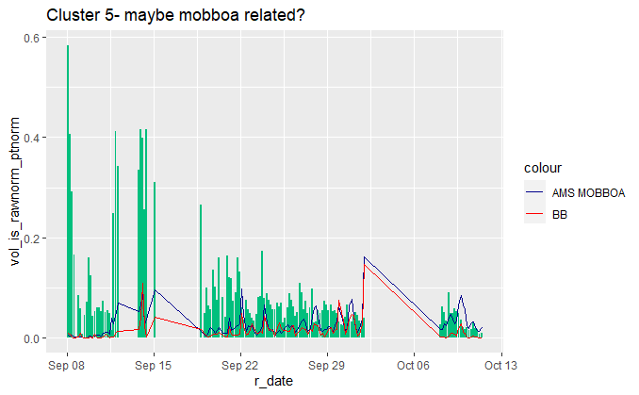
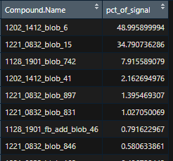
Dry Season- factor by factor
4% cumulative season signal
47 compounds, night abundant (weak)
AMS MOBBOA r = .13
But really not strongly associated with anything
Phthalic acid, butyl isohexyl ester
Phthalic acid, 2-methylbutyl pentyl ester
Limonene ox product
Phthalic acid t-methylbutyl propyl ester
Phthalic acid ester
C17 acid
Phthalic acid ester

Slide 32


Dry Season- factor by factor
3% cumulative season signal
38 compounds, evening abundant?
AMS IEPOX r = .12
Phthalic acid ester
DEET
Beta-caryophyllene aldehyde
Methyl palmitate
Also in this factor: methyl stearate, triacetin,

Slide 33


Dry Season- factor by factor
2% cumulative season signal
50 compounds, day abundant
AME IEPOX r = .29
Phthalic acid r = .25
2-ketybutyric acid
C9 acid
Pinonic acid
hexadecanol

Slide 34
Dry Season- factor by factor
Everything else dry season is < 1.5% signal, moving on

Slide 35







Diurnal Profiles
Biomass Influenced
Baseline Bio?
Urban Influenced
Baseline Bio?

Slide 36

Time of Day Normalized Clustering
Phthalic acid
Levoglucosan

Slide 37
Anthropogenic Influence Overlap Analysis
Factors with strong association with biomass burning or urban influenced tracers indicated-
Note: UP indictes urban plume, BB indicates biomass burning

Slide 38


Anthropogenic Influence and Overlap Analysis
Both BB = Strongly associated with biomass burning both seasons; Both_UP = Strongly associated with urban plume both seasons, IOP1_BB = associated strongly with biomass burning wet season only, not associated with any pollution tracers in dry season; IOP1_UP_IOP2_BB = strongly associated with urban pollution in wet season and biomass burning in dry season (I find this really interesting btw- plays into the theory that wet season urban dominates nox and dry season fires dominate nox and these species are Nox dependent formed), NA = not strongly associated with an anthropogenic pollution tracer in either season

Slide 39


Anthropogenic Influence and Overlap Analysis
Both BB = Strongly associated with biomass burning both seasons; Both_UP = Strongly associated with urban plume both seasons, IOP1_BB = associated strongly with biomass burning wet season only, not associated with any pollution tracers in dry season; IOP1_UP_IOP2_BB = strongly associated with urban pollution in wet season and biomass burning in dry season (I find this really interesting btw- plays into the theory that wet season urban dominates nox and dry season fires dominate nox and these species are Nox dependent formed), NA = not strongly associated with an anthropogenic pollution tracer in either season

Slide 40
Anthropogenic Influence and Overlap Analysis
Wet Season Anthropogenic Influenced Compound Signal
Dry Season Anthropogenic Influenced Compound Signal
Wet Season Anthropogenic Influence Independent Signal (Baseline Biogenic)
Dry Season Anthropogenic Influenced Compound Signal
Dry Season Anthropogenic Influence Independent Signal
Both BB = Strongly associated with biomass burning both seasons; Both_UP = Strongly associated with urban plume both seasons, IOP1_BB = associated strongly with biomass burning wet season only, not associated with any pollution tracers in dry season; IOP1_UP_IOP2_BB = strongly associated with urban pollution in wet season and biomass burning in dry season (I find this really interesting btw- plays into the theory that wet season urban dominates nox and dry season fires dominate nox and these species are Nox dependent formed)
“Anthropogenic Influenced” = compounds with temporal variability strongly associated with tracers of anthropogenic influence, e.g. urban plume tracers and biomass burning tracers. Screened for association independent of general diurnal variability, but this connection could be more exhaustively probed by changing the clustering algorithm- should discuss. “Anthropogenic Influenced” is assumed to include both direct emissions and species whose formation is influenced by alterations in oxidative conditions caused by fire and urban related oxidant emissions.
“Anthropogenic Influence Independent” assumed to include biogenic products NOT strongly influenced by the presence of
Preliminary conclusion: Wet season ~ 40% of OA (in GCxGC detection region) is influenced by human activity In some way, in dry season ~75% OA influenced by human activity

Slide 41

Snapshot of the masterlist
Example: extracting compounds that are strongly associated with urban influence (UP) in both seasons that were identified in monoterpene oxidation filters- possible candidates for tracers of NOx influenced monoterpene oxidation chemistry?

Slide 42
Next Steps
Ensure that I have all of the available chamber data integrated and compared- do we have high Nox specific filters?
Mass spectral library matching to check against past campaigns?
Add in any additional indicators we may have access to- back trajectory analysis for air masses (esp. urban)? Sulfur chemistry indicators? Cloud cover data? Would love to look at correlations btw all clusters and indicators to see if any can explain the factors that don’t correlate with anything
Go back to the unique compound analysis and see what factor the compounds fall into- follow up on the finding of anthropogenic perturbation of oxidation chemistry?
What kinds of preliminary results from this analysis could I include in an abstract?

Slide 43
Additional ideas
Take a time series of the relative contributions of each factor to the total aerosol loading (%) and then look at the distribution- I hypothesize that biomass is getting extremely skewed by the high loading days and that a median percent contribution is far lower- would be helpful way to think about baseline levels/how episodic the factors are

