Slide 1




Heuristic-based Recommendation for
Metamodel–OCL Coevolution
Edouard Batot, Wael Kessentini, Houari Sahraoui, Michalis Famelis
DIRO, Université de Montréal

Slide 2






OCL basics: Family tree example
Type graph
mother
father
Person
Metamodel =
Type graph + constraints
To exclude the bad ones, we need this OCL constraints:
Context Person:
inv inheritance_bares_no_loop_mum:
self.mother->closure()->excludes(self)
inv inheritance_bares_no_loop_dad:
self.father->closure()->excludes(self)
A person cannot be its
own mother or father
… transitively.
Notes:
Here, mention that this example is trivial but that non OCL expert (non IT expert) will struggle writing the rules, and struggle even more maintaining them coherent with the metamodel. Helping if it is to be change.

Slide 3
Schematically:
Type graph
Instance
model
Metamodel
Instance
model
Instance
model
Instance
model
Instance
model
OCL
Instance
model
Instance
model
Instance
model

Slide 4
OCL Coevolution
What happens if the
type model changes ?
mum
mother
father
Person
Name change in type graph impacts OCL constraints
Context Person:
inv inheritance_bares_no_loop_mum:
self.mother->closure()->excludes(self)
inv inheritance_bares_no_loop_dad:
self.father->closure()->excludes(self)
mum
More complicated example of evolution
self.nameCategory
self.category.nameCategory
Employee
Employee
name:Estring
age:EInt
salary:Edouble
nameCategory:EString
name:Estring
age:EInt
salary:Edouble
Indirection inserted
*
1
category
Category
nameCategory:EString

Slide 5
Problem: OCL Coevolution
Type graph version 1.0
Type graph version 2.0
Instance
model
Instance
model
Instance
model
Instance
model
Instance
model
Instance
model
Instance
model
Instance
model
Instance
model
Instance
model
/ ?
Instance
model
Instance
model
Instance
model
Instance
model
Instance
model
OCL ?
Instance
model
OCL
Usually:
Force determinism, or
Trace rationale behind high-level changes

Slide 6
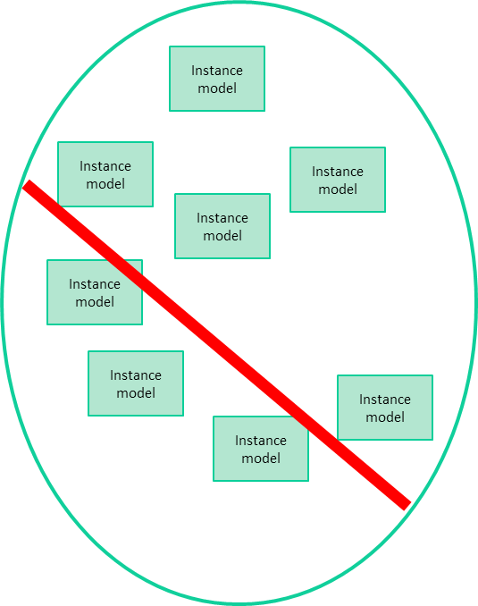
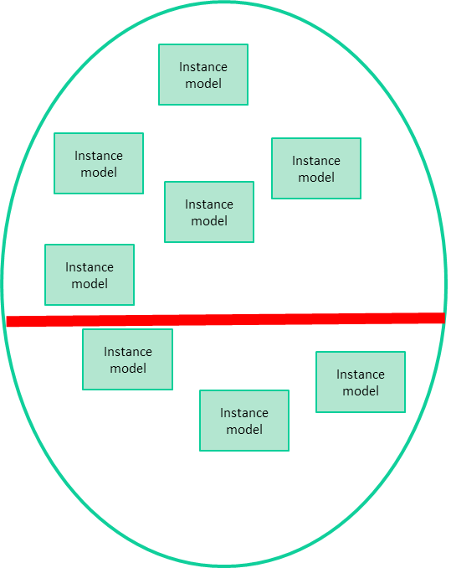
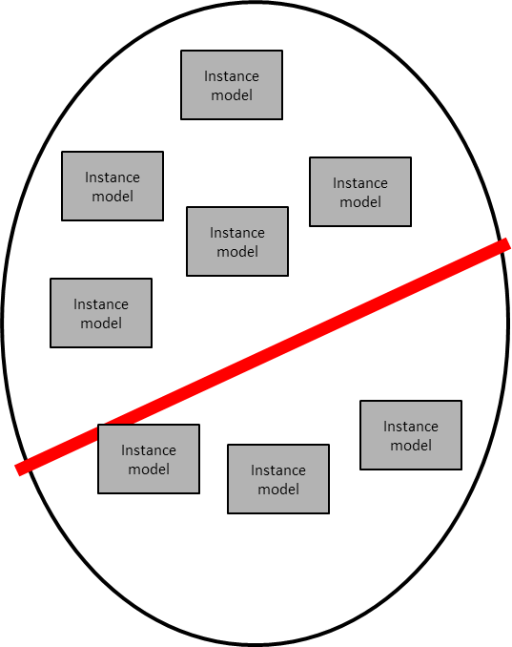
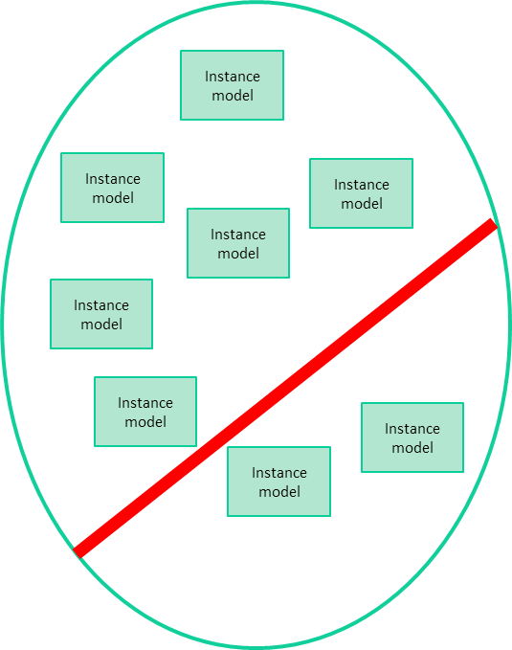
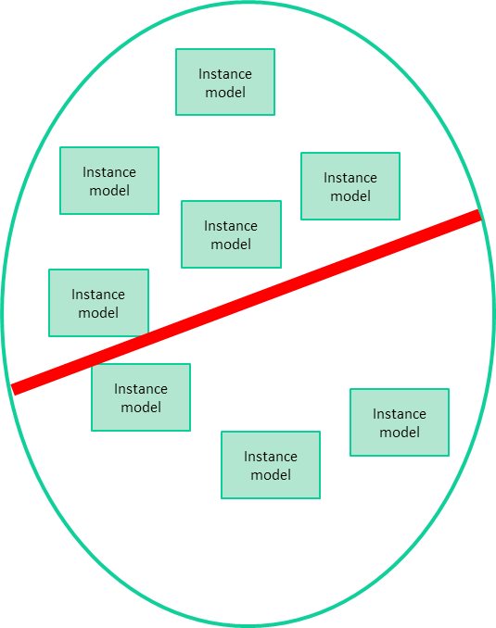
Our Approach
Heuristic search
Recommendation
1
2
3
4

Slide 7
Additional Benefits
Does not depend on tracing of high level changes
(tedious, error-prone)
Search a large solution space
(chance for innovation)
Extensible framework for new coevolution strategies
(as new mutation ops)

Slide 8
Outline
Heuristic search
Recommendation
1
2
3
4

Slide 9
Heuristic Search:
Genetic programming
Repeat
until end condition is reached
Non-dominance
Sorting
Crowding distance
Sorting within the fronts
Genetic operators
G0
Front 1
Pareto front
Front 2
Output
Front 3
Front 3
G1
Q0
Front 4
Rejected
Front 5
Non-sorting Genetic Algorithm – II (NSGA-II)
Notes:
Non-Sorting Genetic Algorithm - 2

Slide 10
Heuristic Search:
Genetic programming
  Representation: a solution is a set of OCL constraints
  Each constraint: Ecore Abstract Syntax Tree
  In each generation, OCL evolved by crossovers and mutations
  End condition: Stabilization, at 300 iterations

Slide 11
Heuristic Objectives
Minimize change
  # of mutations/crossover applied from original
Minimize syntax error
  # of rules fired (Not strict zero to loosen the search)
Minimize information loss
  # of metamodel elements removed during OCL evolution

Slide 12
Genetic operators
Solution representation and creation
  Initial generation = original set of OCL constraints
Point-cut crossover
Point-cut
Parent 1
C
1-1
C
1-2
C
1-3
C
1-4
C
1-5
Crossover
Child 1
C
1-1
C
1-2
C
2-3
C
2-4
C
2-5
Parent 2
C
2-1
C
2-2
C
2-3
C
2-4
C
2-5
Child 2
C
2-1
C
2-2
C
1-3
C
1-4
C
1-5
Mutation patterns
    Renaming
    Context change
    Pruning
    Indirection insertion
    Change typing methode
Set of constraint
Mutation
Mutated set of constraint
Parent
C
1-1
C
1-2
C
1-3
C
1-4
C
1-5
Child
C
1-1
C
1-2
C
1-3
CM
1-4
C
1-5
C
X-X
: Constraint
C1-4
mutant

Slide 13
Output Set: Solutions
NSGA-II: Multi-objective non-dominant search
Output: Pareto front of solutions
  No total ordering
  All solutions in the front are “equally good”
  No solution dominates
Output can be too large to present to user
Instead: generate recommendations

Slide 14
Outline
Heuristic search
Recommendation
1
2
3
4

Slide 15
Recommending solutions
NSGA-II gives many solutions (Pareto front)
Which one is of user’s interest?
Two strategies:
Ranking solutions using fitness objectives
Clustering solutions with syntactic comparison Levenstein distance
Centroid
Abstract centre
of a cluster
Pareto front
Clusters
Recommendations
Solutions representative of their cluster
(closest to the centroid)

Slide 16
Outline
Heuristic search
Recommendation
1
2
3
4

Slide 17
Evaluation
RQ0: Are the results of our approach attributable to the search strategy or to the number of explored solutions?
RQ1: To which extent our approach finds the expected solution?
RQ2: To which extent our approach recommends the expected solution?
Setup
  3 metamodels of different sizes (Family, State Machine, Project Management)
  30 executions for each metamodel/OCL couple
  300 iterations with a population of 100 set of constraints

Slide 18
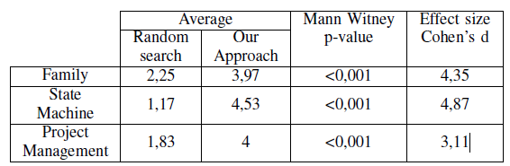
RQ0: Sanity check
Better than random search
Same number of solutions explored, way better results

Slide 19
RQ1: Algorithm recall
Family State Machine Project Management
?!
# of expected solutions found
Family and State Machine cases: solutions found
Project Management case contains two missing constraints that require particularly complex changes
To address such changes we aim at expanding the mutation operator store
Notes:
a constraint whose syntax exactly matches the expected evolved version has been
correctly updated

Slide 20
RQ2: Recommendation system precision
Family State Machine Project Management
# of expected solutions recommended
Accuracy of the recommender grows with the number of recommendations
No dramatic increase beyond 7
Simple ranking is a better recommendation strategy
  Clustering is computationally costlier

Slide 21
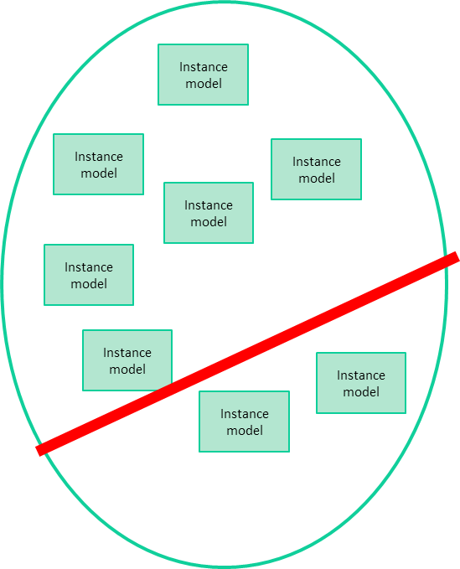
Conclusion
Metamodel-OCL Coevolution is crucial to DSML design and maintenance
Our approach
  Multi-objective optimization problem
  Recommendation of a subset of generated solutions
Benefits
  Does not depend on tracing high-level changes
  Does not assume single solution
  Explores a large solution space
  Extensible with new coevolution strategies
  High recall; Efficient ranking-based recommendation
Heuristic search
Recommendation
Problem definition
Approach
Evaluation
1
2
3
Conclusion
4

Slide 22


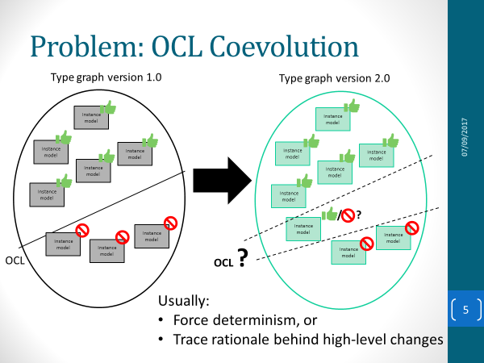
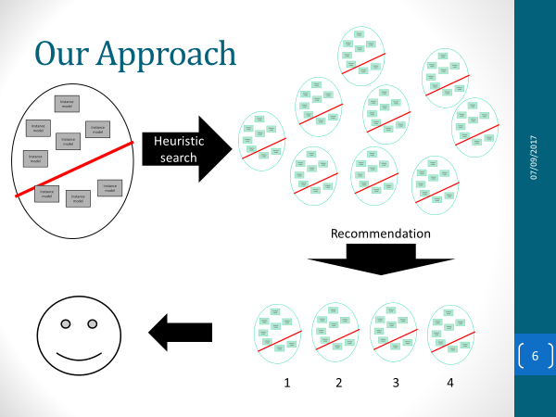
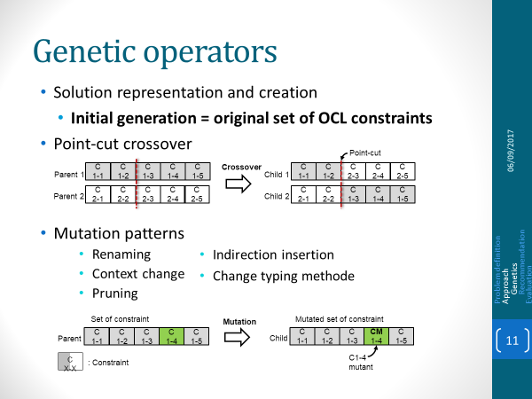
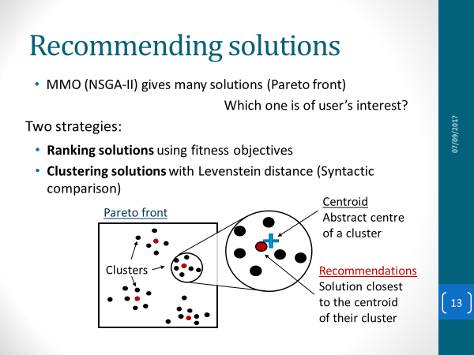
Heuristic-based Recommendation for Metamodel–OCL Coevolution
Edouard Batot, Wael Kessentini, Houari Sahraoui, Michalis Famelis

Slide 23
Outline
Heuristic search
Recommendation
1
2
3
4

Slide 24
Instance
model
Instance
model
Instance
model
Instance
model
Instance
model
Instance
model
Instance
model
Instance
model
Instance
model
Instance
model
Instance
model
Instance
model
Instance
model
Instance
model
Instance
model
Instance
model
Instance
model
Instance
model
Instance
model
Instance
model
Instance
model
Instance
model
Instance
model
Instance
model
Instance
model
Instance
model
Instance
model
Instance
model
Instance
model
Instance
model
Instance
model
Instance
model

Slide 26

Approach – Big picture
OCL1
OCL2
OCL constraint
candidates
Multi-objectives
Genetic
Algorithm
OCL6
OCL5
MM
OCL
OCL9
OCL8
OCL3
OCL4
MM’
Recommendation
Genetics
Approach
Recommendation
System
Evaluation
Fixed OCL
Constraints
OCL4
Clustering
Ranking
OCL’
OCL9
OCL7
OCL3
OCL2

Slide 27
OCL is complicated
OCL text
context Transition inv trigger_event:
Transition.allInstances()->forAll( t | t.source=self.source and t.trigger=self.trigger implies self=t )
OCL tree
:IteratorExp
(forAll)
:OperationCallExp
(allInstances)
:Variable
(t)
:OperationCallExp
(implies)
Renaming
:TypeExp
(Transition)
:OperationCallExp
(and)
:OperationCallExp
(=)
:OperationCallExp
(=)
:OperationCallExp
(=)
:VariableExp
(self)
:VariableExp
(t)
Coevolution
OCL
Approach
Evaluation
:PropertyCallExp
trigger2
:PropertyCallExp
trigger2
More complicated example of evolution
:PropertyCallExp
(trigger)
:PropertyCallExp
(trigger)
:PropertyCallExp
(source)
:PropertyCallExp
(source)
:VariableExp
(self)
:VariableExp
(t)
:VariableExp
(self)
:VariableExp
(t)
self.nameCategory
self.category.nameCategory
Employee
Employee
:PropertyCallExp
(category)
name:Estring
age:EInt
salary:Edouble
nameCategory:EString
name:Estring
age:EInt
salary:Edouble
:PropertyCallExp
(nameCategory)
:PropertyCallExp
(nameCategory)
*
1
:VariableExp
(self)
category
:VariableExp
(self)
Category
nameCategory:EString

