Slide 1



Injecting Social Diversity
in Multi-Objective Genetic Programing:
the Case of Well-formedness Rule Learning
Edouard Batot, Houari Sahraoui
DIRO, Université de Montréal

Slide 2
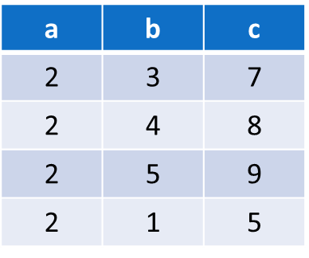




Conundrum
Application
Examples
Problem
Solution
a
Math
Expression
c
b
?
c = 2a + b
?
c = a² + b
  Fitness of a solution = % of correct examples
fit( c = 2a + b ) =
100%
80%
How important is an example
to the fitness of a solution ?
Notes:
Depending on which examples they process correclety, solutions may differ completely.

Slide 3
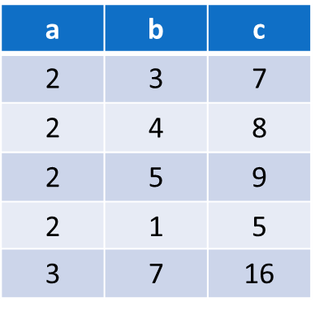

SBSE Adaptation
Solution space representiation
  Arithmetic expression with variables a, and b, equal to c
Fitness of a solution
  Number of examples adequatly executed
Solution Space
Representation
Arithmetic
Language
Arithmetic
Expression
Evolutional Computation
SBSE
Concrete Solution
Application Examples
Fitness Function
% of correct
examples
Learning
from examples

Slide 4
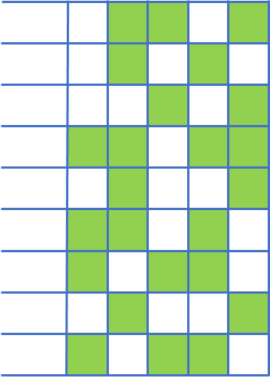
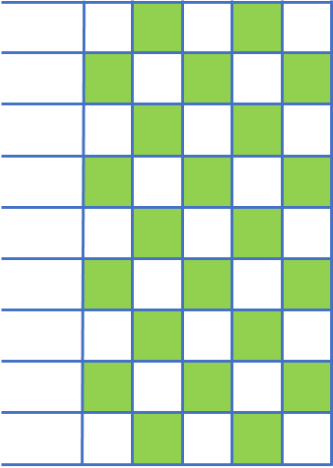

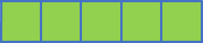
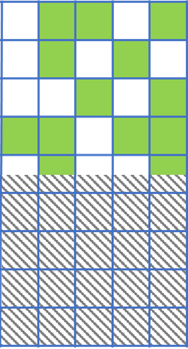
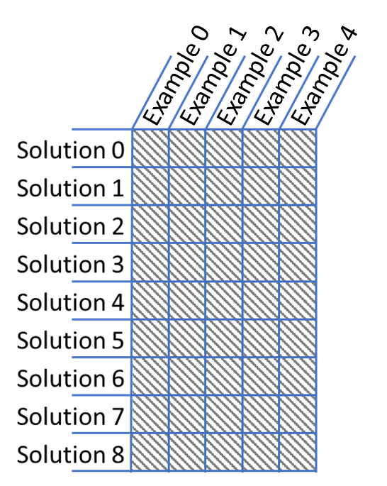
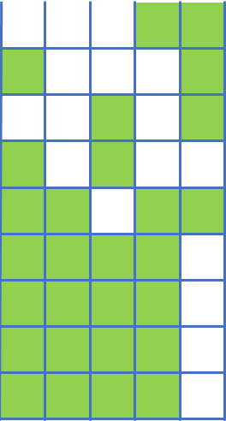
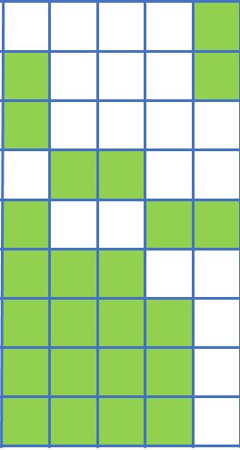
Evolutional Computation
100% #ACC
(2) Execute programs and evaluate their fitness
(3) Termination criteria
Yes
No
(1) Create an initial population of programs
(6) Return the best program
#GEN++
(5) Replace the current population by the new one
(4) Create new programs using genetic operators
A population of candidate solutions..
  Arithmetic expressions
..evolves through generations..
  Genetic evolution
..until a termination criteria is reached.
  Maximum correctness (objective)
Notes:
GP is a metaheuristics Population-based algorithm

Slide 5
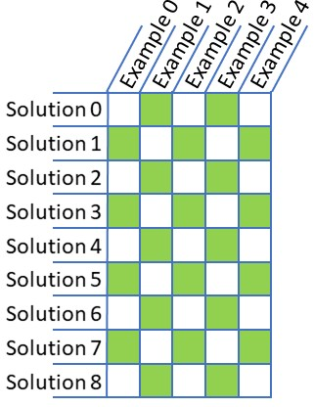
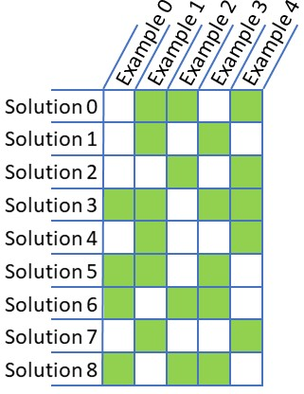
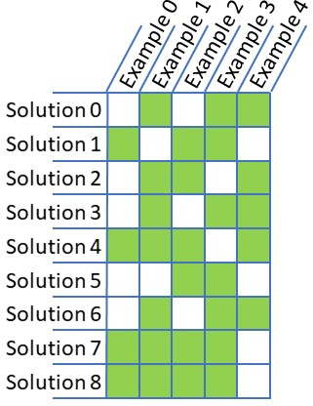
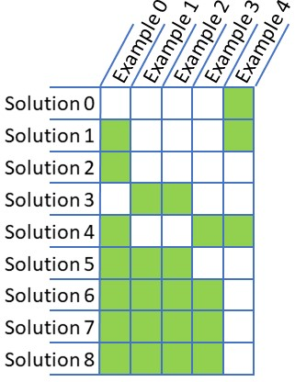
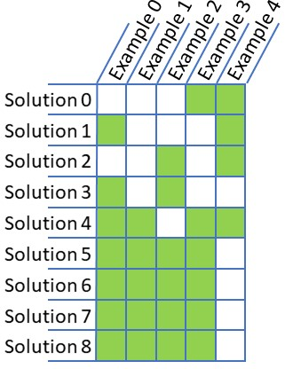
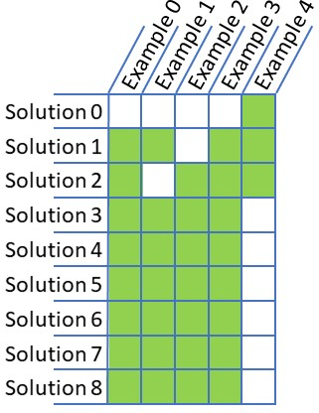
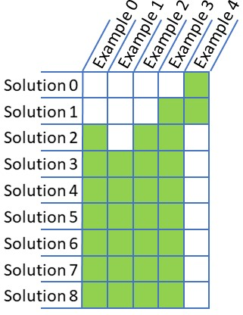
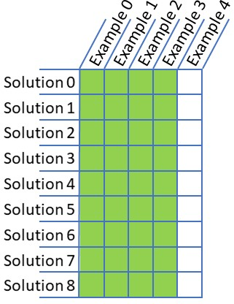
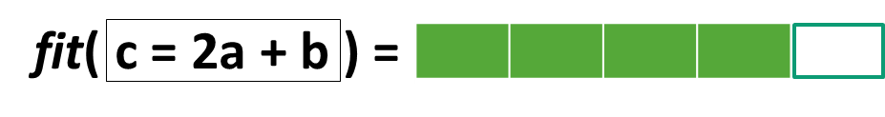
Limitation
How important is an example to the fitness of a solution ?
  Fitness = % of correct output
Fitness
Rank
3
Outsiders
.2
1
.8
3
c = a² + b
.6
2
2
2
.6
2
c = 2a + b
.8
1
.8
1
1
.8
1
αlphas
1
Some examples are
more frequently
solved in general..
1
.8
1
1
.8
1
1
.8
1
1
Single fitness peak
  Diversity of solutions decreases
..and rare cases,
might be neglected !

Slide 6
A Social Resolution for Diversity
Fitness of a solution
  Proportional to the number of examples solved
  Offset by the frequency of which an example is solved by the population’s individuals (IERF)
An example is
less frequently solved..?
..it becomes more valuable !
IERF
9/6
9/8
9/7
9/7
9/1
9/1
A Social Semantic Diversity (SSD)
Notes:
Inverse Example Resolution Frequency !

Slide 7








Well-Formedness Rules (WFRs)
Metamodel
Wellformed
mother
Person
father
WFRs = OCL Constraints
Context Person:
inv inheritance_bares_no_loop_mum:
self.mother->closure()
->excludes(self)
inv inheritance_bares_no_loop_dad:
self.father->closure()
->excludes(self)
Illformed
WFRs
Persons cannot be their
own mother or father
… transitively.
Notes:
WE assess the usefullness of SSD in a case study

Slide 8
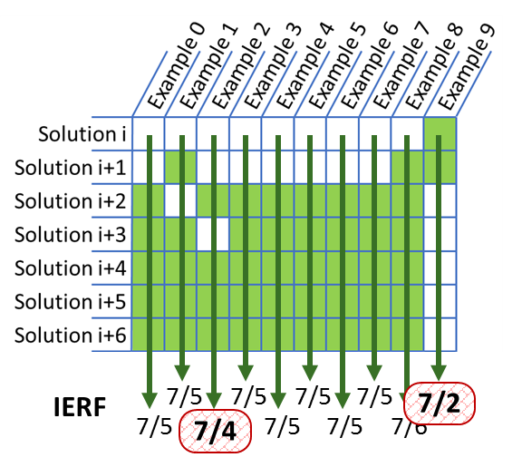
Learning WFR from examples
model
WFRs
Validation
OCL AST
Solution Space
Representation
OCL
Constraints
Well and Ill
formed examples
Computational Evolution
Concrete Solution
Application Examples
Fitness Function
Syntactic
Objectives
% of correct
examples
Size
As a crowding distance ?
…where to inject diversity ?
As a search objective ?

Slide 9
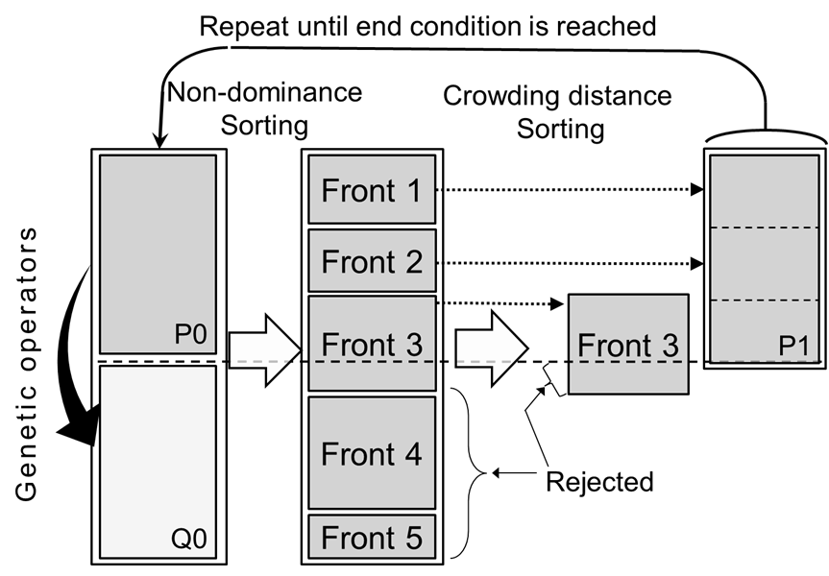
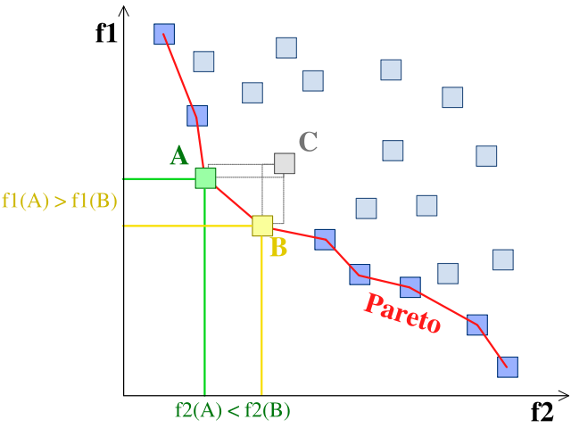
Crowding distance
Multi-objective
  No complete order
Pareto fronts
  Non-dominated solutions sets
Crowding distance
  Measure of density of solutions in the neighborhood
CD
Pareto-optimal front
Non-dominated solutions
Which one to favor
for reproduction ?
SSD for crowding distance !
Notes:
Pareto optimal if no feasible solution exists, which would improve some objective without causing a simultaneous worsening in at least another one.

Slide 10
Research questions
RQ0: Sanity check
RDN
VS
OBJ
RQ1: SSD as a search objective, an improvement ?
OBJ
VS
BASE
RQ2: SSD as a crowding distance, any better yet ?
BASE
VS
CD

Slide 11
Evaluation setting
4 configurations
  Random search
  Without SSD
  SSD as a search objective
  SSD as a crowding distance
RDN
BASE
OBJ
CD
2 dependent variables
  # of generations
  # of examples accurate
3 metamodels
  20 training examples each
  100 evaluation examples each
100 runs for each configuration
  100% DIFF or 3000 generations
#GEN
#ACC

Slide 12
Evaluation results
3000-
-1,0
2500-
-0,9
-0,8
2000-
-0,7
Accuracy of solutions found
# of generations
-0,6
1500-
-0,5
1000-
-0,4
-0,3
500-
-0,2
-0,1
0-
-0
Standard
CD
Standard
CD
BASE
OBJ
Crowding
distance
BASE
OBJ
Crowding
distance
Objective
Objective
Project Manager
Statemachine
#GEN: unbeatable speed up !
  Up to 30 times faster
#ACC: accuracy, and generalisation power are improved
  Small but significant (Mann Witney p-value > 0.01)
Notes:
Results on two metamodels (Family is solved with all configurations)

Slide 13
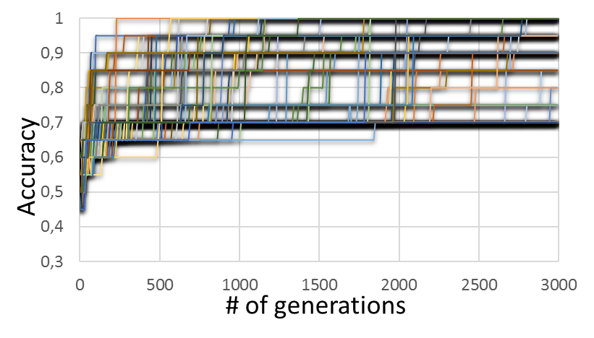
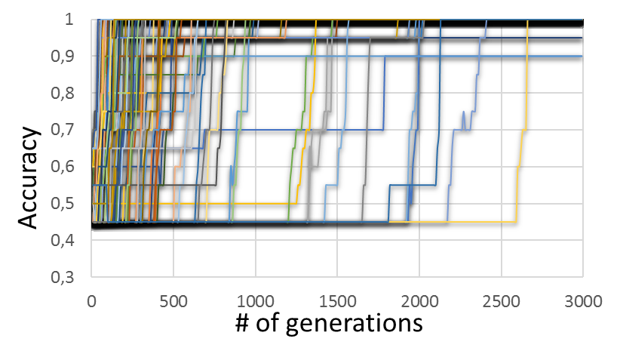
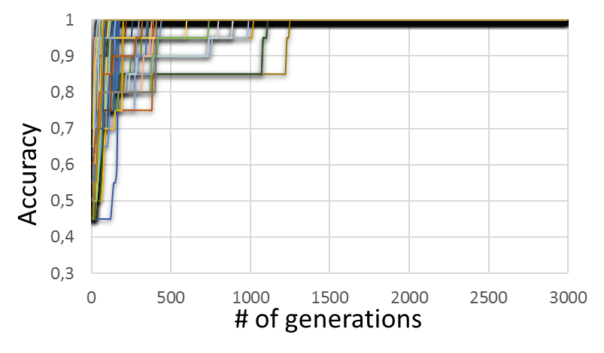
Convergence
#ACC
BASE
OBJ
Algorithm converges faster
and more consistently
CD
Evolution of individuals’ average accuracy
on Project Manager metamodel
(hundred runs a plot)

Slide 14

Social Semantic Diversity
Conclusion
SSD
SBSE
OBJ
CD
#GEN
#ACC
batotedo@iro.umontreal.ca

Slide 16
Example-Based MDE
Example-Based automation of MDE (EB-MDE) stands that
it is easier to provide examples of application illustrating well a problem, than to draw a general theory about how to solve it.
Notes:
Examples with MDE abstract representations
Valid and Invalid models
Optimization with SBSE metaheuristic algorithms
In search for OCL constraints

