Slide 1


Towards the Automated Recovery of Complex Temporal API-Usage Patterns
Mohamed A. Saied, Houari Sahraoui, Edouard Batot, Michalis Famelis, Pierre-Olivier Talbot
, Université de Montréal

Slide 2
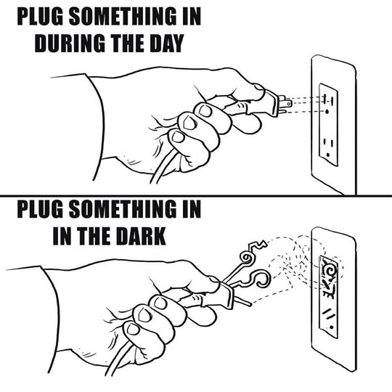
Software development and APIs
Modern software makes heavy use of APIs
Using APIs is difficult and effort consuming
Misuse of APIs results in different issue types
Documentation is often incomplete
Impact on the productivity

Slide 3
Supporting API Usage
Specification mining
  Complement the documentation
Usage pattern mining
  Unordered patterns (Sets of co-used methods)
    Methods m1 and m2 are used together
  Sequential patterns (Ordered sets of co-used methods)
    When m1 is called then m2 is called sometime after
  Temporal patterns (patterns with temporal properties)
    When m1 is called either m2 is called after or m3 is called sometime later but not both

Slide 4
Supporting API Usage
Specification mining
  Complement the documentation
Usage pattern mining
  Unordered patterns (Sets of co-used methods)
    Methods m1 and m2 are used together
  Sequential patterns (Ordered sets of co-used methods)
    When m1 is called then m2 is called sometime after
  Temporal patterns (patterns with temporal properties)
    When m1 is called either m2 is called after or m3 is called sometime later but not both

Slide 5
Supporting API Usage
Specification mining
  Complement the documentation
Usage pattern mining
  Unordered patterns (Sets of co-used methods)
    Methods m1 and m2 are used together
  Sequential patterns (Ordered sets of co-used methods)
    When m1 is called then m2 is called sometime after
  Temporal patterns (patterns with temporal properties)
    When m1 is called either m2 is called after or m3 is called sometime later but not both

Slide 6
Limits of Existing Work
Mined patterns
  Many, redundant and simple (unordered and sequential patterns)
  Very complex and not practical (specification automata)
  Simple, based on two method calls and predefined templates (temporal patterns)

Slide 7
We Propose:
Learn temporal API patterns without using predetermined templates
Handle a wider spectrum of patterns

Slide 8
Temporal Pattern Learning
Search space
API properties A
S Temporal expressions

Slide 9
Temporal Pattern Learning
Search space
Search parameters
  Size and complexity of the candidate patterns
  Predefined pattern templates
  Thresholds on the frequency and accuracy of the candidate patterns
API properties A
P_{T} Search space of technique T
S Temporal expressions

Slide 10
Temporal Pattern Learning
Pattern usefulness
  H: understood by humans with reasonable cognitive effort (small with low complexity)
API properties A
P_{T} Search space of technique T
H Humanly understandable
S Temporal expressions

Slide 11
Temporal Pattern Learning
Pattern usefulness
  M: can be efficiently leveraged by automated techniques to assist humans in the correct usage of APIs (large and/or complex)
    IDE recommender system
    Detector of uncommon or suspicious API usages
API properties A
P_{T} Search space of technique T
M Machine usable
H Humanly understandable
S Temporal expressions

Slide 12
Temporal Pattern Learning
Pattern usefulness
  I: cannot be practically used either by humans or automated techniques (generally too large and too complex, and extremely frequent in the learning data)
API properties A
P_{T} Search space of technique T
I Impractical
M Machine usable
H Humanly understandable
S Temporal expressions

Slide 13
Complex temporal pattern mining
android.database.sqlite.SQLiteProgram.bindString(int#java.lang.String)
android.database.sqlite.SQLiteProgram.bindString(int#java.lang.String)
android.database.sqlite.SQLiteStatement.simpleQueryForLong()
android.database.sqlite.SQLiteClosable.acquireReference()
android.database.DatabaseUtils.getSqlStatementType(java.lang.String)
android.database.sqlite.SQLiteClosable.releaseReference()
android.database.sqlite.SQLiteProgram.clearBindings()
android.database.sqlite.SQLiteProgram.bindString(int#java.lang.String)
android.database.sqlite.SQLiteProgram.bindString(int#java.lang.String)
android.database.sqlite.SQLiteStatement.simpleQueryForLong()
android.database.sqlite.SQLiteClosable.acquireReference()
android.database.DatabaseUtils.getSqlStatementType(java.lang.String)
android.database.sqlite.SQLiteClosable.releaseReference()
android.database.sqlite.SQLiteProgram.clearBindings()
android.database.sqlite.SQLiteProgram.bindString(int#java.lang.String)
android.database.sqlite.SQLiteStatement.simpleQueryForLong()
android.database.sqlite.SQLiteClosable.acquireReference()
android.database.DatabaseUtils.getSqlStatementType(java.lang.String)
android.database.sqlite.SQLiteClosable.releaseReference()
android.database.sqlite.SQLiteProgram.bindString(int#java.lang.String)
android.database.sqlite.SQLiteStatement.simpleQueryForLong()
android.database.sqlite.SQLiteClosable.acquireReference()
android.database.DatabaseUtils.getSqlStatementType(java.lang.String)
android.database.sqlite.SQLiteClosable.releaseReference()
…
Learning LTL formulas
From execution traces
Using genetic programming
Trace conformance score
Spaces of possible LTL formulas
ϕ
ϕ
ϕ
ϕ
ϕ
ϕ
ϕ
ϕ
ϕ
ϕ
ϕ
ϕ
ϕ
ϕ
ϕ
ϕ
ϕ
ϕ
ϕ
ϕ
ϕ
ϕ
ϕ
ϕ
Traces
LTL formulas conforming to traces

Slide 14
Complex temporal pattern mining
android.database.sqlite.SQLiteProgram.bindString(int#java.lang.String)
android.database.sqlite.SQLiteProgram.bindString(int#java.lang.String)
android.database.sqlite.SQLiteStatement.simpleQueryForLong()
android.database.sqlite.SQLiteClosable.acquireReference()
android.database.DatabaseUtils.getSqlStatementType(java.lang.String)
android.database.sqlite.SQLiteClosable.releaseReference()
android.database.sqlite.SQLiteProgram.clearBindings()
android.database.sqlite.SQLiteProgram.bindString(int#java.lang.String)
android.database.sqlite.SQLiteProgram.bindString(int#java.lang.String)
android.database.sqlite.SQLiteStatement.simpleQueryForLong()
android.database.sqlite.SQLiteClosable.acquireReference()
android.database.DatabaseUtils.getSqlStatementType(java.lang.String)
android.database.sqlite.SQLiteClosable.releaseReference()
android.database.sqlite.SQLiteProgram.clearBindings()
android.database.sqlite.SQLiteProgram.bindString(int#java.lang.String)
android.database.sqlite.SQLiteStatement.simpleQueryForLong()
android.database.sqlite.SQLiteClosable.acquireReference()
android.database.DatabaseUtils.getSqlStatementType(java.lang.String)
android.database.sqlite.SQLiteClosable.releaseReference()
android.database.sqlite.SQLiteProgram.bindString(int#java.lang.String)
android.database.sqlite.SQLiteStatement.simpleQueryForLong()
android.database.sqlite.SQLiteClosable.acquireReference()
android.database.DatabaseUtils.getSqlStatementType(java.lang.String)
android.database.sqlite.SQLiteClosable.releaseReference()
…
Learning LTL formulas
From execution traces
Using genetic programming
Trace conformance score
Spaces of possible LTL formulas
ϕ
ϕ
ϕ
ϕ
ϕ
ϕ
ϕ
ϕ
ϕ
ϕ
ϕ
ϕ
ϕ
ϕ
ϕ
ϕ
ϕ
ϕ
ϕ
ϕ
ϕ
ϕ
ϕ
ϕ
Traces
LTL formulas conforming to traces

Slide 15
Complex temporal pattern mining
Genetic programming
Create initial population of LTL formulas
Return best formula set
Yes
End Criteria
Evaluate formulas using traces
No
Replace current population with the new one
Derive new formulas using genetic operators

Slide 16
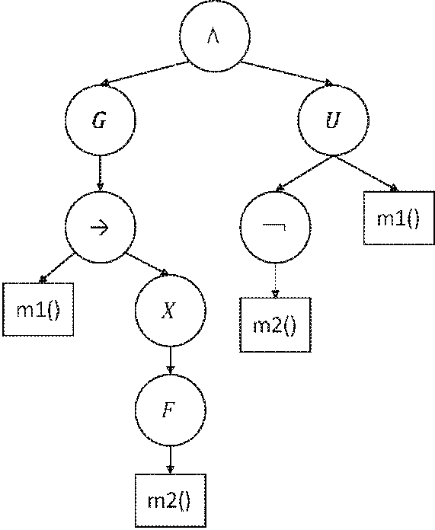
Complex temporal pattern mining
Modelling LTL candidate patterns
  Formulas as trees
    A call to the API method m1() is always followed by a call to the API method m2() with the restriction that method m2() cannot be called before the method m1()
G(m1 → XFm2) ∧ G(¬m2 ∪ m1)

Slide 17
Complex temporal pattern mining
Deriving LTL candidate patterns
P1
P12
P21
Crossover
P2
Mutation
P1
P1’

Slide 18
Complex temporal pattern mining
Evaluating LTL candidate patterns
  Basic metrics
    Support potential: for a pattern p, number of events in the trace that could falsify p
    Support: number of events that could falsify p, but do not
    Confidence: ratio of support over support potential
  Fitness function
    Maximize the confidence
    Penalize patterns that under support (specific patterns that are not easily generalizable)
    Penalize patterns that over support (so general, that they are usually trivial)
    Boost patterns with good support

Slide 19
Complex temporal pattern mining
Evaluating LTL candidate patterns
  Basic metrics
    Support potential: for a pattern p, number of events in the trace that could falsify p
    Support: number of events that could falsify p, but do not
    Confidence: ratio of support over support potential
  Fitness function
    Maximize the confidence
    Penalize patterns that under/over support
      (under) specific patterns that are not generalizable
      (over) so general, that they are usually trivial
    Boost patterns with good support

Slide 20
Evaluation
Setting
  Research questions
    RQ1: What kind of patterns can we interfere with our approach?
    RQ2: Are the inferred patterns generalizable to other “new” client programs that are non-seen in the mining process?
    RQ3: Are the inferred patterns meaningful for developers?
  Data
    8 API
    45 mobile apps
    Typical usage scenarios of each app
 | Traces
API | Nb events | Nb Traces
database | 4057 | 10
graphics | 1210 | 21
hardware | 559 | 3
text | 483 | 12
util | 878 | 27
view | 1255 | 45
webkit | 320 | 15
widget | 444 | 5
Notes:
Formulas vs patterns.

Slide 21
Evaluation
Results
  RQ1: What kind of patterns can we interfere with our approach?
    Variable portion of API methods covered by the patterns
 | Patter |  |  | ns
API | coverage | Nb patterns | Nb methodPerPattern | depthPattern | widthPattern | support
database | 0,44 | 124 | 6,07 | 2,40 | 7,00 | 567,47
graphics | 0,08 | 115 | 5,26 | 2,23 | 6,34 | 278,05
hardware | 0,47 | 80 | 3,33 | 2,42 | 6,76 | 158,13
text | 0,21 | 89 | 3,87 | 2,37 | 6,99 | 101,28
util | 0,08 | 115 | 5,36 | 2,34 | 6,74 | 168,64
view | 0,12 | 115 | 5,15 | 2,24 | 6,59 | 335,73
webkit | 0,33 | 110 | 4,78 | 2,51 | 7,09 | 28,47
widget | 0,31 | 94 | 3,99 | 2,23 | 6,45 | 86,40
Notes:
Formulas vs patterns.

Slide 22
Evaluation
Results
  RQ1: What kind of patterns can we interfere with our approach?
    Patterns are not trivial
 | Patter |  |  | ns
API | coverage | Nb patterns | Nb methodPerPattern | depthPattern | widthPattern | support
database | 0,44 | 124 | 6,07 | 2,40 | 7,00 | 567,47
graphics | 0,08 | 115 | 5,26 | 2,23 | 6,34 | 278,05
hardware | 0,47 | 80 | 3,33 | 2,42 | 6,76 | 158,13
text | 0,21 | 89 | 3,87 | 2,37 | 6,99 | 101,28
util | 0,08 | 115 | 5,36 | 2,34 | 6,74 | 168,64
view | 0,12 | 115 | 5,15 | 2,24 | 6,59 | 335,73
webkit | 0,33 | 110 | 4,78 | 2,51 | 7,09 | 28,47
widget | 0,31 | 94 | 3,99 | 2,23 | 6,45 | 86,40
Notes:
Formulas vs patterns.

Slide 23
Evaluation
Results
  RQ1: What kind of patterns can we interfere with our approach?
    Patterns have a good support w.r.t. the trace sizes
 | Patter |  |  | ns
API | coverage | Nb patterns | Nb methodPerPattern | depthPattern | widthPattern | support
database | 0,44 | 124 | 6,07 | 2,40 | 7,00 | 567,47
graphics | 0,08 | 115 | 5,26 | 2,23 | 6,34 | 278,05
hardware | 0,47 | 80 | 3,33 | 2,42 | 6,76 | 158,13
text | 0,21 | 89 | 3,87 | 2,37 | 6,99 | 101,28
util | 0,08 | 115 | 5,36 | 2,34 | 6,74 | 168,64
view | 0,12 | 115 | 5,15 | 2,24 | 6,59 | 335,73
webkit | 0,33 | 110 | 4,78 | 2,51 | 7,09 | 28,47
widget | 0,31 | 94 | 3,99 | 2,23 | 6,45 | 86,40
Notes:
Formulas vs patterns.

Slide 24
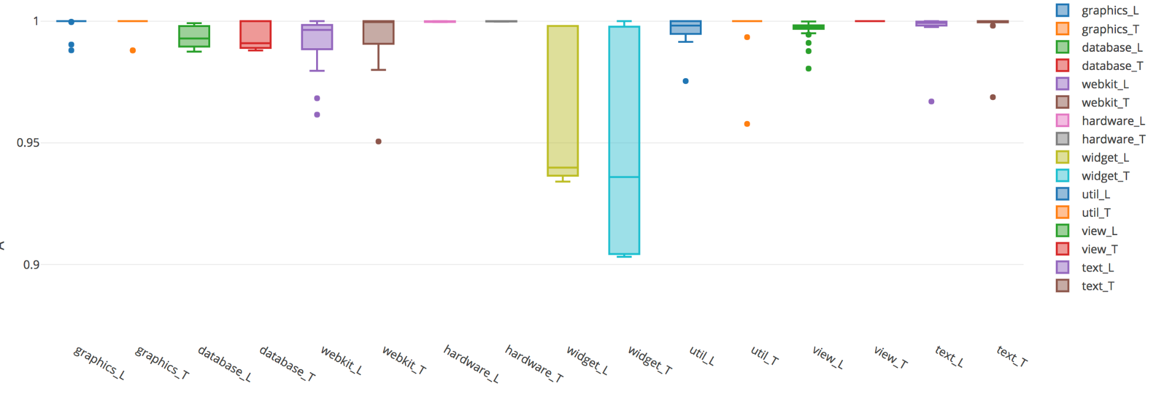
Evaluation
Results
  RQ2: Are the inferred patterns generalizable to other “new” client programs that are non-seen in the mining process? (leave-one-out cross validation)
Notes:
Formulas vs patterns.

Slide 25
Evaluation
Results
  RQ3: Are the inferred patterns meaningful for developers?
    Sample of 22 patterns randomly selected
    Evaluated by two subjects (sensible vs non sensible)
    After a calibration session (7 patterns) to define the evaluation procedure
    12-15 out of 22 patterns where found sensible
Notes:
Formulas vs patterns.

Slide 26
Evaluation
Results
  RQ3: Are the inferred patterns meaningful for developers?
    Example 1
Variable | Methods in P1
a | SQLiteClosable.close()
b | SQLiteOpenHelper.onOpen()
c | SQLiteDatabase.update()
G(c → XG(¬b)) ⊕ G(c → X ¬a)
Story:
After calling update, if we call close, then onOpen will never be called.
Notes:
Formulas vs patterns.

Slide 27
Evaluation
Results
  RQ3: Are the inferred patterns meaningful for developers?
    Example 2
Variable | Methods in P2
p86 | SQLiteQueryBuilder.query3()
p48 | SQLiteDatabase.compileStatement()
p67 | SQLiteOpenHelper.SQLiteOpenHelper()
p85 | SQLiteQueryBuilder.query1()
p48 | SQLiteDatabase.compileStatement()
(G((p86 → Xp48) → XXp67) →
((p85 → ¬XFp85)UXp48))
Story:
If the method used for extracting data from the database involves compiling a new statement and opening a new database object after every query, then compiled queries cannot be reused.
Notes:
Formulas vs patterns.

Slide 28
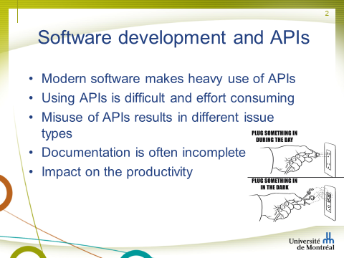
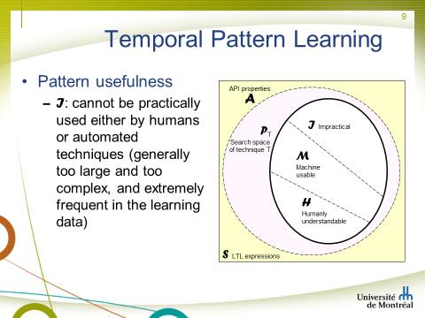
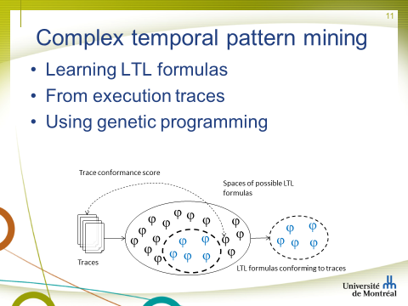
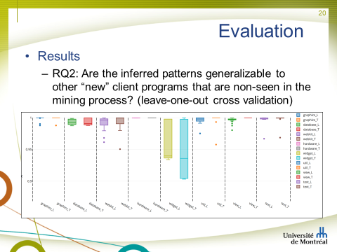
Conclusion

