Slide 1
Global Biodiversity Loss:
Anthropocene extinction
Vertebrate extinction rates are (conservatively) estimated to have increased 100-fold in the last 500 years.

Slide 2
Sala et al. (2000) Science
Large set of human-caused factors thought to be responsible for biodiversity decline.
Declines in biodiversity have been linked to:
Loss of ecosystem services
Decline in ecosystem function
Much of our understanding of how biodiversity loss operates comes from small-scale manipulative experiments.

Slide 3
Global meta-analysis reveals no net change in local-scale plant biodiversity over time
Vellend et al. (2013) PNAS
…Using a global database of
168 published studies and >16,000 nonexperimental, local-scale vegetation plots, we show that mean temporal change in species diversity over periods of 5–261 y is not different from zero…
…the clear lack of any general tendency for plant biodiversity to decline at small scales in nature directly contradicts the key assumption linking experimental results to ecosystem function as a motivation for
biodiversity conservation in nature…

Slide 4
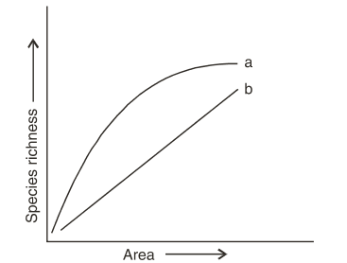
Biodiversity Change is a
Scale-Dependent Phenomenon
Scale | Net Effect
Global | -
Continental | +
Regional | +
Landscape | ?
Local | ?
(Or Number of Sampling Units)
Notes:
8.7 Million species
510 Trillion Meters Squared

Slide 5
Invasive plants have scale-dependent effects on diversity by altering species-area relationships
Powell et al. (2013) Science
Invasive plants cause large declines in biodiversity at small scales (<1m²).
However, they often have effectively no effect on species richness at larger scales (>1000m²)
While similar approaches to quantifying biodiversity change are not common, existing studies produce largely similar results.

Slide 6
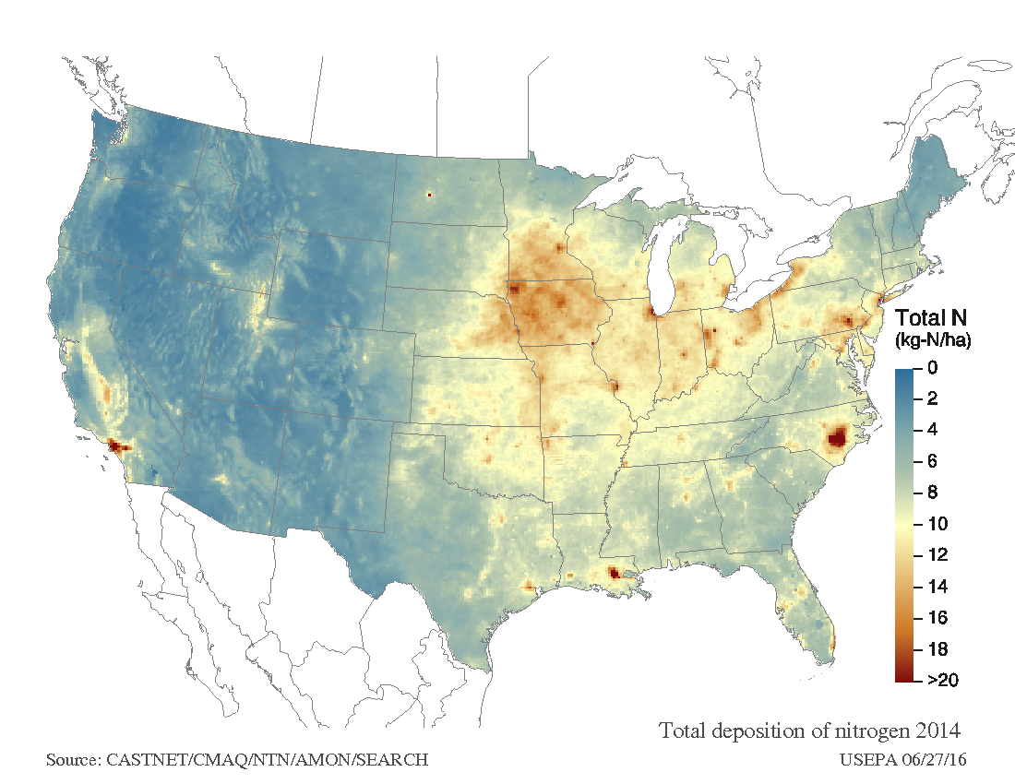
Human impacts on nutrient cycling
Human activity has:
Doubled N inputs (~140 Tg annually)
Quadrupled P inputs (~10 Tg annually)
Majority of terrestrial vegetation limited by these nutrients
Notes:
Following rapid industrialization, humans have had major impacts on the availability of key limiting nutrients. Through fertilizer production, agriculture, and many other actions humans have roughly doubled the amount of plant-available nitrogen and quadrupled the availability of phosphorous in terrestrial and freshwater systems. While this is a global problem, it is important to note that changes in nutrient availability form hotspots. As the majority of terrestrial vegetation is limited by mineral nutrients to some degree, addition of these same nutrients can have dramatic effects on many ecosystem processes. (35s)

Slide 7
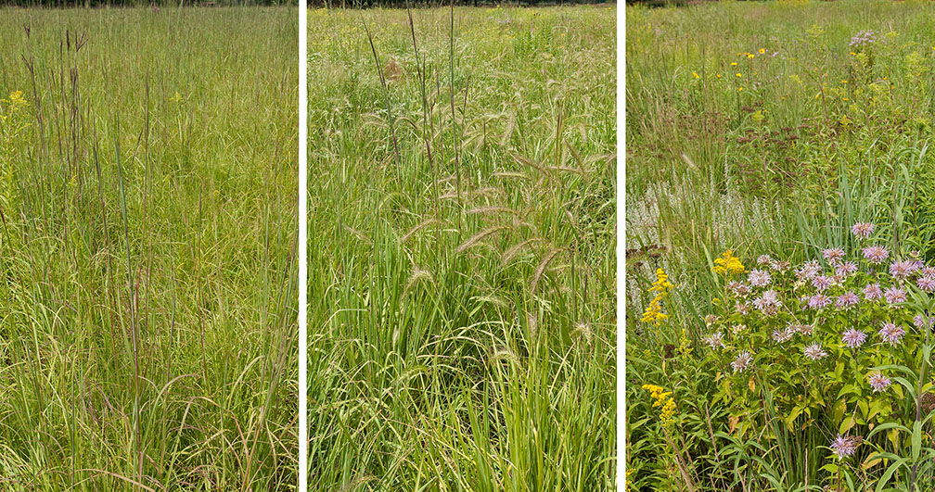
Notes:
To date, significant scholarship has been devoted to determining the effects of nutrient enrichment on plant communities. In many cases, addition of nutrients results in a decline in species diversity, often resulting in the loss of drought and stress-tolerant species in favor of effective competitors. (20s)

Slide 8
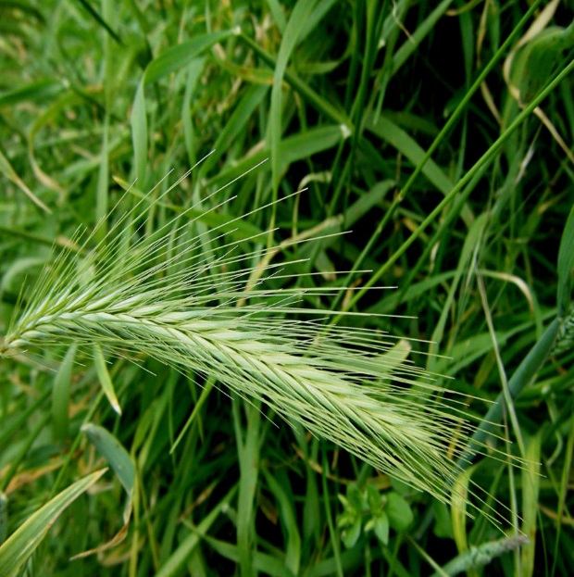
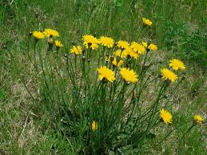
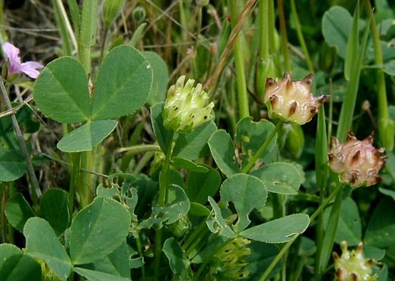
California grasslands as a model system
High diversity, despite large exotic biomass
Annual life history
Mediterranean climate regime—colimitation of both nutrients and water
Variable responses of different species and functional responses to nutrient enrichment
Substantial plasticity
Grasses
Forbs
Legumes
Notes:
California grasslands are an excellent system within which to answer these questions. They are naturally very high in species diversity. Most species are annuals and exhibit rapid demographic responses to experimental treatments. The Mediterranean climate contributes to limitation by both nutrients and water, and different species and functional groups respond differently to these resources. And particularly among exotic taxa, traits and phenotypes are highly plastic. Grassland communities are often divided into three major groups—grasses, forbs, and legumes—which appear to have different affinities for nitrogen and phosphorous, in particular. (35s)

Slide 9
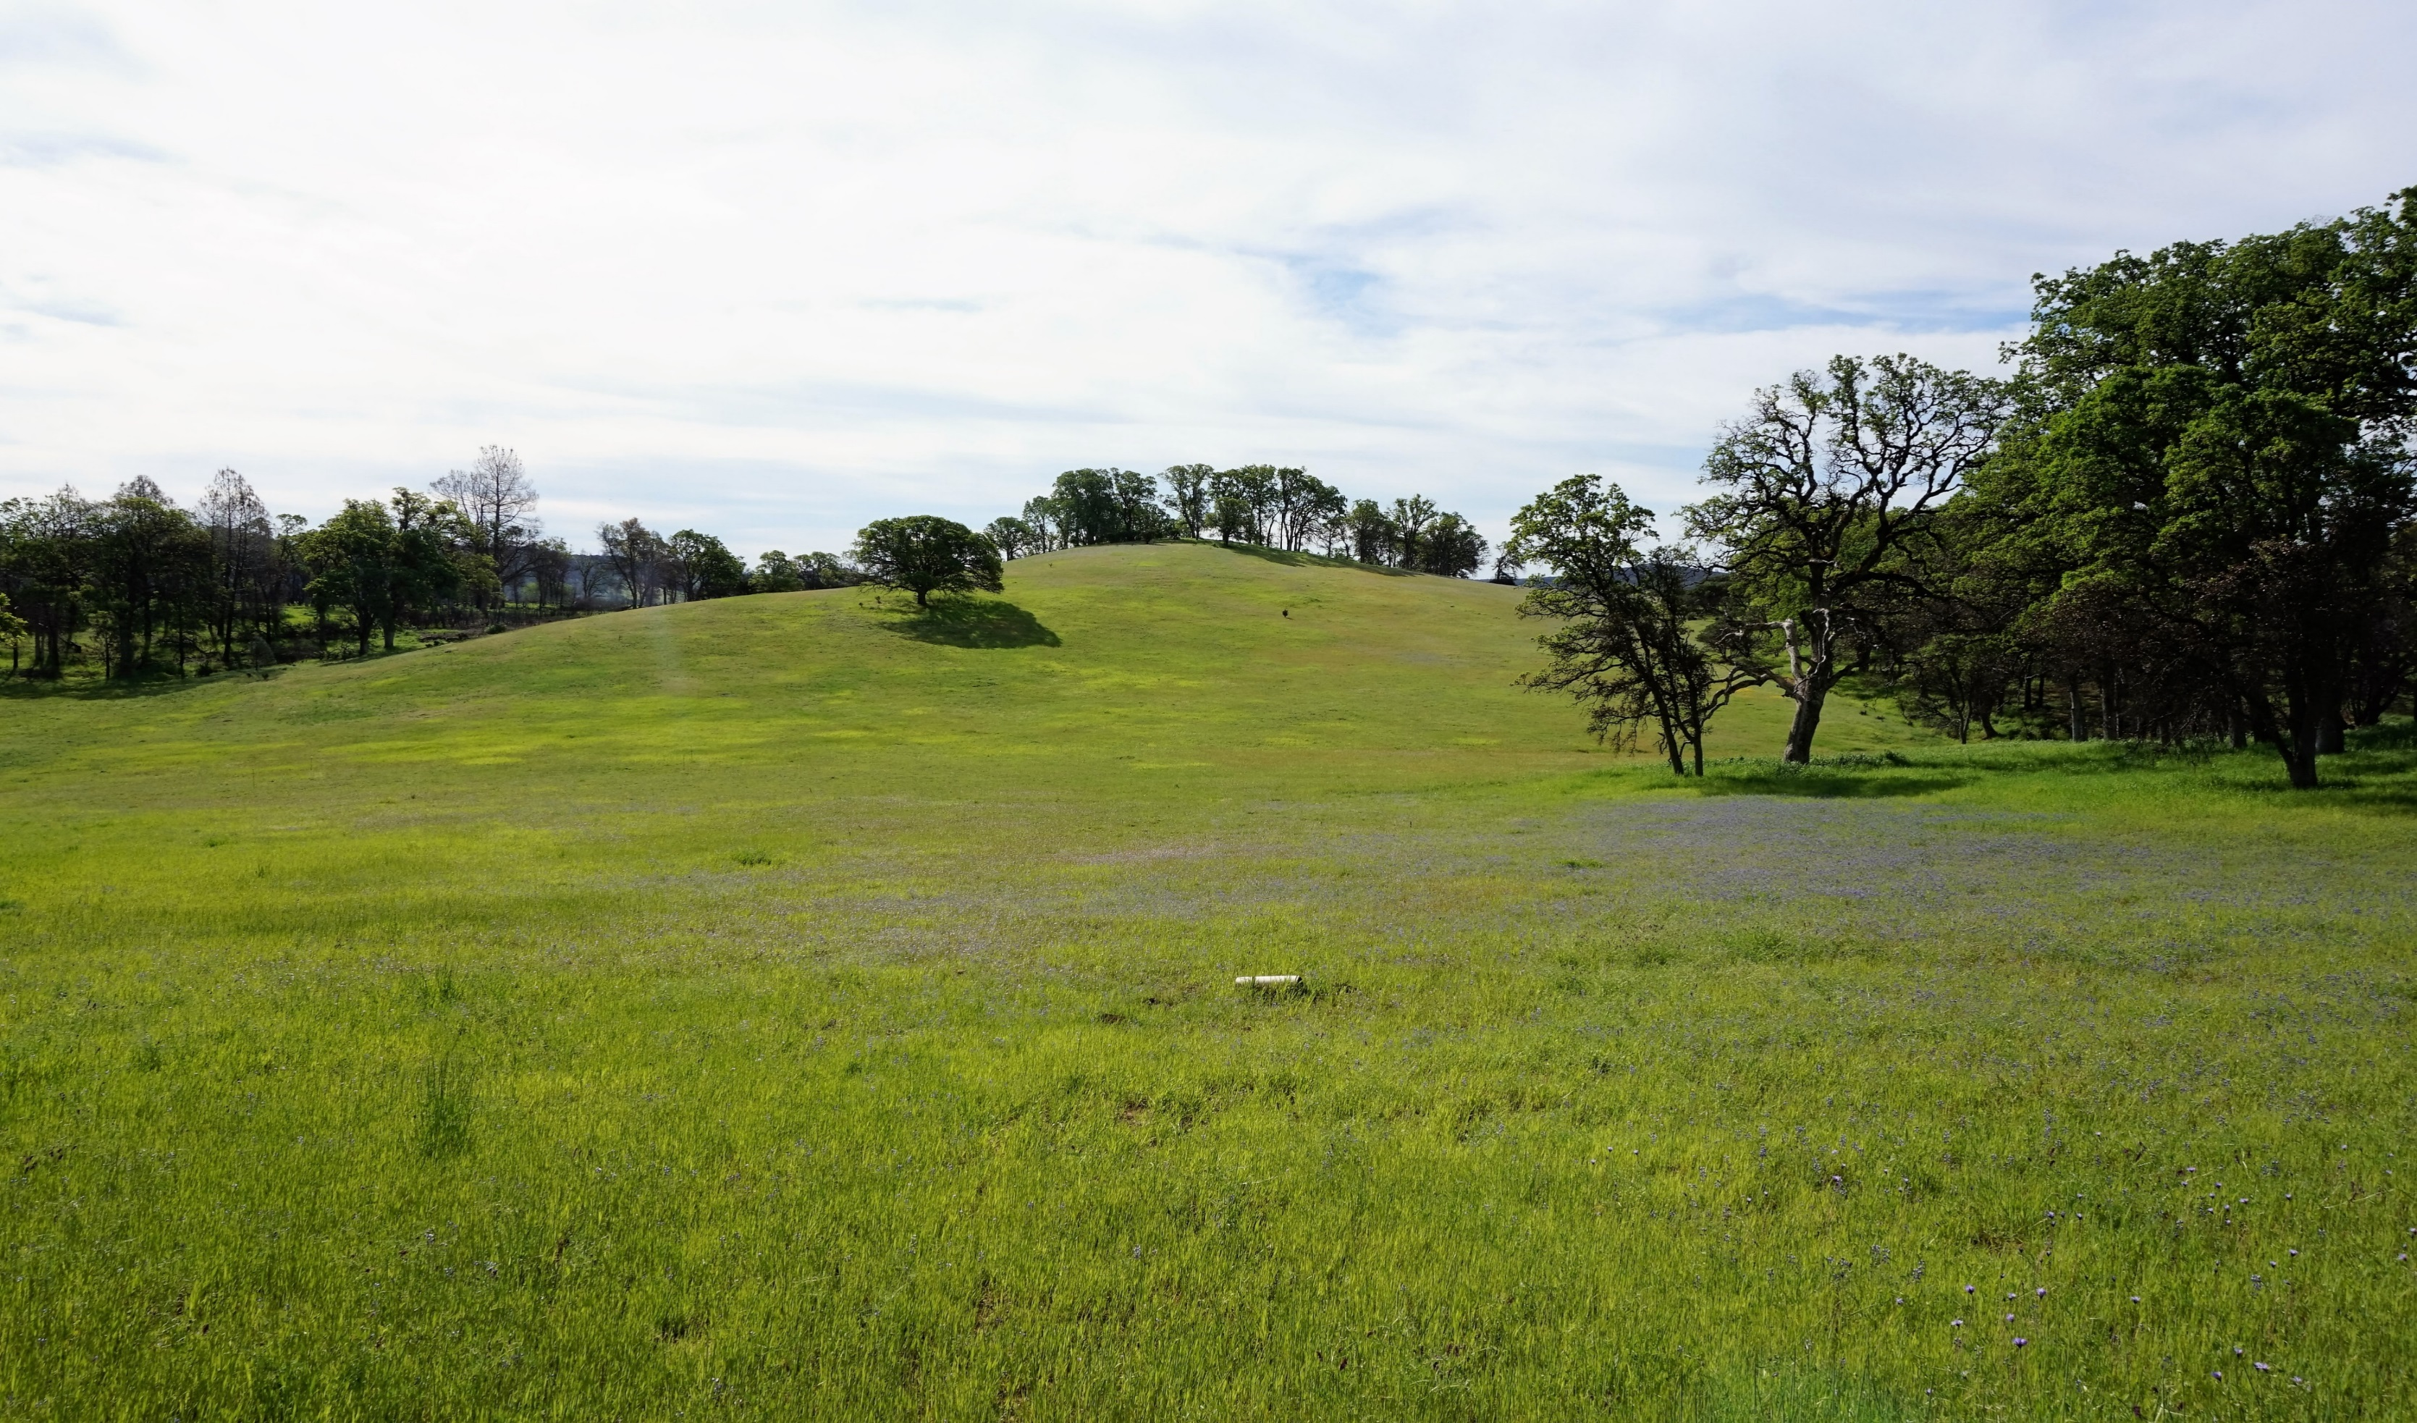
Notes:
To give you an idea of how different degrees of spatial patchiness form in these communities, here’s an example of one site, showing the presence of broad gradients in cover, such as the purple lupine in the center of the slide, but also very fine-scale patches of other species present. (15s)

Slide 10
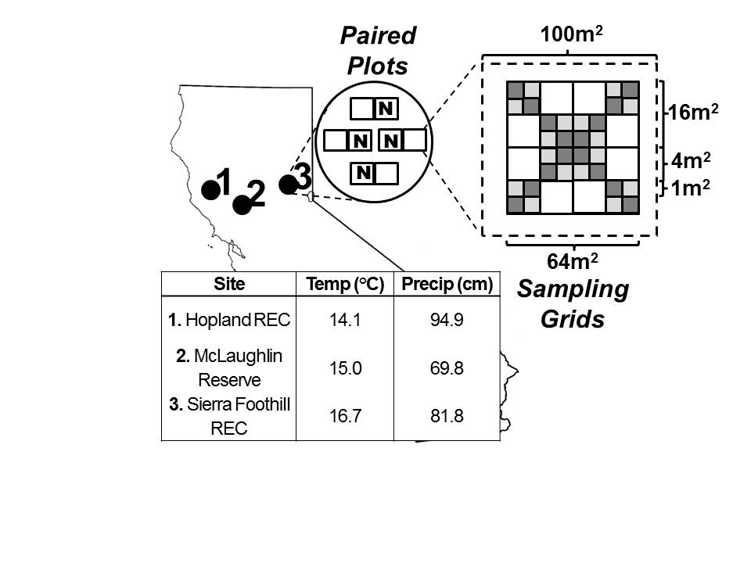
Figure 1: Sampling Sites and Plot Design
Experimental Design:
- Establishment of
Addition of slow-release nitrogen at a rate of 10g N / m²
Estimates of community diversity and relative abundance in a series of sampling grids

Slide 11
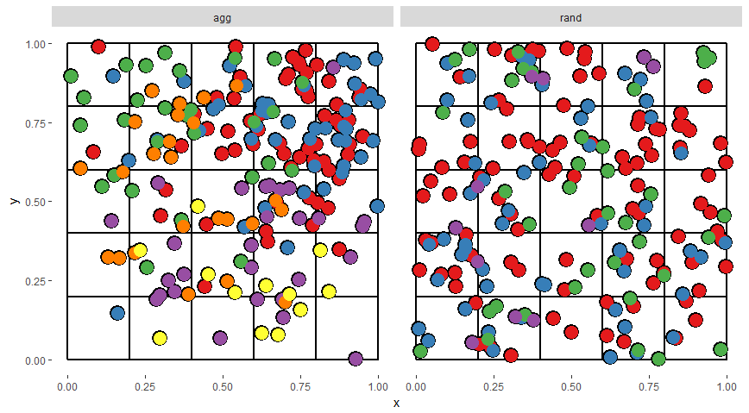

Slide 12
6
5
6
2
3
3
4
2
5
4
1
1

Slide 13
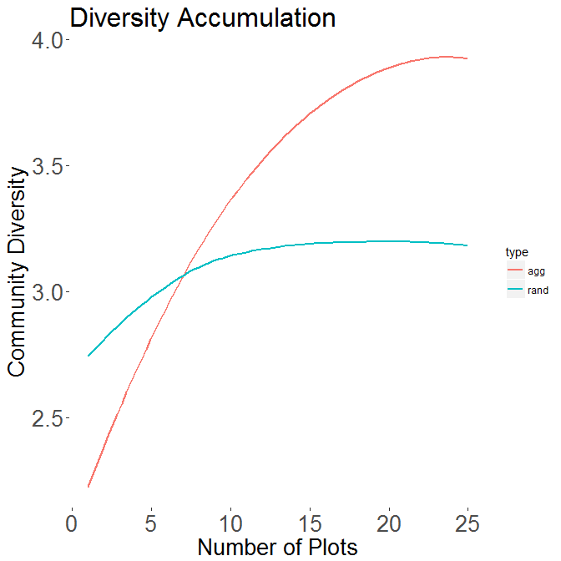

Slide 14
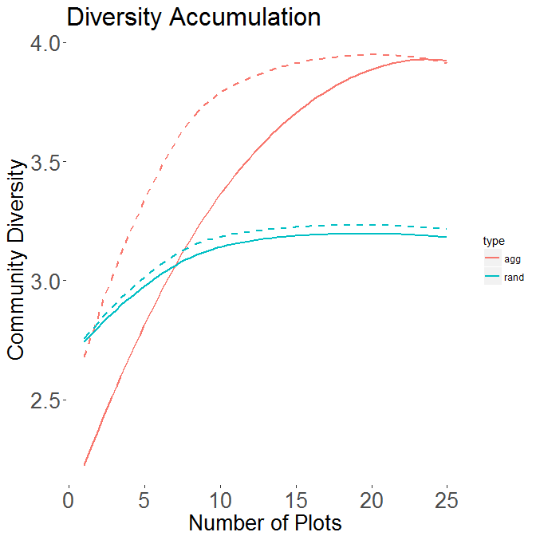

Slide 15
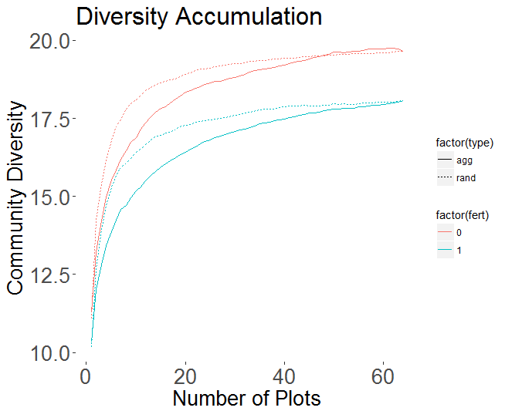
McLaughlin Block 1

Slide 16
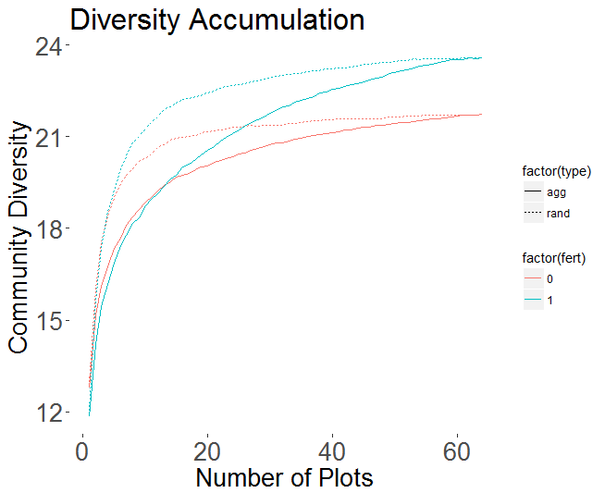
McLaughlin Block 2

Slide 17
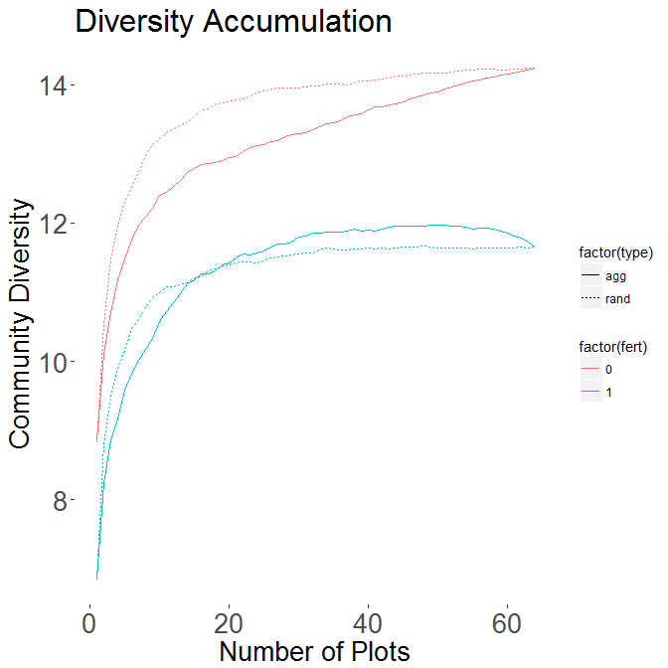
McLaughlin Block 3

