Slide 1
State Change in California Annual Grasslands

Slide 2
Introduction to California Annual Grasslands
Introduction to California annual grasslands:
Perennial native life history
Annual exotic grasses
Temporal variation:
Characterization of temporal turnover in the system
How do we think about some of the drivers of temporal variation in species composition?
Life history strategies
Priority and persistence
Environmental variation
Water limitation and drought stress

Slide 3
Conceptualizing Turnover
Species-specific patterns can be messy at small scales
State-transition models find discrete “states” that best define the total variation in vegetation types.
History of use in rangeland management:
Strong links between vegetation and soil characteristics
State assignments and transition frequencies related to environmental variables and management practices (RDM)

Slide 4
Questions re: State-Change Models
States:
How many are there? What species define states? Reliance on expert opinions.
Transitions:
What governs transitions between states? Which states are the most stable? Can be difficult to conduct separate trials of state change.
Can provide a more quantitative assessment by:
Detecting the optimal number of states in the dataset.
Incorporating transitions between discrete states into modelling framework.

Slide 5
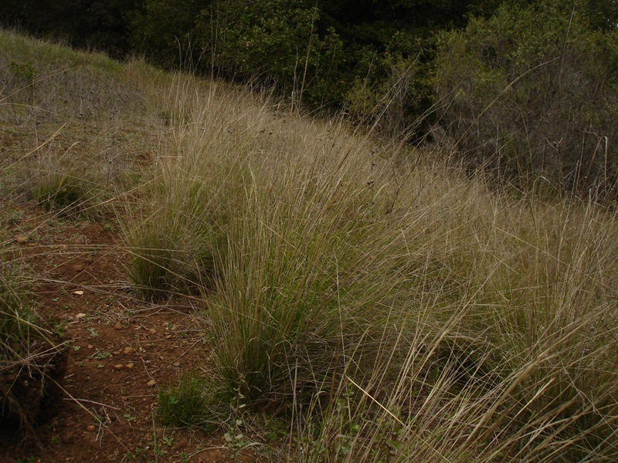
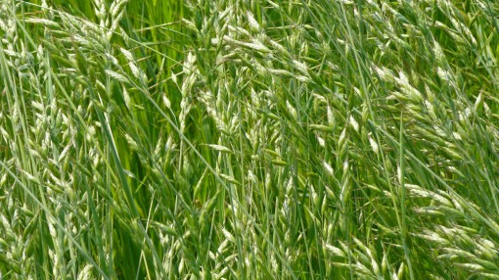
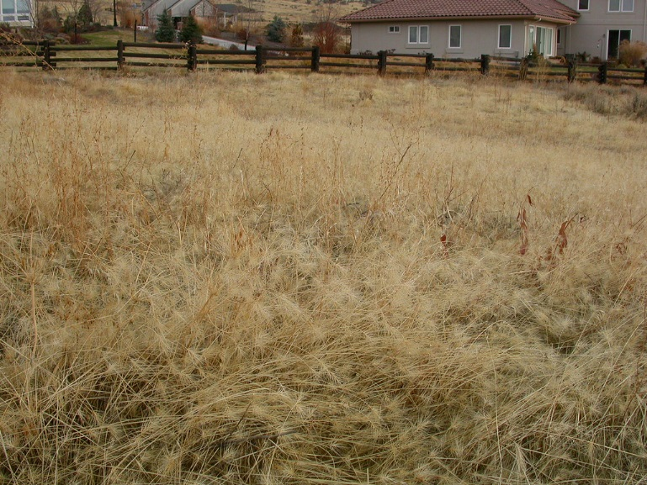
Classic models of California grasslands suggest that there are three key “states” in annual rangelands:
Native Perennials
Limited recruitment
Seed limitation
Strong competitors once established
Resilience to adverse environmental conditions
Naturalized Annuals
Strong priority effects
Large seeds, high fecundity
Variable competitive ability
Limited persistence
Small seed bank
Invasive Species
Effective invaders of annual-dominated systems
Drought sensitivity
Late phenology

Slide 6
Introduction to the WAPS data:
3 species mixtures:
Naturalized Annuals
Native Perennials
Invasive Species
Observed consistently for 10 years with observations of percent areal cover
Environmental data provided from a local CIMIS (California Irrigation Monitoring System)

Slide 7
What questions can we ask with this data?
What states arise from different planting compositions?
How do state assignments vary over time? Are transitions between states characterized by continuous, reversible changes, or non-reversible changes?
What governs transitions between states? How do priority and

Slide 8
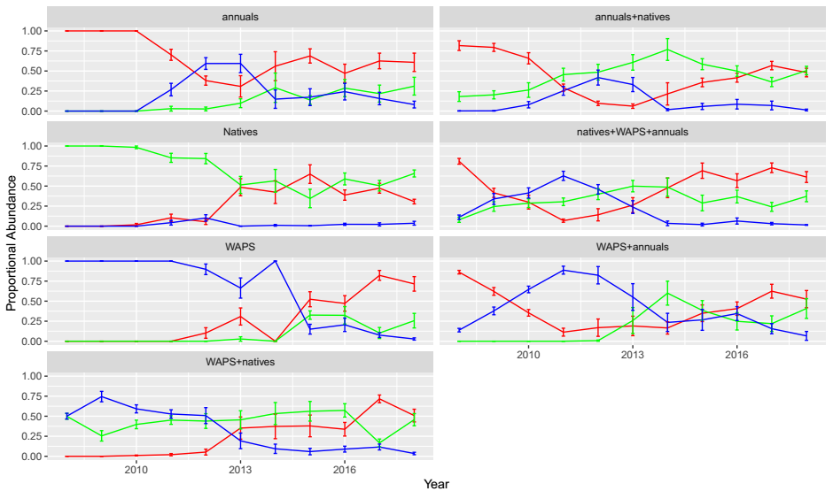
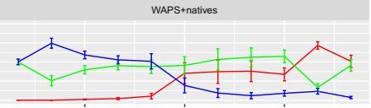
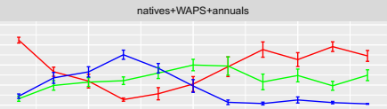
One Group Mixes
Two Group Mixes
Three Group Mix
Functional Group Proportional Abundances
Annual exotic grasses
Native perennial grasses
Invasive grasses

Slide 9
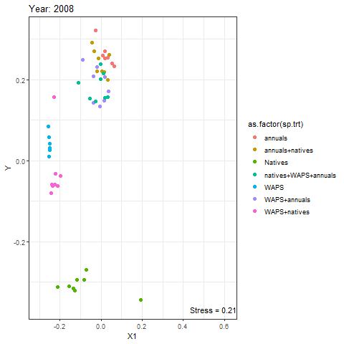
Native
Invasive
Naturalized
Native + Invasive
Native + Naturalized
Invasive + Naturalized
Native + Invasive + Naturalized

Slide 10
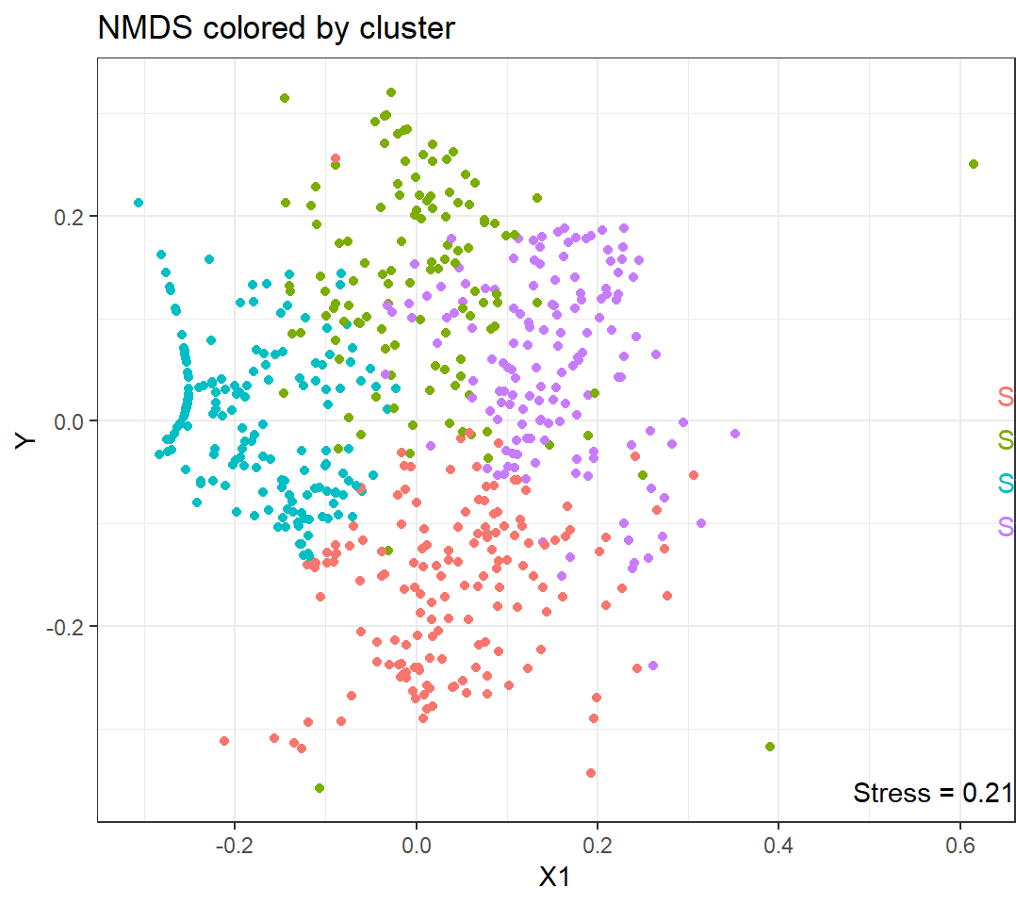
 | Species | Stat | P-Value
Grp 1 | Elymus (N) | 0.801 | 0.001
 | Nassella (N) | 0.574 | 0.001
 | bro.carinatus (N) | 0.548 | 0.001
 | Vulpia (N) | 0.284 | 0.001
Grp 2 | Lolium (E) | 0.825 | 0.001
 | Bro. hord. (E) | 0.723 | 0.001
 | Trifolium (E) | 0.607 | 0.001
Grp 3 | Taeniatherum (I) | 0.871 | 0.001
 | Aegilops (I) | 0.741 | 0.001
Grp 4 | Avena (E) | 0.819 | 0.001
 | Bro.diandrus (E) | 0.553 | 0.001
 | Leymus (N) | 0.303 | 0.036
 | Lotus (E) | 0.274 | 0.011

Slide 11
Summary of Conclusions

Slide 12
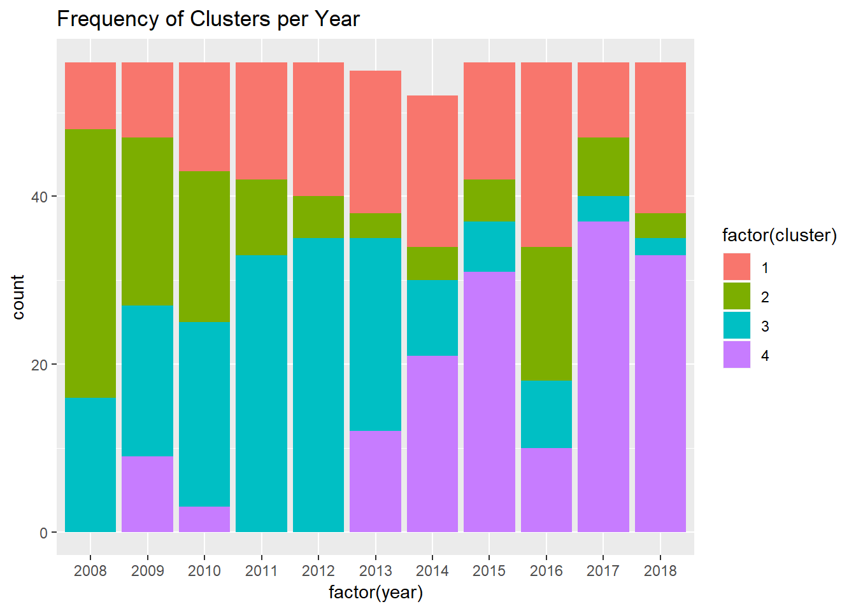

Slide 13
Fitting Markov Models
Priority (does being part of the initial planting group increase the odds of a state assignment later on?)
Environmental variation (drought stress)
SPEI metric – standardized function of drought stress that offers flexibility in scale; compare droughts of 1, 2, 3, and 4 year duration
Used in analysis by other analyses of drought stress in California

Slide 14
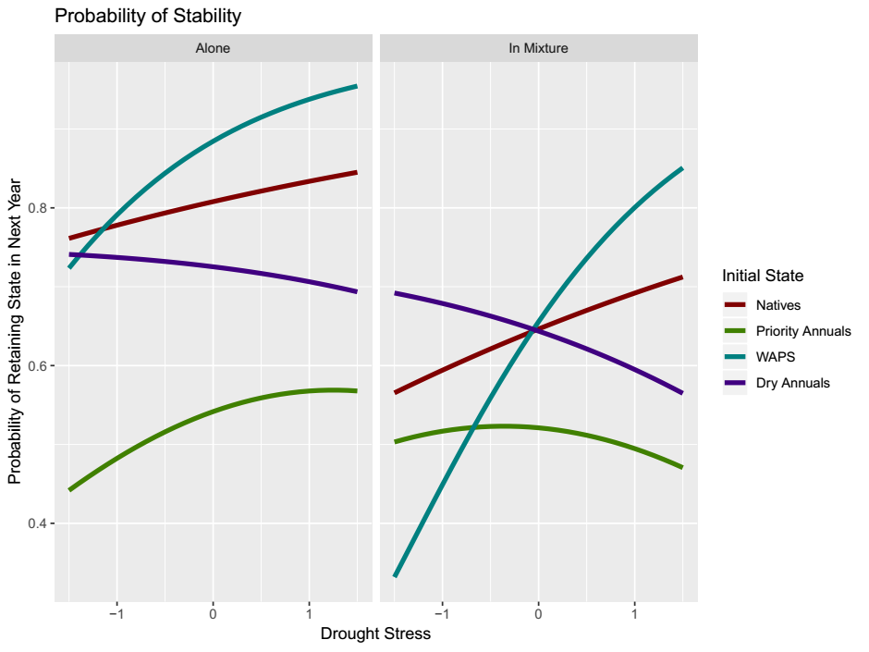

Slide 15
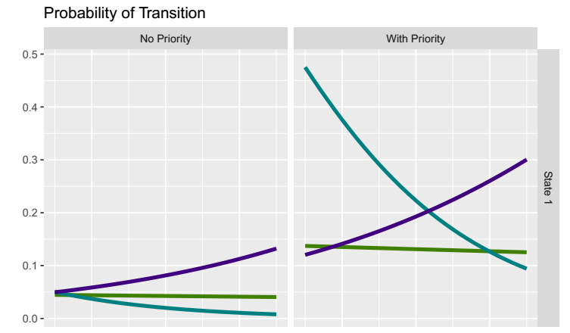
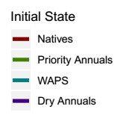

Slide 16
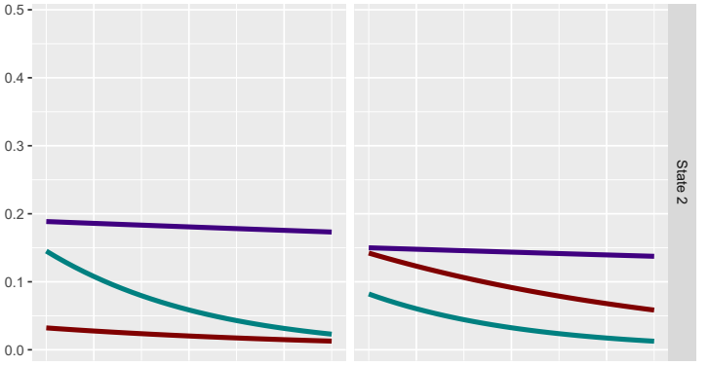

Slide 17
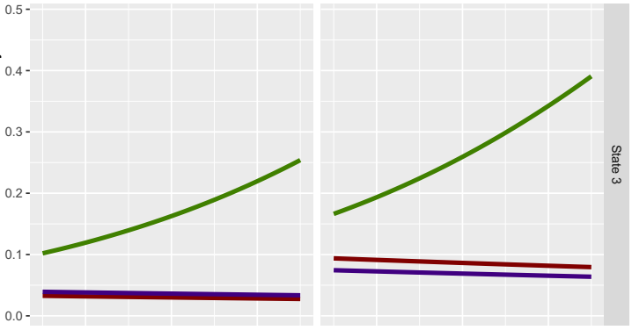

Slide 18
