Slide 1
JavaScript

Slide 2
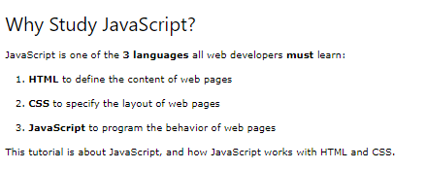

Slide 3
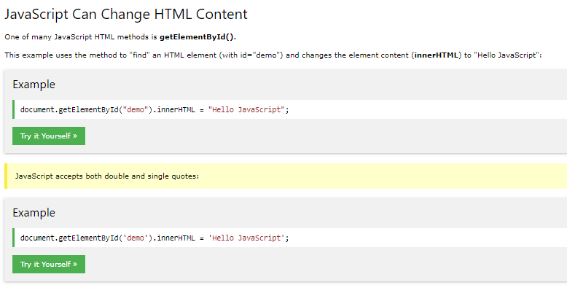

Slide 4
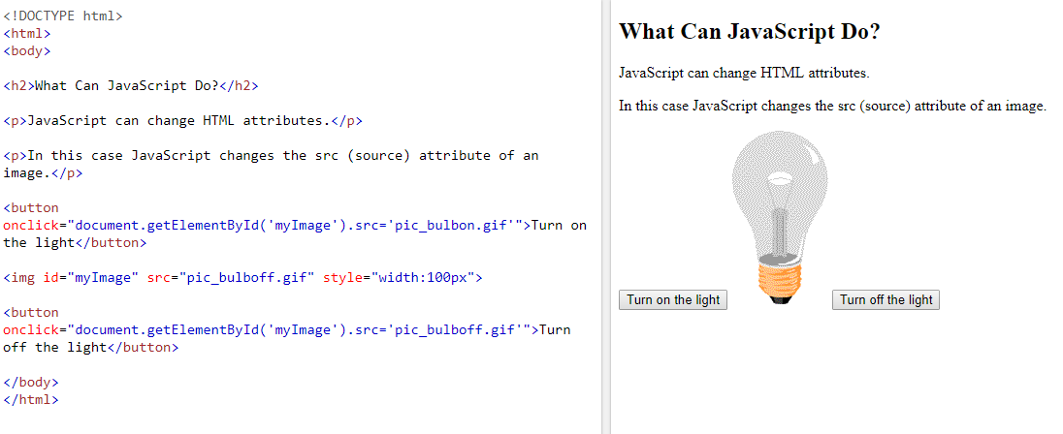

Slide 5
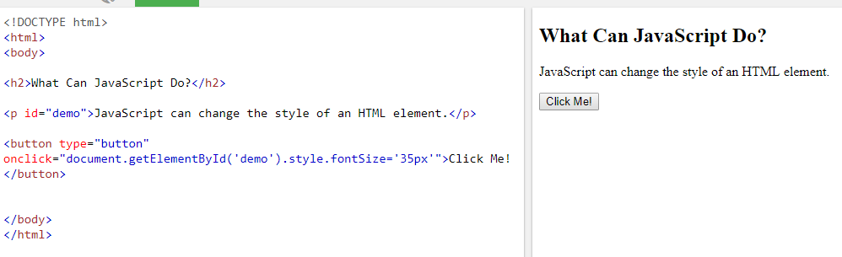

Slide 6
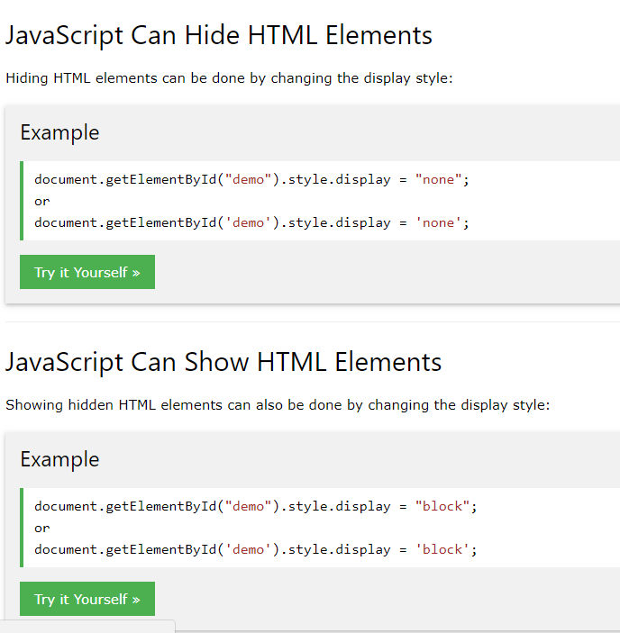

Slide 8
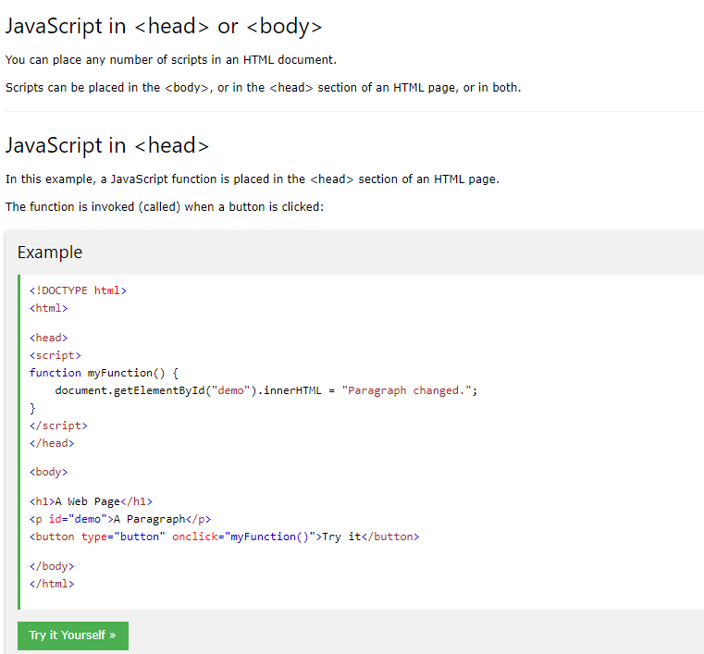

Slide 9
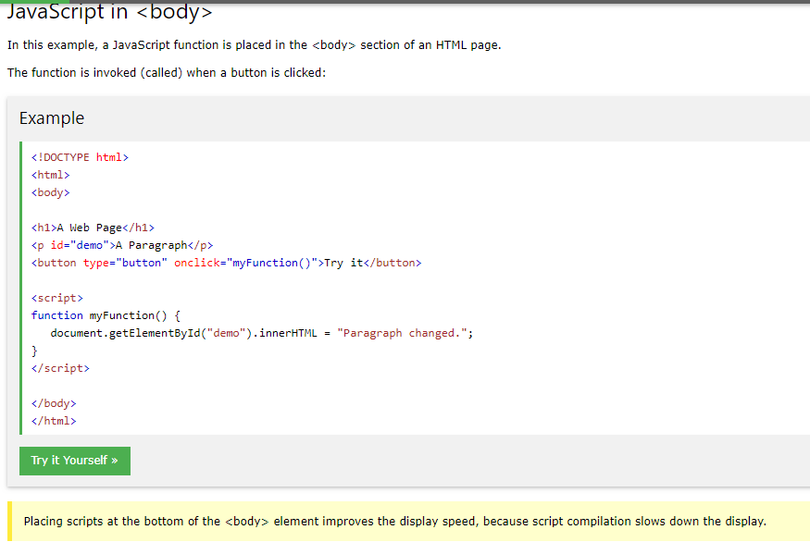

Slide 10
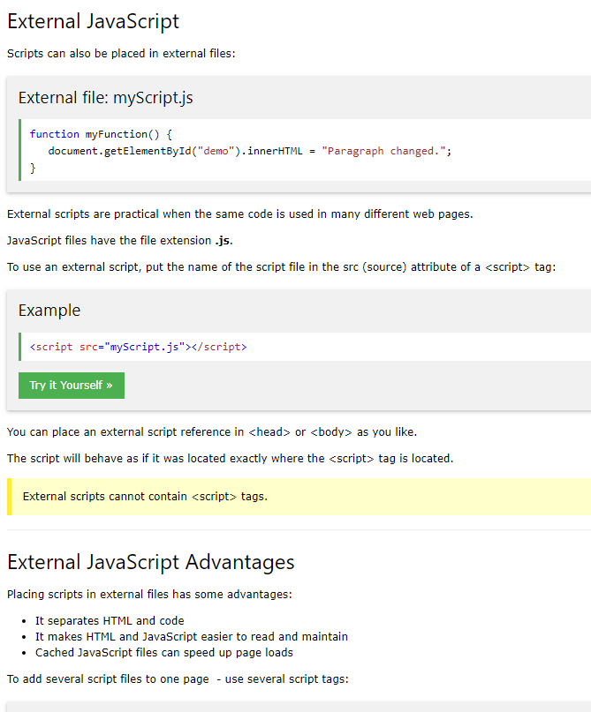

Slide 11
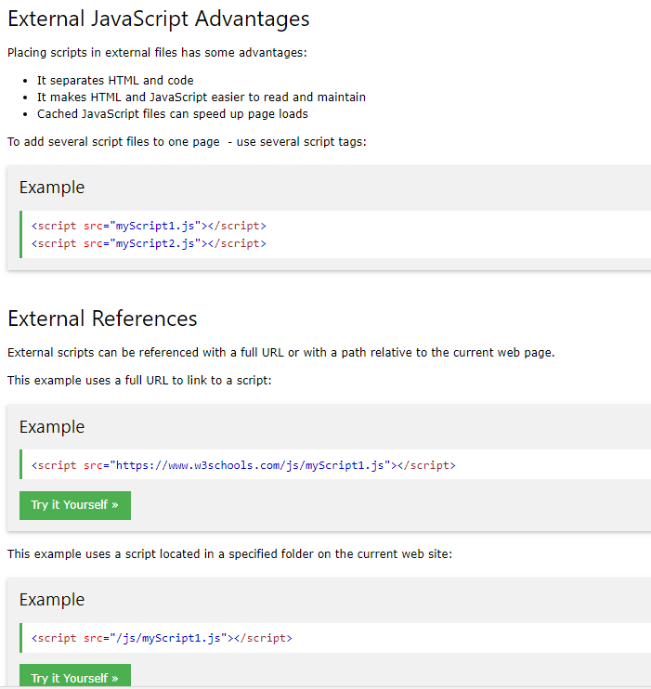

Slide 12
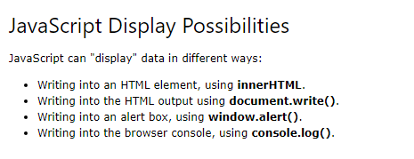
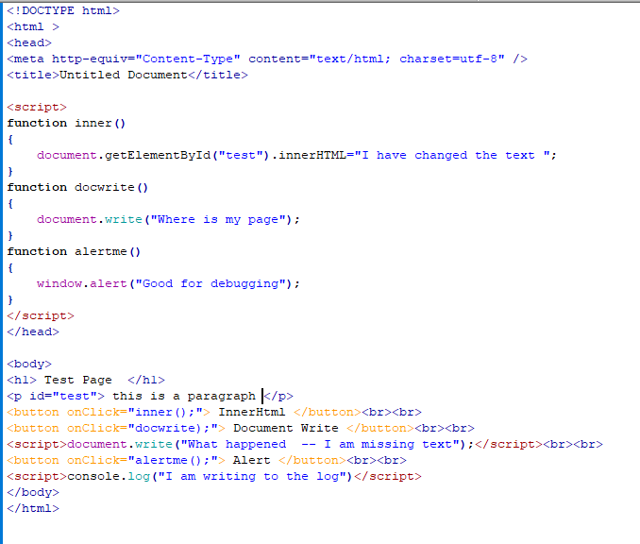
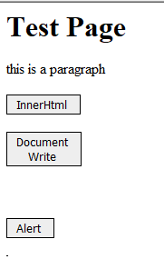

Slide 13
<!DOCTYPE html>
<html >
<head>
<meta http-equiv="Content-Type" content="text/html; charset=utf-8" />
<title>Untitled Document</title>
<script>
function inner()
{
document.getElementById("test").innerHTML="I have changed the text ";
}
function docwrite()
{
document.write("Where is my page");
}
function alertme()
{
window.alert("Good for debugging");
}
</script>
</head>
<body>
<h1> Test Page </h1>
<p id="test"> this is a paragraph </p>
<button onClick="inner();"> InnerHtml </button><br><br>
<button onClick="docwrite);"> Document Write </button><br><br>
<script>document.write("What happened -- I am missing text");</script><br><br>
<button onClick="alertme();"> Alert </button><br><br>
<script>console.log("I am writing to the log")</script>
</body>
</html>
Code from previous page

Slide 14
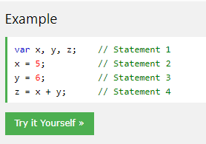
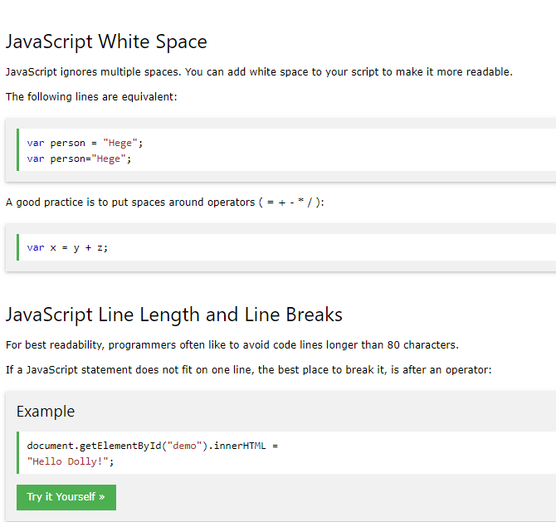
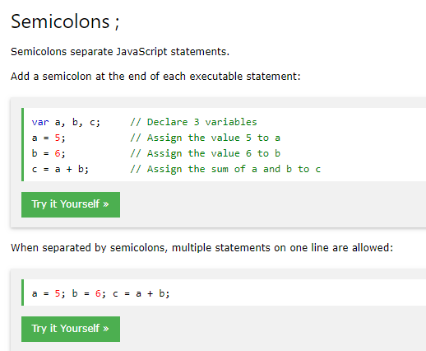

Slide 15
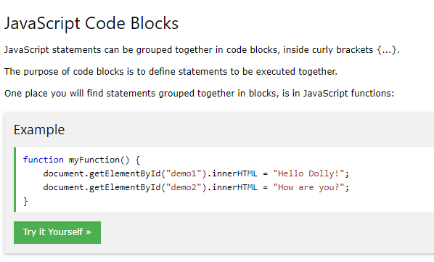
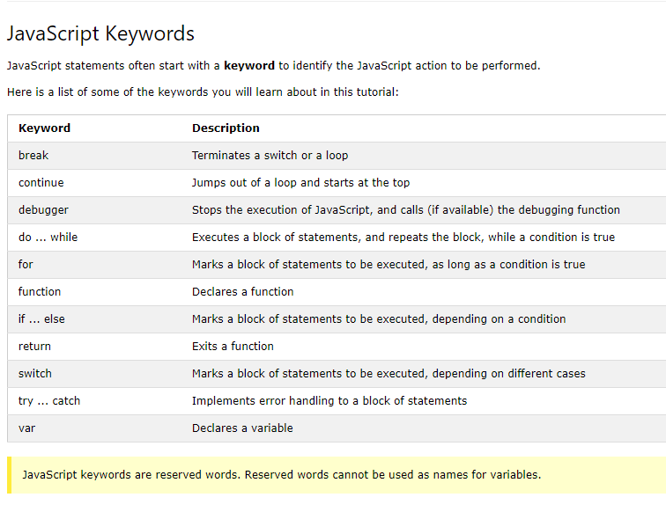

Slide 16
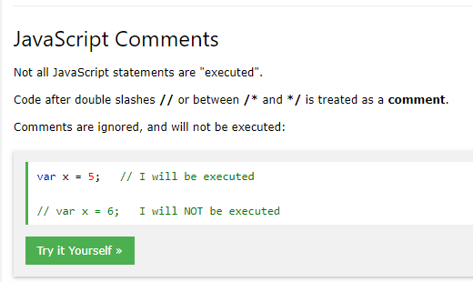
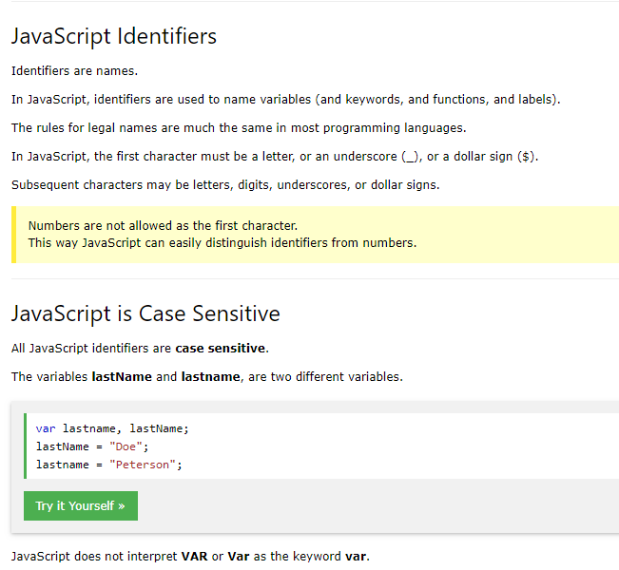

Slide 17
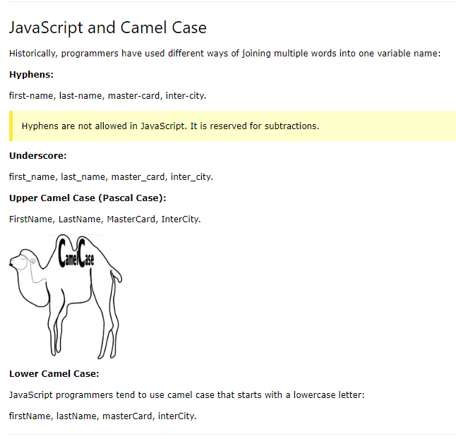
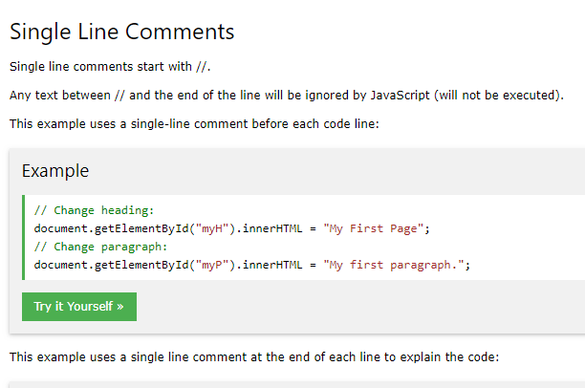

Slide 18
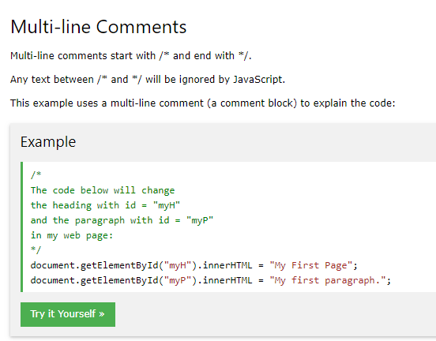
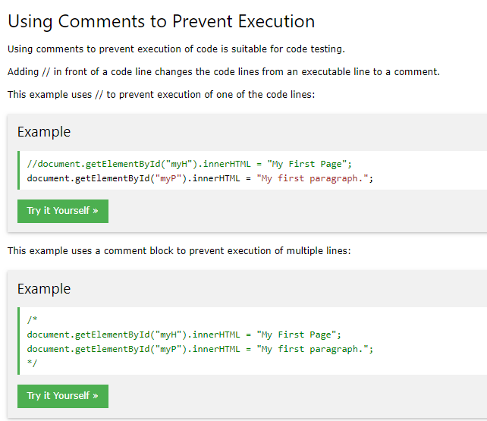

Slide 19
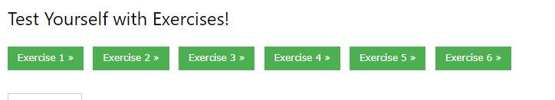
Complete each exercises and submit to Blackboard--

Slide 20
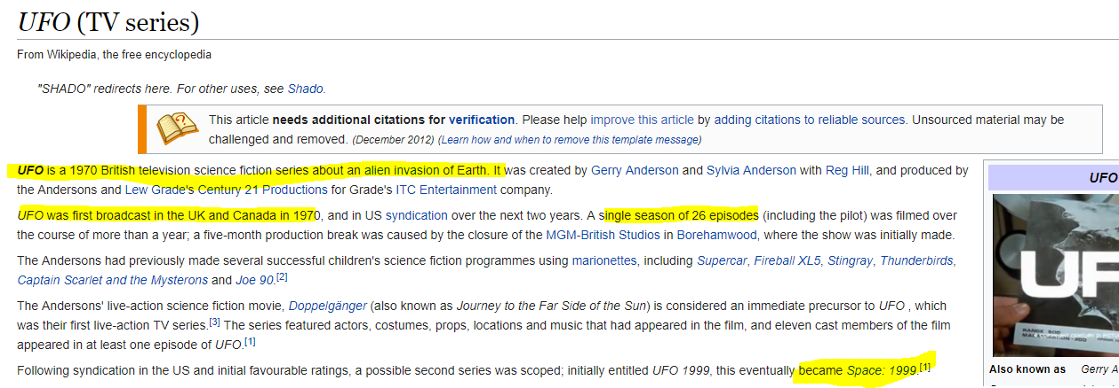

Slide 21
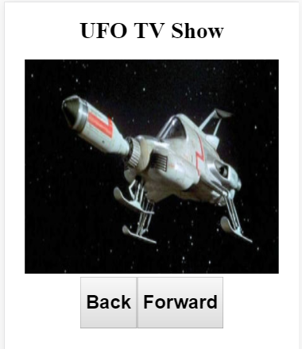
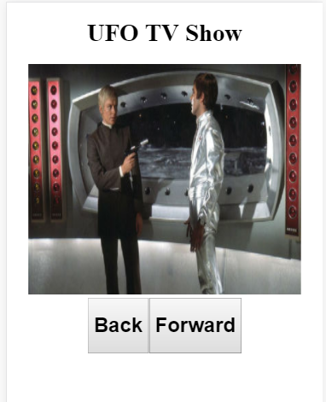
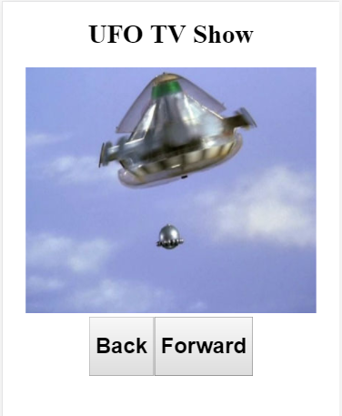
Create an application: slide show

Slide 22
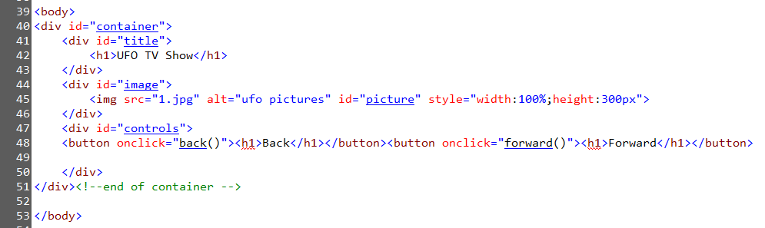
HTML

Slide 23
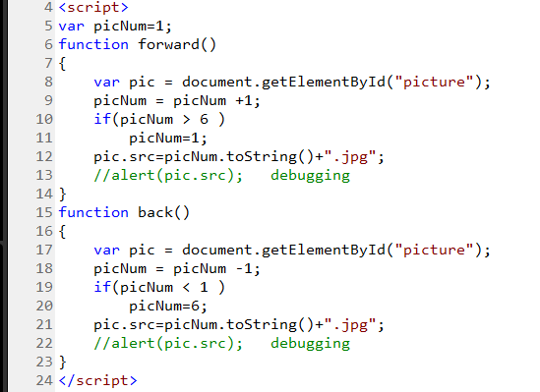
JavaScript

Slide 24
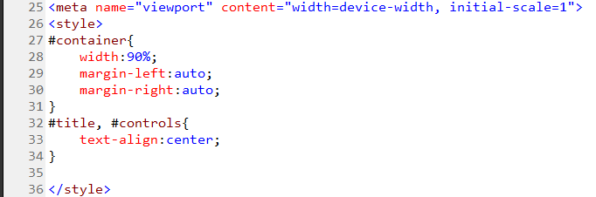
Styles

Slide 25
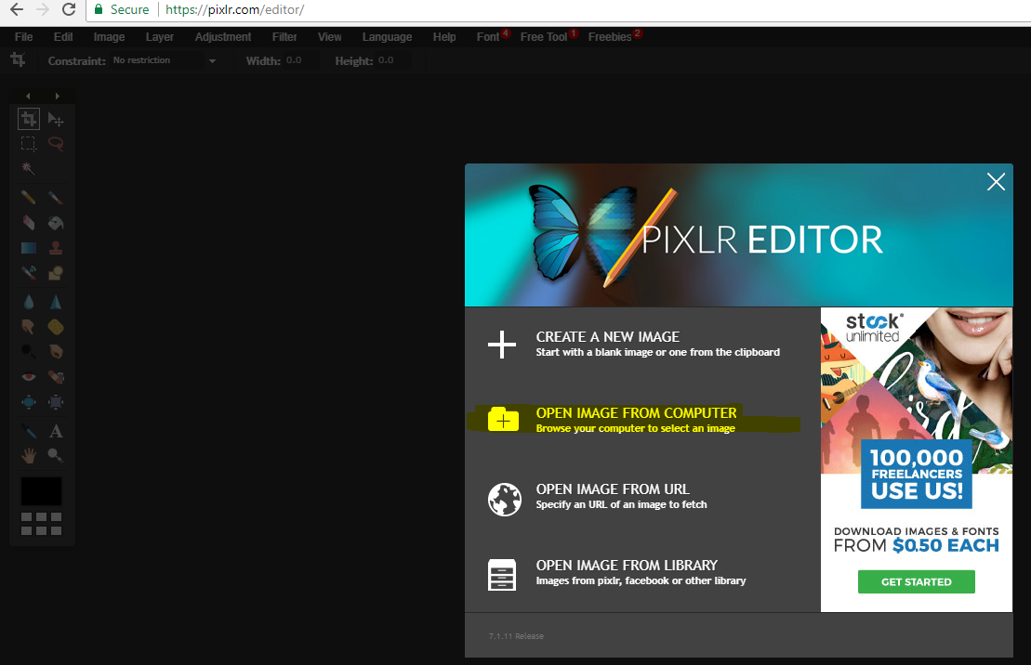
Pixlr used to size images-Pixlr.com

Slide 26
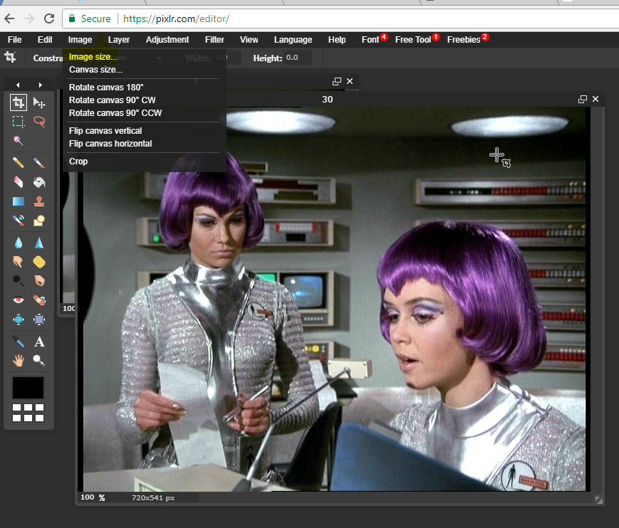
Image Image size

Slide 27
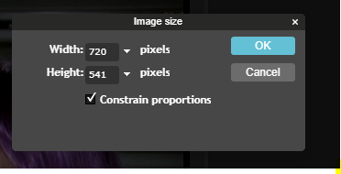
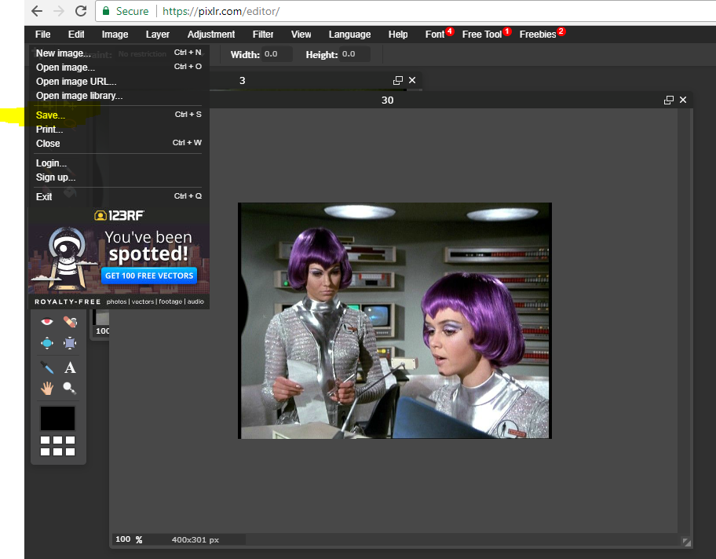
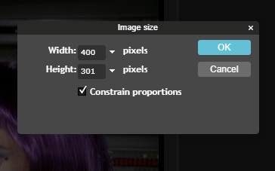
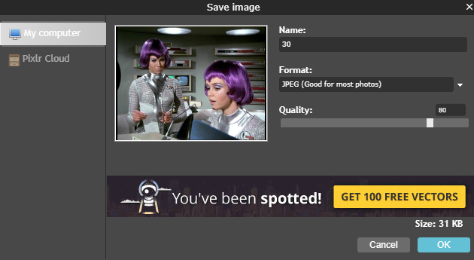
Change Size

Slide 28
Slide Exercise
Create your own slide application, assume we will be converting it to a phone apk
Select a tv show (past or present) and gather and resize 6 images
Create the code (html, css, javascript)
Test your app
Zip the app and submit to Blackboard

