Slide 1
WEB 231
Week 9

Slide 2
Introduction
Classes
Strings
Assignment 9.2 guidance

Slide 3
Classes
To create a class in JavaScript, you use the keyword class followed by an opening and closing curly brace.
Class Person {}
Methods are the functions inside of a class.
getFirstName(), getLastName()
Properties are the fields inside of a class.
firstName, lastName
Constructor is a special method assigned to all classes and is used to initialize an object created with the class keyword.
let krasso = new Person();

Slide 4
Classes contd.
Examples
https://github.com/buwebdev/web-231/blob/master/week-9/fruit-service.js
https://github.com/buwebdev/web-231/blob/master/week-9/func-add.js
https://github.com/buwebdev/web-231/blob/master/week-9/func-to-fixed-position.js

Slide 5
Strings
Strings are a sequence of characters.
“Hello my name is Professor Krasso.”
Strings are created with single/double quotes.
Concatenation is the process of appending characters to an existing string. This is done through the “plus” sign.
“Hello my name is “ + “Professor Krasso.”
Output: Hello my name is Professor Krasso.

Slide 6
Strings contd.
Variables can be used to create complex strings.
let myName = “Professor Krasso”
“My name is “ + myName;
Output: My name is Professor Krasso
Strings can be created using back ticks ``
`Hello my name is Professor Krasso.`
With back ticks, strings can be concatenated using ${}.
let myName = “Professor Krasso”
`Hello my name is ${myName}.”
Output: Hello my name is Professor Krasso.

Slide 7
Assignment 9.2 guidance
Create a class named Card with properties for face and suit and initialize the class using the classes constructor.
class Card {}
constructor (face, suit) { this.face = face; this.suit = suit; }
Special note. A constructor is defined in the body of a class.
Create a class named Dealer with properties for CARD_COUNT, cards, faces, and suits.
The Dealer class should also have a constructor and two methods: getDeckOfCards() and shuffle().

Slide 8
Assignment 9.2 guidance contd.
Register an onClick event for the shuffle HTML button.
Create a new instance of the dealer class.
let dealer = new Dealer();
Call the dealer.shuffle() method.
Add a for…of loop to iterate over the dealer.cards array.
Inside of the for…of loop add a switch statement for card.suit and create a concatenated string for each of the suits.

Slide 9
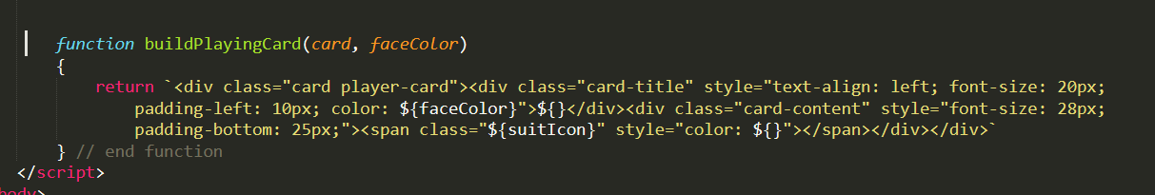
Assignment 9.2 guidance contd.
Build a function named buildPlayingCard with parameters for card, suitIcon, faceColor, suitColor and return a concatenated string.
**Warning** the below code is incomplete, you will have to fix it to match the instructions.

Slide 10
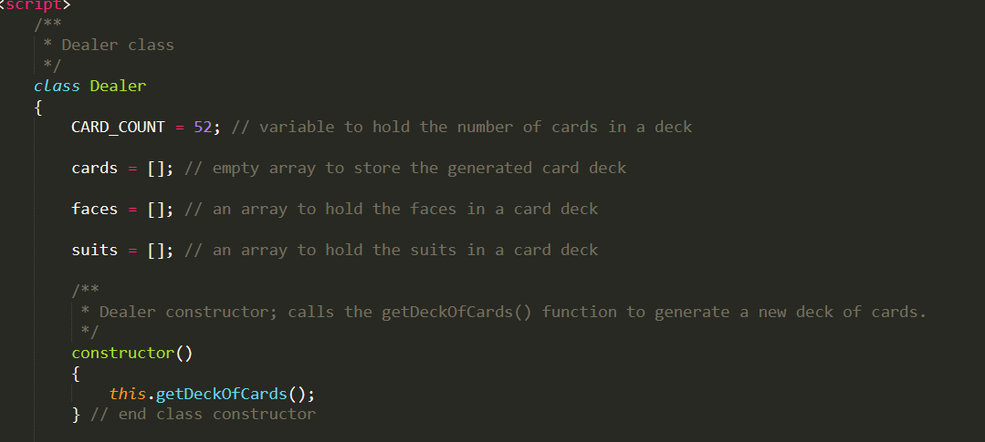
Assignment 9.2 guidance contd.
Dealer class.
**Warning** incomplete.

Slide 11
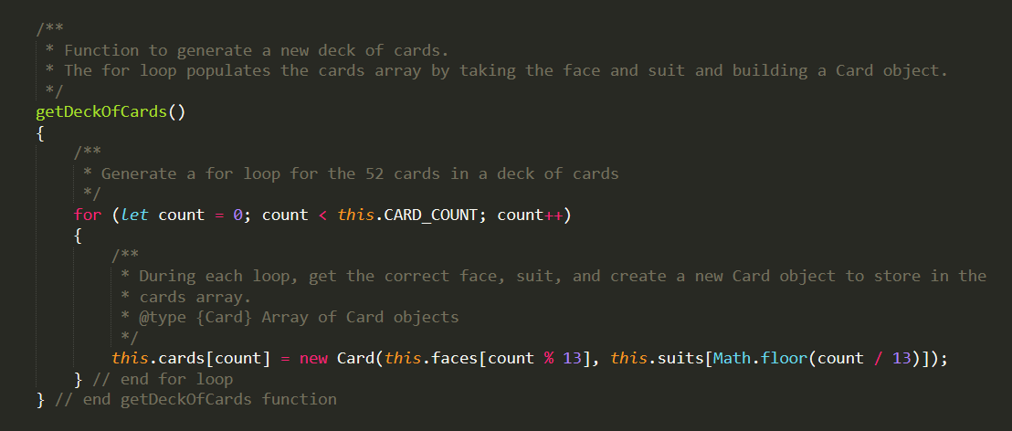
Assignment 9.2 guidance contd.
Dealer class contd.

Slide 12
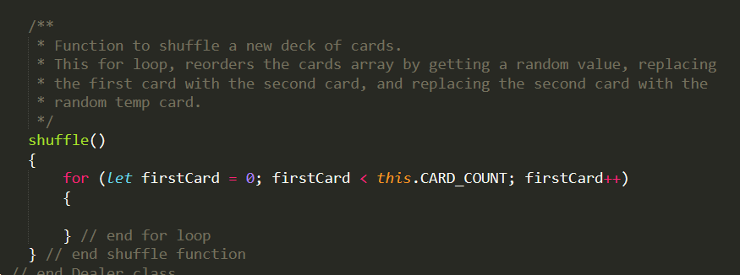
Assignment 9.2 guidance contd.
Dealer class contd.
**WARNING** This function is incomplete; you will need to fix it.

Slide 13
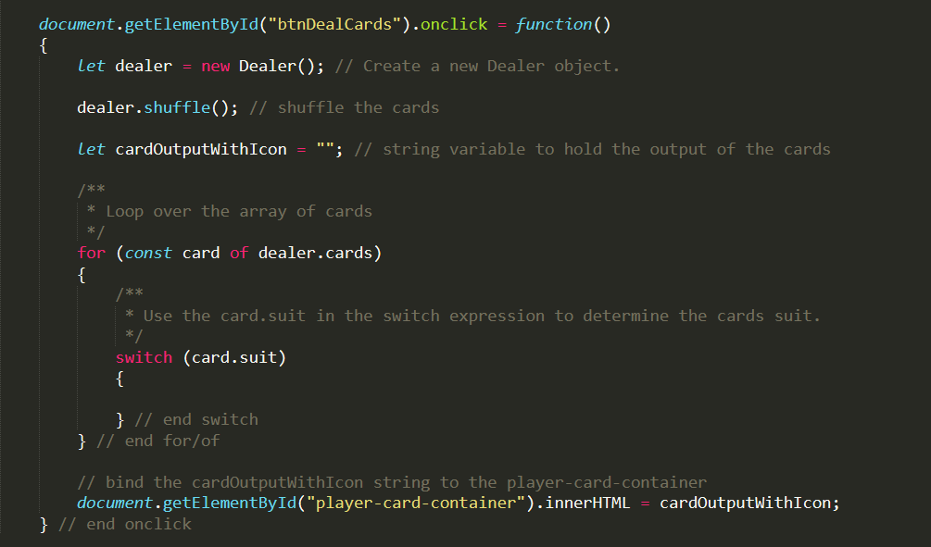
Assignment 9.2 guidance contd.
HTML page
**WARNING** incomplete.

