Slide 1
Text-mining for Cohort Ascertainment and Analysis of Patients with EVA
E Bryan Crenshaw III, PhD Children’s Hospital of Philadelphia

Slide 2
Acknowledgements
Put previous slide here

Slide 3
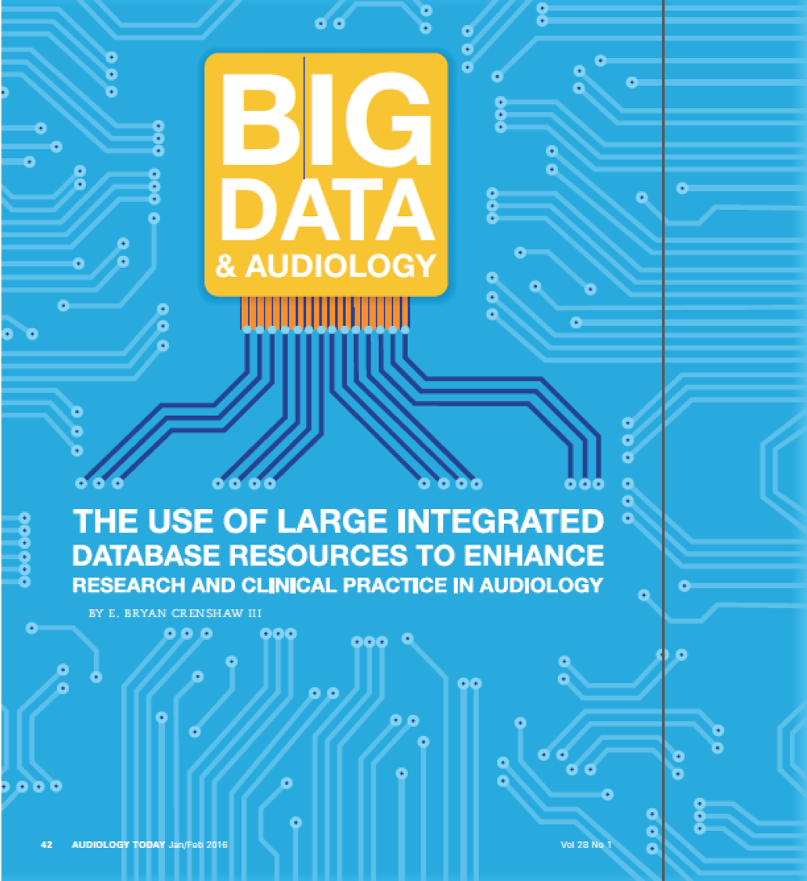
Big Data & Audiology
Audiology Today, 28:42-49 (2016)

Slide 4
Big Data: Opportunties & Challenges
Provides opportunities
Large cohort sizes
Comparison across institutions
Compendium of data resources to bring to bear on a problem
Rapid testing of hypotheses
Presents Challenges
Observational studies
Sparsity of data
Significant amounts of data in the form of text, which isn’t readily accessible to computational methods without further work

Slide 5
The Audiological and Genetic Database (AudGenDB)
Pediatric hearing research integrates complex data from varying specialties, on large numbers of patients.
Examples of data in AudGenDB:
Audiogram for hearing thresholds
Evoked responses (e.g. ABR)
Speech and language performance
Diagnoses and problems
Procedures
Temporal bone imaging
Large-scale hearing research projects would benefit from an integrated electronic database that incorporates these varied data.

Slide 6
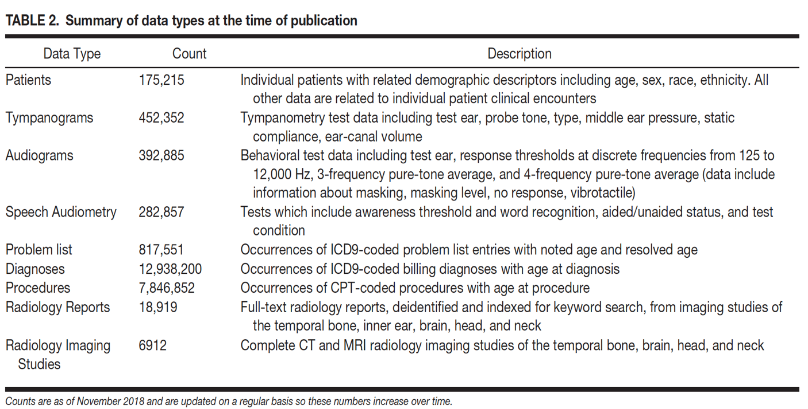
Database Summary
Pennington et al., 2019

Slide 7
Data Science – Machine Learning
Use slide from down’s presentation

Slide 8
Talk Outline
Work in Progress
Demonstrate textmining approaches
Discuss algorithms to identify progression
Discuss mathematical modeling to facilitate our analyses
Touch on how these approaches facilitate the long term goal of predictive analytics

Slide 9
Hearing Loss Progression
The larger question – Enlarged Vestibular Aqueduct (EVA) is a subset of the HL Progression problem
How to determine which patients will progress?
What computational approaches can we bring to bear on the problem?
Can machine learning techniques be used to predict HL progression?
What features are available for inclusion as features?
Can we generate ‘computed phenotypes’?

Slide 10
Identifying an EVA Cohort
No unique ICD Code
How to identify the cohort?
Track in the clinic (Approach Taken at Boston Children’s & Vanderbilt)
Text Mining Radiology Reports (CHOP Approach)
Radiology Reports are ‘Semi-Structured’
Organization is stereotyped
Language is idiosyncratic for each clinician
(Some believe verbosity is elegant ;-)

Slide 11
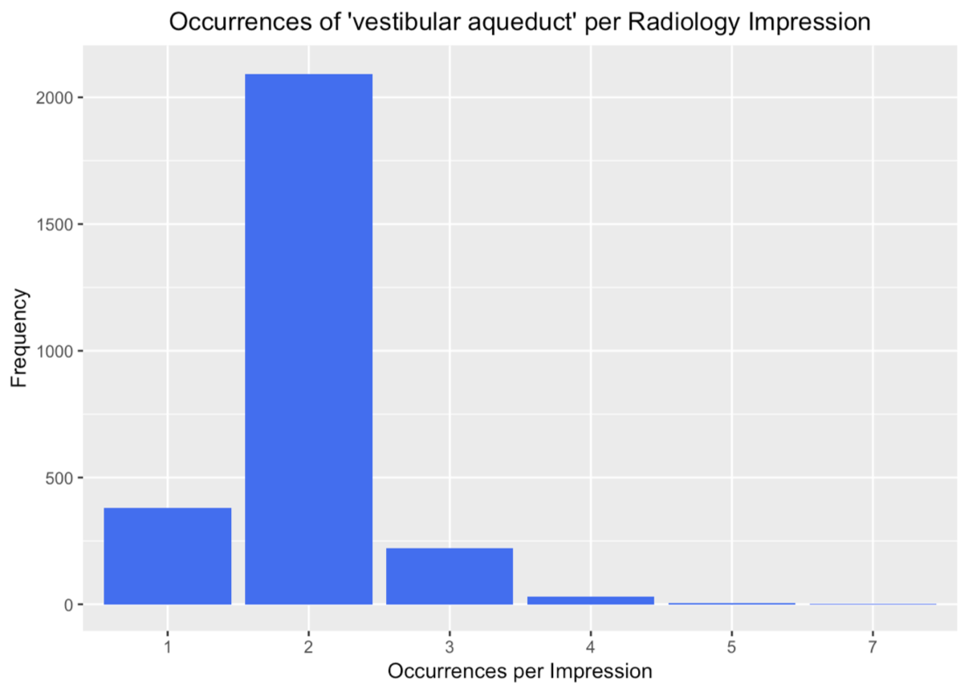
Text Mining for the Term ‘vestibular aqueduct’

Slide 12
Text Mining for the Term ‘vestibular aqueduct’
18,919 radiology impressions in AudGenDB
2726 observations can be found with the term, ’vestibular aqueduct`
256 impressions have the term more than twice
Hand-curated 30 of these
21 describe EVA
2 definitely not enlarged
5 used radiology CYA words (ambiguous)
1 duplicate report
1 thin vestibular aqueduct
A list of specific terms assembled

Slide 13
Text Mining: Regular Expressions
Dispositive Expression (5): Example: (vestibular(\n| )aqueducts?.+(is|are|with)(\n| ) ?(mildly|markedly)?(\n| )(enlarged|dilated|widened))
Exclusionary Expression – Negative (13): Example: no( |)evidence of enlarg(ed|ement of the) vestibular aqueducts?
Exclusionary Expression – Ambiguous (4): Example: may representvestibular aqueducts

Slide 14
Text Mining: Regular Expressions
13,289 radiology impressions in AudGenDB
6,255 patients
206 impressions from 190 patients are found using the regex algorithms
344 patients cumulatively at the three institutions represented in AudGenDB

Slide 15
Computational Methods to Identify HL Progression
Most in the audience familiar with identifying HL progression using a collection of audiograms from a single patient
Our task was to develop computational methods that could screen ~400,000 audiograms in AudGenDB from ~136,000 patients
Given the large number of audiograms, we had one luxury: making a rigorous definition
Our definition: Using masked bone thresholds, find patients whose PTA4 dropped by 10 dB from first to last hearing test.

Slide 16
HL Progression in AudGenDB
135,706 total patients with audiograms in AudGenDB
15,581 patients fitting inclusion criteria using masked bone conduction.
Inclusion Criteria: Patients must have at least 3 hearing tests that dropped by 10 dB HL or more from first to last hearing test that were tested at 4 frequencies (500, 1000, 2000, and 4000 Hz).
390 patients with HL progression defined by these criteria

Slide 17
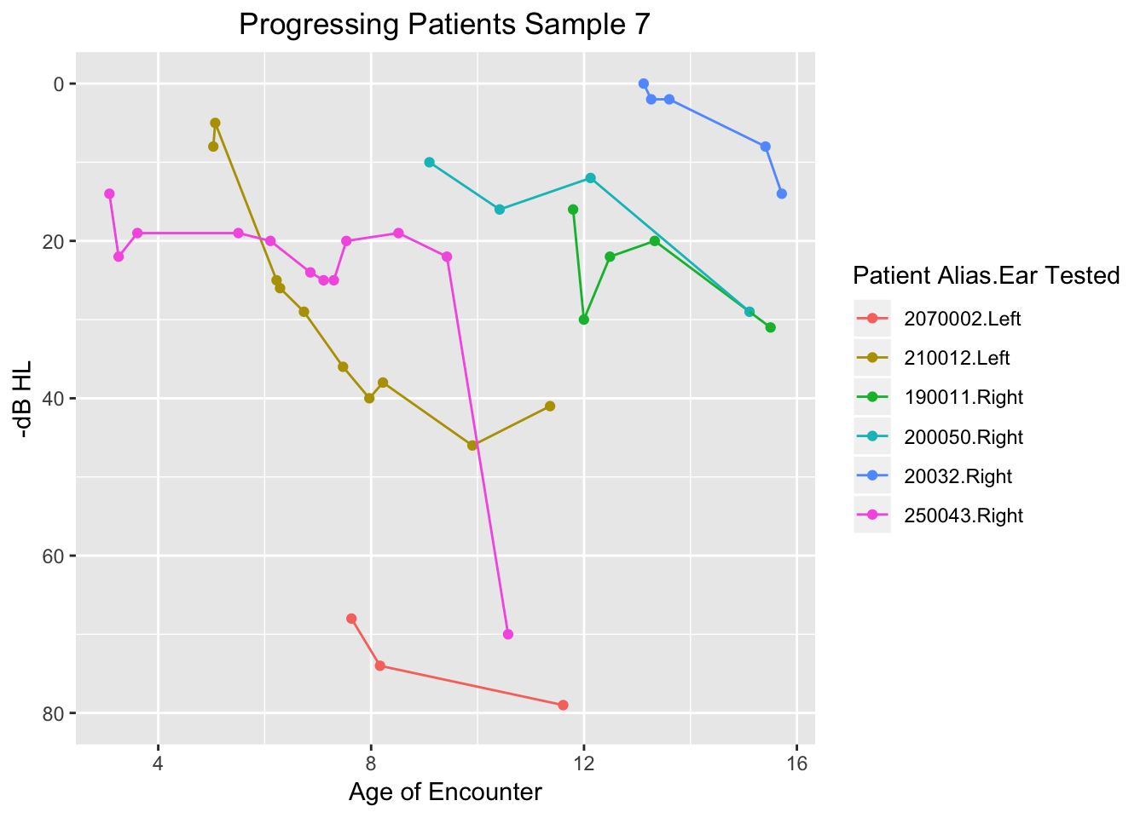
Sample of Patients Demonstrating HL Progression
Notes:
Graph from < file:///Users/ebciii3/Public/AudGenDB%20Data%20Mining/Hearing%20Loss%20Progression/html/TemporalGraphsHLprogressionCohort.html#data_analysis > HL103 Temporal Graphs of HL Progression Cohort

Slide 18
HL Progression in EVA Patients
Changed definition: Our definition: Using air thresholds, find patients whose PTA4 dropped by 10 dB from first to last hearing test.
For routine monitoring of EVA patients, only air thresholds were measured
155 patients (of the 190 found at CHOP) have enough audiogram data for analysis (at least 3 audiograms with all PTA4 frequencies included)
60 patients demonstrated progressive hearing loss
39% of the qualifying EVA patients have progressive hearing loss

Slide 19
Computational Method for Identifying Patients with Fluctuating Hearing
Approach: Calculate difference in PTA 4 from test to test as the patient ages
Definition: Maximum >= 10 dB between tests & minimum <= -10 dB between tests
In other words, test-to-test change must go up at least 10 dB and drop by at least 10 dB
Results
190 total CHOP patients with EVA
155 patients meet all inclusion criteria using air conduction for testing
71 ears from 60 patients showed progression demonstrated progressive hearing loss
36 ears that qualify as fluctuating in the entire data set
19.9% of the hearing tests
13 ears with fluctuating hearing thresholds among the progressive HL patients

Slide 20
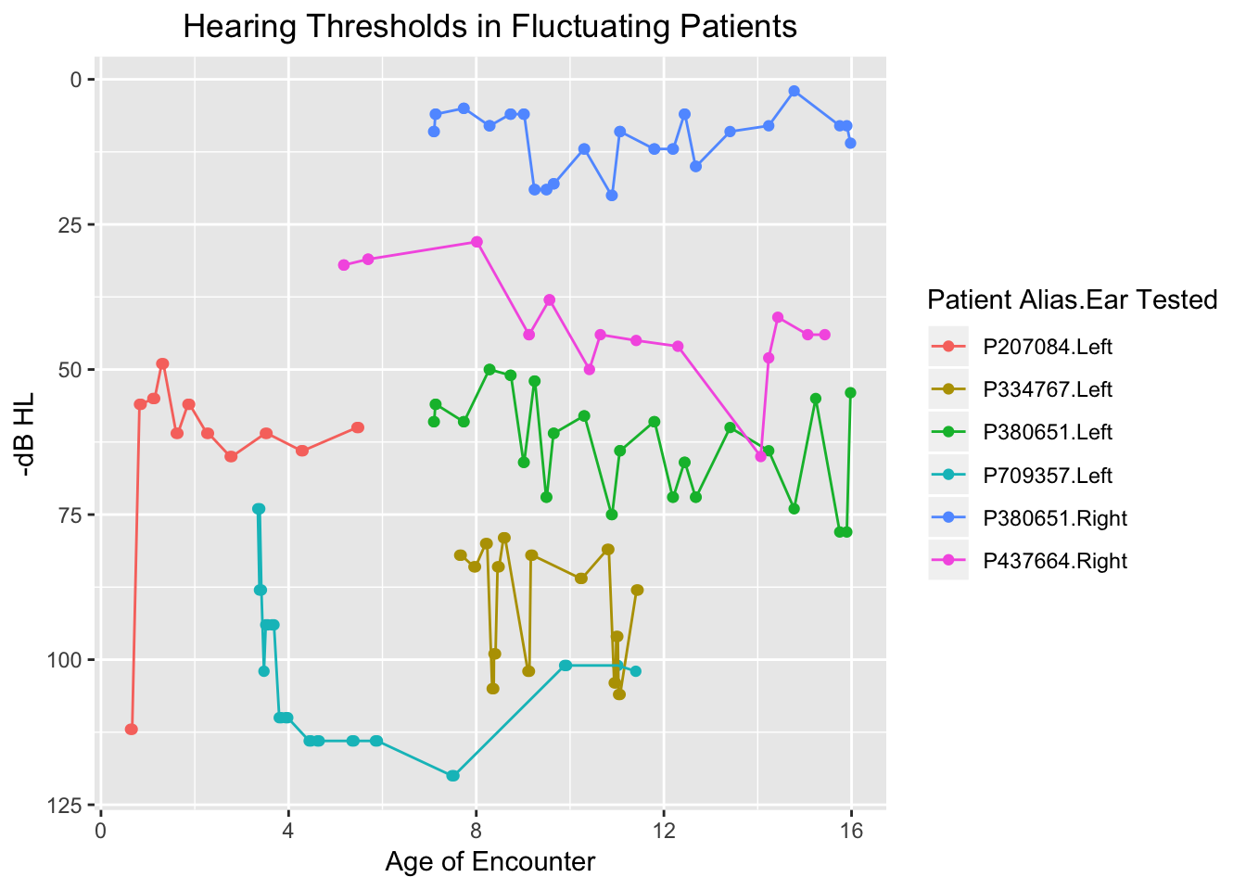
Examples of Fluctuation in EVA Patients

Slide 21
Mathematical Modeling to Identify Progression Types
Sudden hearing loss is a prominent feature of HL Progression
Can we use mathematical modeling to categorize HL Progression profiles?
Note: add images/MathModelsHLprogression.jpeg here
Model each patients pta4 ~ age curve
Extract variable values
linear (m/b1, b/b0, r2)
4th order polynomial (b4, b3, b2, b1, b0, r2)
Clustering
Note add < images/ClusterHLprogression_small.png > here

Slide 22
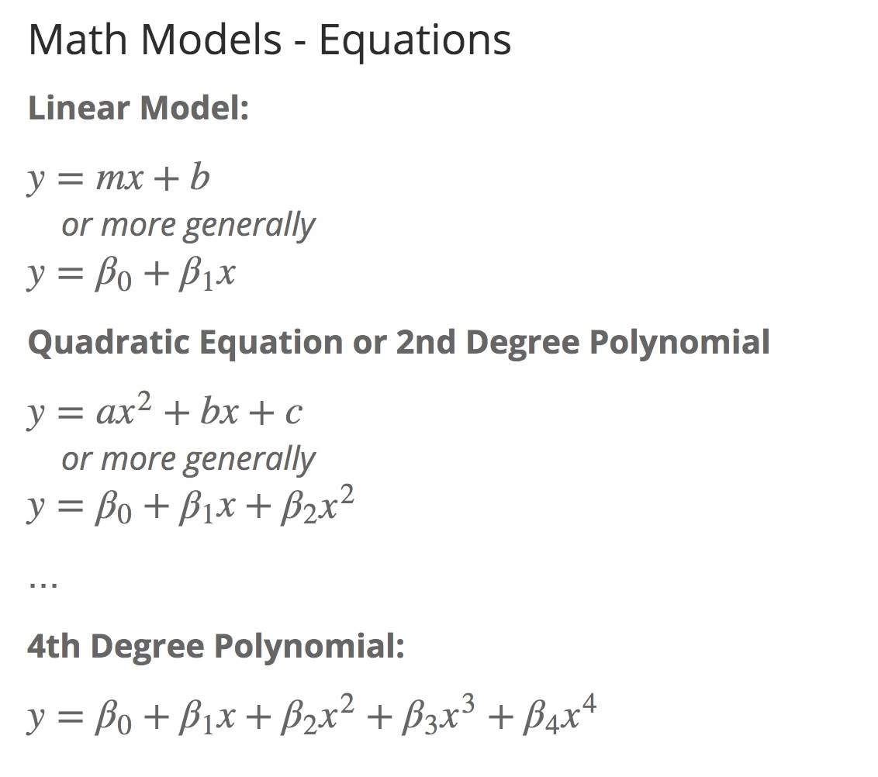
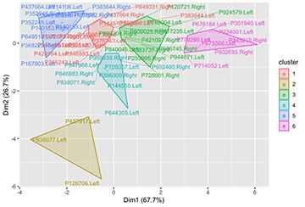
Mathematical Modeling to Identify Progression Types

Slide 23
Mathematical Modeling:
Theoretical Curves

Slide 24
Sudden Hearing Loss is best modeled with 4th degree polynomial
Linear model fits the data poorly, which is reflected in a low r2 value
4th order polynomial model fit is good, and r2 value is high
Slow HL Progression is well-modeled with both approaches
Linear model fit is good and r2 value is high
4th order polynomial is good, and r2 value is high

Slide 25
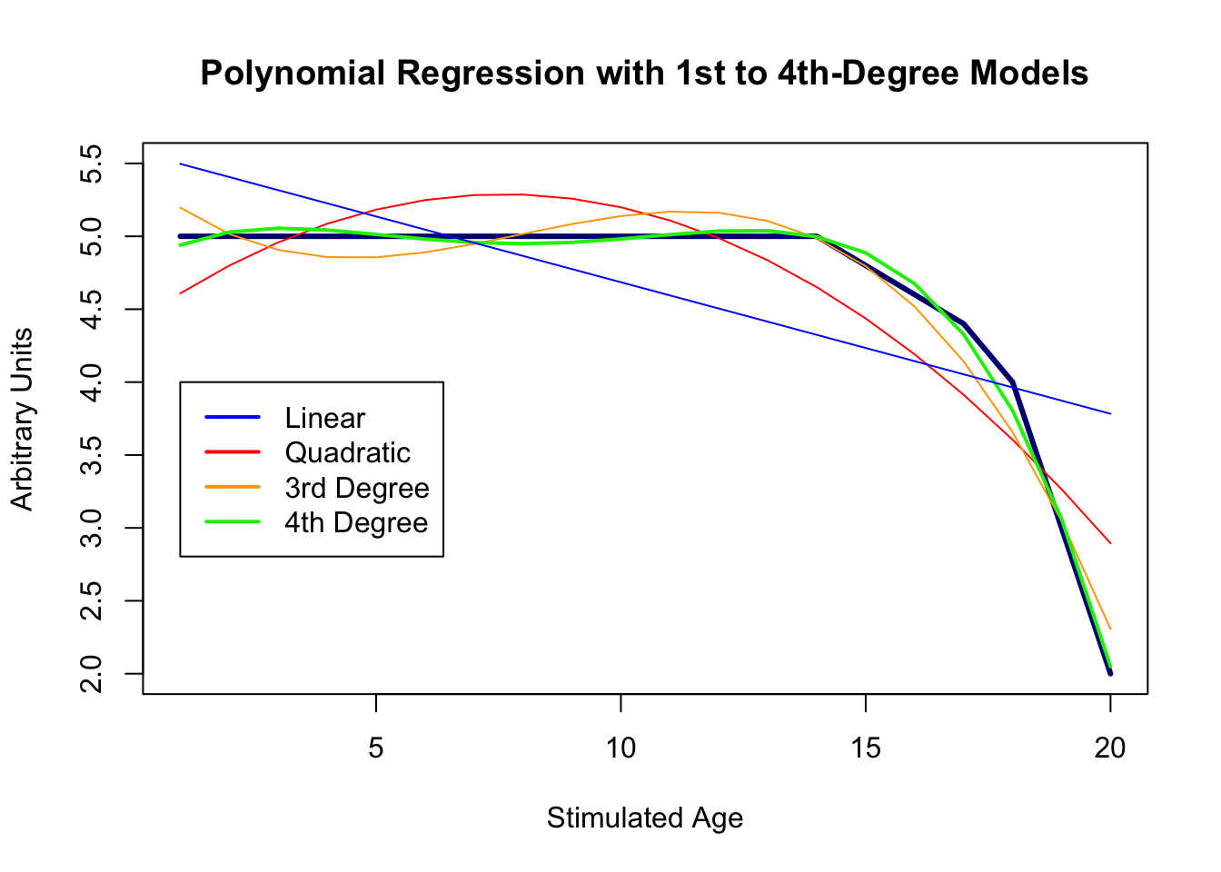
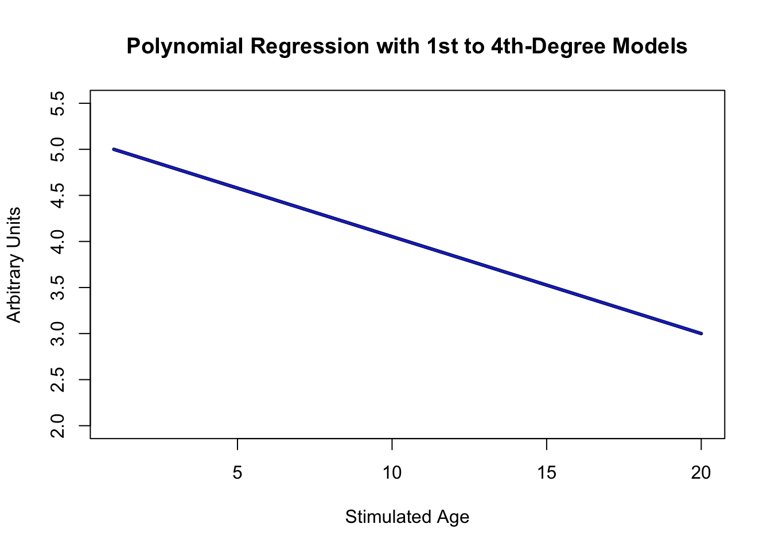
Mathematical Modeling to Identify Progression Types

Slide 26
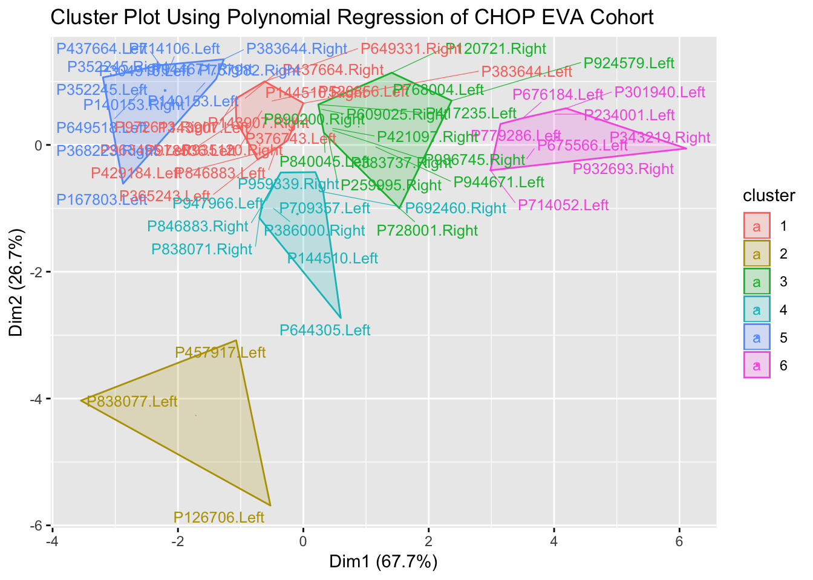
Clustering HL Progression Profiles (PTA4 ~ Age)
Clustering of Models Can Generate Useful Categorization of HL Progression

Slide 27
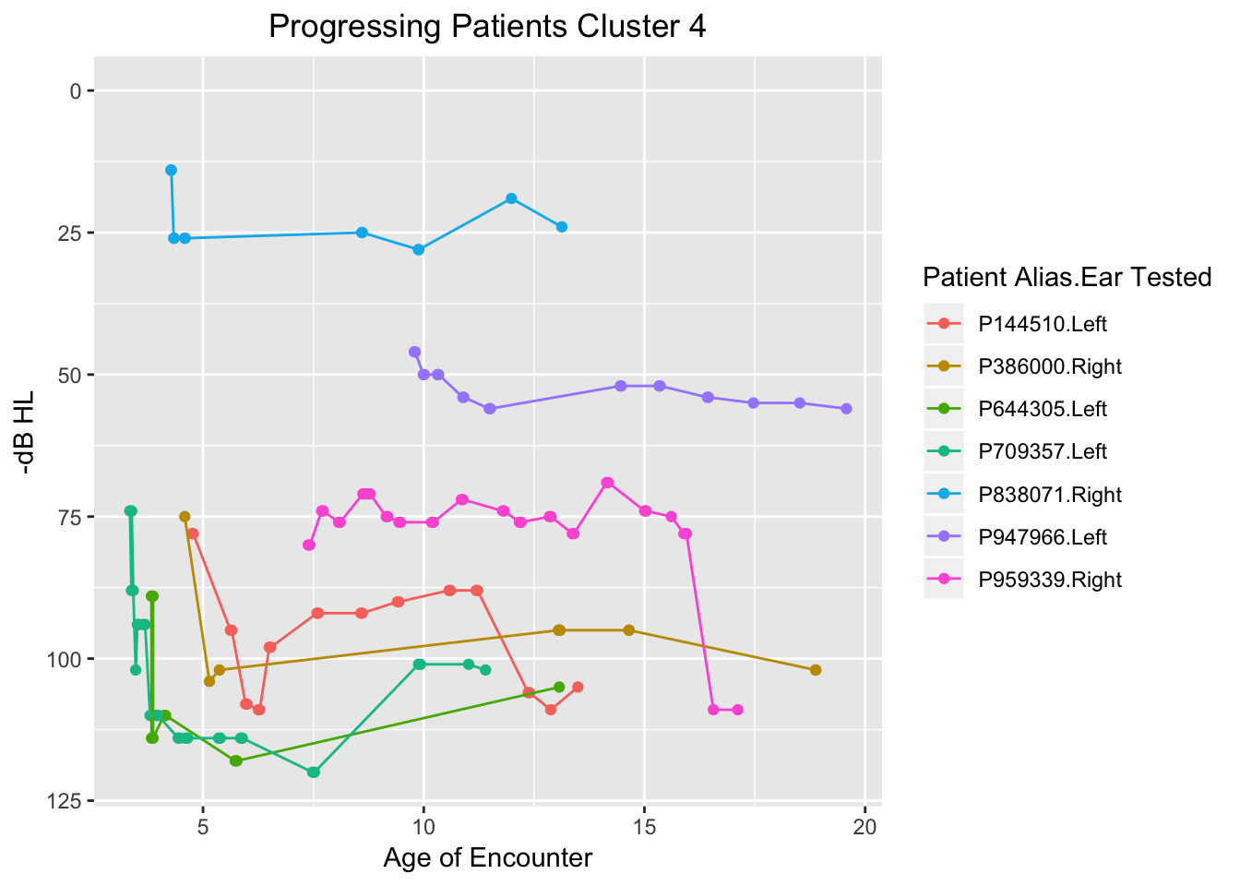
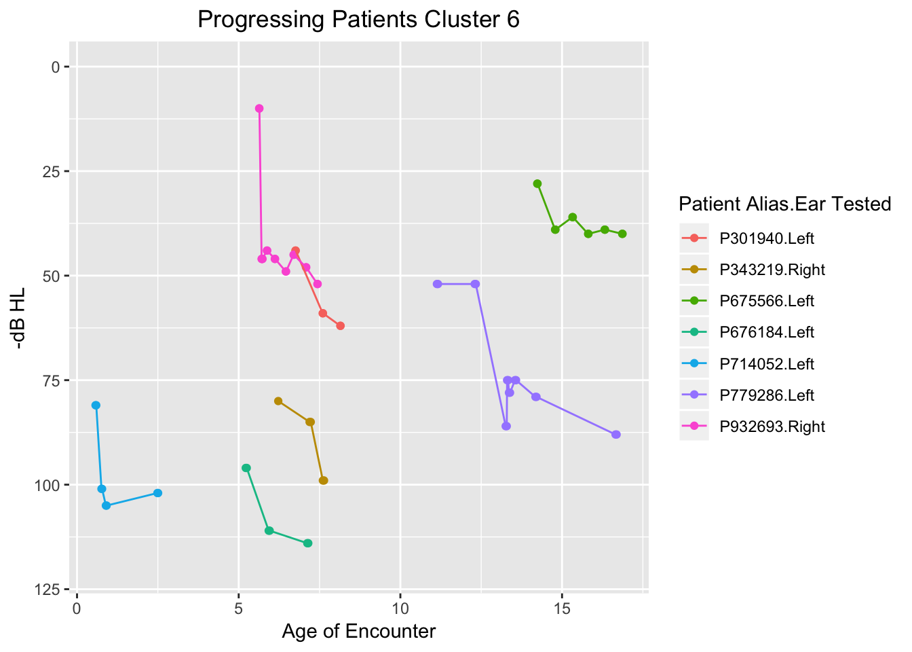
Two Categories of Sudden Hearing Drop Profiles Distinguished by Clustering: CHOP EVA Cohort
Sudden Drops In An Overall Stable Profile
Sudden Drops Without an Otherwise Stable Profile

Slide 28
Conclusions
Big Data in hearing sciences requires development of new computational methods to characterize hearing data
Text mining approaches can be used to identify patient cohorts that have traditionally taken considerable effort to find
Algorithms have been developed to identify temporal patterns in hearing tests relevant to hearing research, such as HL progession and fluctuation
These approaches can digest large datasets, and provide ‘features’ for machine learning
In the long term, predictive analytical techniques using these approaches can be developed
Clinical decision support (CDS) systems can then incorporate predictive analytic models to facilitate the evaluation of patients in audiological and otolaryngological practices

Slide 29
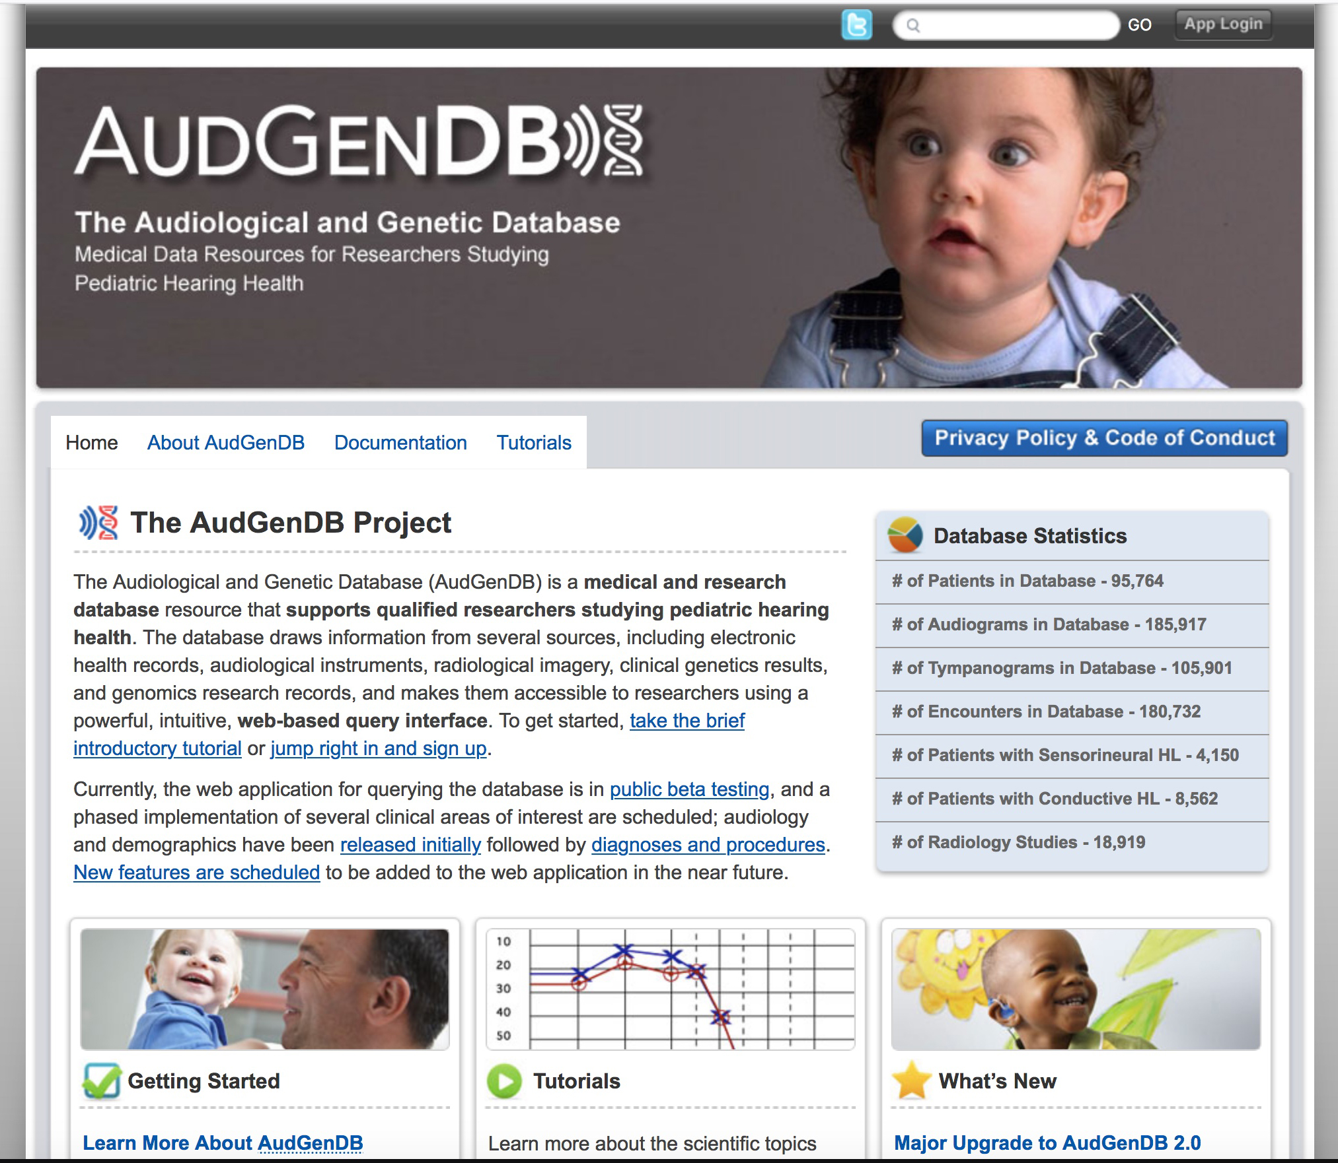
AudGenDB Home Page
AudGenDB website is found at https://audgendb.chop.edu/.

Slide 30
Questions?

Slide 31
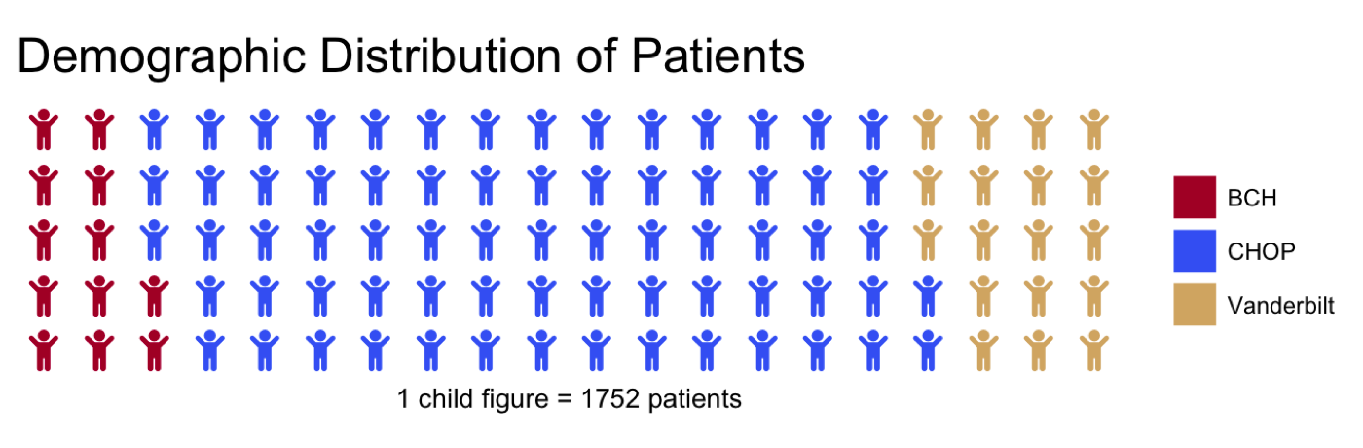
Distribution of Patients in AudGenDB
Color Scheme: CHOP Blue, Harvard (BCH) Crimson, and Vanderbilt Commodore Gold.

