Slide 1
About Daytocode Inc.
Founded in 2016, Daytocode Inc. is a nonprofit organization based in Maryland, USA. We are recognized as a tax-exempt public charity under Section 501(c)(3) of the Internal Revenue Code. Our primary mission is to empower youth and women in underserved communities by promoting education through computer programming, thereby fostering self-confidence through STEM (Science, Technology, Engineering, and Mathematics).
Our core values are integrity, consistency, and compassion. These principles guide us in our daily operations and strategic decisions.
Our vision extends beyond individual empowerment. We aspire to be an organization that enables people to uplift themselves, their communities, and their country. By investing in education and skill development, we believe we can contribute to a brighter future for all.

Slide 2
Hands-on activities: Robotics Assembly and Programming
Summary of activities for Harvest Tech Fair for Students
Learning objectives
- Discover the content of the robotic kits
- Learn how to assemble the robotic kits for basic projects
- Learn how to push readily available code to the robotic kits to perform different actions like turn on light, play sound, read temperature, etc.

Slide 3

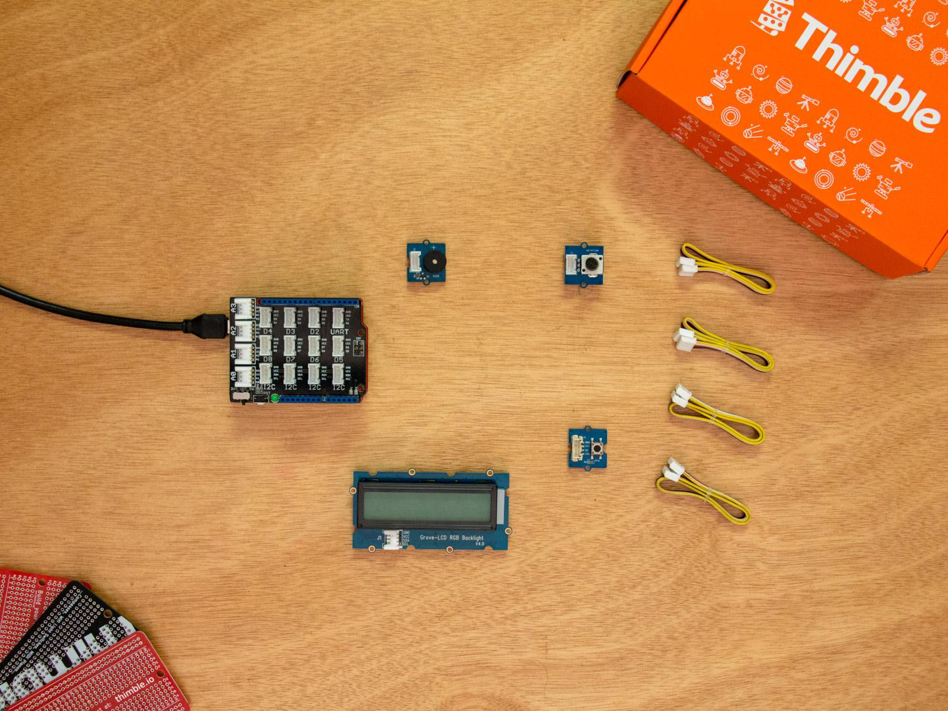
Robotics basics
Activity 1: Intro to Robotics - Assembly
Activity 2: Intro to Robotics - Programming

Slide 4
Projects for Harvest Tech Fair
Project 1: LCD Write your name and Say Hello!
Project 2: Intruder Alarm
Project 3: Desired temperature and alarm

Slide 5
LCD Write your name and say hello
Take a cable and unwrap it. Plug one side into the LCD Display and the other into any I2C socket.
Write basic code structure and upload it to the board to test
Copy and paste ready made into the code editor
Upload code and see results.

Slide 6
Intruder Alarm
Take a cable and unwrap it. Plug one side into the light sensor and the other into Analog socket A0.
Take another cable and unwrap it. Plug one side into the buzzer socket and the other into Digital socket D6.
Upload code and see results. When it is bright in the room the alarm goes on and when it is dark the alarm stays off.

Slide 7
Smart thermostat and alarm
Double check that the switches found on the Seeeduino Studio Grove and base shield are set to 5V and not 3V3.
Take a cable and unwrap it. Plug one side into the temperature sensor socket and the other into Analog socket A0.
Take a cable and unwrap it. Plug one side into the Analog Angle Sensor and the other into Analog socket A1.
Take a cable and unwrap it. Plug one side into the LCD Display and the other into any I2C socket.
Take a cable and unwrap it. Plug one side into the Sound Buzzer and the other into any D4 socket.
Upload code and see results.

Slide 8
Keep learning
Register for our bi-weekly coding and robotic workshops at www.daytocode.org.
Follow us on Instagram at: Instagram.com/daytocode

