Slide 1
Rolsa
A static backup of the site

Slide 2
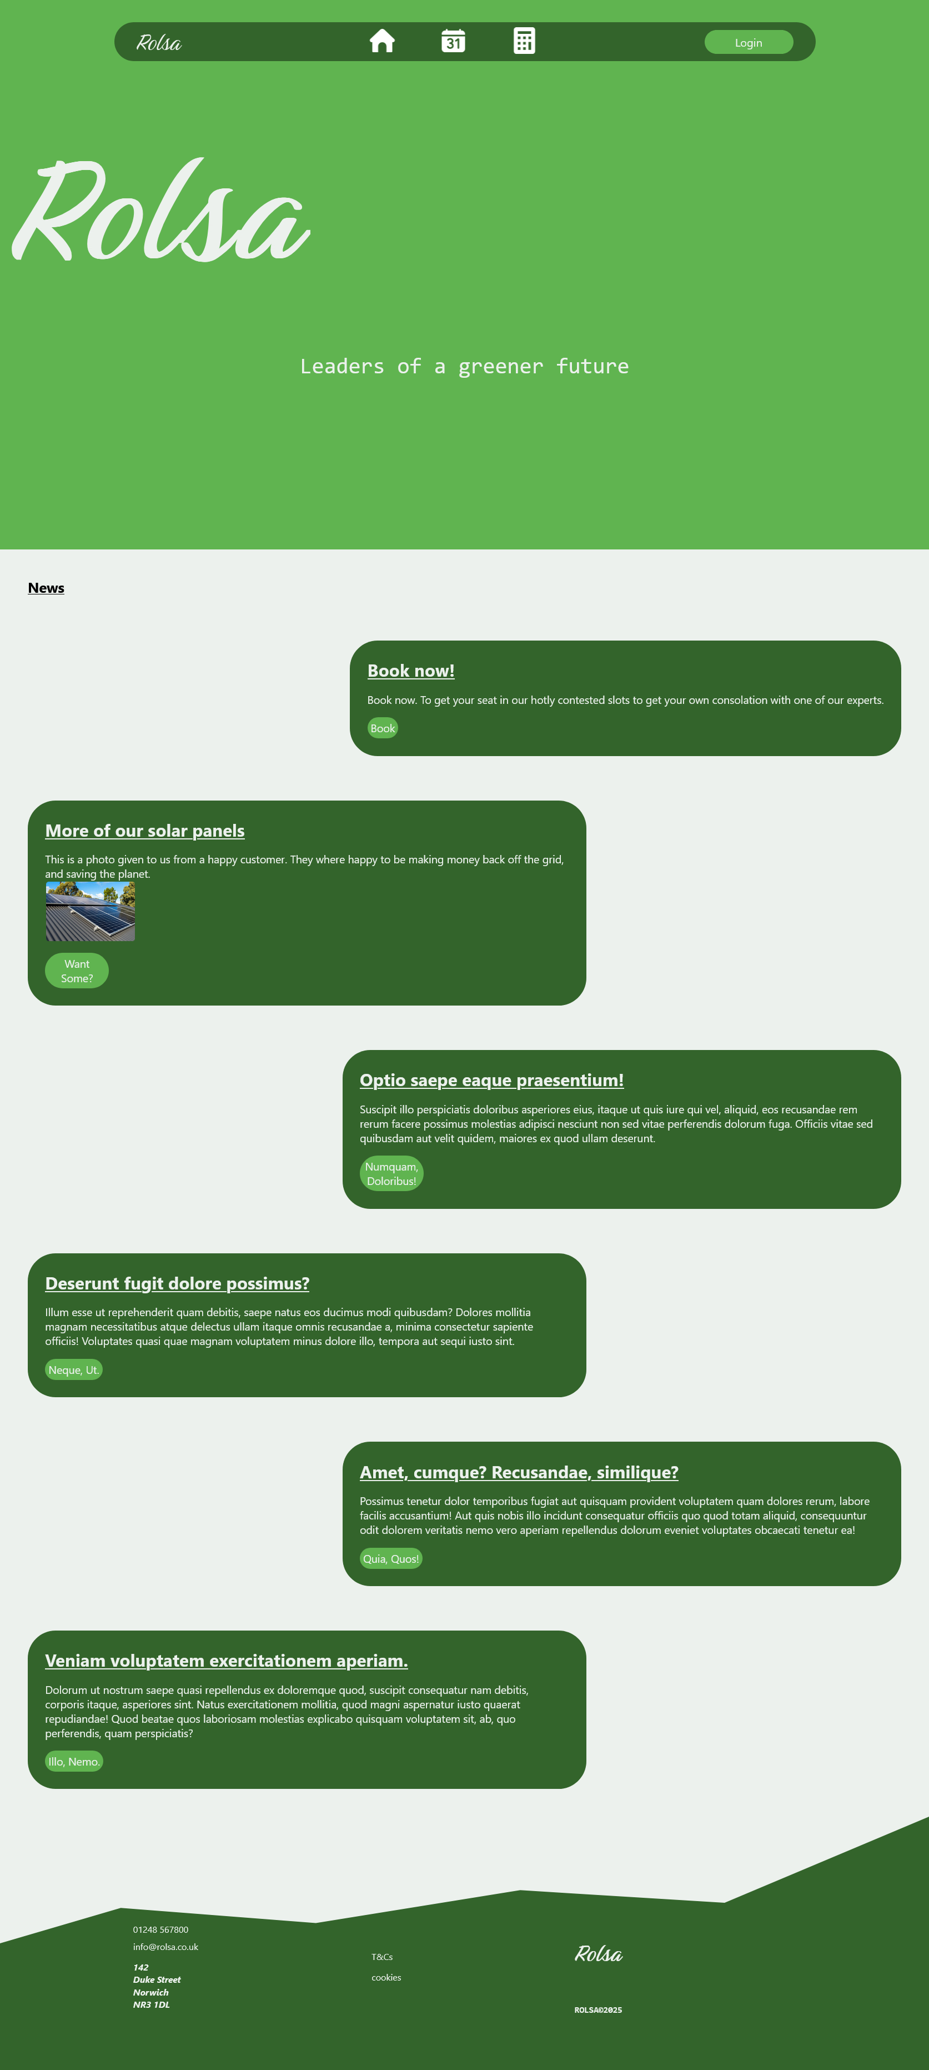
Home Page
This is the home page you are put immediately on loading the site, this has a series of articles you can click on.

Slide 3
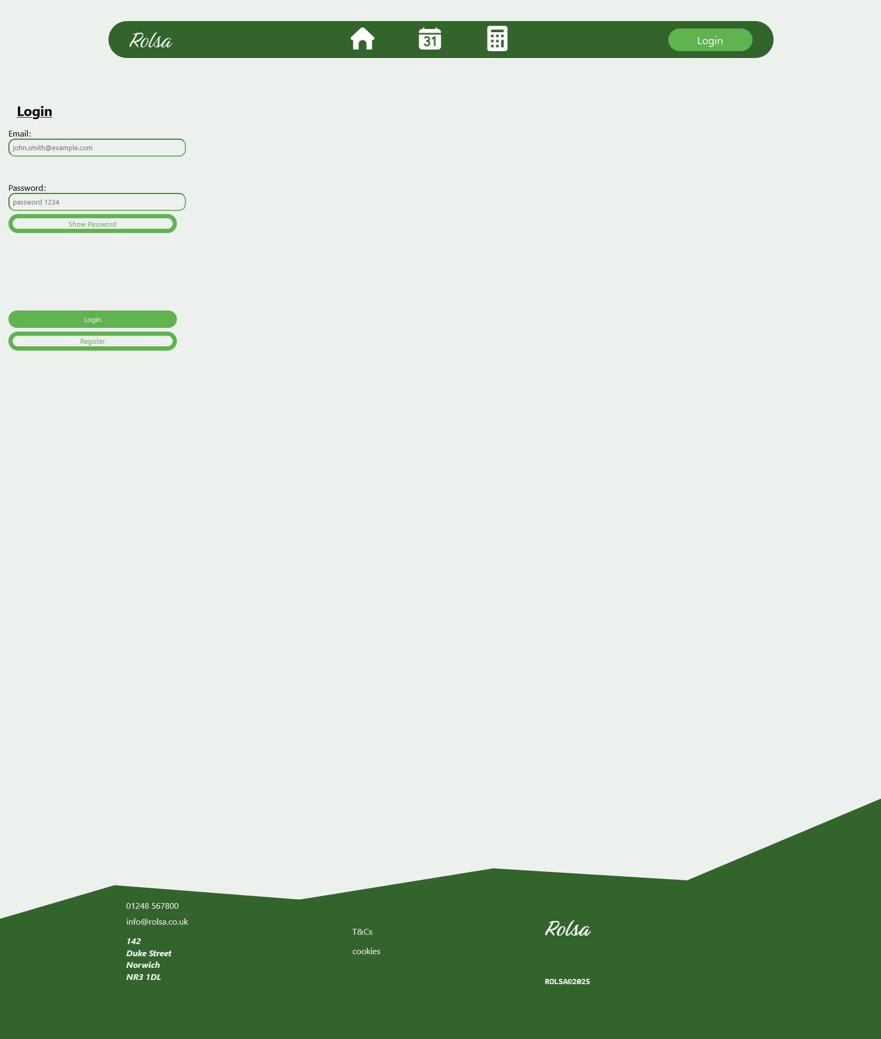
Login page
This is the page you go to after clicking the login button in the navbar.

Slide 4
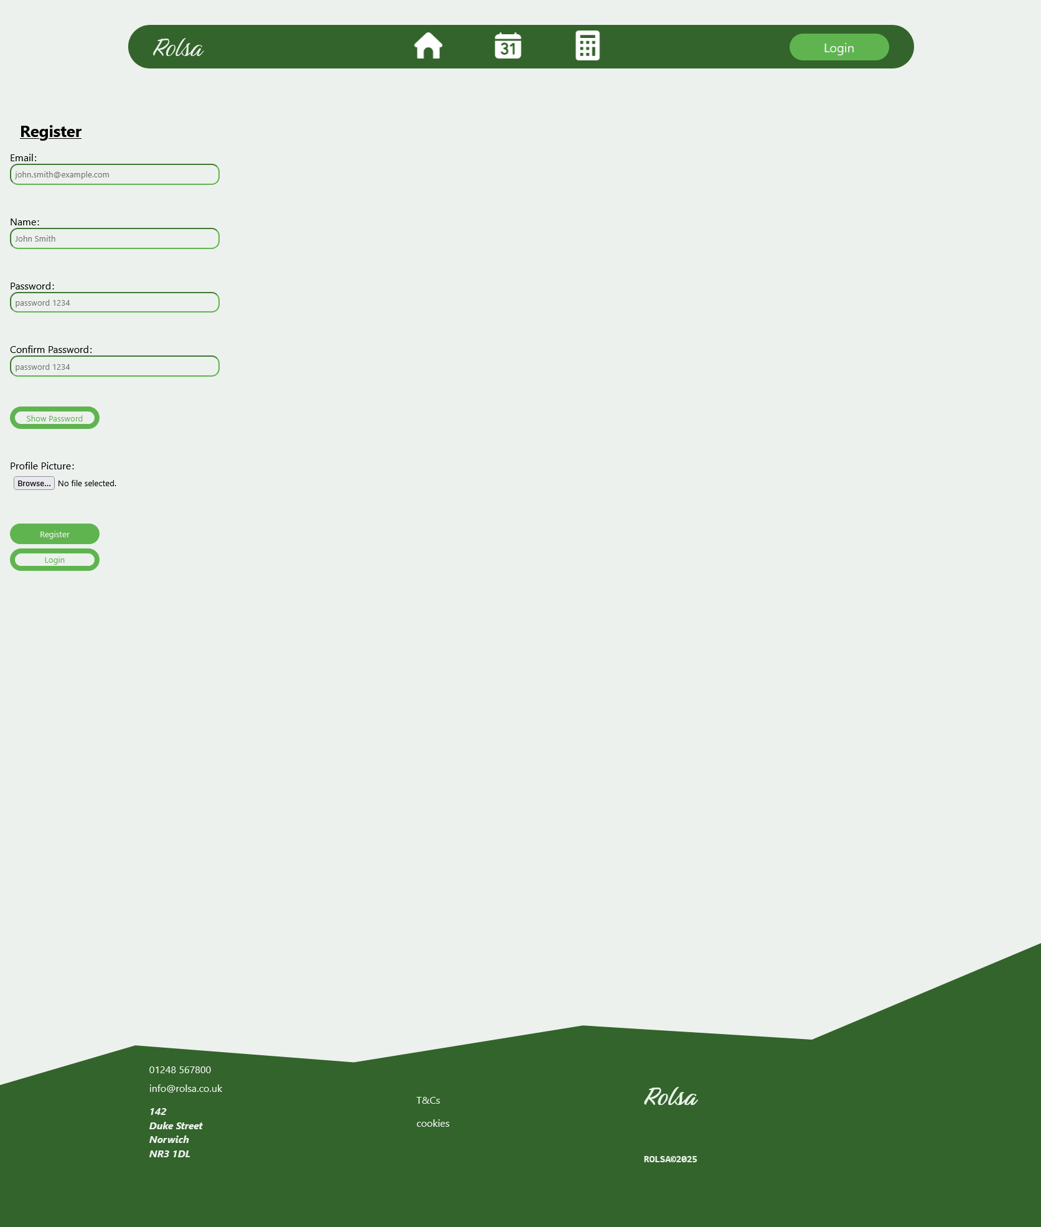
Register page
This the page you arrive at after pressing the register button on the login screen. You can go back by pressing the login button.

Slide 5
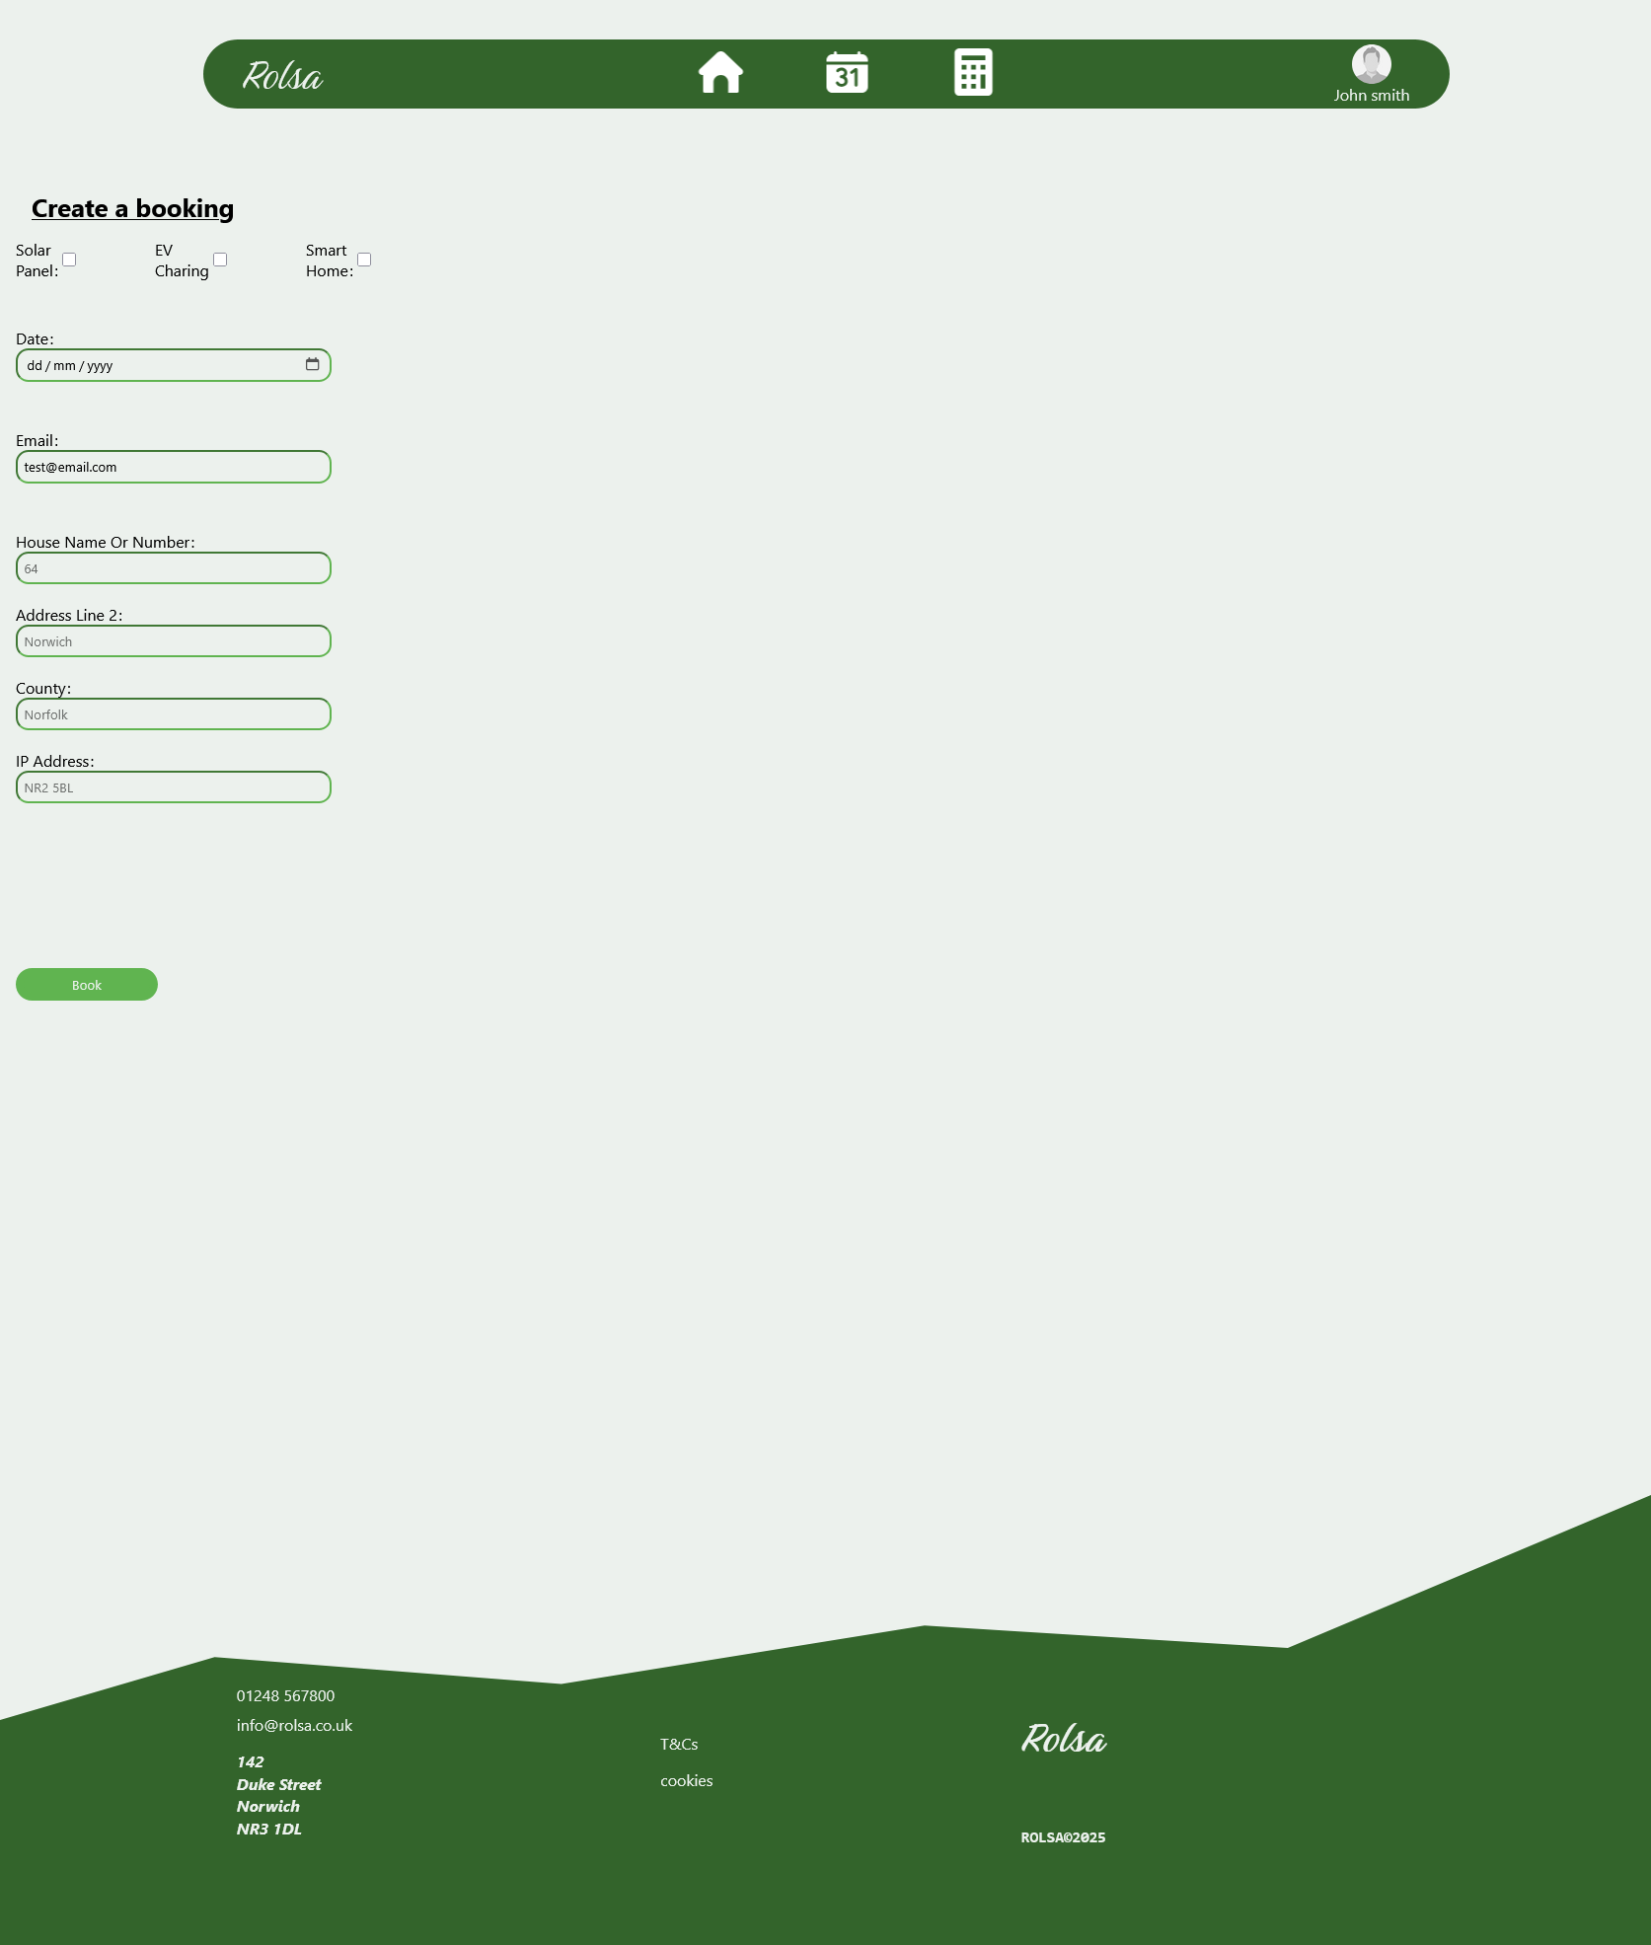
Bookings page
This the page where you can make a new booking.

Slide 6
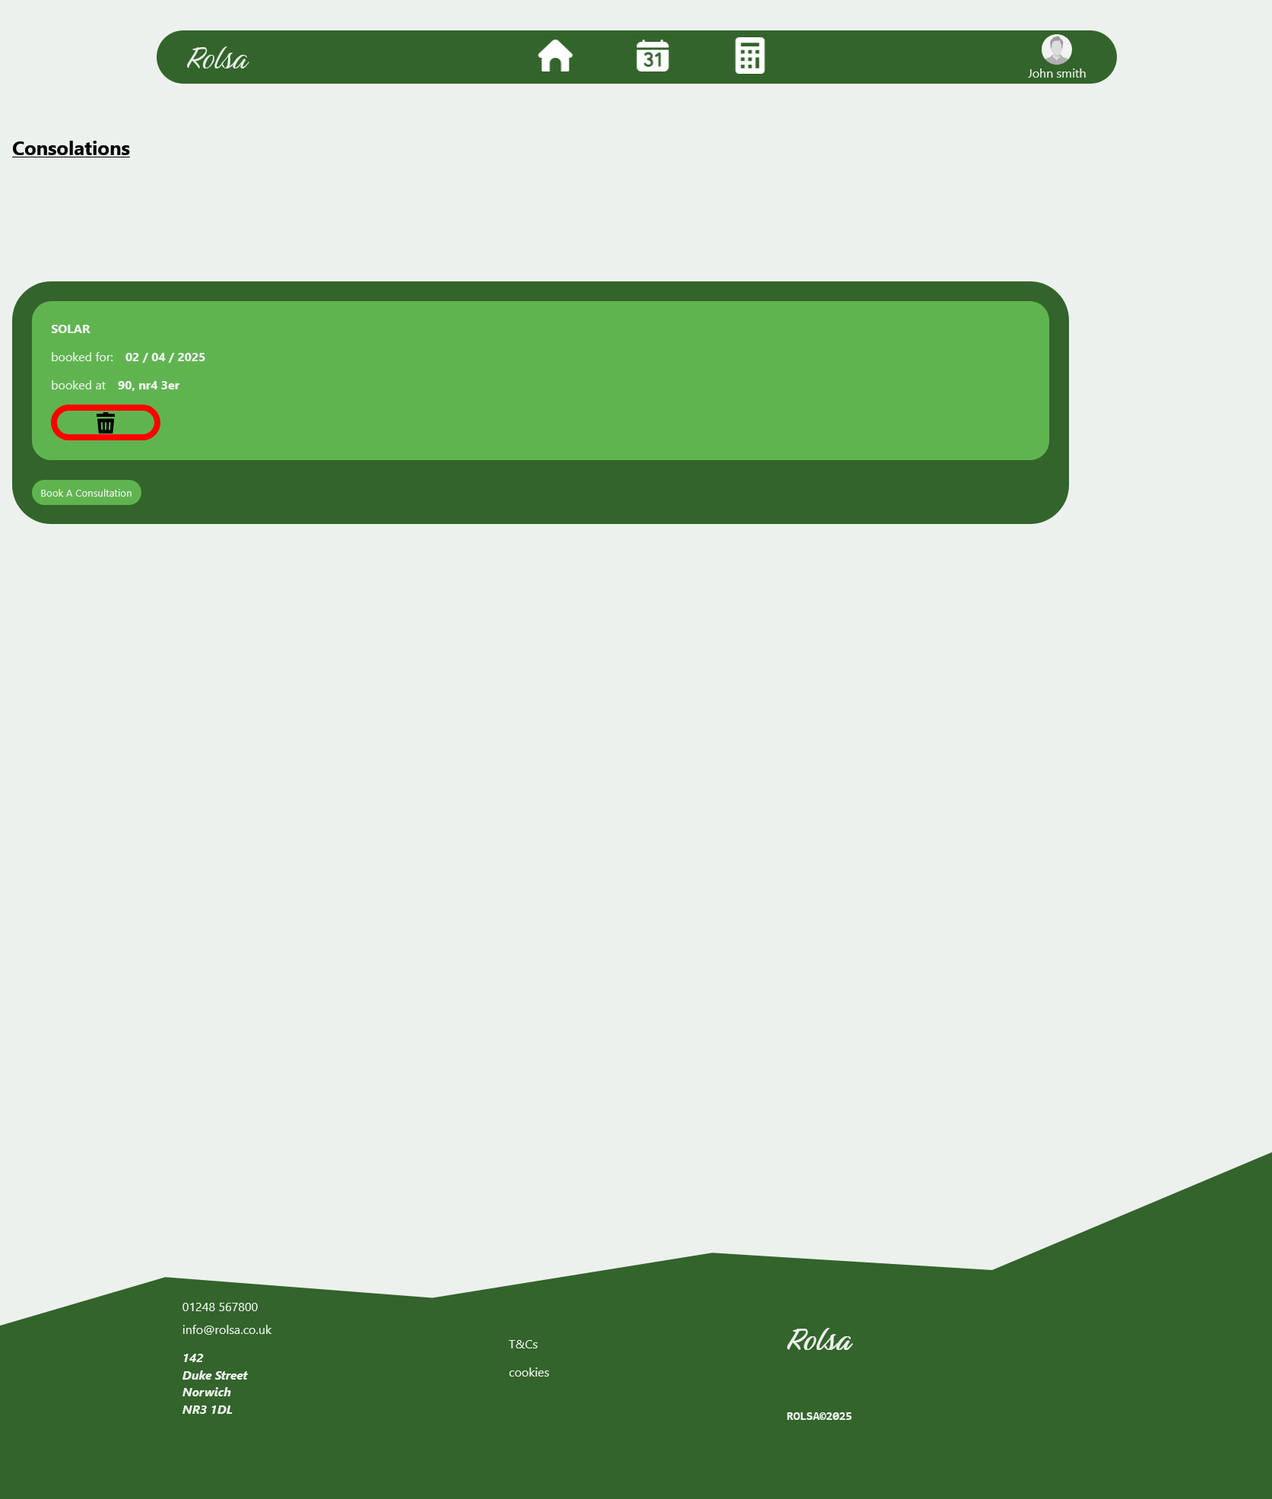
Consultations page
This is the page you get after logging in and clicking the calendar icon. This page shows you all your bookings.

Slide 7
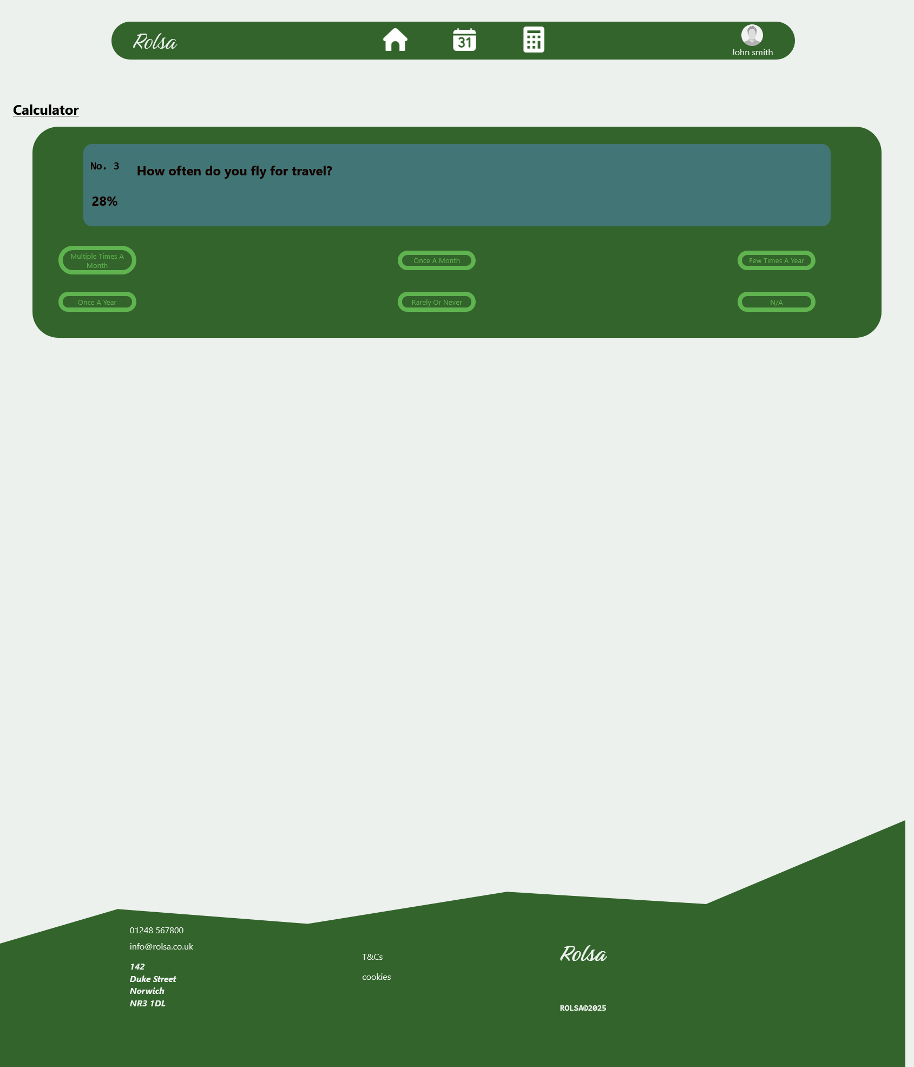
Calculator page (questions)
This the page you get after clicking on the calculator icon. This page will ask you a serries of questions and give you a carbon footprint.

Slide 8
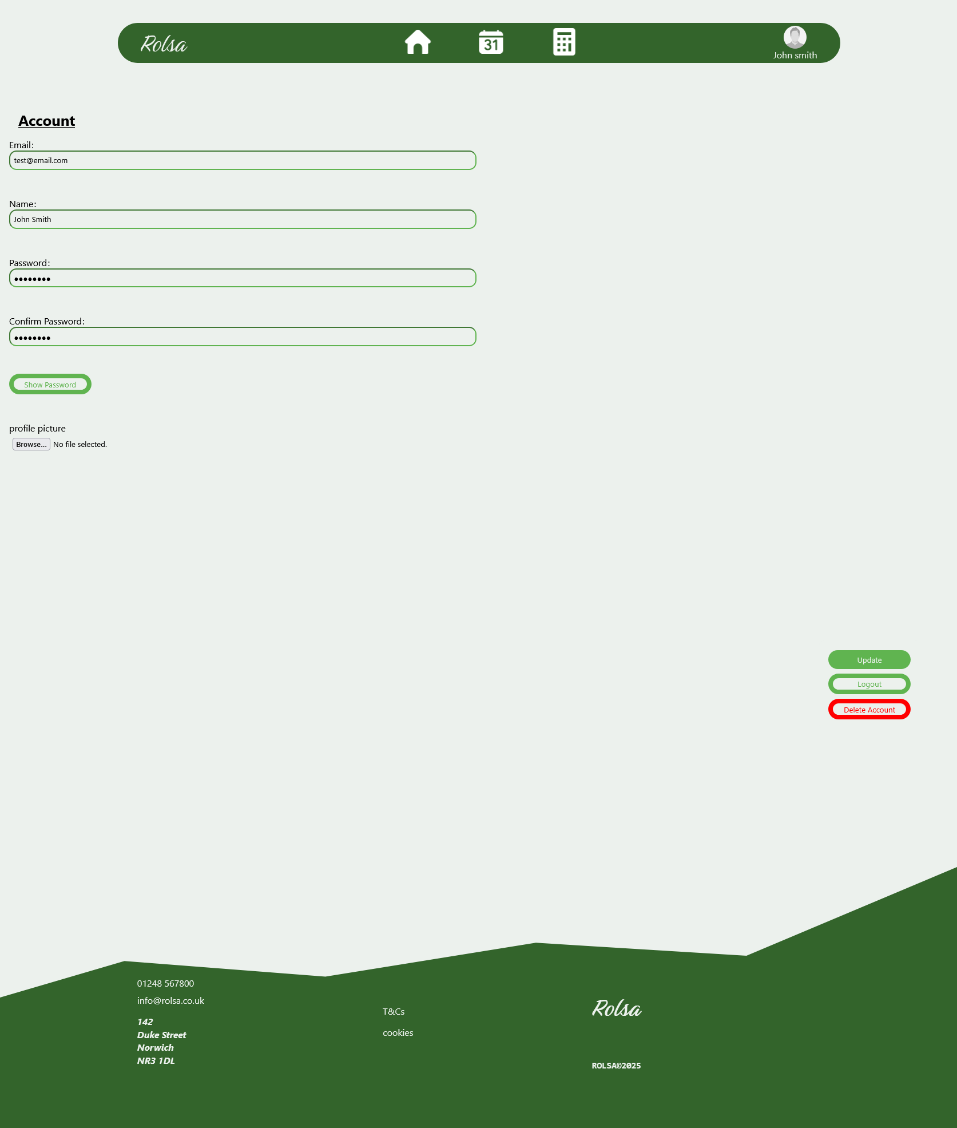
Account page
This is the page you go to after logging in and clicking your account. The buttons for update, logout, and delete are found in the bottom right of the screen and move with page.

Slide 9
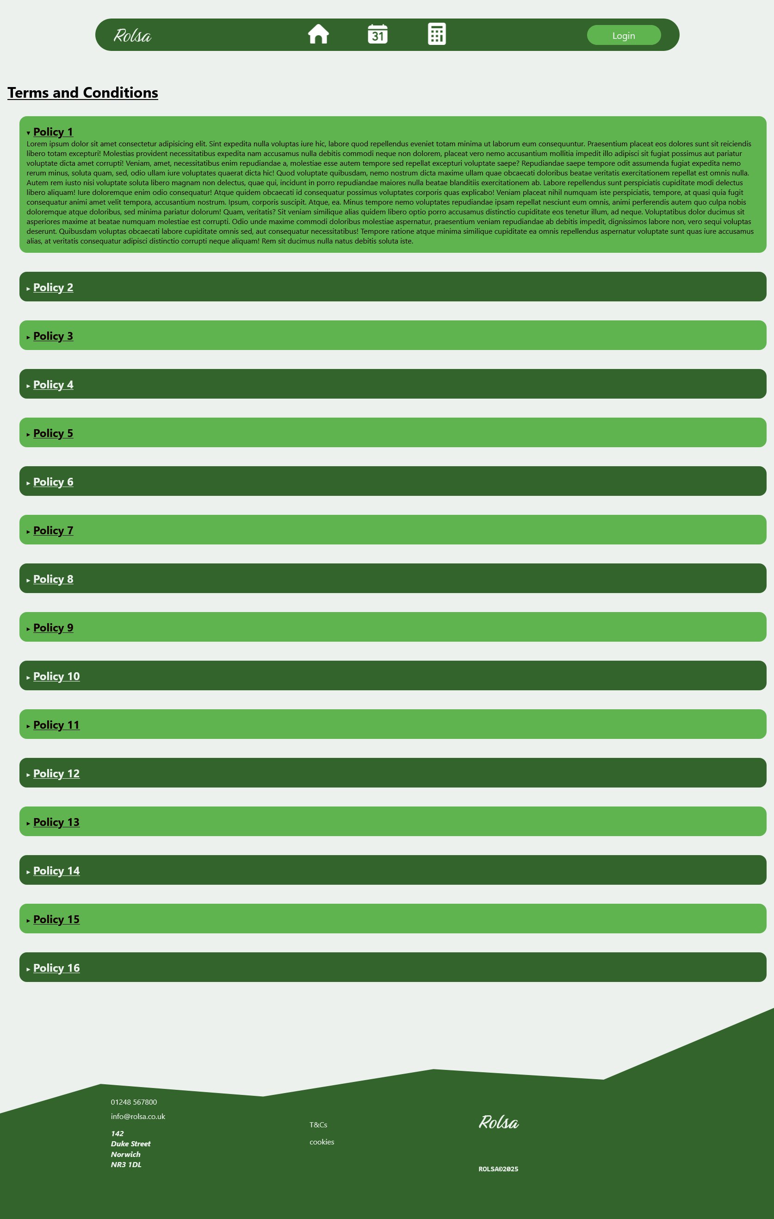
T&Cs page
This is the page you get after clicking the “T&Cs” link in the footer.

Slide 10
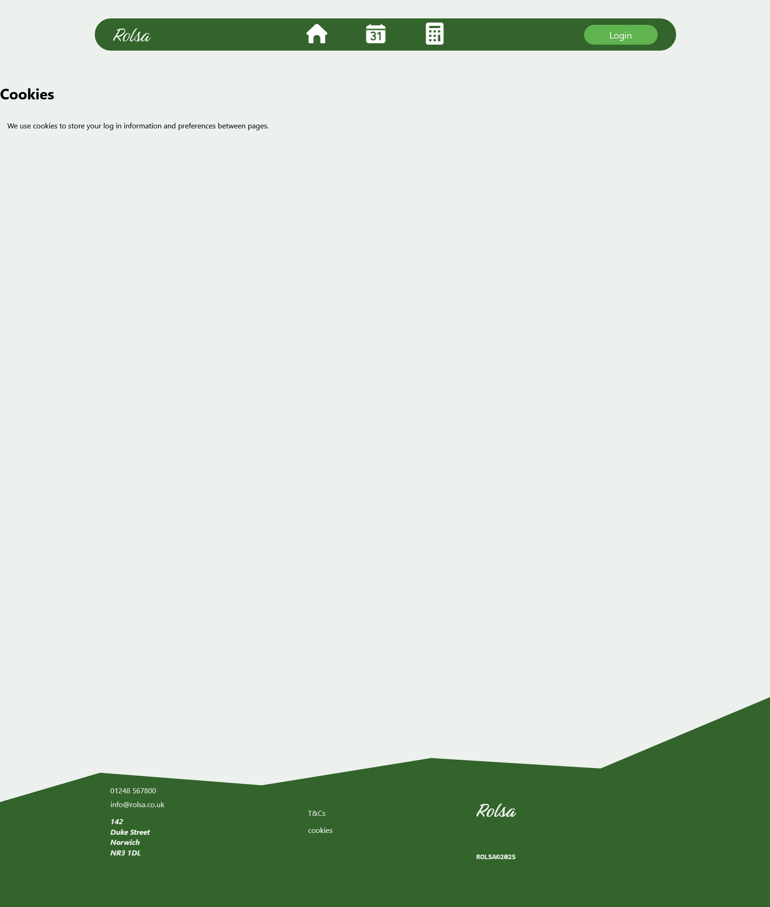
Cookies page
This is the page you get to after clicking the “cookies” link in the footer.

