Slide 1
FINAL PROJECT
Global Food
Prices 2026
From descriptive analysis to prediction
Excel
Structured checks
and pivot analysis
01
End-to-End Data Analysis & Prediction
Power BI
Star schema
& dashboard
02
Tableau
Interactive
visual exploration
03
Excel • Power BI • Tableau • Python • Machine Learning
Python
Cleaning
& EDA
04
ML
Regression
& prediction
05
Common dataset | 84,920 cleaned rows | 59 countries | 2026
NTI Advanced Data Analysis Training

Slide 2
1. Project Overview
A shared dataset, five tools, one analytical story.
Cleaned records
Countries
Original columns
Markets (Tableau)
Commodities (Power BI)
84,920
59
17
1,722
539
Project goal
Excel
Quick structured checks, PivotTables and focused charts
Power BI
Data modeling, Star Schema, DAX measures and dashboard
Study global food prices in 2026, explain the main patterns, and move from descriptive analysis to price prediction.
Tableau
Interactive dashboard, maps, trends and comparisons
Python
Cleaning logic, EDA and analytical decisions
The same WFP Global Food Prices dataset was reused across the project, while each tool answered a different part of the analytical workflow.
Machine Learning
Leakage-aware regression and model evaluation

Slide 3
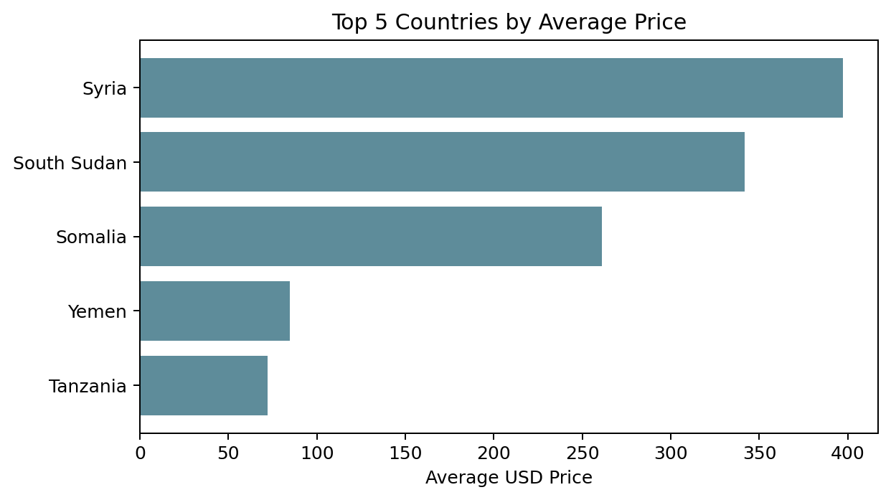
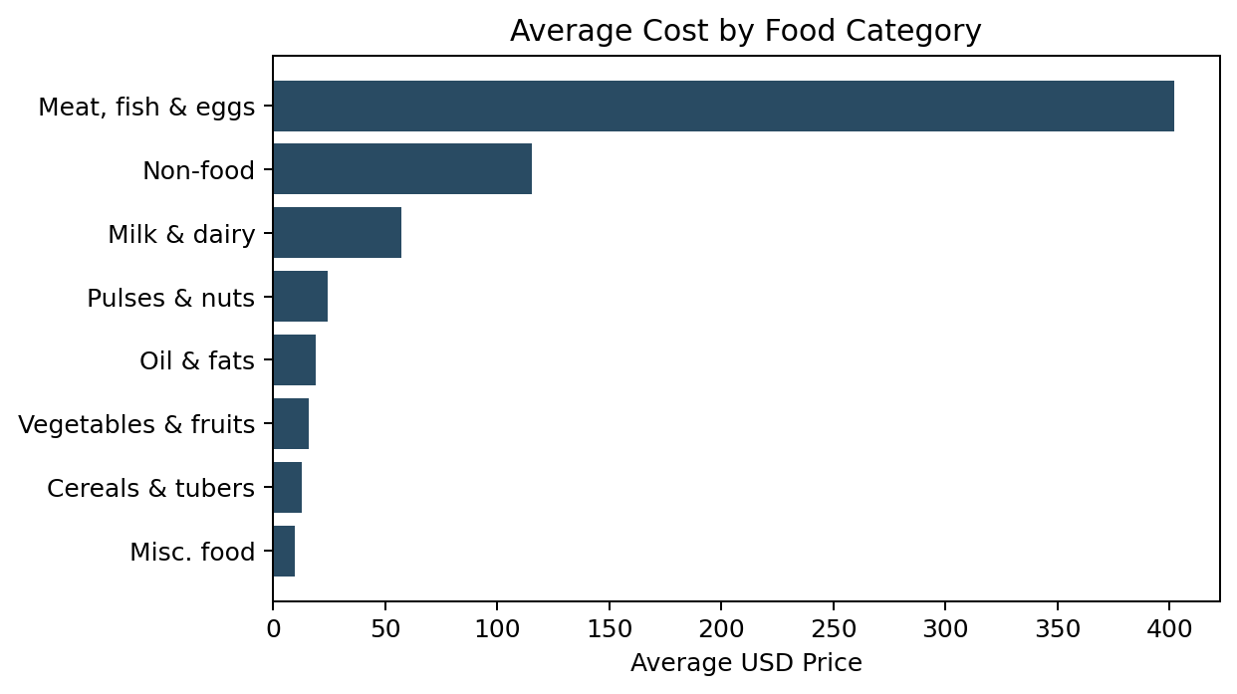
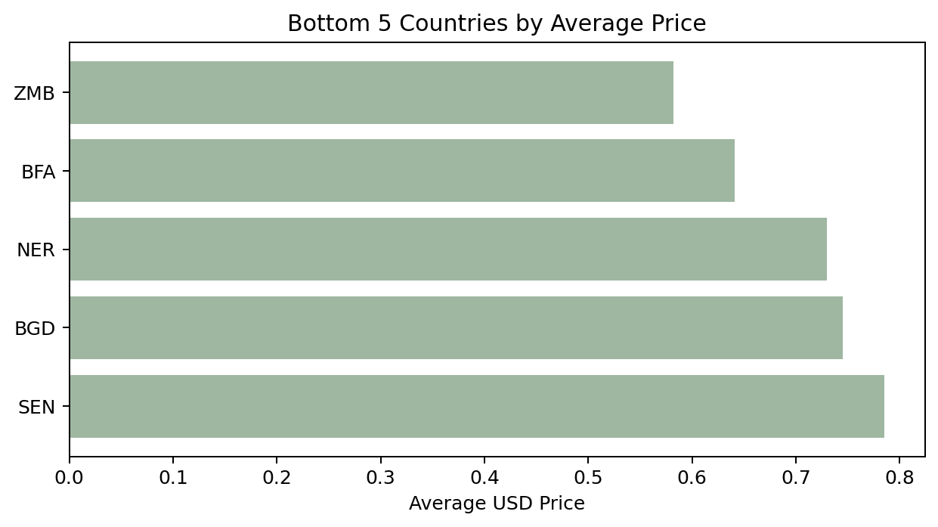
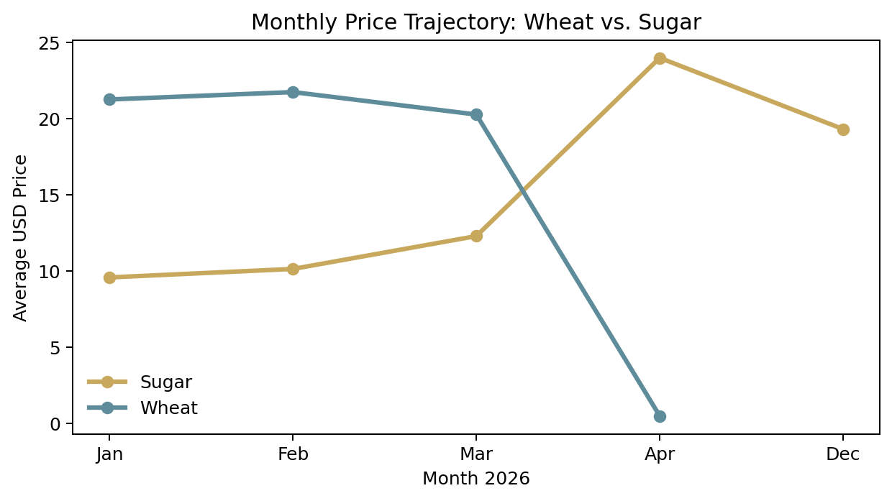
2. Excel Analysis
PivotTables and focused visual checks used to surface the first patterns.
PIVOT ANALYSIS
Used PivotTables to compare average USD prices across countries and food categories.
Built focused views for top/bottom countries and monthly price movement for Wheat vs. Sugar.
Kept the analysis simple and decision-oriented before moving into dashboarding tools.
The Excel stage acted as a compact first pass: identify where prices differ, which categories matter, and where time patterns are visible.
Source: project Excel workbook (Pivot Table + Dashboard sheets).

Slide 4
2.1 Excel – Key Findings
The first analytical layer highlighted large geographic and category differences.
Geographic spread
Category signal
Monthly movement
Top 5 countries by average price
Syria
$397
South Sudan
$342
Somalia
$261
Yemen
$85
Tanzania
$72
Meat, fish and eggs were the highest-priced category in the workbook analysis, followed by non-food and milk & dairy.
The workbook also compared Wheat and Sugar by month, showing different price trajectories across the observed months.
Bottom 5 values in the workbook were below $1 per average record, showing how widely the global price scale varies across the dataset.

Slide 5
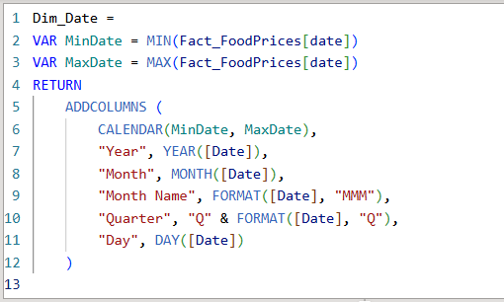
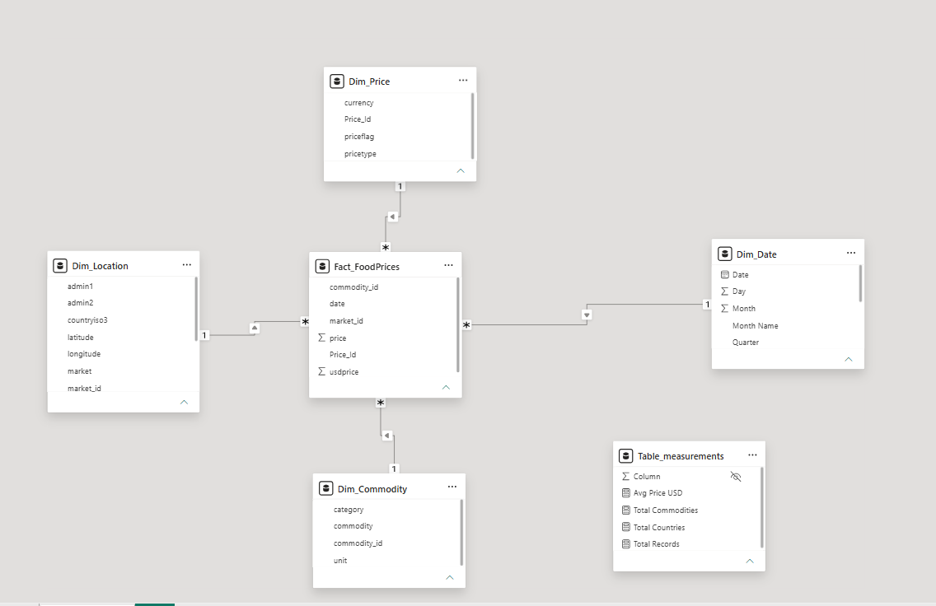
3. Power BI
From cleaned rows to a reusable analytical model.
DATA MODEL
Power Query removed records with null/empty values in key fields; the cleaned dataset contained 84,920 rows.
Built a Star Schema with Fact_FoodPrices and dimensions for Location, Commodity, Price and Date.
Created one-to-many relationships with single-direction filtering from dimensions to the fact table.
Added a measures table for Avg Price USD, Total Commodities, Total Countries and Total Records.
Star Schema
Date dimension
Continuous date range based on MinDate and MaxDate in the fact table.
DAX-generated calendar attributes support time analysis across the dashboard.
Dimensions feed the central fact table; the Date dimension provides Year, Month, Month Name, Quarter and Day.

Slide 6
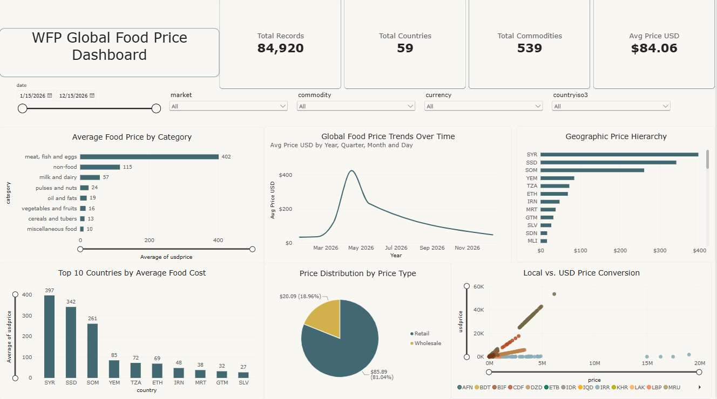
3.1 Power BI – Dashboard & Insights
Interactive filters, KPIs and multiple views connected to the Star Schema.
Dashboard KPIs
84,920 records • 59 countries • 539 commodities • $84.06 avg USD
Geographic hierarchy
Country → Admin 1 → Admin 2 → Market enables drill-down by geography.
Price story
Meat, fish & eggs averaged about $402; Syria, South Sudan and Somalia were the highest-priced countries in this dashboard view.

Slide 7
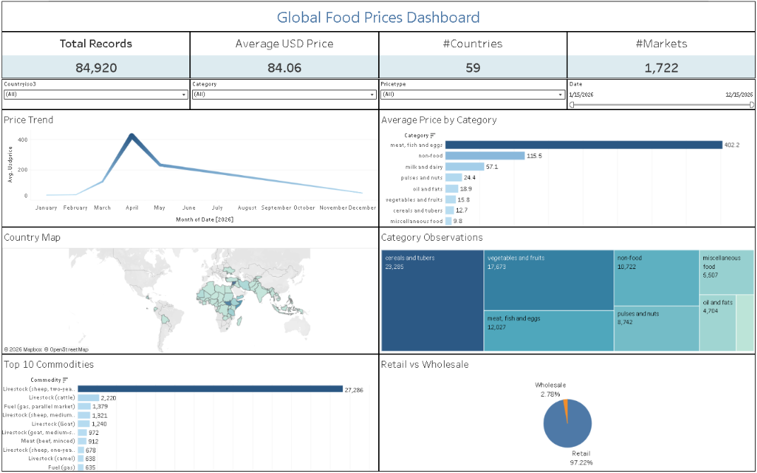
4. Tableau
A second interactive dashboard focused on visual exploration.
KPI cards • filters • price trend • category comparison • map • top commodities • retail vs wholesale

Slide 8
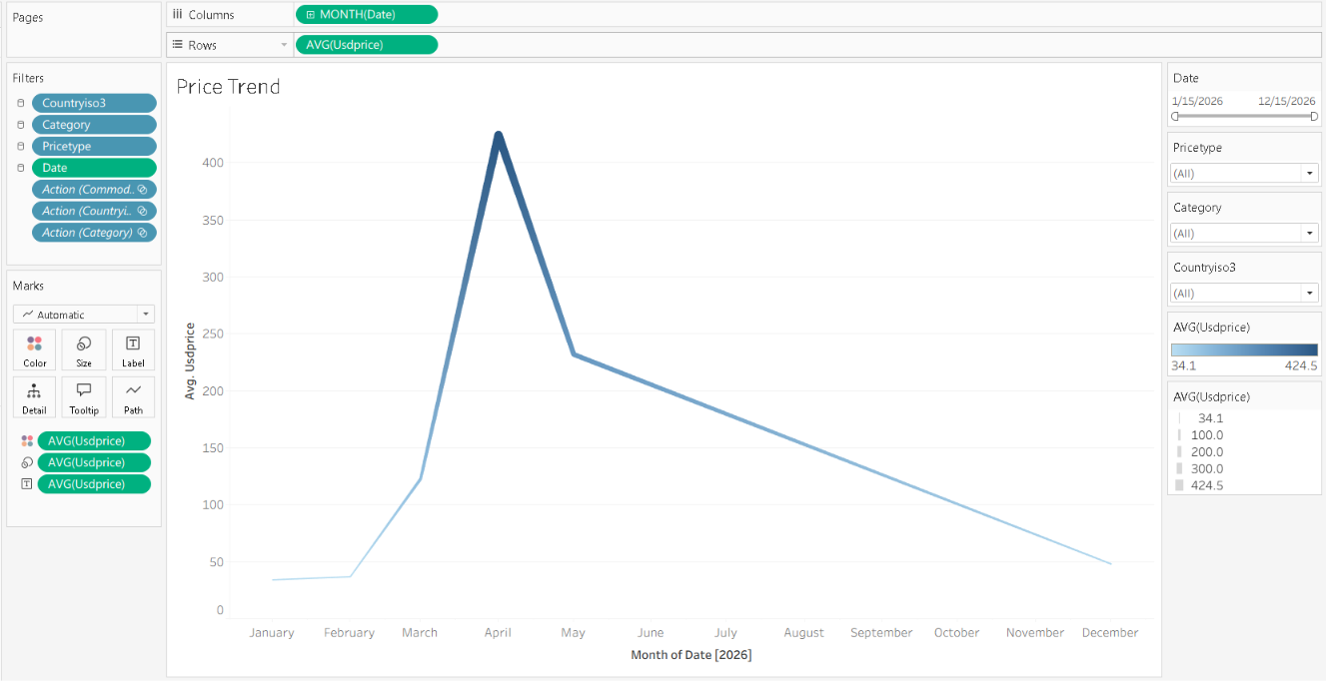
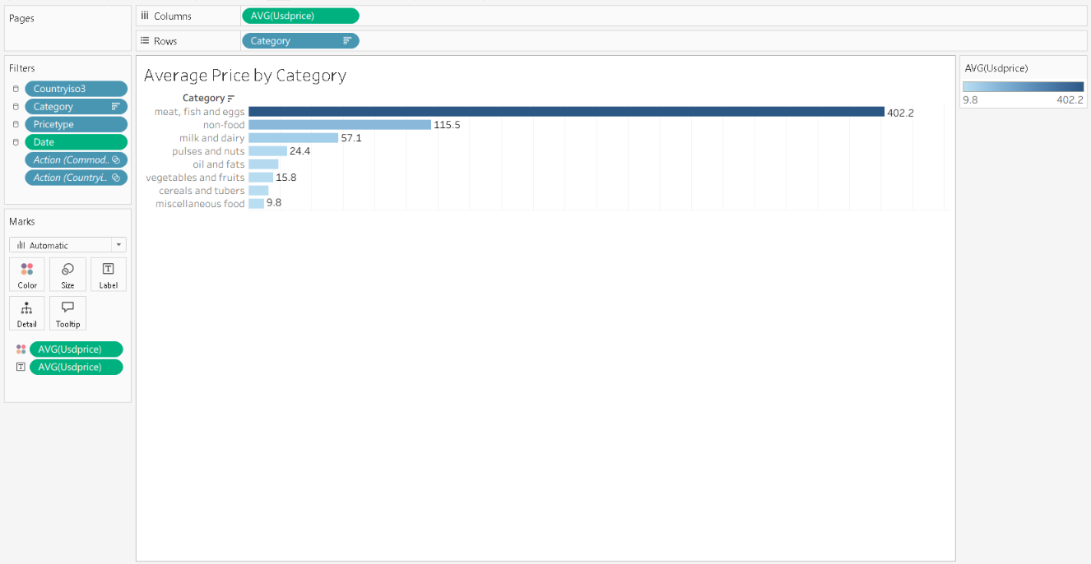
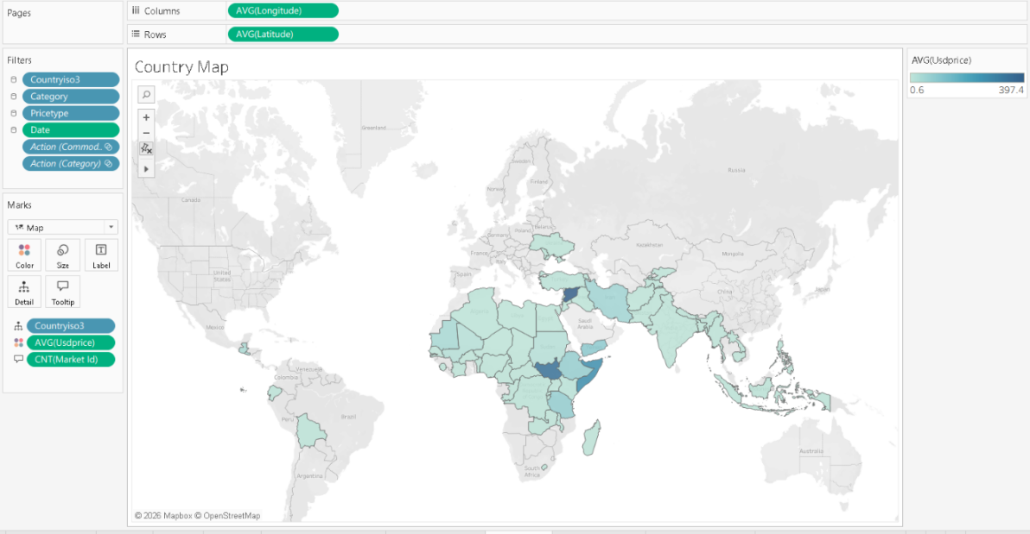
4.1 Tableau – What the dashboard makes visible
Interactive views make the patterns easier to compare and explore.
Price trend
Category
Geography
Retail vs Wholesale
Average price rises sharply in spring, then falls through the rest of the year.
Meat/fish/eggs is the highest-priced category in the dashboard view.
The map shows the concentration of sampled markets across regions.
Retail observations dominate the dataset by share.
Interactive filters used: Countryiso3, Category, Pricetype and Date.

Slide 9
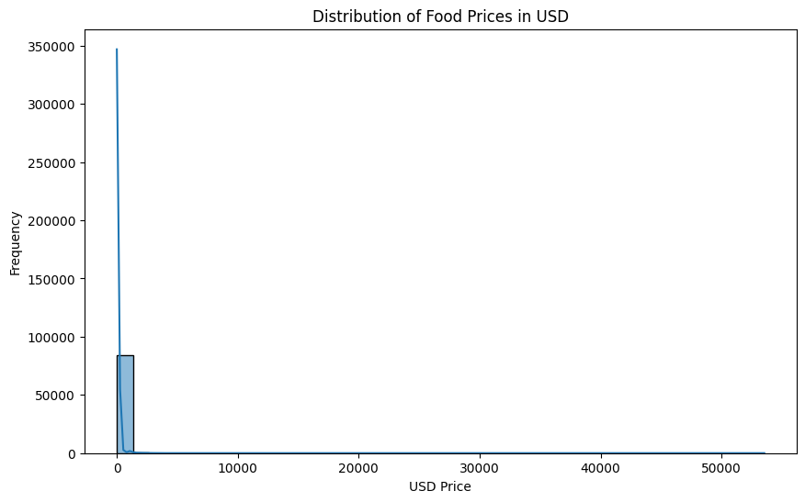
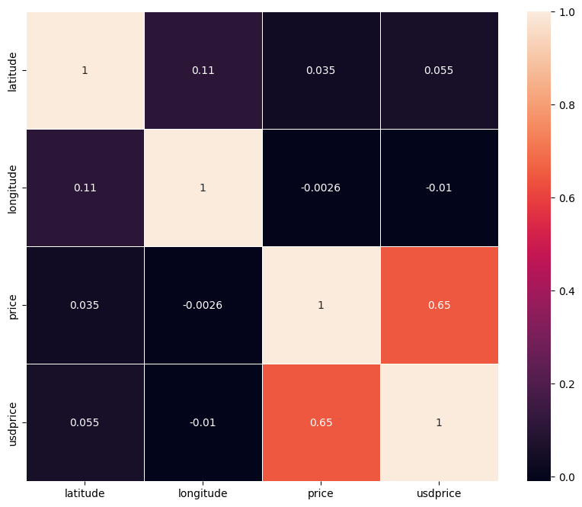
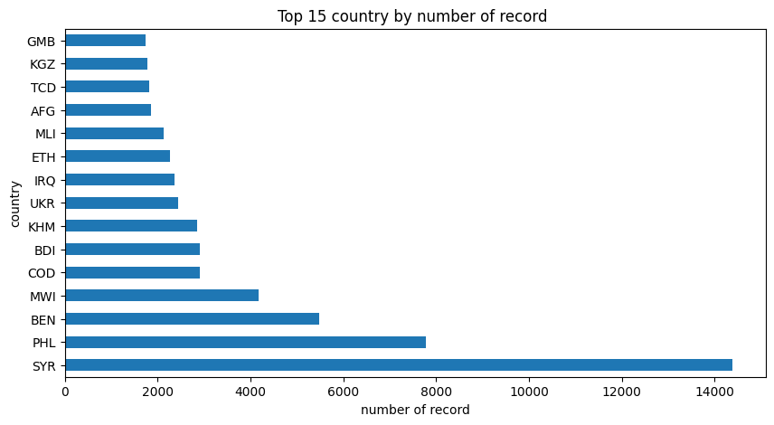
5. Python – Analysis & Data Preparation
Python provided the deeper cleaning logic and exploratory analysis.
DATA QUALITY
Checked shape, data types, missing values, duplicates and unique values.
Cleaned dataset: 84,920 rows from an original 85,289 rows.
Identified inconsistent units and filtered per-unit comparisons to KG where appropriate.
Excluded market_id and commodity_id from correlation analysis because they are reference IDs, not measurements.
Analytical choices that improved the story
• Commodity × category was highly sparse because each commodity belongs to one category.
• Commodity × month gave a more informative heatmap.
• Median price was often more robust than average when outliers dominated the distribution.

Slide 10
5.1 Python – Key Findings
The exploratory stage exposed the strongest patterns and the main data-quality caveats.
Coverage is uneven
Outliers matter
Syria, Philippines and Benin had the largest record counts in the analysis.
The USD price distribution had a long upper tail; a small number of observations strongly affected means.
Category hierarchy
Price over time
Cereals & tubers and vegetables & fruits made up almost half of the records.
Some categories showed sharp spikes in spring 2026, with much flatter levels in other months.
Python was the layer where the team challenged the data first, so later dashboard and ML decisions could be based on a cleaner analytical foundation.

Slide 11
6. Machine Learning – Problem Setup
Moving from “what happened?” to “can we predict the price?”
ML rows after filtering
Target
Target scale
Observation dates
Test size
41,944
usdprice
USD / kg
5
20%
Modeling population
Feature design
Leakage control
unit = KG
pricetype = Retail
priceflag = actual
Country • Admin 1 • Admin 2 • Market
Category • Commodity • Month
(+ fixed pipeline fields)
GroupShuffleSplit
Groups = country + market + commodity
33,552 train rows | 8,392 test rows
14,057 train groups | 3,515 test groups
Overlapping groups = 0
Excluded: local-currency price, reference IDs, and coordinates in the final feature matrix.
The filter creates one consistent measurement basis and keeps actual retail price observations.

Slide 12
6.1 ML – Model Development & Experiments
The final model came from controlled comparisons, not from choosing one algorithm at the start.
Target transformation experiments
Model / target
MAE
RMSE
R²
Decision
Linear + log
3.0694
15.6676
0.9492
Retained
Linear + raw
10.8312
28.9535
0.8264
Not used
Basic XGB + log
2.7623
15.5449
0.9500
Not used
Basic XGB + raw
2.3594
11.3357
0.9734
Retained
Tuned XGB + log
2.5256
14.3848
0.9571
Not used
Tuned XGB + raw
2.2316
11.2245
0.9739
Retained
Alternative model tested: CatBoost Regressor → MAE 2.8425 | RMSE 16.0394 | R² 0.9467 → not retained in the final notebook.
Key decision: log transformation helped Linear Regression, while XGBoost performed better on the raw price target.

Slide 13
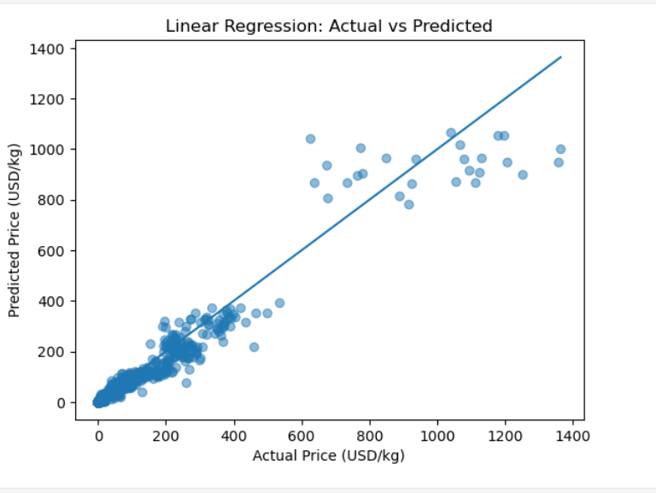
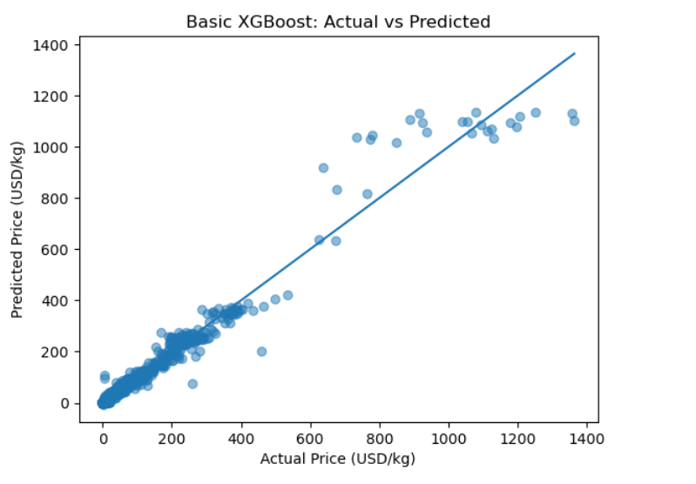
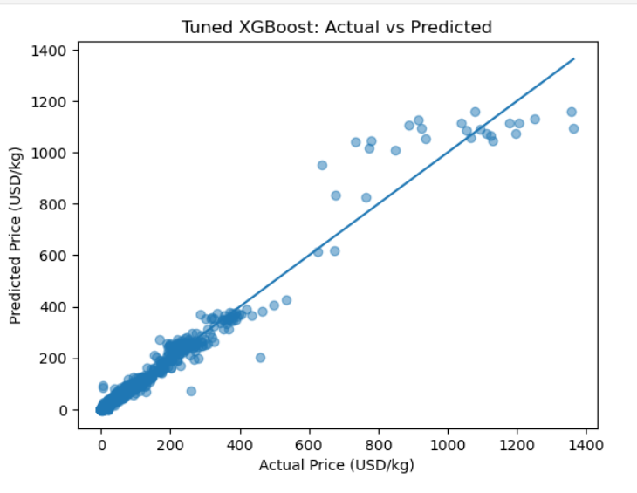
6.2 ML – Final Results
All final metrics are reported on the original USD/kg scale using the same held-out test set.
Final comparison
Model
MAE
RMSE
R²
Linear Regression
3.0694
15.6676
0.9492
Basic XGBoost
2.3594
11.3357
0.9734
Tuned XGBoost
2.2316
11.2245
0.9739
MAE: average absolute error
RMSE: penalizes larger errors more strongly
R²: proportion of variance explained
Linear Regression
Basic XGBoost
Tuned XGBoost
Tuned XGBoost reached MAE = 2.2316 USD/kg, RMSE = 11.2245 USD/kg and R² = 0.9739.

Slide 14
7. Final Takeaway
The project combines descriptive analysis, modeling, and prediction into one workflow.
01
Excel
Found the first geographic, category and monthly signals.
02
Power BI
Built a Star Schema and interactive dashboard for structured exploration.
03
Tableau
Added a second interactive view focused on trends, maps and comparisons.
04
Python
Validated data quality and refined the analytical choices.
05
Machine Learning
Converted the descriptive problem into a regression task and achieved R² = 0.9739.
Current ML task: price prediction, not time-series forecasting, because the filtered ML dataset contains only five observation dates.
Thank you

