Slide 1



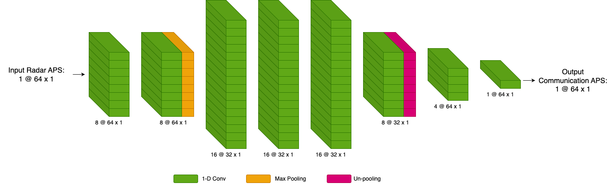
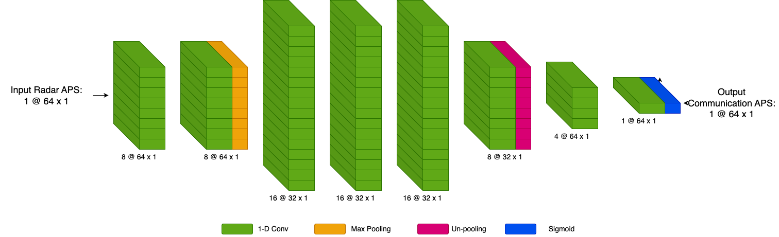
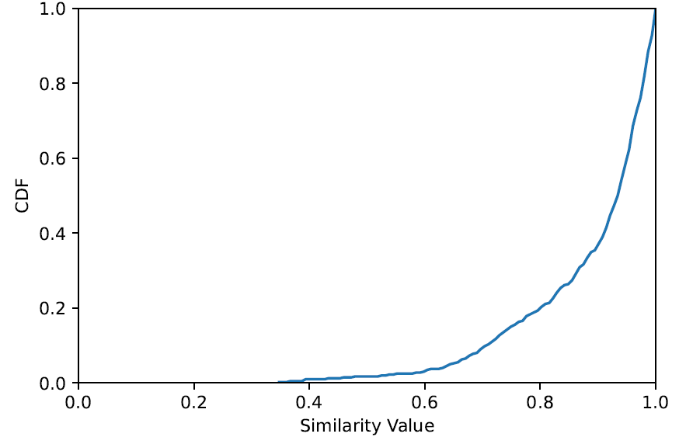
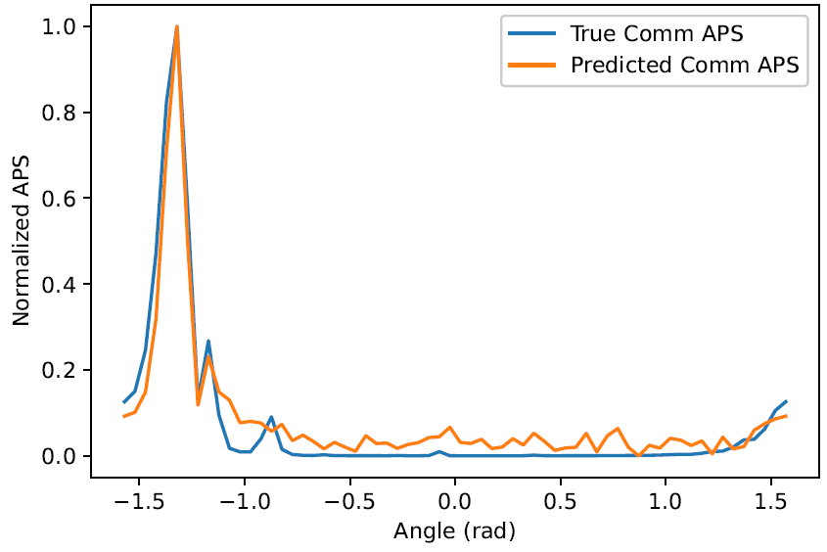
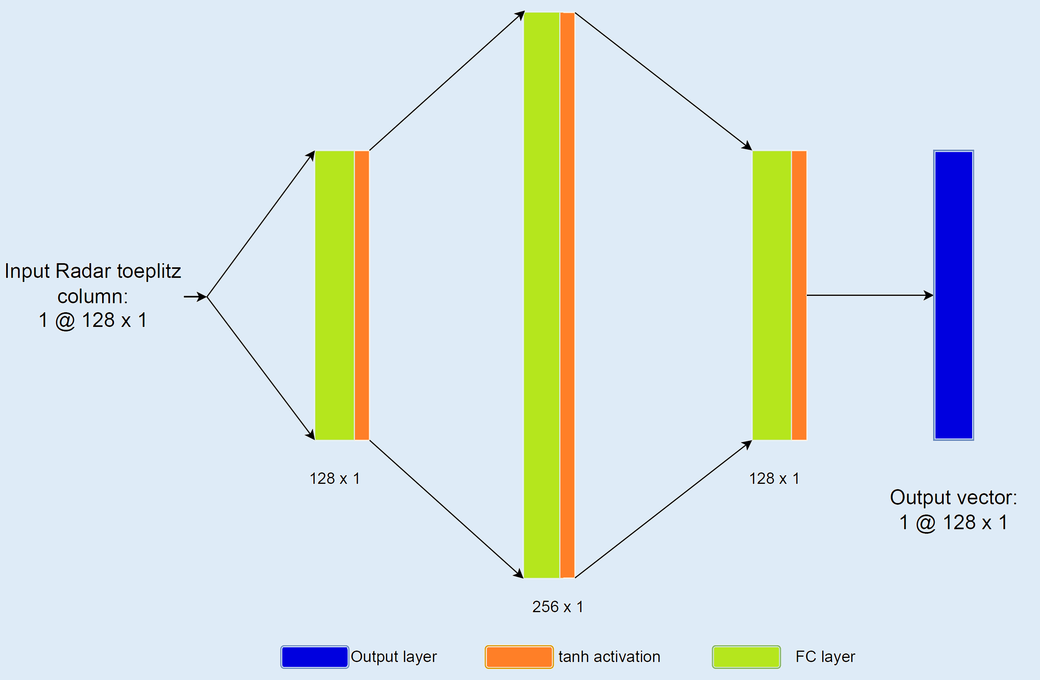
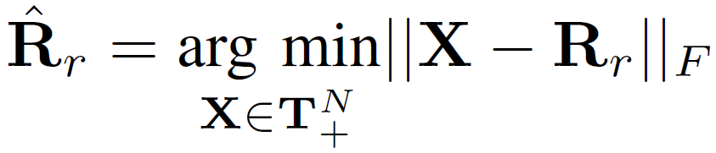
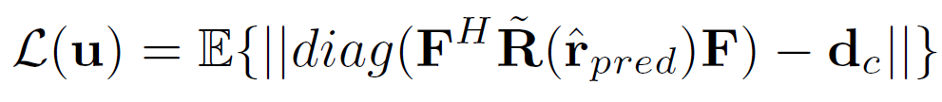
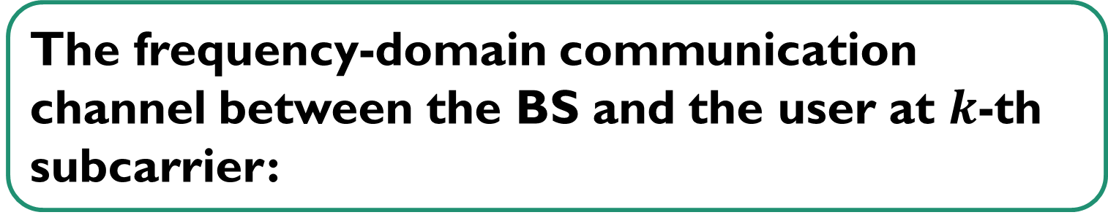

Deep Learning for Radar-aided mmWave Vehicular Communication Systems
ECE 792-061
Spring 2023
Murat Bayraktar, Bibhor Kumar, Ermek Belekov
Vehicular communication system with a base station (BS) and a passive radar are collocated at the roadside
The frequency-domain communication channel between the BS and the user at $k$-th subcarrier:
The vehicles are equipped radar transmitters and communication receivers
Radar
Received signal at the passive radar for $I$ samples:
The radar and communication channels between the vehicle and the roadside unit share similar dominant angles
Communication covariance:
Radar covariance:
BS
In order to reduce the channel estimation overhead at the BS, the spatial covariance observed at the passive radar can be utilized
Angular power spectrum (APS):
DFT matrix
Ground truth
Data
Architecture
APS based prediction (Phase I)
Results
Encoder-Decoder structured architecture was used
MaxPooling layers extracted the local features of the radar APS
UnPooling layers are employed to reconstruct the communication APS
LeakyReLU activation function was used to mitigate vanishing gradient problem
APS prediction network captured the location of peak in the true communication APS with similarity value of 0.998
APS prediction network could not capture the mismatch between the radar and communication APS with similarity value of 0.759
Hyperparameter tuning with the dense output layer
Improved APS based prediction (Phase II)
Optimized model
Good APS estimate:
Similarity value = 0.98
Bad APS estimate:
Similarity value = 0.84
Faster convergence and lower loss achieved with the addition of a dense layer at the output (model 3)
The similarity value that shows the accuracy of the estimation for the peak regions is improved with the dense layer
Various number of layers, optimizers, loss functions, number of epochs and validation are used to further optimize the network
SUMMER
Architecture
Toeplitz-projection based prediction (Phase II)
Results
Motivation
APS computation provides limited info. of the received signal
Cannot use the full size of covariance matrix
Toeplitz completion
Loss function
Input – Real and imaginary parts of Toeplitz vector
Output – Toeplitz vector of communication channel
More than 50% of the cases have
similarity value greater than 0.9
True and predicted communication APS coincides with Similarity value of 0.98
Toeplitz-projection method provides much better results than APS based prediction

