Slide 1
Automated Document Upload using Redcap API

Slide 2
RESTful Application Programming Interface (API)
Specifies how web resources are accessed using stateless operations
Used for interoperability between systems
Request is made to a resource URI using HTTP
Response is returned in JSON, XML, HTML format

Slide 3
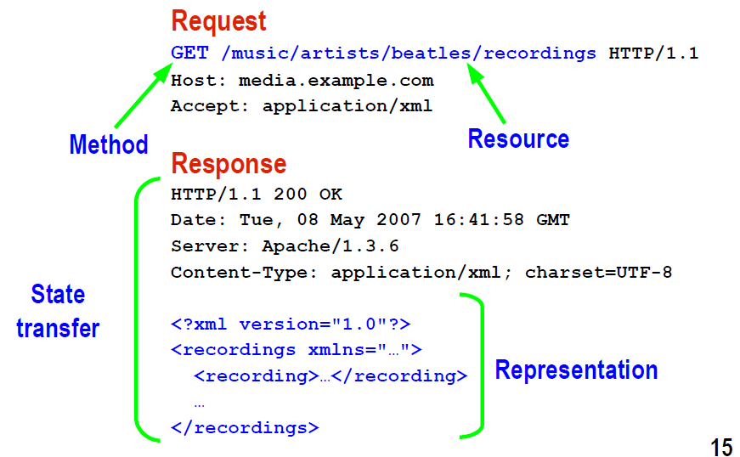
REST API request/response Example
http://www.javapassion.com/webservices/RESTPrimer.pdf

Slide 4
Need for REST API Use
Data is generated using propriety software
Closed source software scheme (i.e. does not allow automation)
We need a way to automate data import into Redcap
This can be achieved by building a web application in which the backend makes REST request to Redcap API
Redcap provides sets of API’s to achieve this.
Request is made to update data
Response is returned (status OK)

Slide 5

Implementation
I want to import my data to RedCap
Web Interface
Rest API request to upload (containing File to upload)
upload csv
Response
Client
Redcapi API Endpoint

Slide 6
Implementation (cont’d)
User trying to upload data to Redcap visits Web API developed using Redcap API in the backend.
Web API makes a HTTP POST request using data as input parameter.
Request made is evaluated by Redcap server and a response is returned (OK, DENY etc).

Slide 7
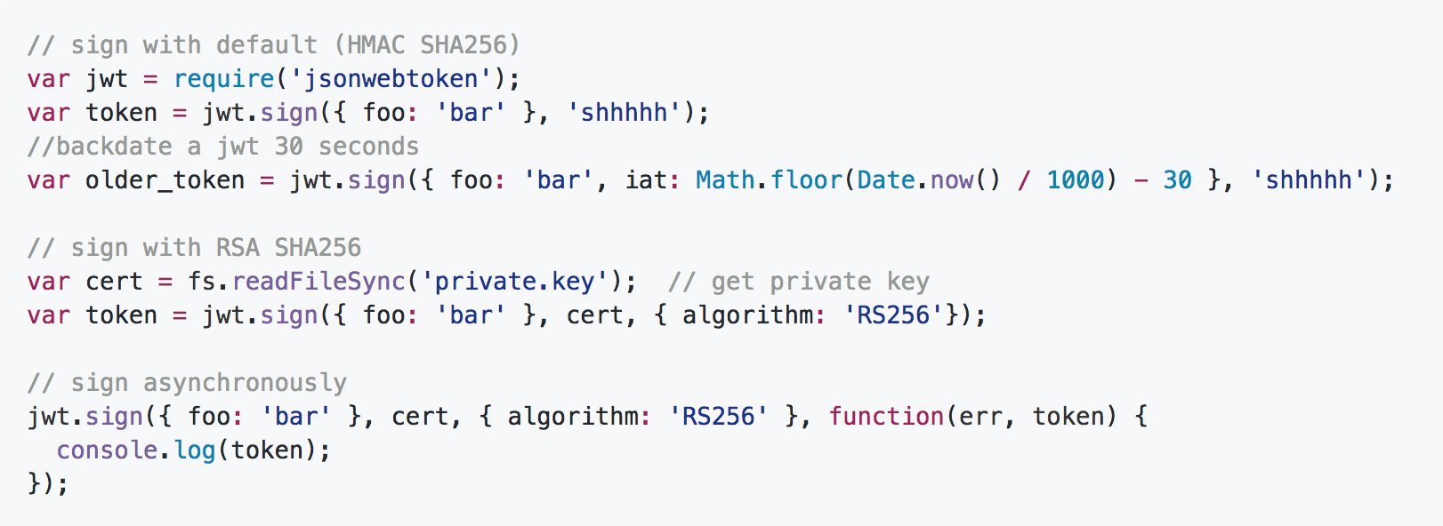
Authentication
To authenticate Redcap login, user request token from admin
Token is a string with an expiry time used for authentication
Token generated must be kept secret at all times!
Code Snippet for Web Token Authentication

