Slide 1
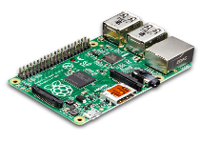
Normal System behavior
Learning Phase
IoT Device
Graph Similarity
Detection Phase
Anomaly

Slide 2
Normal System behavior
Learning Phase
IoT Device
Graph Similarity
Detection Phase
Anomaly

Slide 3
c
A
c
B
A
o
D
g
v
k
E
C
c
E
v
x
g
C
A
B
E
w
g
(a) Learning Phase
(b) Detection Phase

