Slide 1
10647452
Switching and Routing project 2018/2019
Prof. Guido Maier
Ph.D. student Sebastian Troìa
10647452
10647452)
10491234
DYNAMIC TRAFFIC LOAD BALANCING
Emmanuele Benedetto, 10520167
Ilaria Campagna, 10491234
Fabio Carminati, 10526562
Dhiraj Bhasin 10512720

Slide 2
Outline
Introduction
EdgeStats class
Controller
Plot
Testbed

Slide 3
Introduction
Load balance the traffic based on link parameters or load on a switch
When a new flow has to be routed, we look for the shortest path between the sender and the receiver in order to distribute flows among the network and avoid overloaded links
Links statistics are constantly monitored
If a link exceeds a certain threshold, the controller looks for the flow which is using more bandwidth between those with the lower DSCP

Slide 4
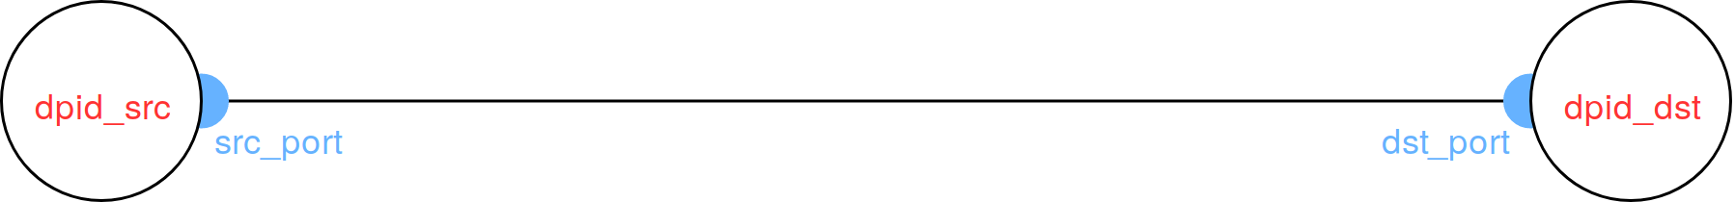
EdgeStatsClass - Attributes
link = (src_dpid, dst_dpid)
src_port
dst_port
match_to_stats / src_port_stats
throughput
mean_troughput
prev_tx_byte
curr_tx_byte
prev_alive_time
curr_alive_time
time_interval
throughputs_array

Slide 5
EdgeStatsClass - Methods
initialize_port_dict
add_match_to_edge
remove_match_from_edge
retrieve_value
update_weight_from_FlowStatsReply
update_weight_from_PortStatsReply
extract_fields

Slide 6
Controller - Constants
DEFAULT_WEIGHT
NUMBER_OF_SWITCH_PORTS
SLEEP
WAIT_FOR_STATISTICS
SLEEP_TH
LINK_THRESHOLD
MAX_RTT_ADMITTED
MIN_FLOW_BW

Slide 7
Controller - Methods
_monitor
_request_flow_stats / _request_port_stats
flow_stats_reply_handler / port_stats_reply_handler
_monitor_threshold
reallocate_flow
choose_match
switch_features_handler
_packet_in_handler
_mac_learning
_handle_ipv4_packets
restart_pkt_in
add_flow
flow_removed_handler

Slide 8
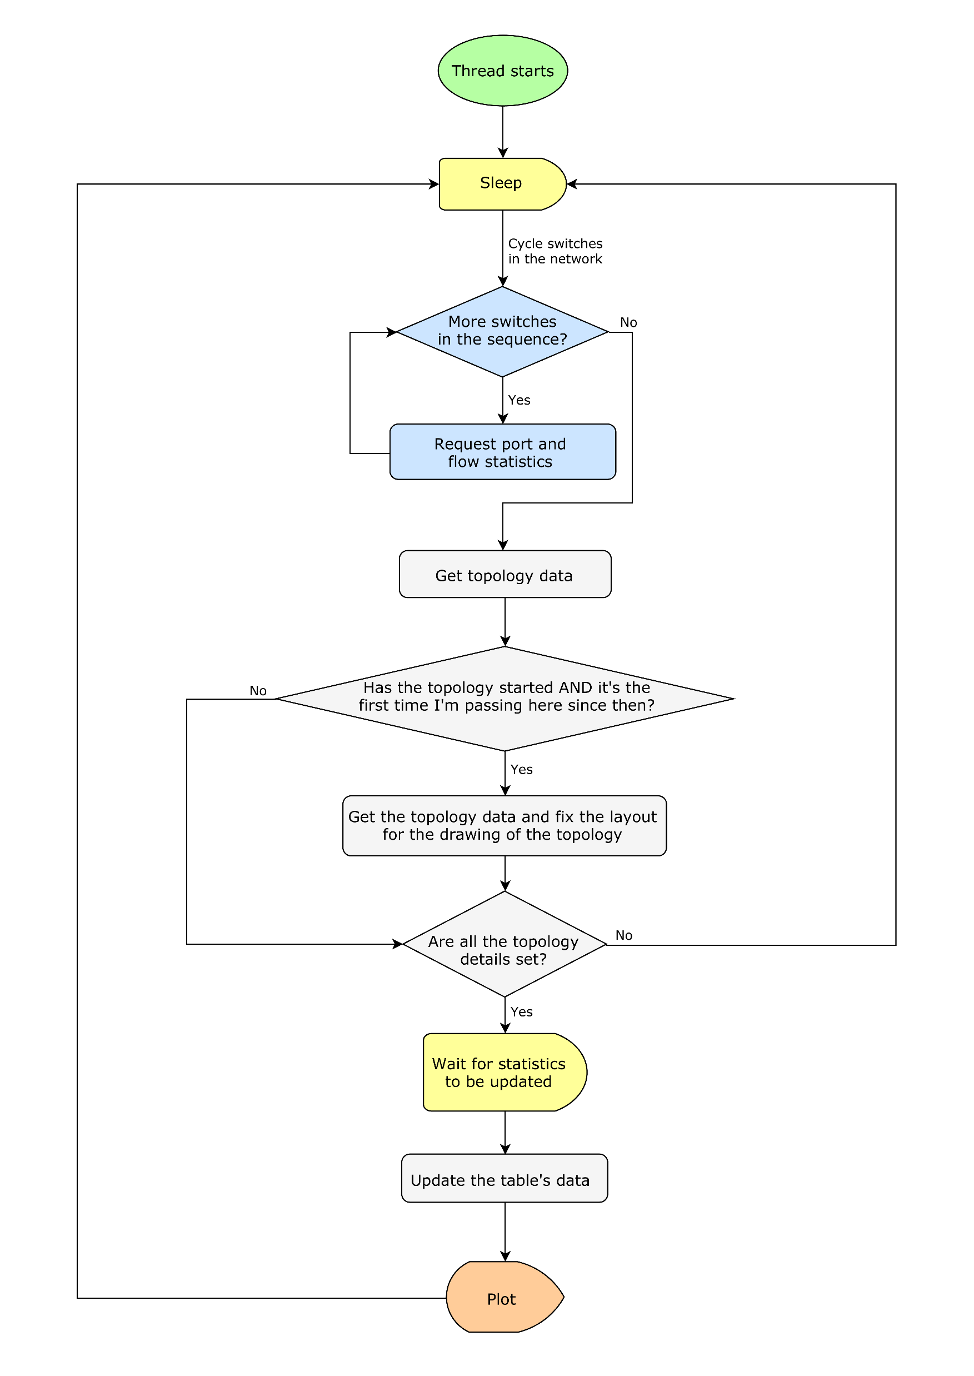
Controller - Monitor

Slide 9
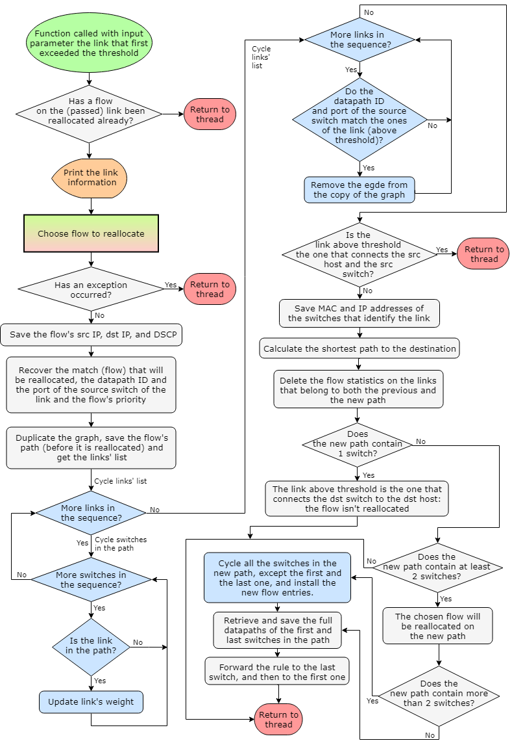
Controller - _reallocate_flow

Slide 10
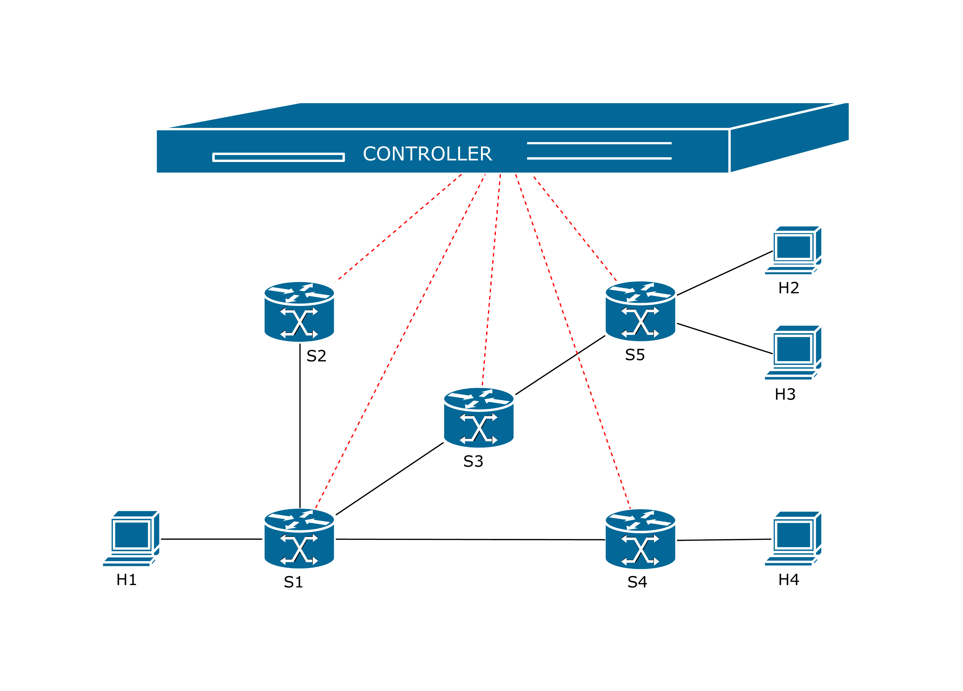
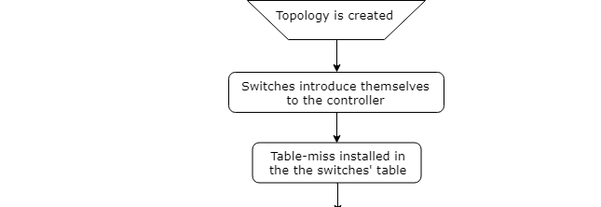
Controller - _packet_in_handler

Slide 11
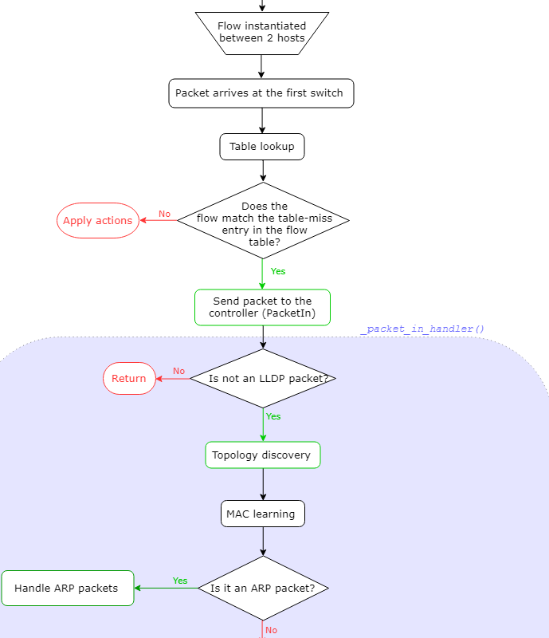
Controller - _packet_in_handler

Slide 12
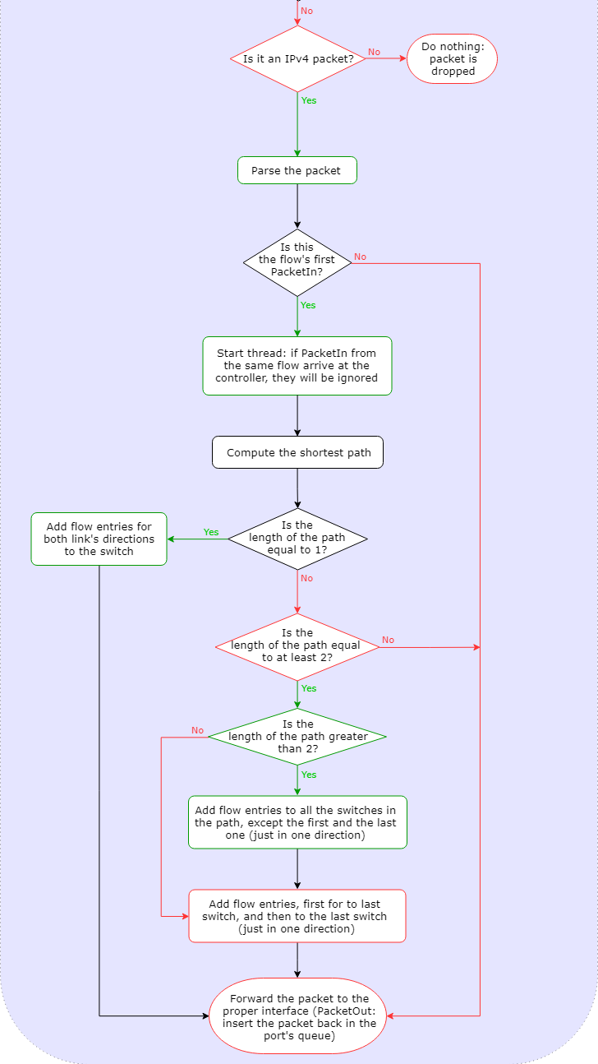
Controller - _packet_in_handler

Slide 13
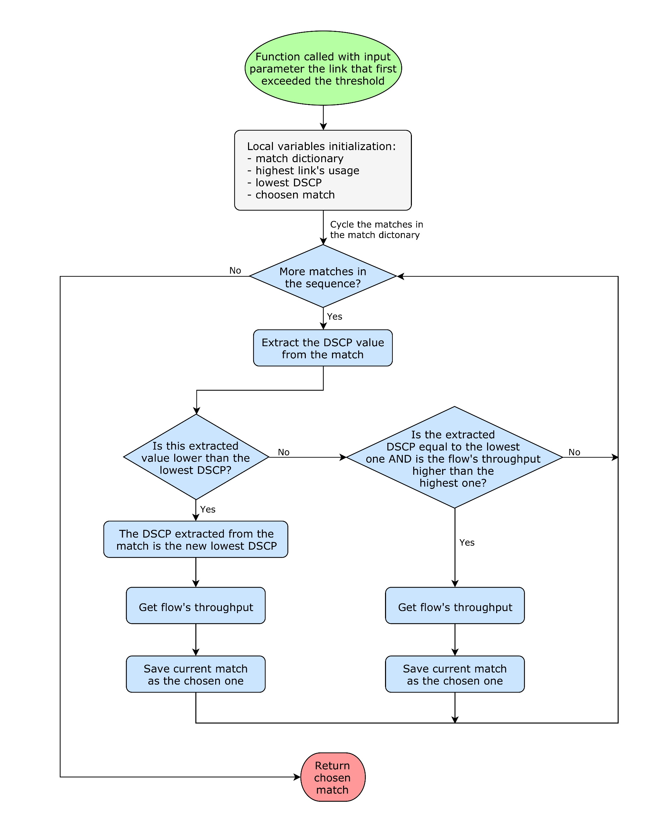
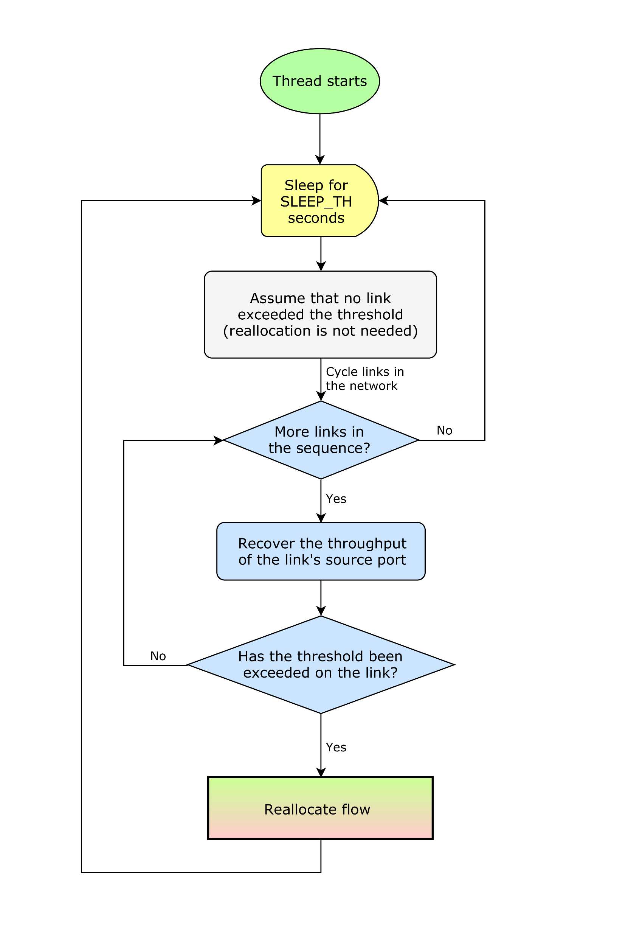
Controller - _monitor_threshold

Slide 14
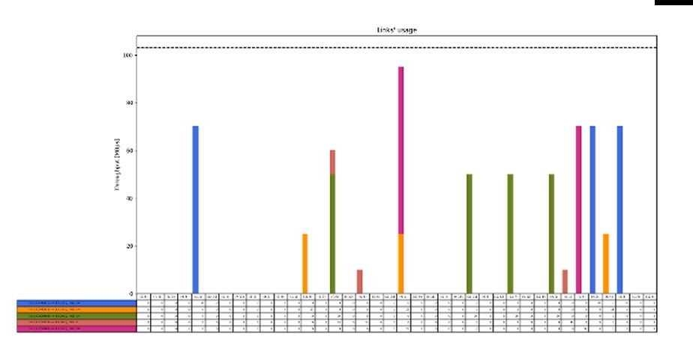
Plot

Slide 15
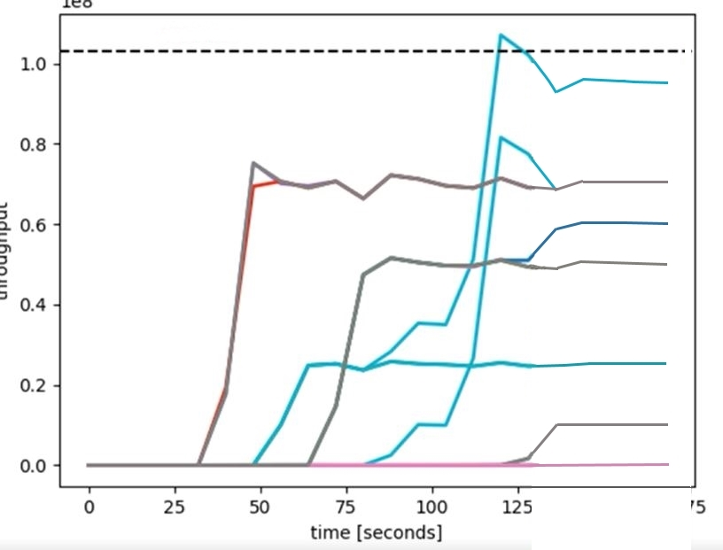
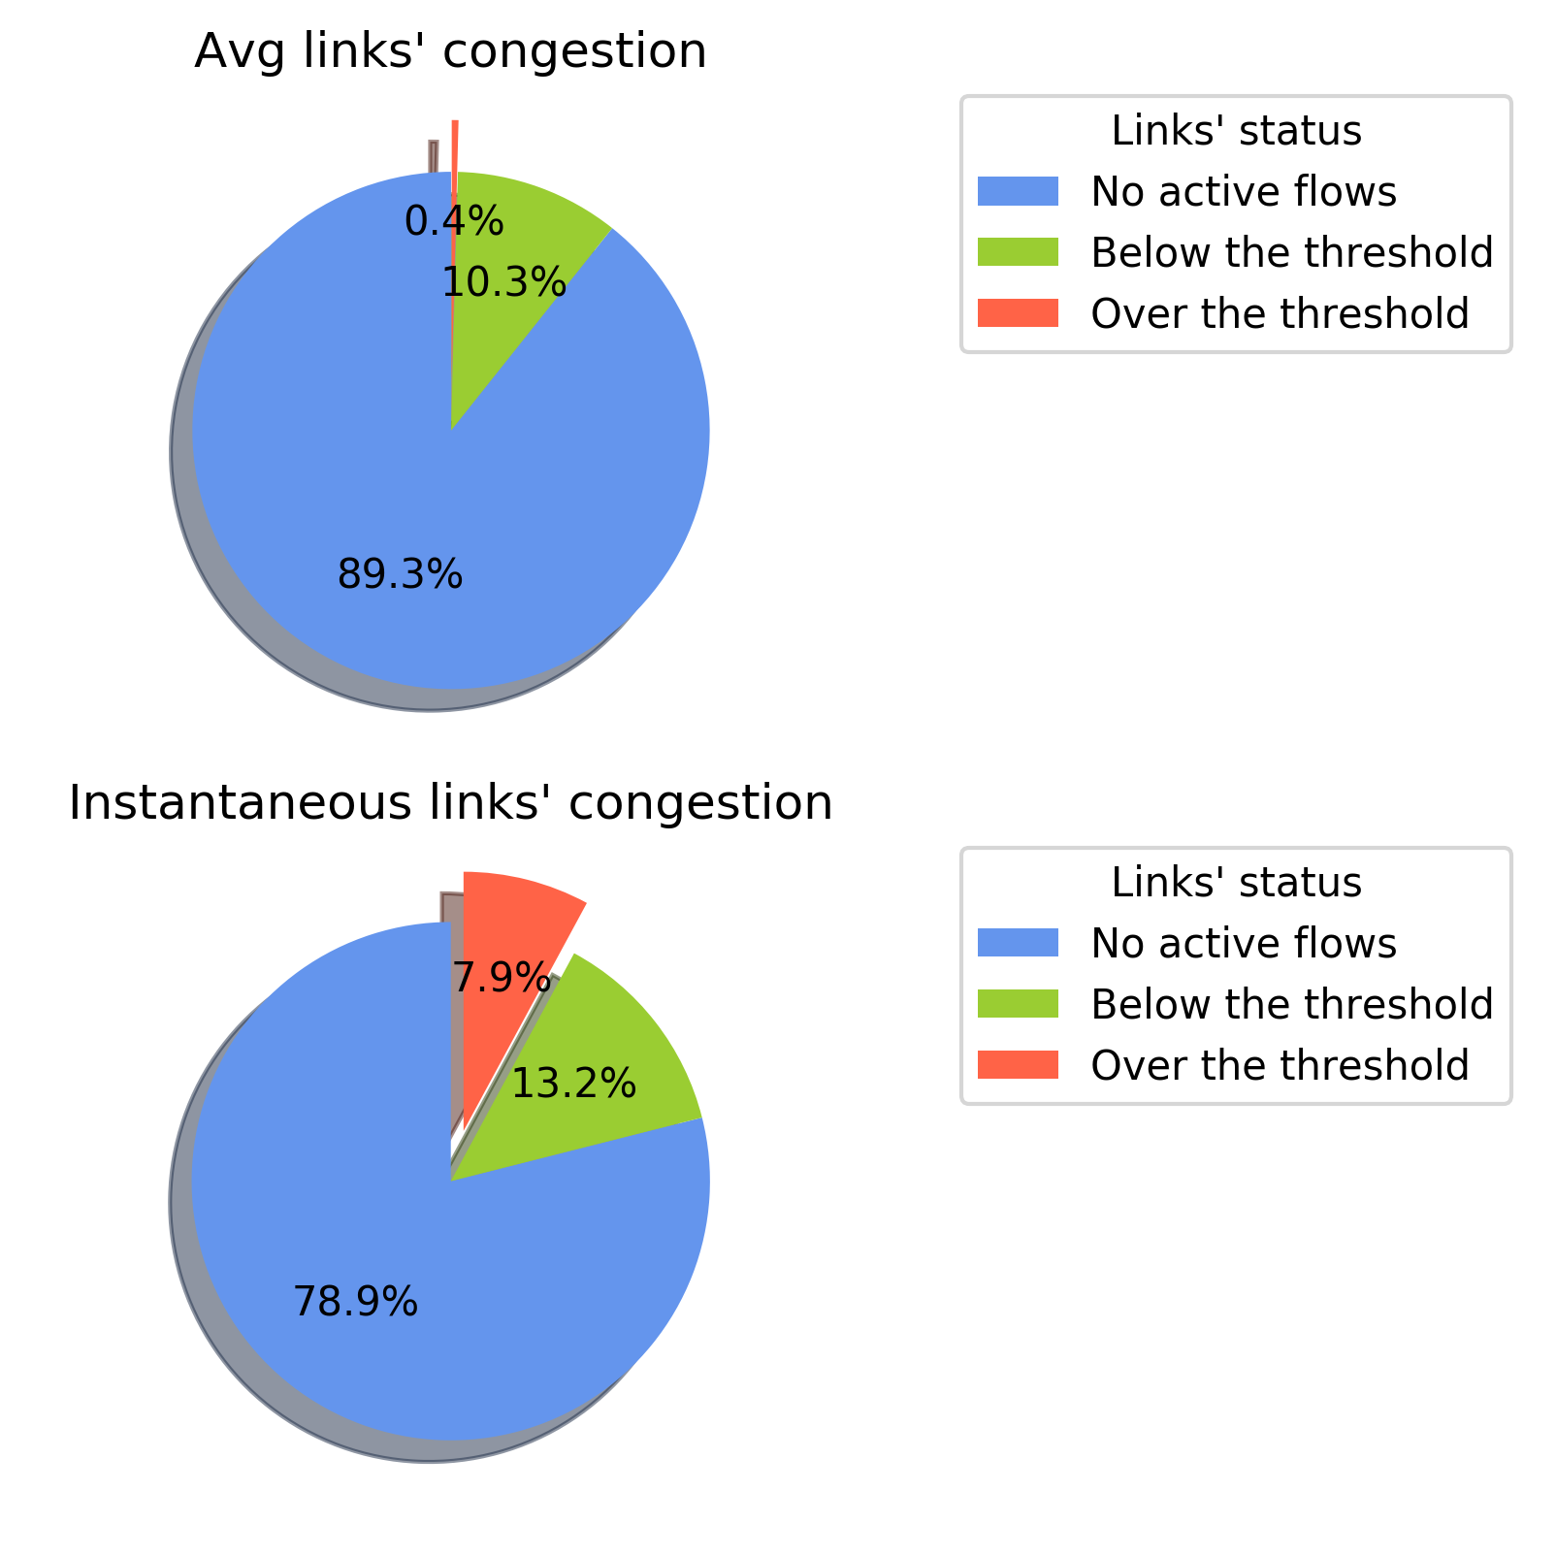
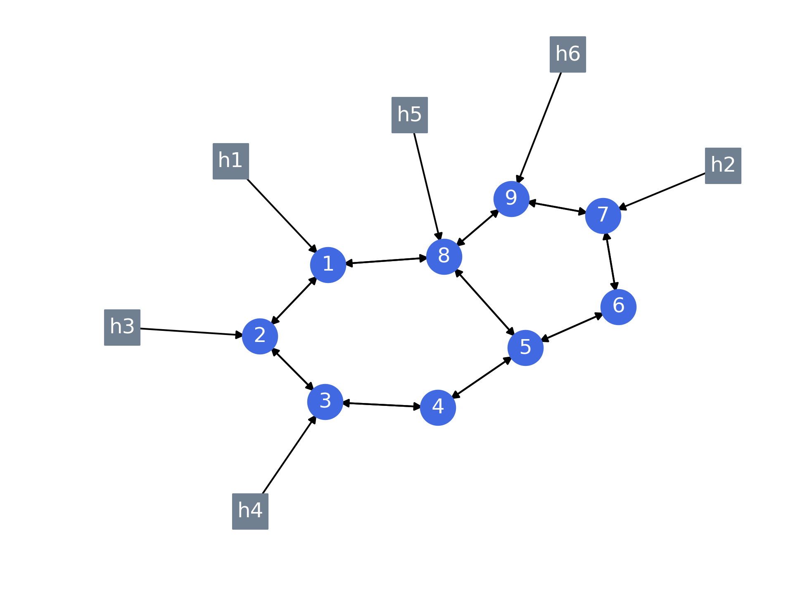
Plot

Slide 16
Testbed
Always on network
clear ARP tables
Rule modified, byte_count won’t reset
use an offset
Statistics about ports are not supported by switches.
Switches, when replying to the _request_flow_stats, put in the message a flow with an empty action field
In mininet, the MAC addresses of the hosts and the datapath IDs of the switches are incremental.

Slide 17
END
Questions?

