Slide 1
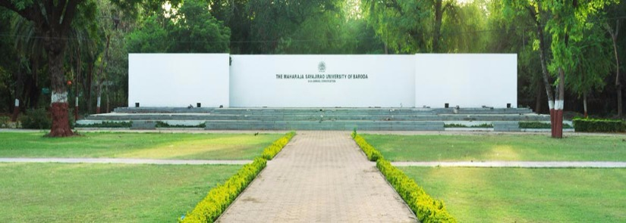


Slide 2

FACULTY OF SCIENCE
A Business Modeling Project Report
on
BOX OFFICE MANAGEMENT
Guided By
Mrs. Mitali Hora
In Fulfillment for the Award of the Degree of
BACHELOR OF COMPUTER APPLICATION
in Department of Computer Applications.
Submitted by:
> Patel Priyansh Akash
> Harshit Chandani
> Ebenezer Isaac Veeraraju
> Iqram Abdul Karim Shaikh
> Hardik Palrecha

Slide 3

ACKNOWLEDGEMENT
Success cannot be achieved single handedly. For this reason, I would like to express my deepest gratitude to all those involved in making this task a success. This project would not have been success fully completed without the help of the people.
First of all, I would like to thank almighty for his grace and love showered on me.
Secondly I thank Prof. S.R.Shrivastava (H.O.D.) who have me this opportunity to work for the project which will add to my experience for giving me a chance to prove my knowledge skill and abilities.
I would also like to thank Mrs. Mitali Hora who provided me guidelines throughout the course of the project.
Not missing to thank my own C.A Department, for giving me this opportunity to gain practical experience and enable me to understand the demand of the experience and professional environment. I gained valuable experience which has given me confidence and had enhanced out professional skill for my competent career.
I would also like to thank all my teacher staff and family members and friends for helping, bearing, encouraging and boosting my moral throughout my studies especially during the project period. Last but not the least I would like to express my sincere gratitude to those who helped me in completing my project directly or indirectly.

Slide 4

DEFINITION
What is box office management?
> A box office or ticket office is a place where tickets are sold to the public for admission to an event. It is an procedure of booking and managing tickets and relative information for respective shows and events . Its main purpose is of being a easiest intermediate between costumer and theaters.
Who is box office manager?
> A Box Office Manager is responsible for managing the box office and supervising the box office assistants and other staff.

Slide 5

SCOPE
The Scope of this project is to understand all the elements of Box office Management, to understand how Box Office works and how all the factors are managed to perform process successfully .
A computer based management system is designed to handle the entire primary information required to manage the whole data. Separate database is maintained to handle the details required for the correct statement calculation and generations.
This project intends introduce more user friendly in the various activities such as record updating, maintenance, and searching. The objective and scope of this project is to give customers the ability to book tickets from a ticket counter for any of the theaters owned by the screening authority. The desktop application will give the ability to book tickets at another theater if the current theater has expired its tickets. This feature will be possible as all ticket counters will be interconnect with the help of internet. During implementation, every ticket counter operator will be given appropriate training to suit the specific needs of the customer.

Slide 6
STAKE HOLDERS
Manager
Admin
Receptionist
Maintenance Staff

Slide 7
MODULES
Registration
Ticket Booking
Management
Payment

Slide 8
ACTORS
Customer
Receptionist
Manager

Slide 9
USE CASE DIAGRAMS

Slide 10
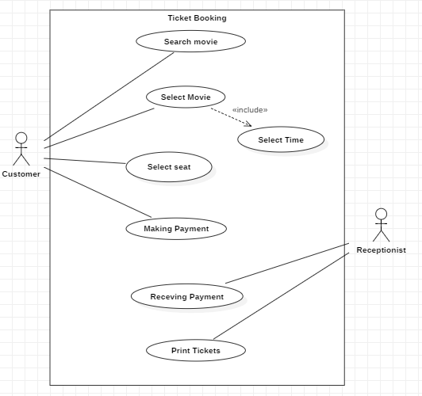
TICKET BOOKING

Slide 11
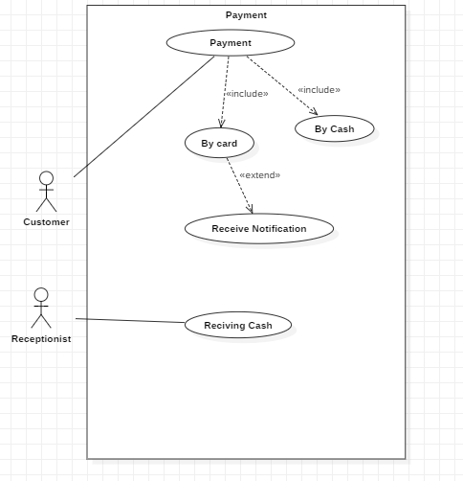
PAYMENT

Slide 12
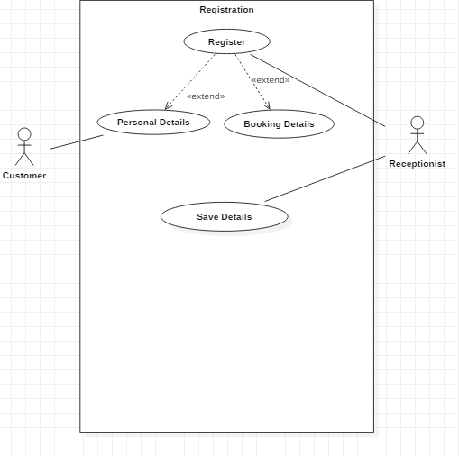
REGISTRATION

Slide 13
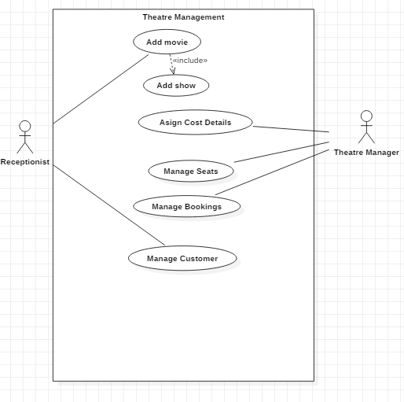
THEATRE MANAGEMENT

Slide 14
ACTIVITY DIAGRAMS

Slide 15
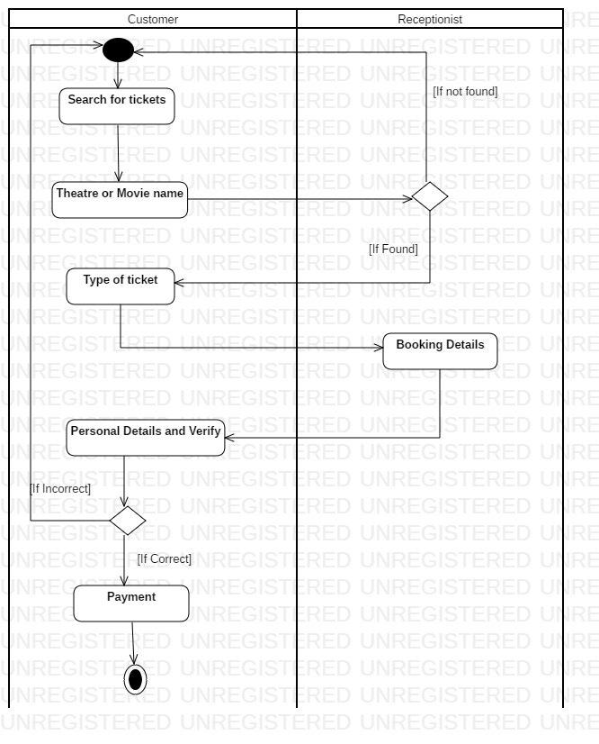
TICKET BOOKING

Slide 16
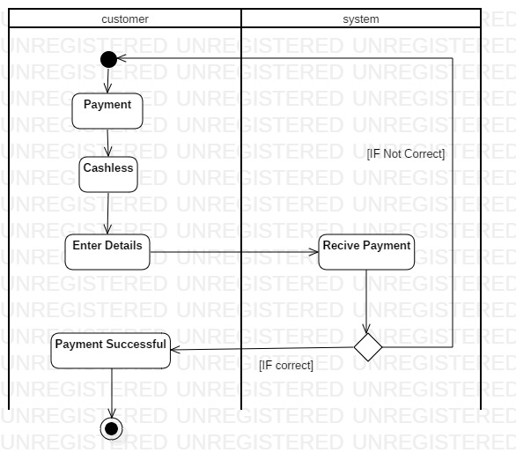
PAYMENT - CASHLESS

Slide 17
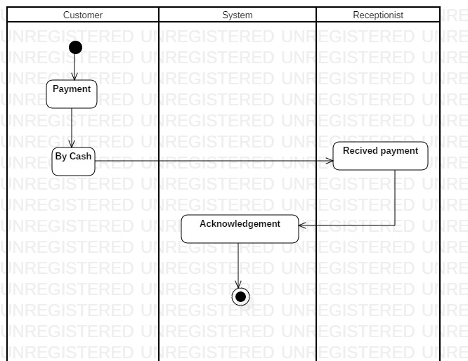
PAYMENT - CASH

Slide 18
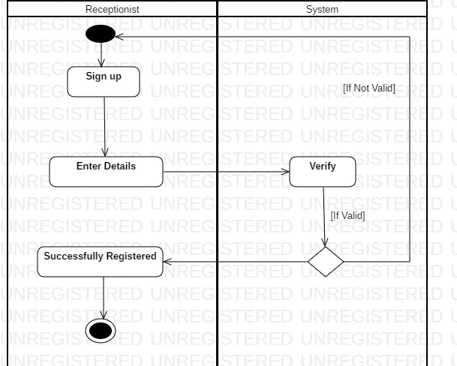
REGISTRATION

Slide 19
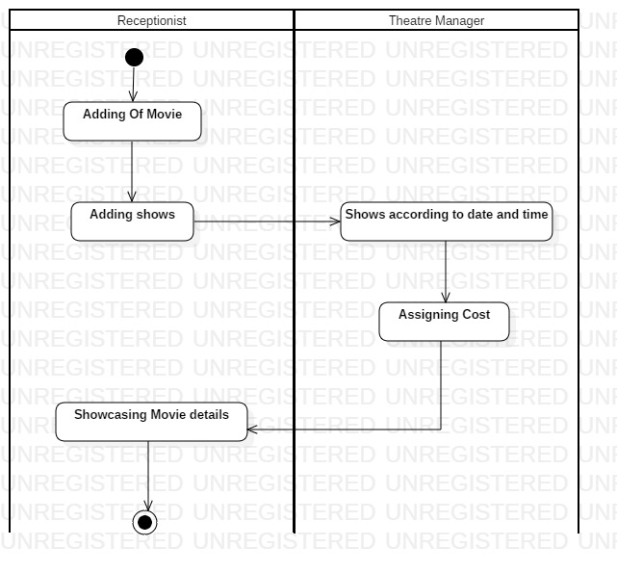
MANAGEMENT

Slide 20
SEQUENCE DIAGRAMS

Slide 21
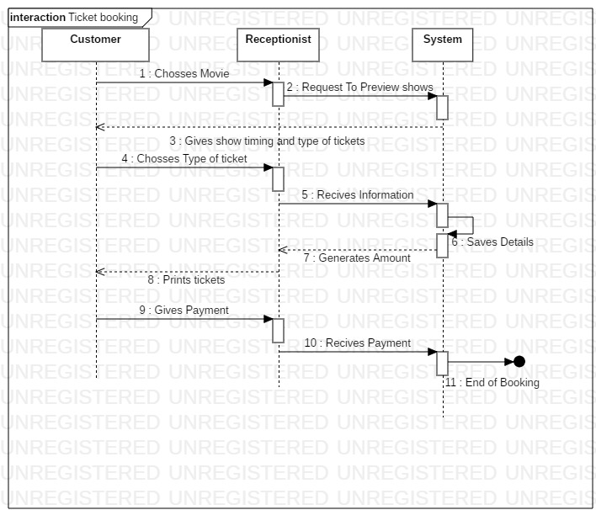
TICKET BOOKING

Slide 22
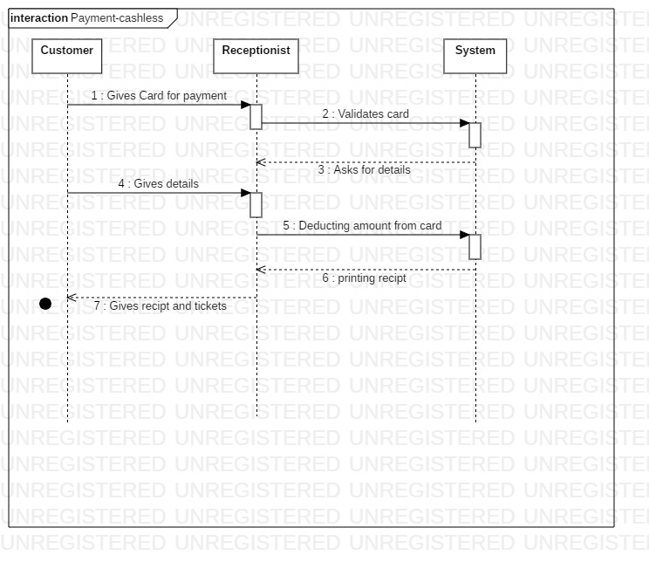
PAYMENT - CASHLESS

Slide 23
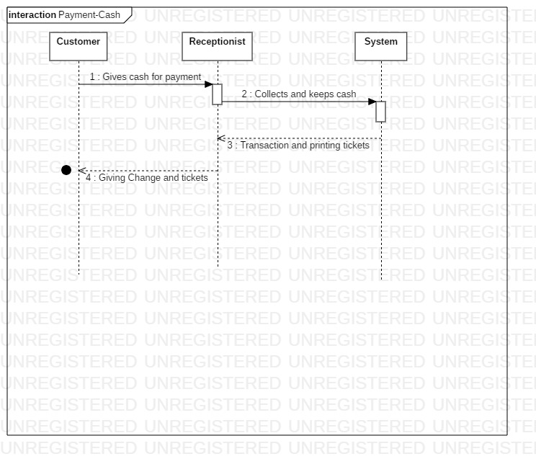
PAYMENT - CASH

Slide 24
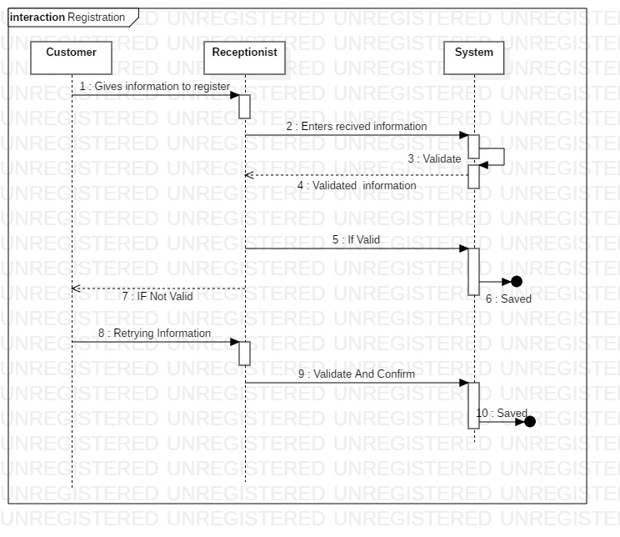
REGISTRATION

Slide 25
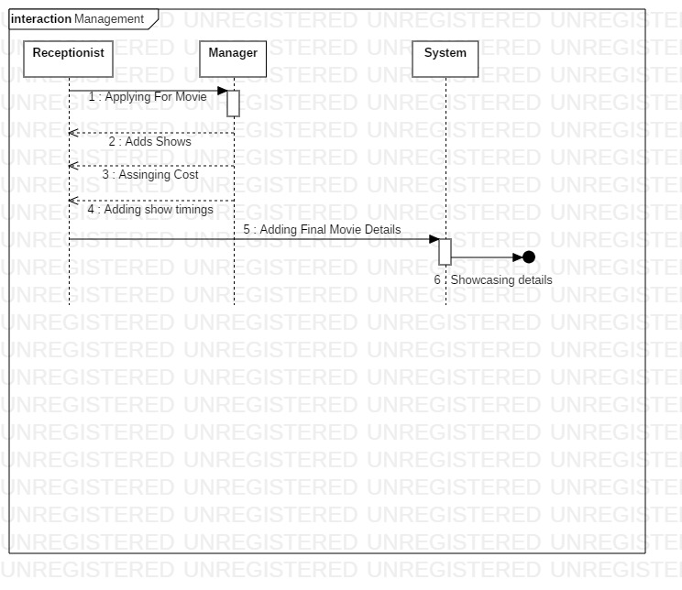
MANAGEMENT

Slide 26
CLASS DIAGRAM

Slide 27
BIBLIOGRAPHY
Use case
www.smartdraw.com
www.wikipedia.com
Activity Diagram
www.tutorialspoint.com
www.youtube.com
Sequence Diagram
www.geeksforgeeks.org
Class Diagram
www.wikipedia.com
Books
A Fragment Guide To Business Modelling by John Holt

Slide 28
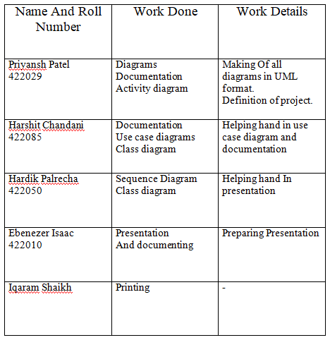
WORK DISTRIBUTION

Slide 29
TOOLS USED
WhatsApp
-Used For Communication
StarUML
-Used Fo making Diagrams
Gmail
-Used for sending files and documents

