Slide 1






CERBERUS – Biometric Attendance.

Slide 2
Cerberus - Live Project
Guide:
Mr. Krishnanand Rastogi
Team Members:
Ebenezer Isaac [522025]
Lokhandwala Haji Huseinali [522035]
Vraj R. Kotwala [522033]

Slide 3



1.
Project Summary
Let’s start with the first set of slides

Slide 4
Our project focuses on managing a distributed system of devices that are capable of scanning biometrics for the use of attendance for a large scope of stakeholders automatically on the basis of a timetable.

Slide 5
The student will be marked present through biometric (fingerprint) module and the attendance data can be accessed on our website by the users.

Slide 6

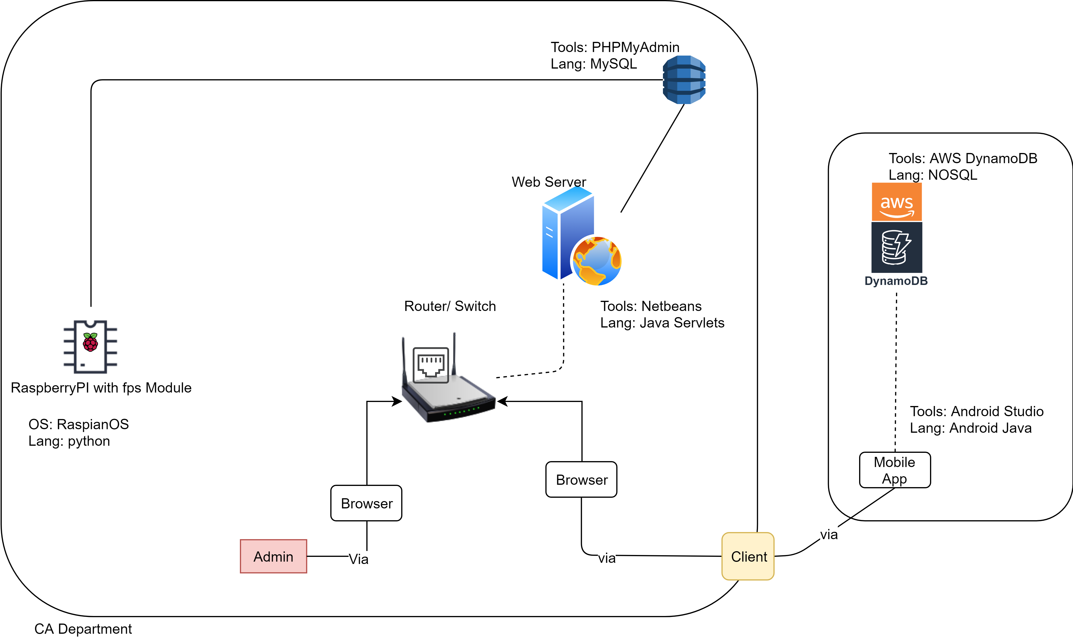
Architecture

Slide 7
Scope of Device (w RaspberryPi)
Enroll fingerprints
Authentication
Manage Faculty/ Admin (Fingerprint data)
Manage Student (Fingerprint data)
Background Activities:
Sync:
Attendance to database
Fetch templates from database
Fetch timetable from database.
Fetch PRN

Slide 8
Scope of Web-App (made w Servlet)
For Faculty:
Login
Timetable Management
Subjects Management
Student Management
Attendance Management (Manual)
Admin Management
Student Progression
OTP for devices
Profile Management
For Students:
Login
View Attendance
Select Electives

Slide 9
Tools and Technology Used:
On Device (RaspberryPi):
OS: Raspbian
Lang: Python
Tool: Notepad++
On Web-App:
frontend:
AJAX, HTML, JS, CSS
backend:
Java-Servlet, JSP.
Database: MySQL
Server: Apache Tomcat 8.0

Slide 10








Agile Methodology
To iterate the development and testing throughout the software development lifecycle of the project.
Extreme programming (XP) is a software development practice which is intended to improve software quality and responsiveness to changing customer requirements.

Slide 11
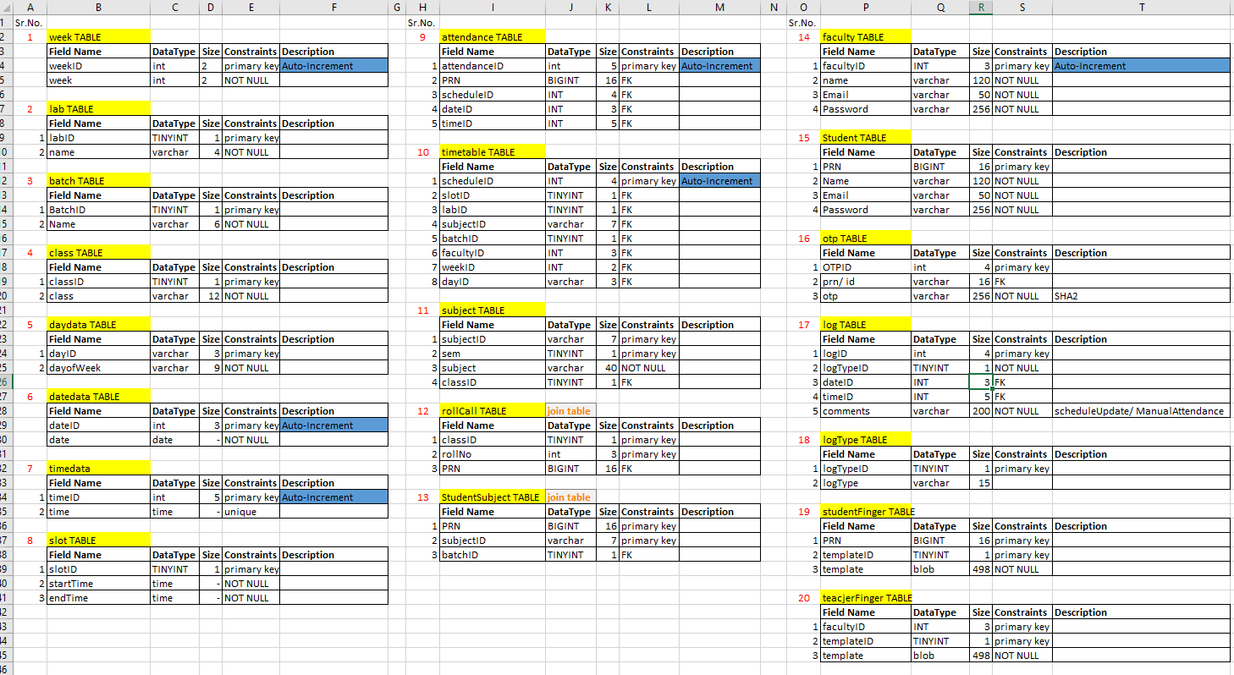
Tables of Database – (Data Dictionary)

Slide 12
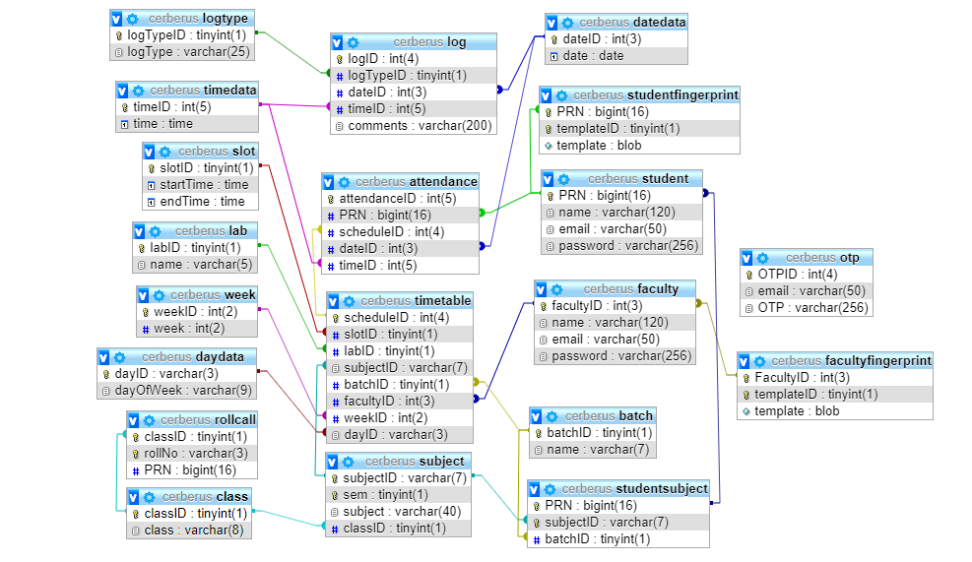
System Design – ERD (Relational)

Slide 13
2.
Implementation
ScreenShots and Live Demo

Slide 14
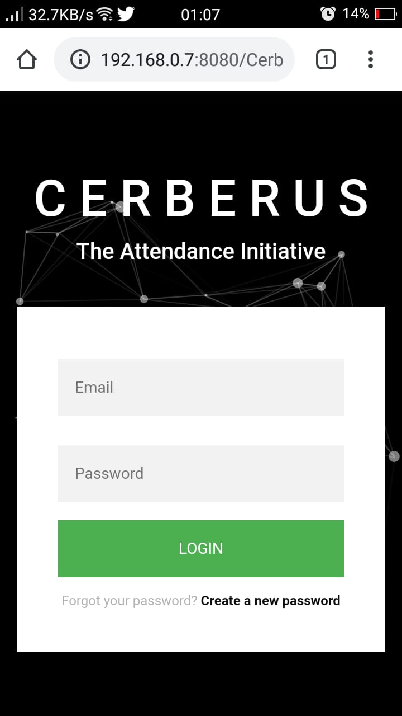
Mobile project
Perks of using Bootstrap - Index Page with Login
Place your screenshot here

Slide 15
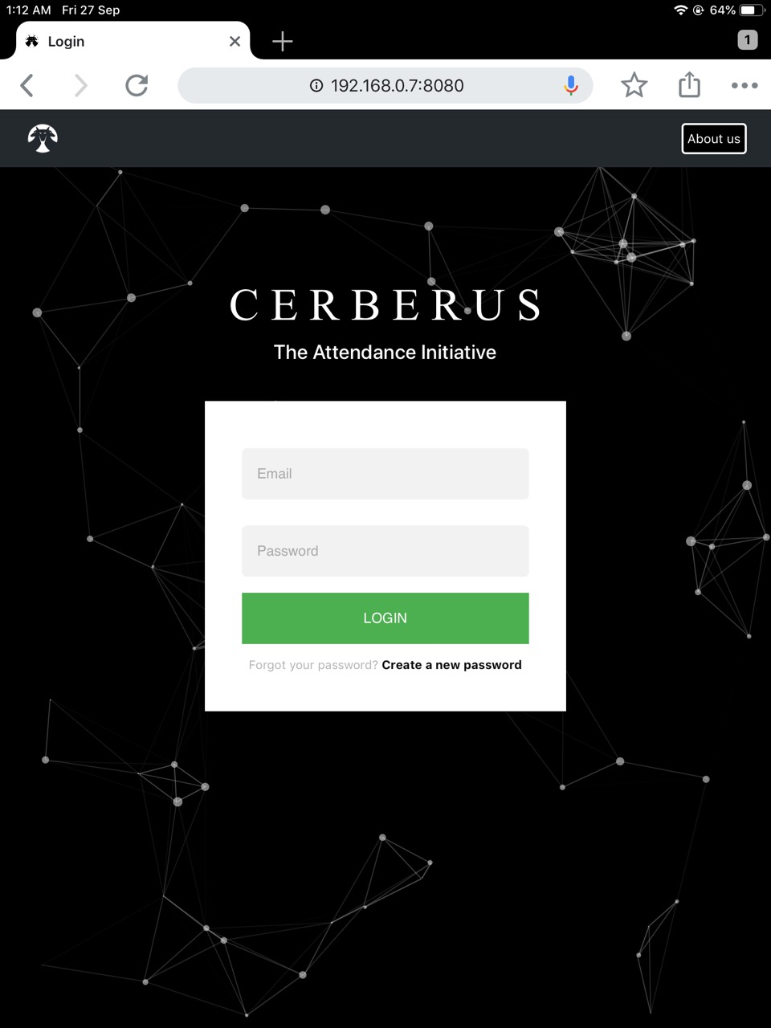
Tablet project
Index Page with Login
Place your screenshot here

Slide 16
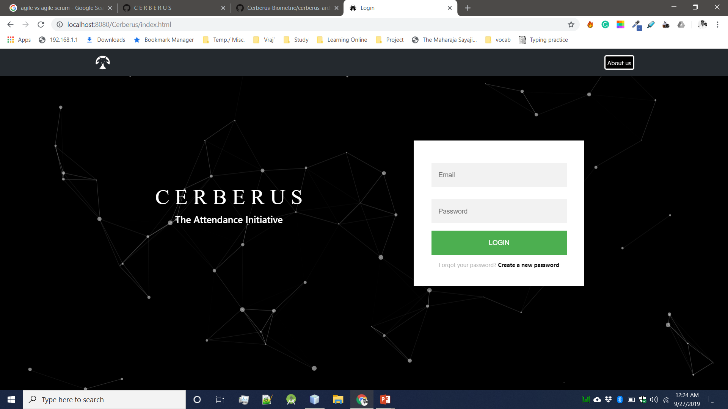
Desktop project (Web)
Index Page with Login
Place your screenshot here

Slide 17
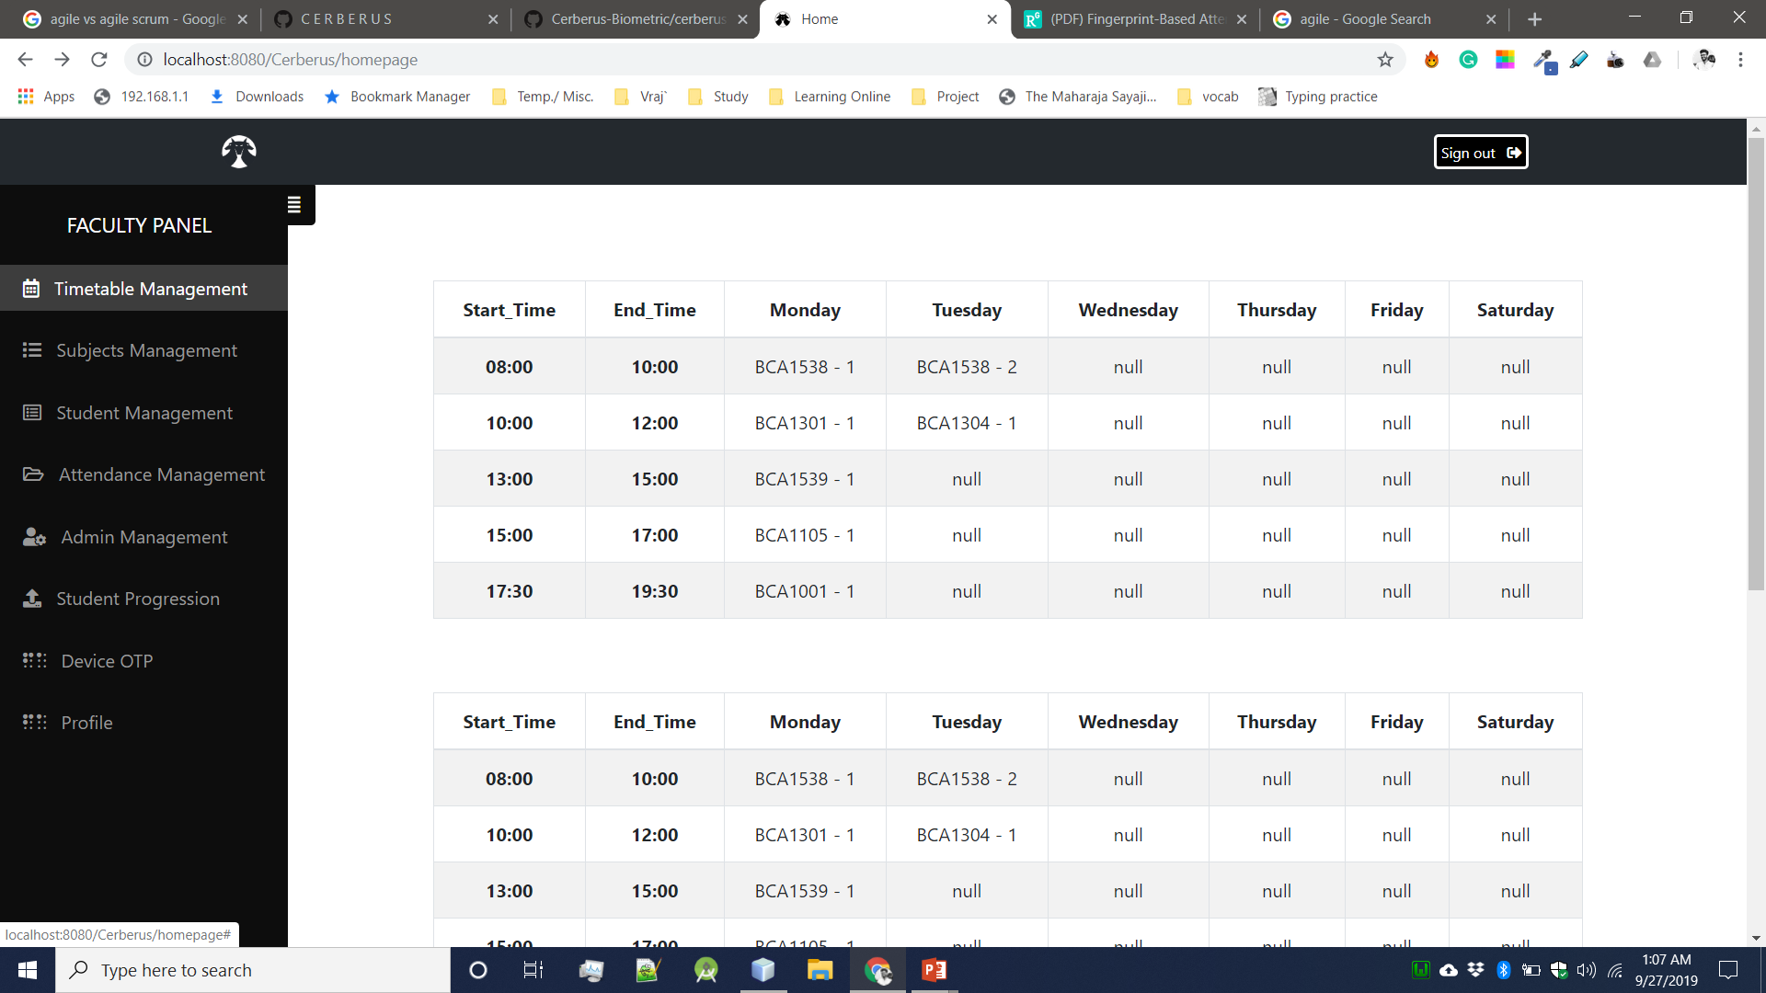
Desktop project (Web)
Home page when faculty logs In.
Place your screenshot here

Slide 18
Project Work Division
Arduino and circuit design: Ebenezer and Vraj
RaspberryPi: Ebenezer
Box design: Ebenezer.
Backend: Ebenezer & Vraj
Front end & GUI: Huseinali
Database & SQL: Vraj
Documentation: Vraj
Testing: All 3 of us.
Mobile-App: Huseinali

Slide 19

Thank you!
Any questions?

