Slide 1
Object Detection With Tensor Flow
Ebenezer Issac Veeraraju - 2020178014
Dennis Churchill J - 2020178011
Mahmood Raj Mohamed - 2020178034
Suvetha E - 2020178056

Slide 2
Project Description
Object detection is a computer vision technique that allows us to identify and locate objects in an image or video.
With this kind of identification and localization, object detection can be used to count objects in a scene and determine and track their precise locations, all while accurately labeling them

Slide 3
Uses
Detection of objects of a road
It is widely used in computer vision tasks such as image annotation, vehicle counting, activity recognition, face detection, face recognition, video object co-segmentation.
It is also used in tracking objects, for example tracking a ball during a football match, tracking movement of a cricket bat, or tracking a person in a video.

Slide 4
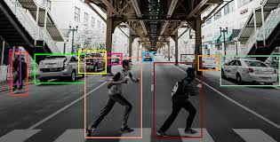
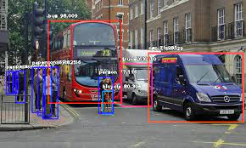
Some examples are

Slide 5
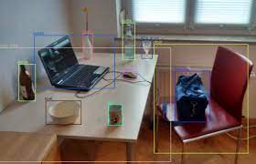
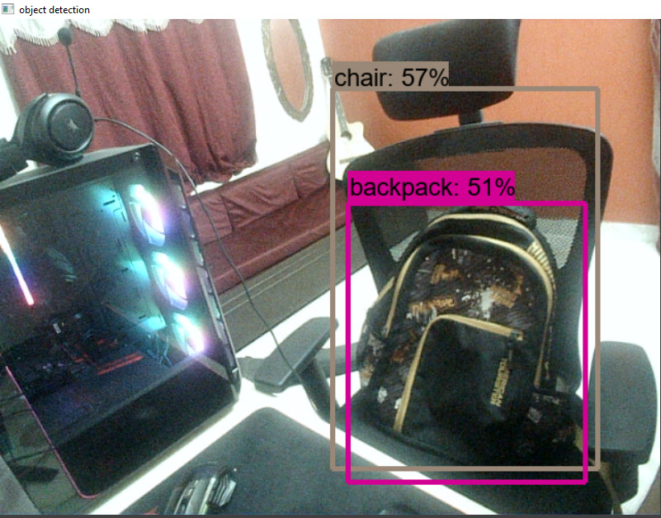
Our samples

Slide 6
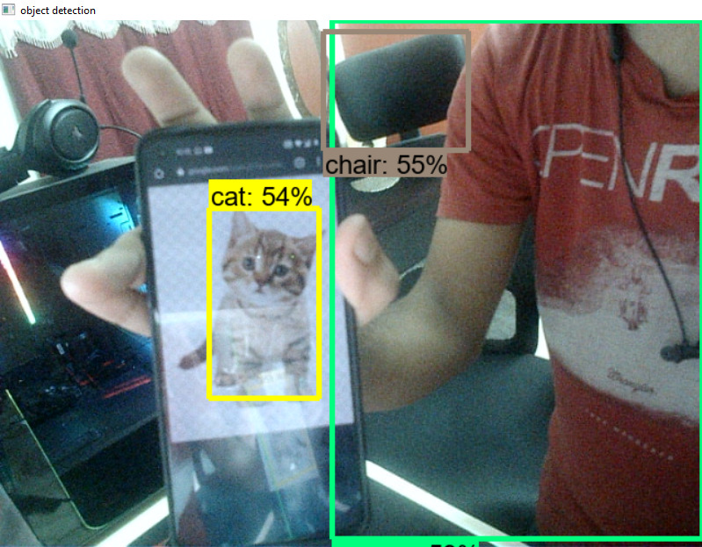
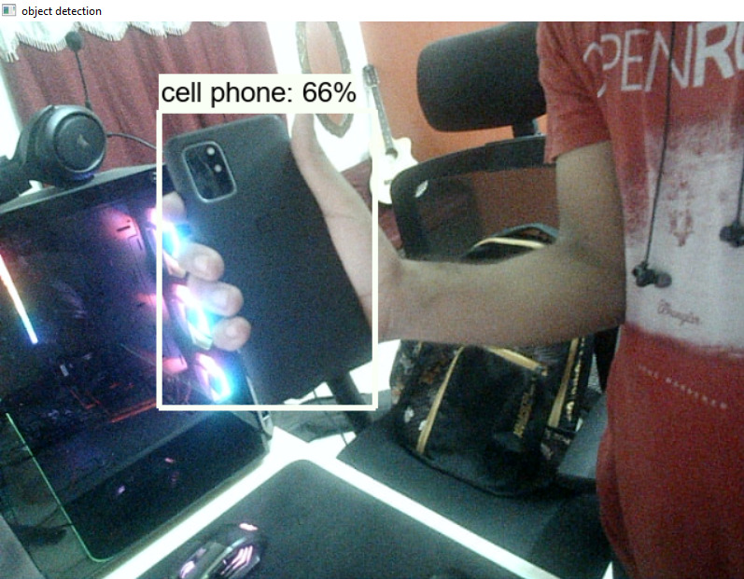

Slide 7
Neural Network
A neural network is a series of algorithms that endeavors to recognize underlying relationships in a set of data through a process that mimics the way the human brain operates.
In this sense, neural networks refer to systems of neurons, either organic or artificial in nature.

Slide 8
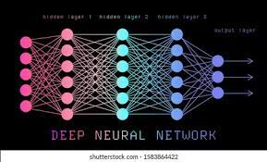
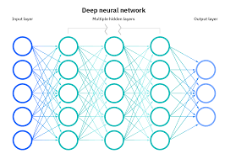
How does neutral network work

Slide 9
Convolutional Neural Network
A Convolutional Neural Network (ConvNet/CNN) is a Deep Learning algorithm which can take in an input image, assign importance (learnable weights and biases) to various aspects/objects in the image and be able to differentiate one from the other.
The pre-processing required in a ConvNet is much lower as compared to other classification algorithms. While in primitive methods filters are hand-engineered, with enough training, ConvNets have the ability to learn these filters/characteristics.

Slide 10

Tensorflow Object Detection API
The TensorFlow Object Detection API is an open source framework built on top of TensorFlow that makes it easy to construct, train and deploy object detection models.

