Slide 1
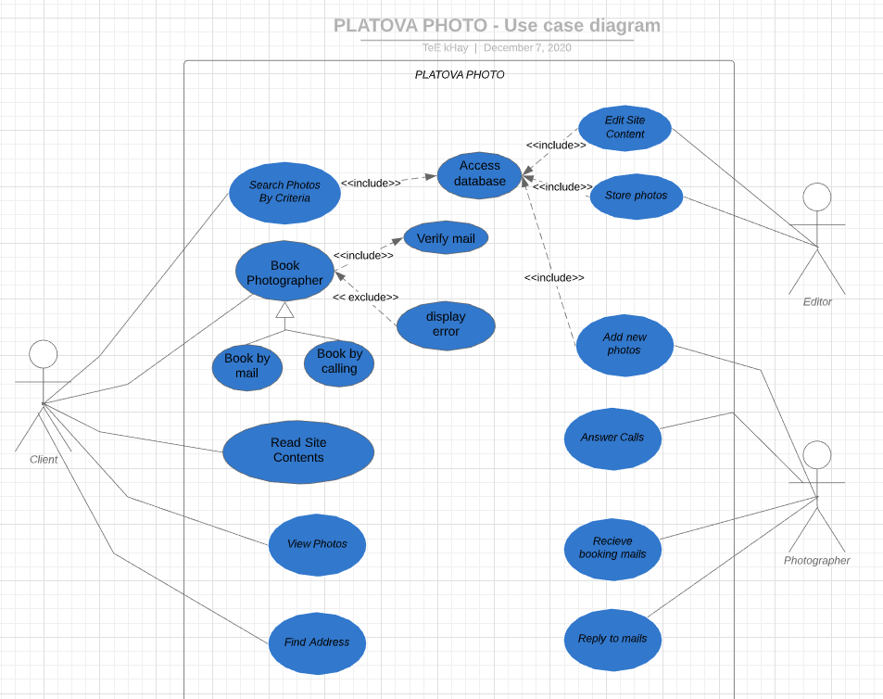
Use case Diagram

Slide 2
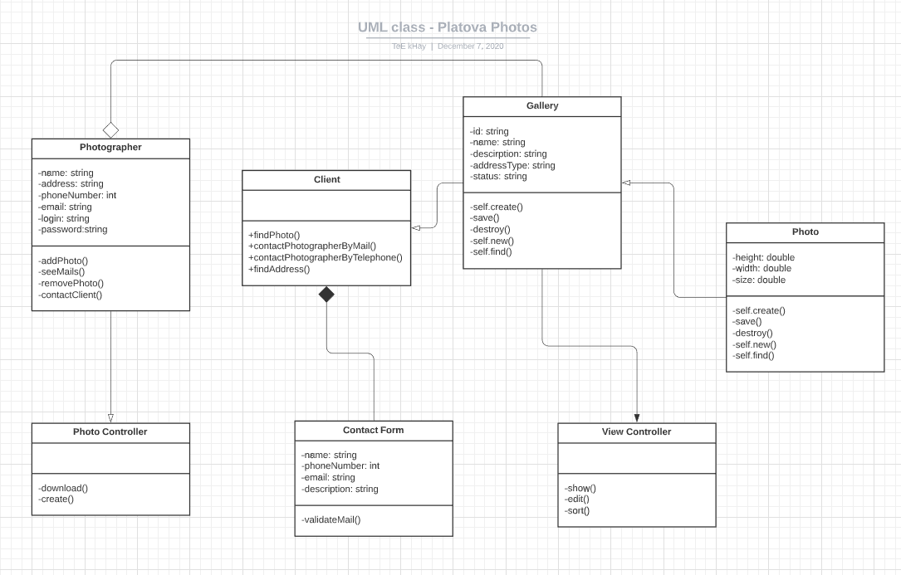

Slide 3
Sequence Diagram for “Fill Gallery”

Slide 4
Sequence Diagram for “View Gallery”

