Slide 1
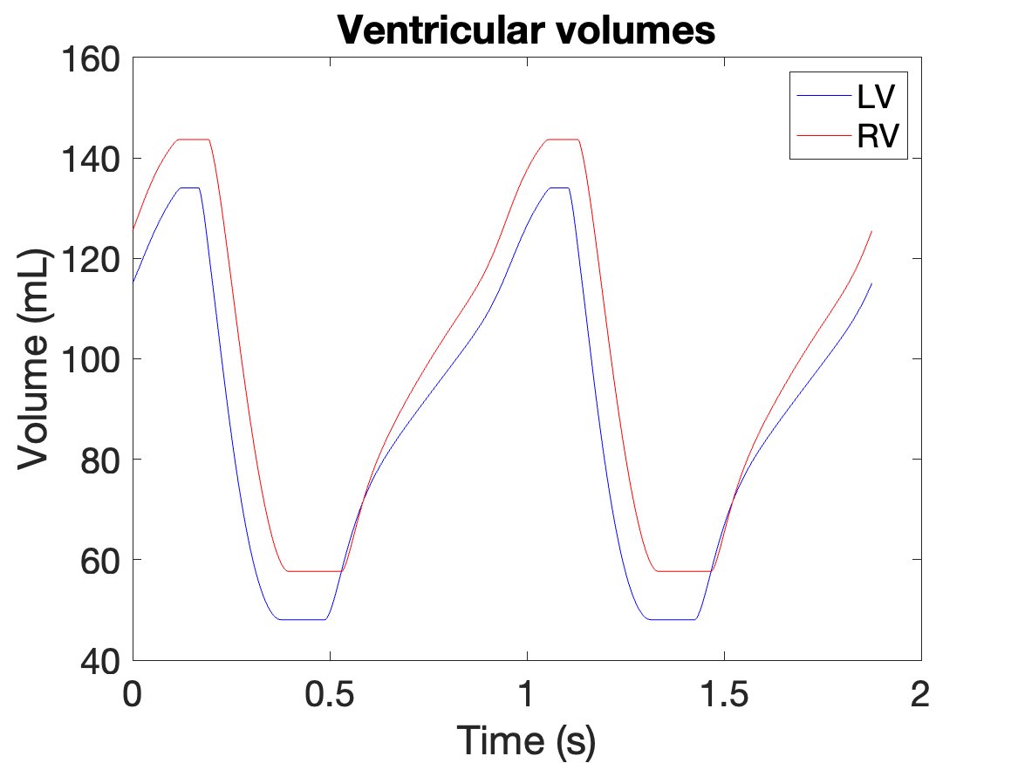
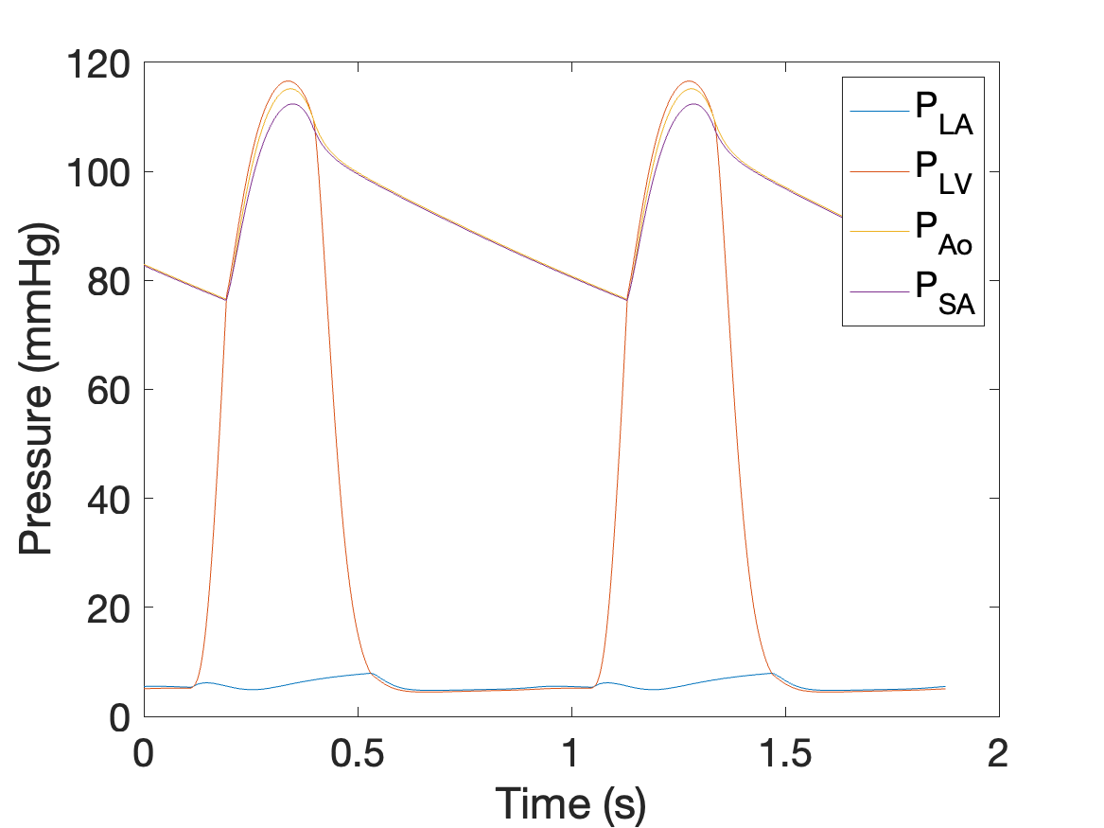
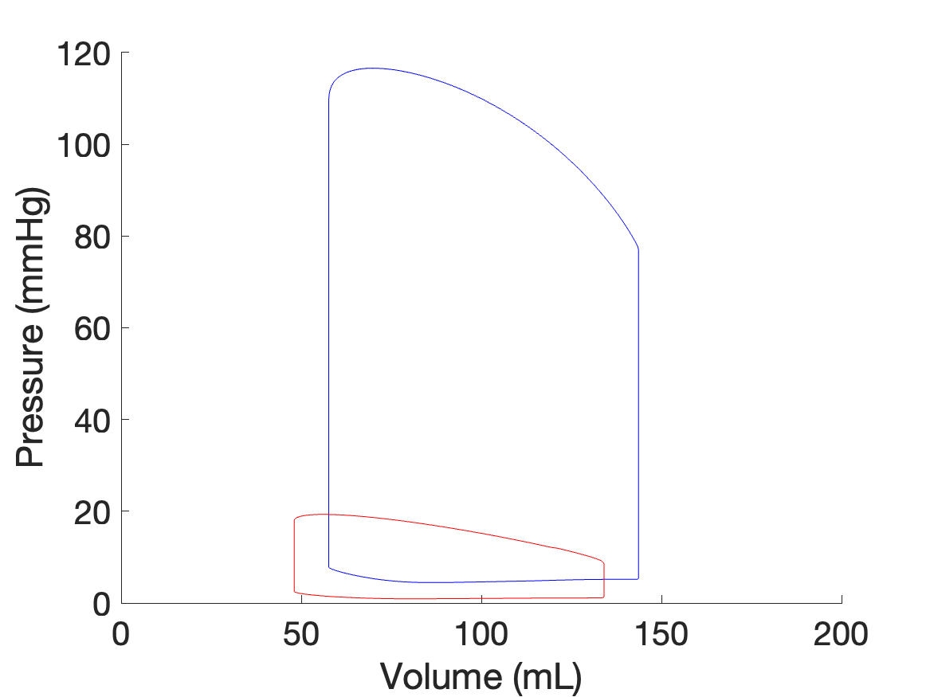
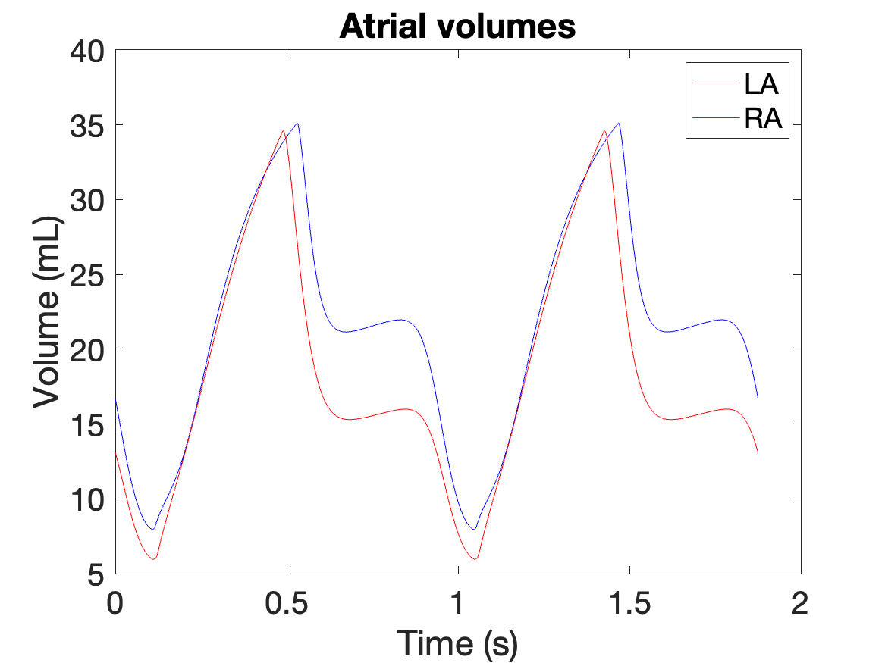
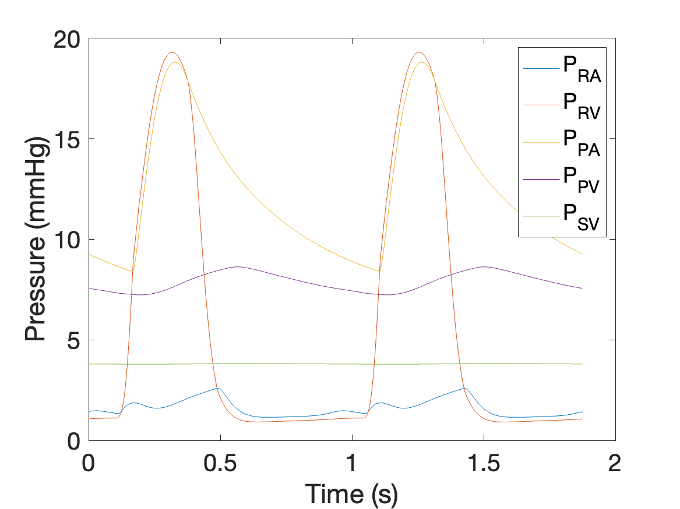
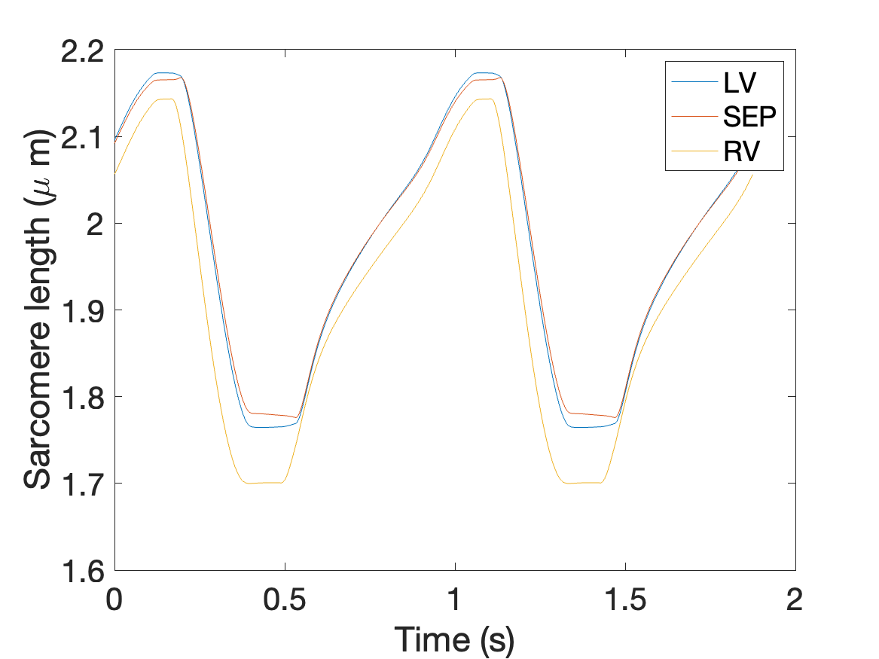
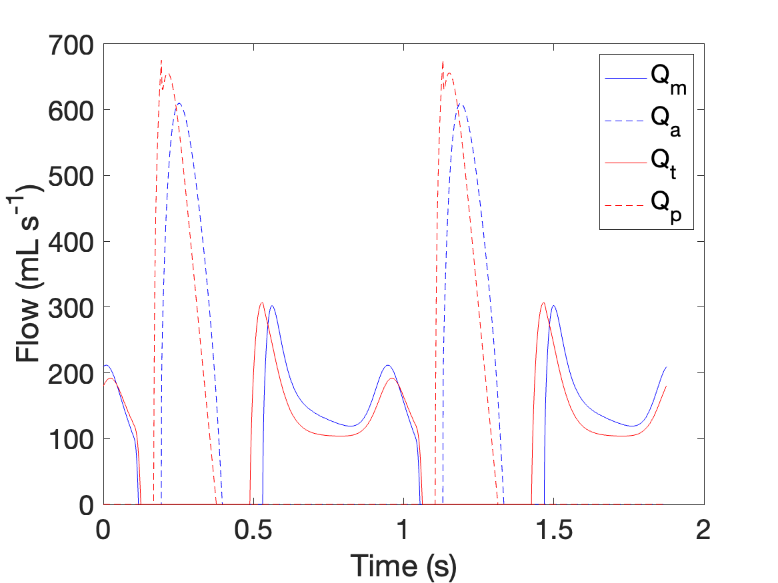
Original (Dan’s) version

Slide 2
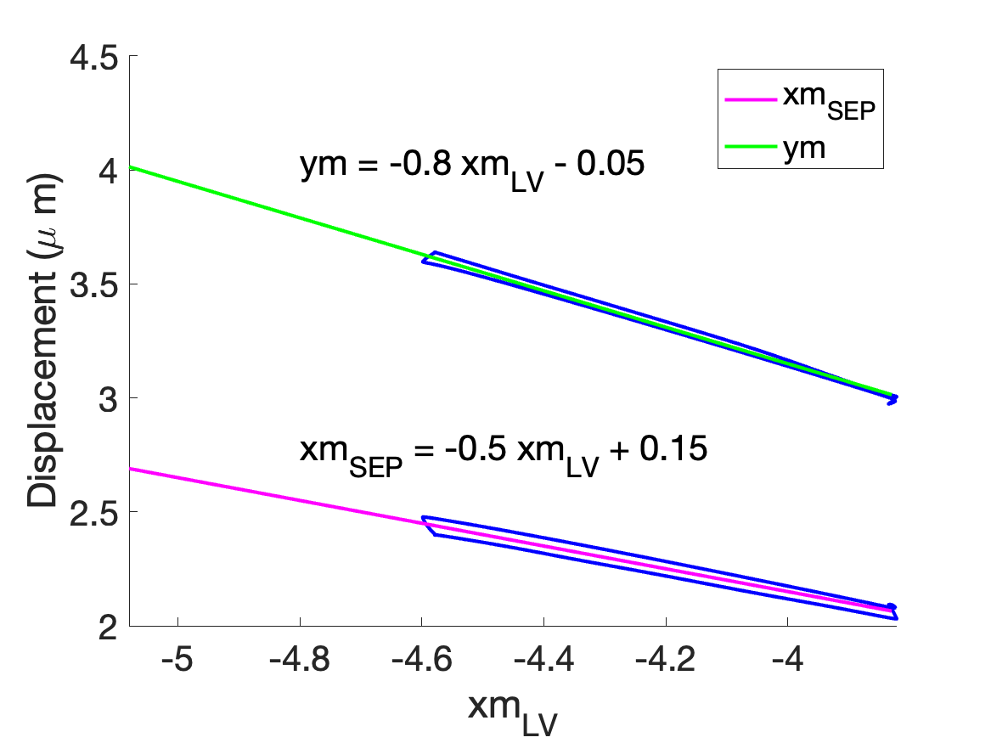
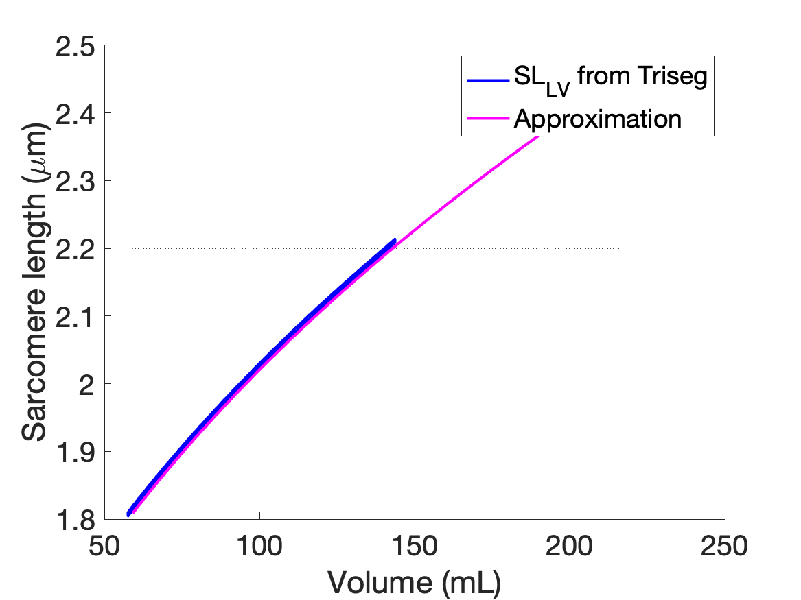
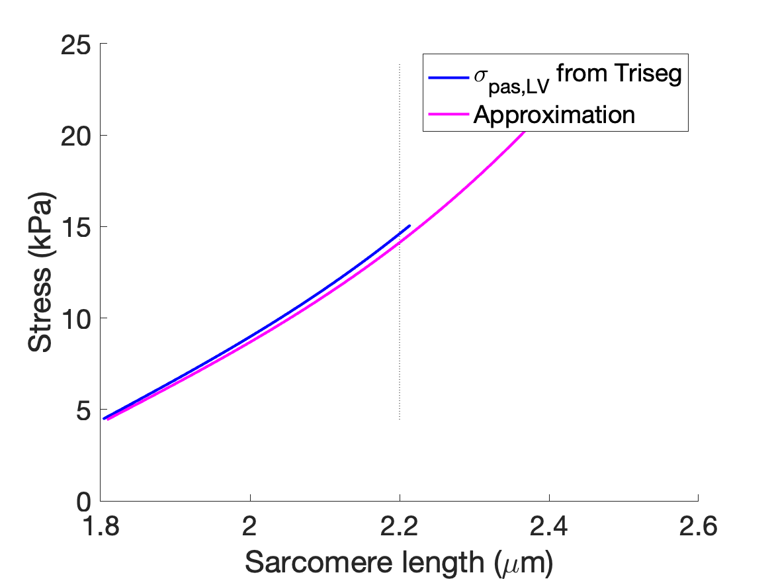
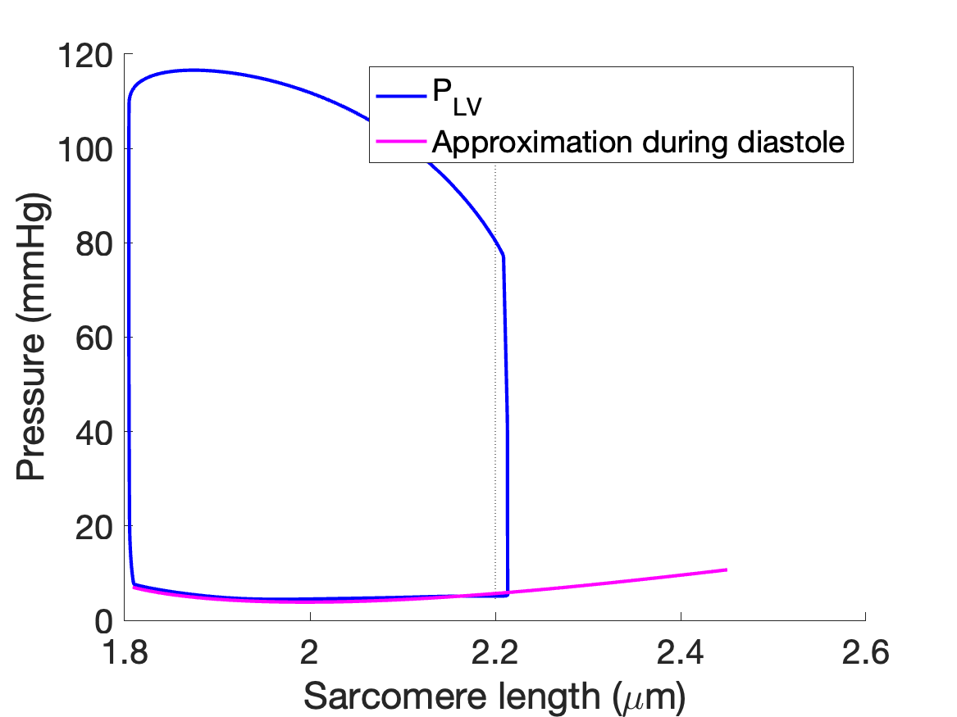
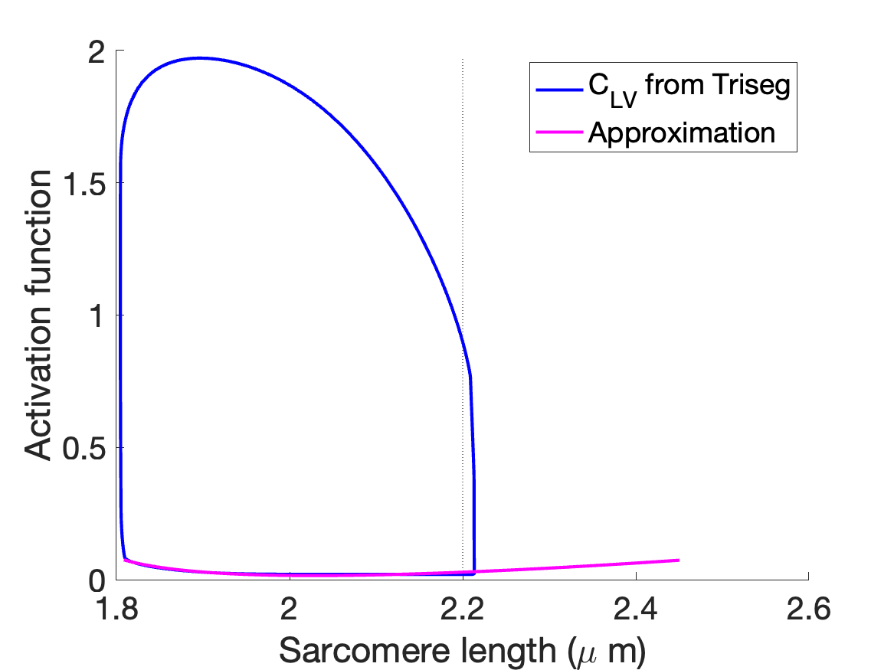
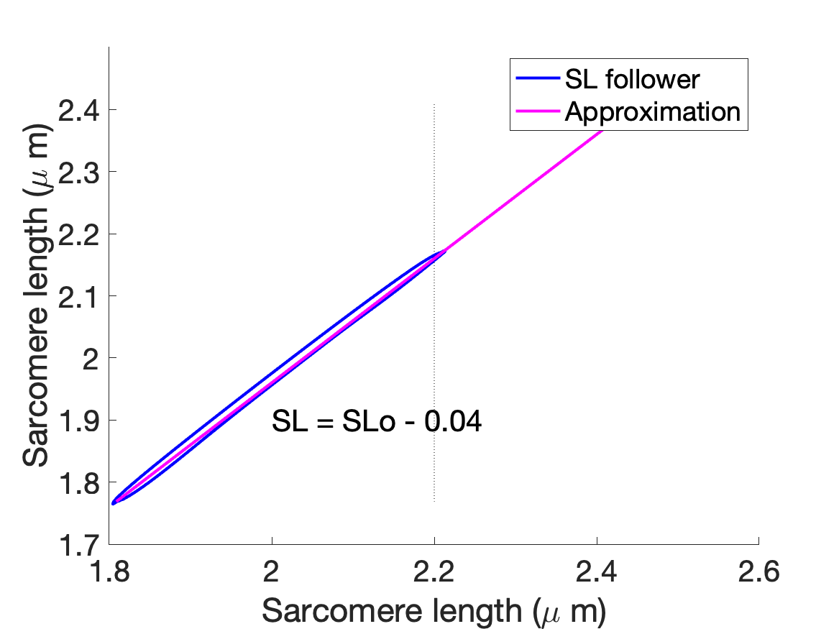
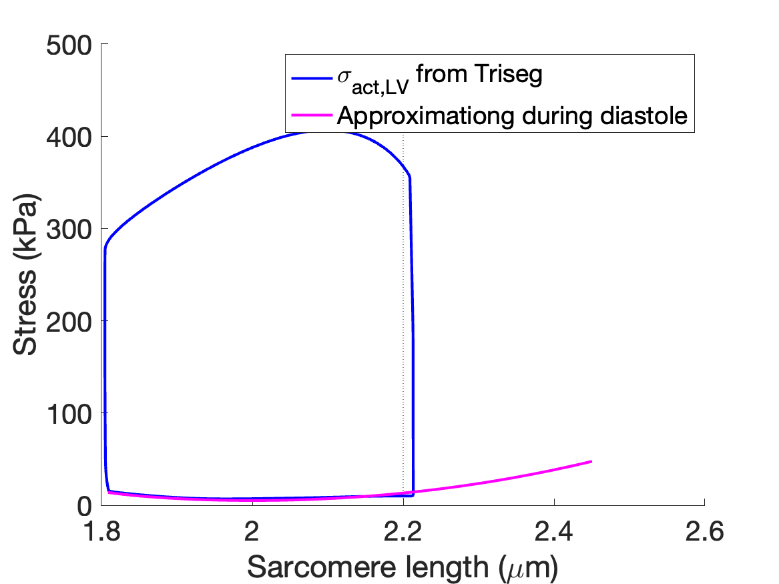
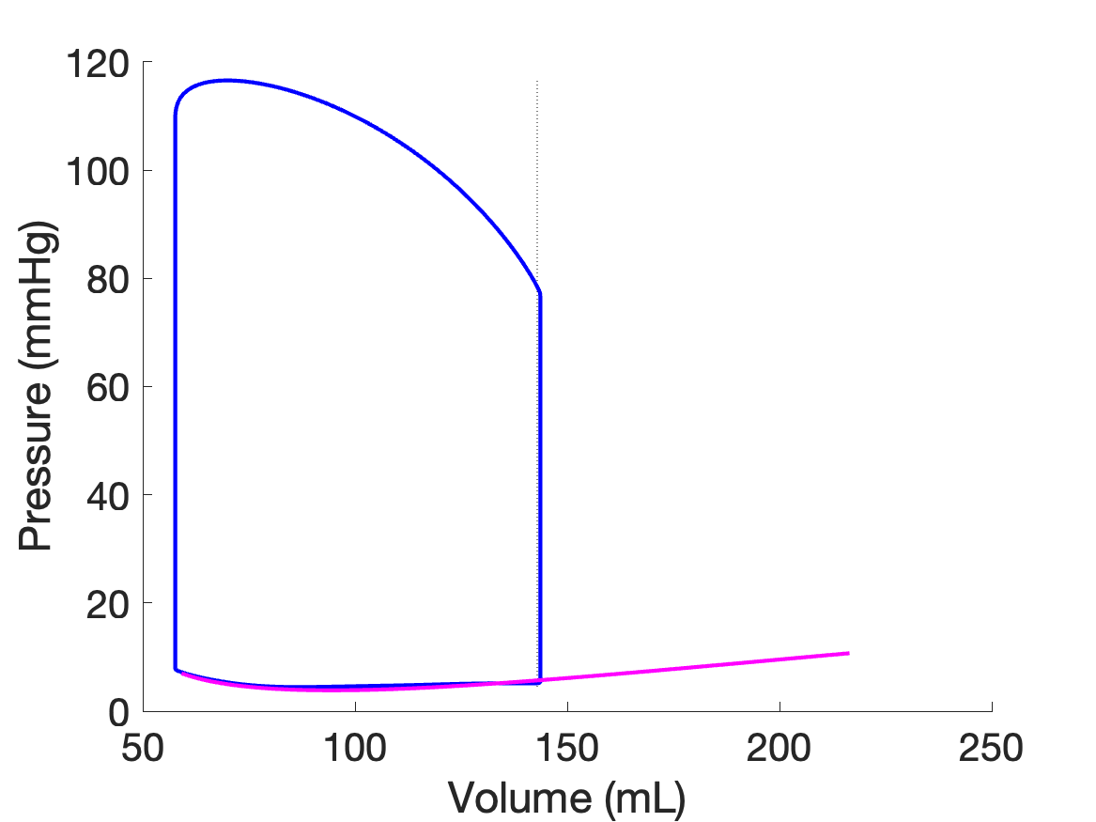
Approximations

Slide 3
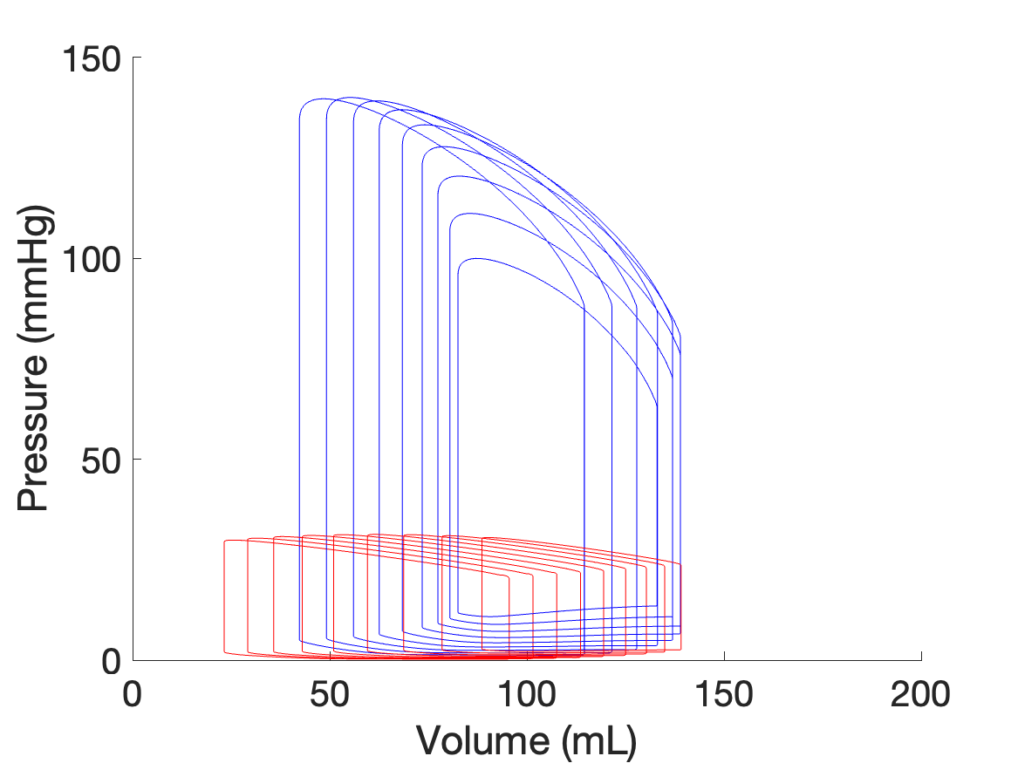
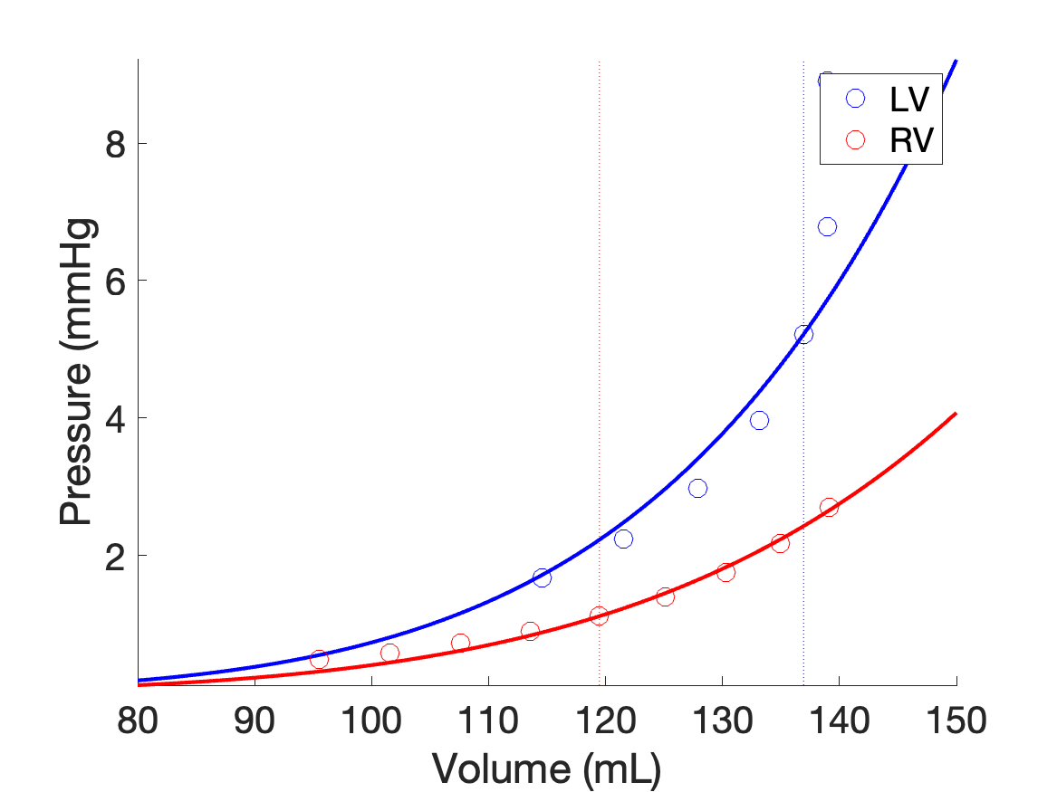
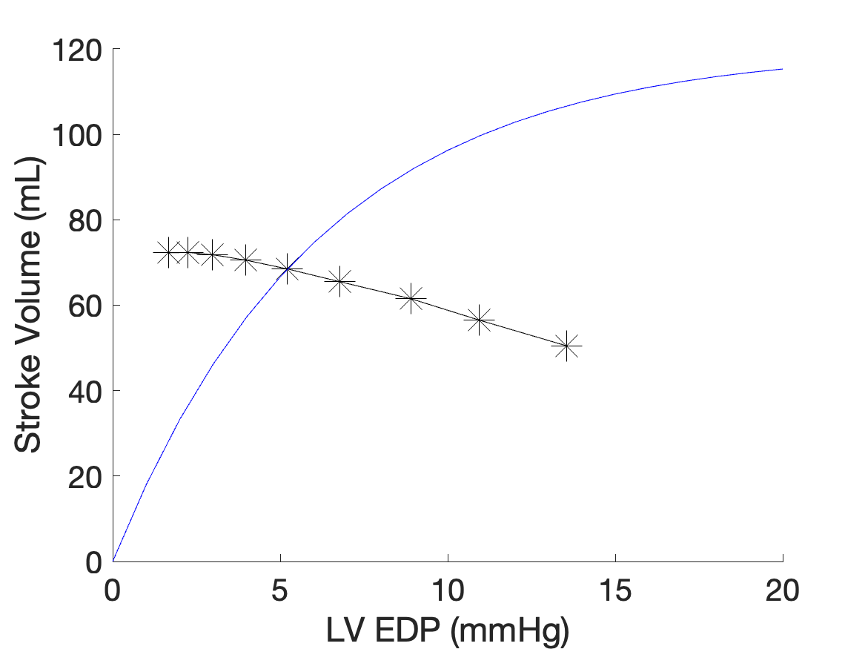
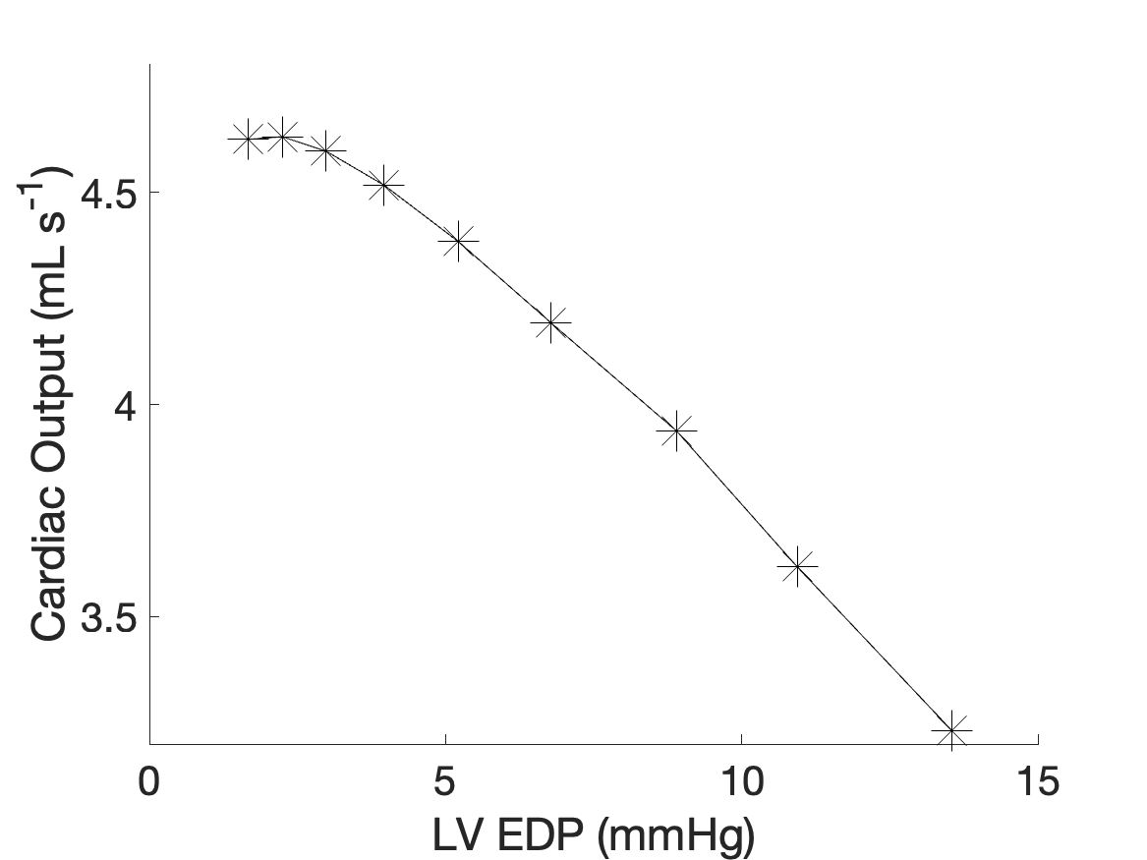
EDPVR curve
Changing Amref_X and k_pas with increasing volume loading where X = LV, SEP, or RV
Volume loading done by multiplying the initial condition for the Ao, SA, SV, PA, and PV compartments by a scalar from 0.8-1.2
Zoom of EDP and EDV points on estimated EDPVR curve
SV at each loop
Blue curve is a generic Frank-Starling mechanism that I made just for comparison
CO at each loop

Slide 4
So the EDP and EDV points are staying along the EDPVR curve, which is good
But as the circulating volume is increased, shouldn’t the SV also increase?
It seems to me that as volume increases, there should be greater contractility and hence greater SV
I’m not changing anything directly with the active stress (Amref changes, which affects active stress, but I’m not changing any of the parameters)
Am I thinking about this correctly?

