Slide 1





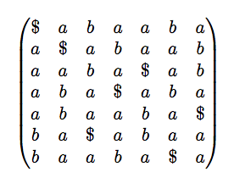
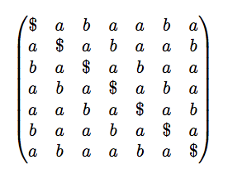
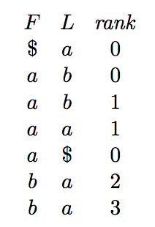
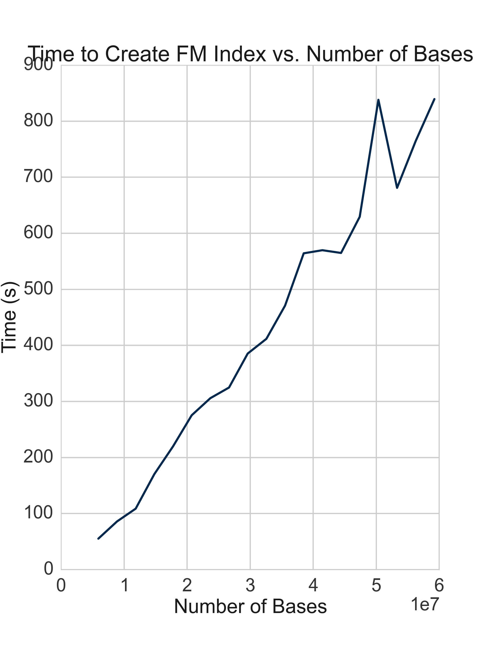

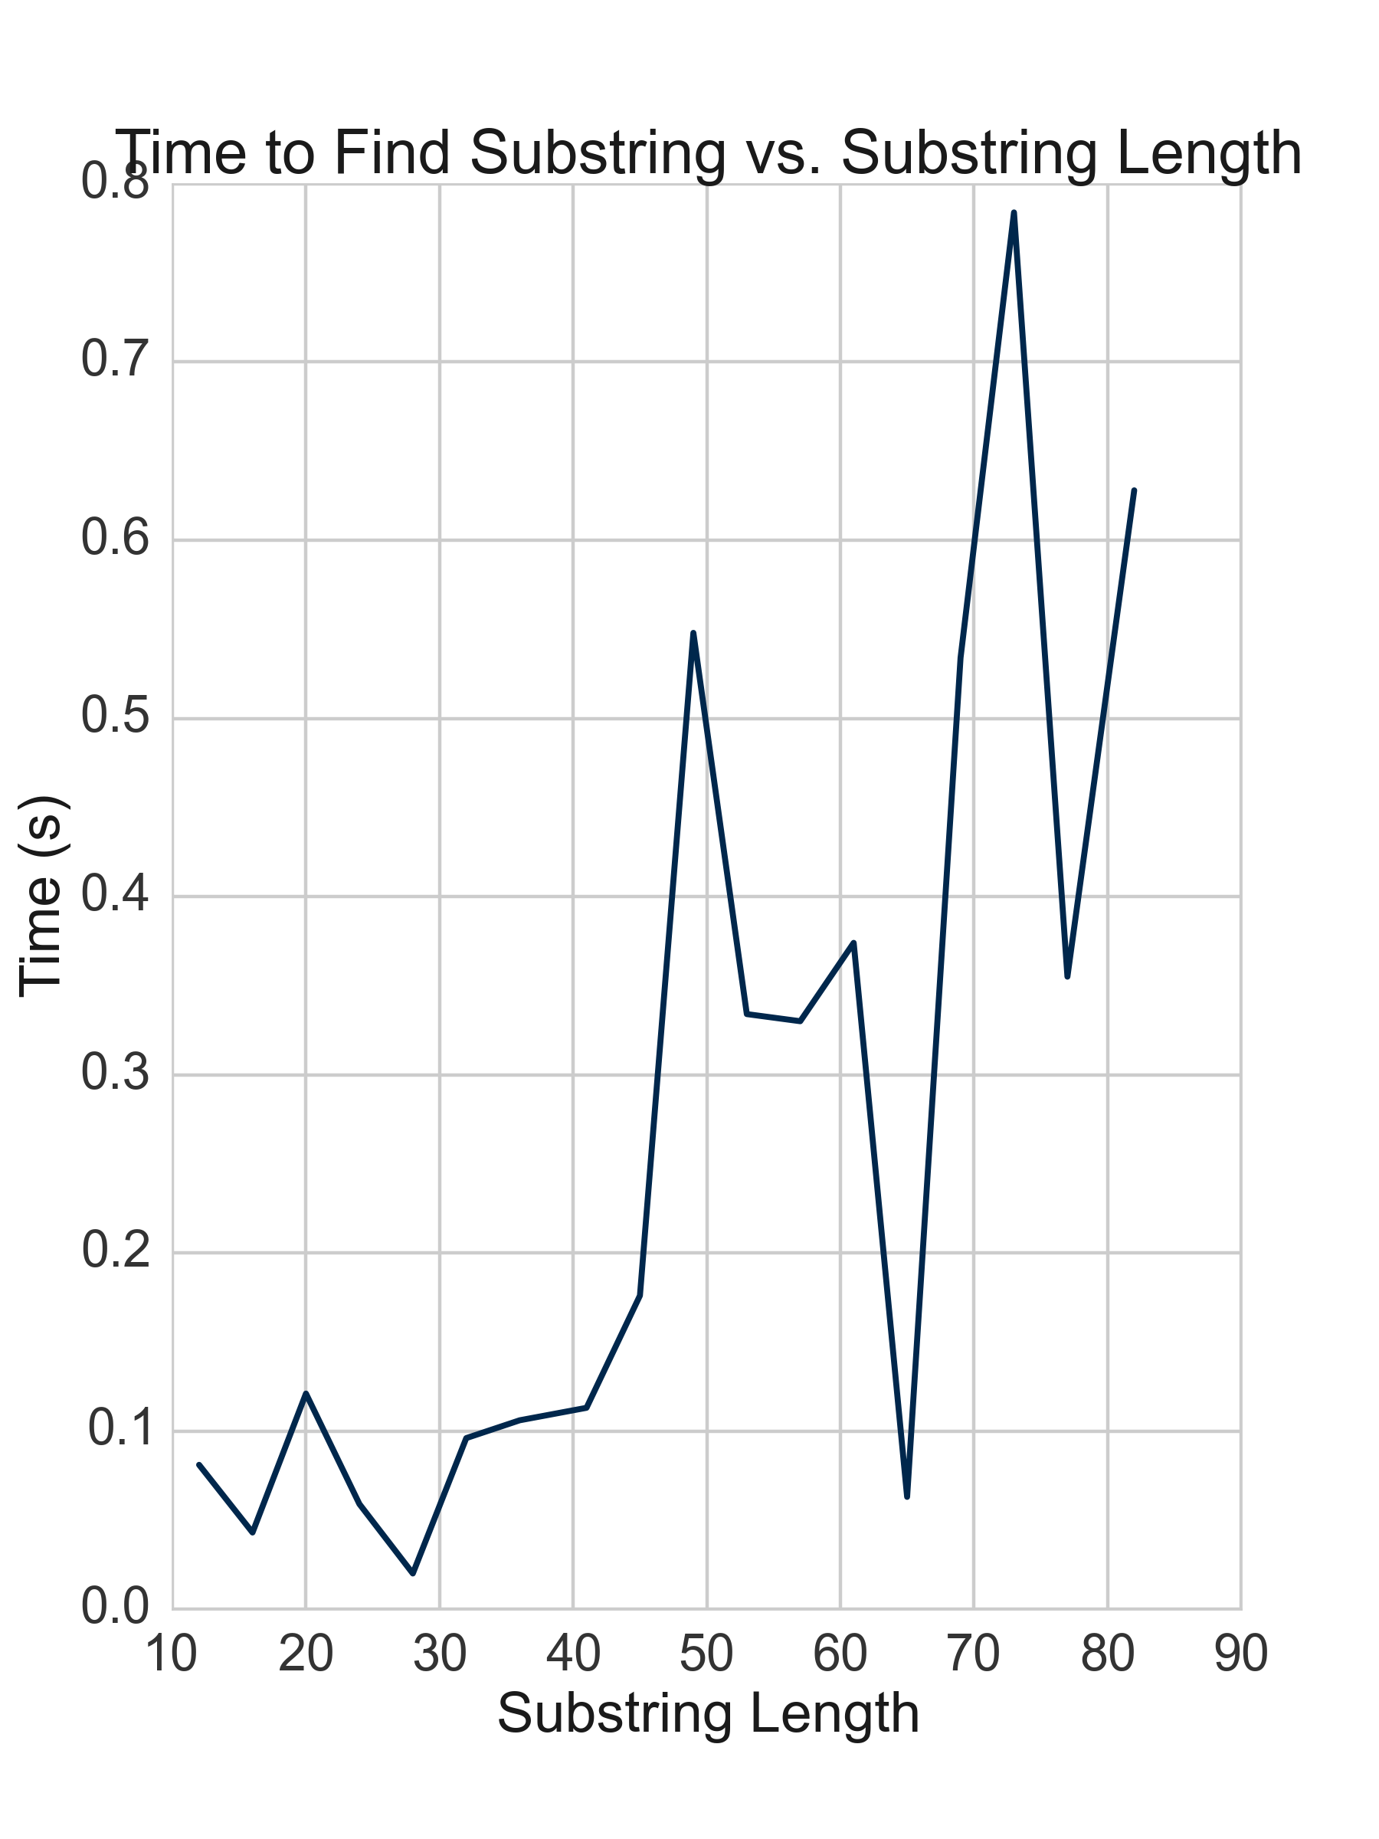


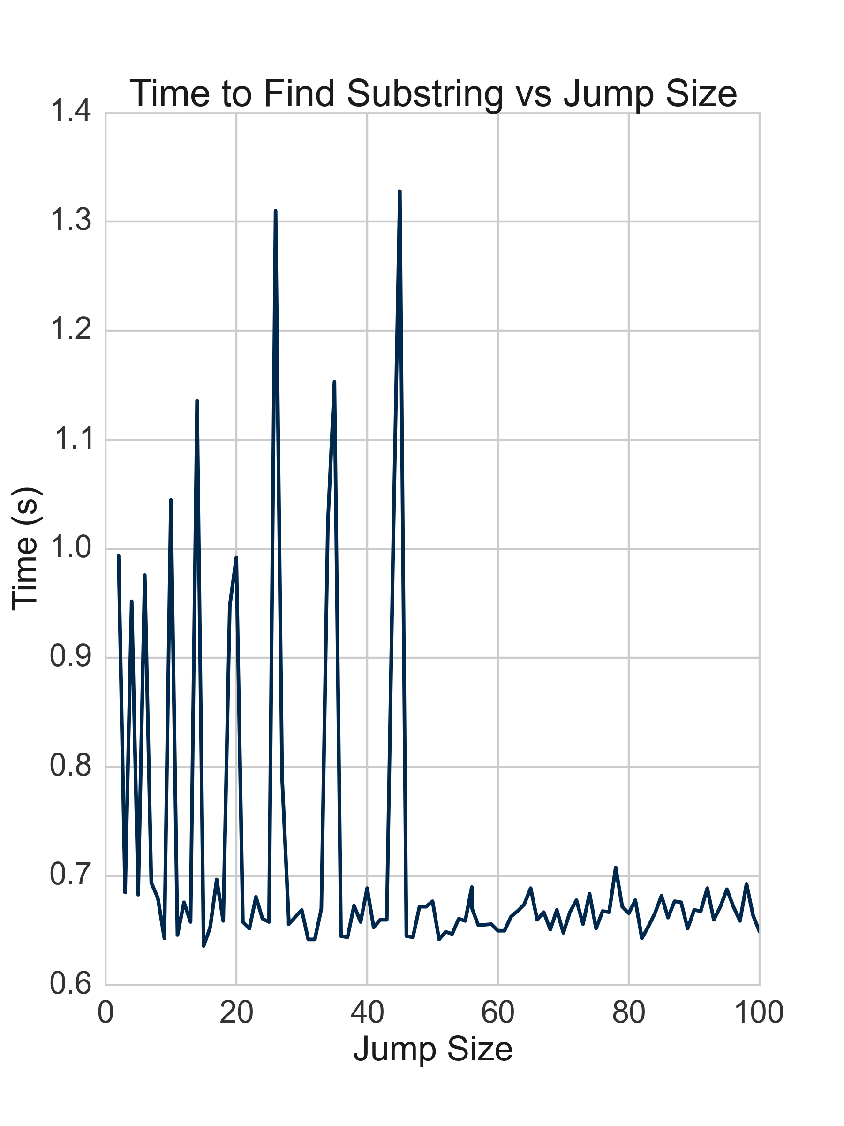
Rapid Indexing and Searching of Genomes
Eli Ben-Michael, Cynthia Chen
Department of Biostatistics, University of Michigan, Ann Arbor, MI, USA
Abstract
Algorithms
Insert Abstract HERE
Burrows – Wheeler Transform
The Burrows-Wheeler Transform is a reversible permutation of the characters of a string T, with cardinality m, into another string, BWT(T). T is assumed to end with a terminator character, $, which is lexicographically prior to all other characters and does not appear anywhere else in T.
FM Index
The Burrows-Wheeler Transform, along with some complementing data structures, can be utilized to create a space-efficient index of T, typically using less than half the space required to store m integers and allowing for searching if specific substrings exist within T in linear time.
e.g. input string: abaaba$
The Burrows-Wheeler Transform of T possess a property called LF Mapping; consequently, by storing the last column(BWT(T)) and select ranks, one can achieve O(1) search time.
e.g. process of searching for “baab” in string “abaaba$”
BWT(T)
sort lexicographically
by row
Indices are obtainable through storing the number of occurrences of the different letters in the original string due to alphabetical ordering.
All rotations of T stacked vertically into an m x m. matrix
The last column of the resulting matrix corresponds to the Burrows-Wheeler Transform of T.
END
Because the Burrows-Wheeler transform places characters with similar right contexts in T together, it makes T more compressible, allowing for various software methods for compression, such as Huffman coding and Arithmetic coding to shrink BWT(T).
START
Results
Challenges and Solutions
The challenges we faced in this project were typically due to the large size of the genomic file we utilized. While the coding of the Burrows-Wheeler Transform and FM Index took less than one week, the rest of the time was devoted towards optimizing it to run more quickly.
The first issue which occurred was not accounting for the fact that arrays could only be accessed by integers, which have a maximum value of roughly two billion. Because the number of bases in the human genome exceeds two billion, we were forced to split the genome into two halves corresponding to chromosomes 1-9 and 10-23, creating two FM Indices as a result.
After splitting the genome into two parts, the next difficulty we encountered was with our method of reading in the genome. Our initial strategy involved reading in each half genome line by line and concatenating each line onto one string. This proved to be extremely slow due to the immutability of strings. Thus, every line we concatenated required the creation of a new string, making the reading increasing slow as we read more of the file. We fixed this by using a String Builder instead, and allocating the capacity during construction.
Lastly, we experienced a slowdown when attempting to create the two FM Indices after reading the file. This was due to the nature of Java garbage collection, as we were creating an individual Base object for each character read, which also caused the program to run less efficiently. This was fixed by creating four Base objects from the beginning and instead assigning pointers to the corresponding base for each character read.

