Slide 1
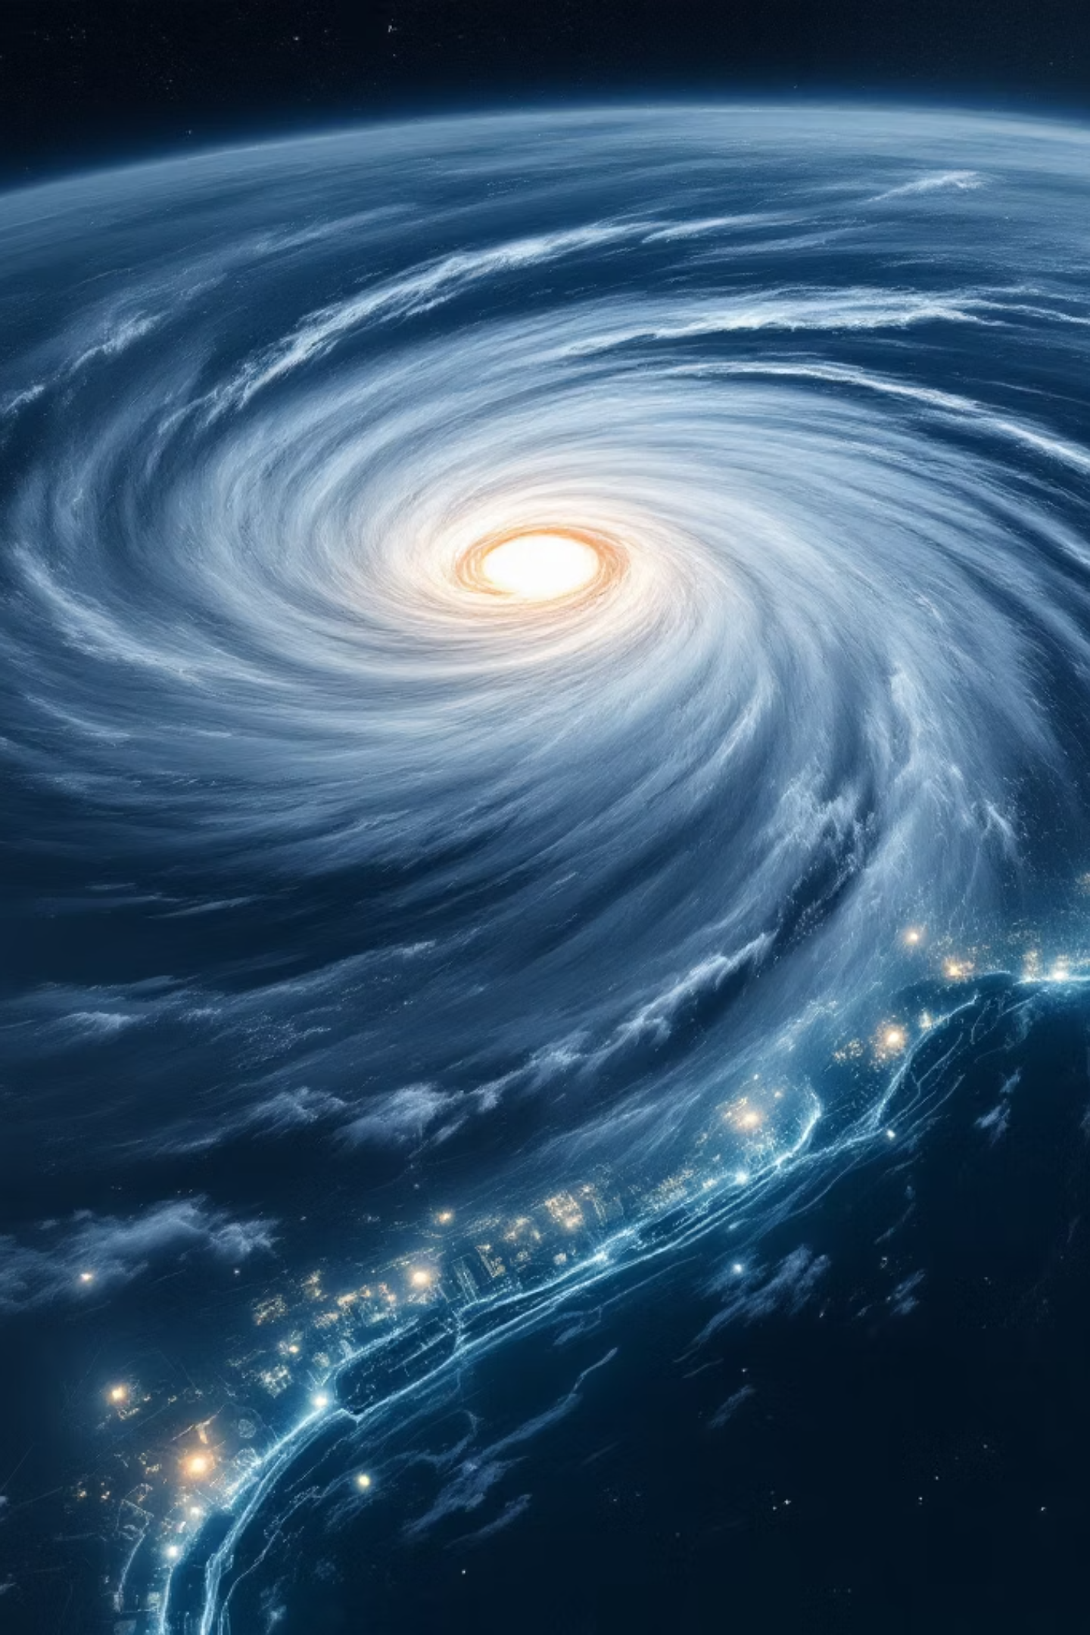
Climate Risk Intelligence Platform
Agent-Based Cascade Simulation for Portfolio Risk
Describe any climate event in plain English — the platform simulates how damage cascades through company dependencies and your portfolio.
POWERED BY MIROFISH ARCHITECTURE
GRAPH RAG
LLM AGENTS

Slide 2

THE CHALLENGE
Climate Events Create Hidden Financial Risks
A single hurricane triggers chain reactions through supply chains, insurance networks, and infrastructure — far beyond the obvious damage.
Direct Damage
Hidden Cascades
Portfolio Impact
A hurricane hits Texas, damaging oil refineries, power grids, and coastal real estate. The obvious loss.
When the grid fails, factories shut down. Refineries close, fuel prices spike nationwide.
Seemingly unrelated companies suffer because they share the same damaged infrastructure.
Key Insight: Traditional models assess companies in isolation. In reality, a single climate event can amplify losses 2–5× through hidden dependency chains.

Slide 3

THE SOLUTION
Describe an Event. See the Cascade. Protect Your Portfolio.
Type any climate scenario in plain English — AI agents simulate how damage ripples through the economy and your holdings.
Agent Network
Cascade Timeline
AI Narrative
Interactive graph of companies and their dependencies, sized by loss severity.
Round-by-round view of how damage spreads from direct impact through the network.
Executive briefing explaining what happened, why, and how losses amplified.
Loss Analysis
Recommendations
Sortable table of every affected company, loss figures, and amplification metrics.
Actionable steps: rebalance, hedge, diversify, or exit positions based on simulation results.

Slide 4
HOW IT WORKS
From Plain English to Portfolio Insights in 6 Steps
01
02
Event Parsing
Agent Generation
AI identifies disaster type, affected regions, and impacted industries from your description.
AI agents created for relevant companies — ExxonMobil for Texas hurricanes, PG&E for California wildfires.
03
04
Knowledge Graph
Cascade Simulation
Dependency network built: who supplies, insures, and powers whom.
Round 0: direct damage. Rounds 1–3: agents reason about losses via Graph RAG.
05
06
Narrative & Analysis
Recommendations
AI writes an executive briefing, quantifies losses, and shows amplification effects.
Portfolio advice: rebalance, hedge, diversify, or exit based on simulation results.

Slide 5
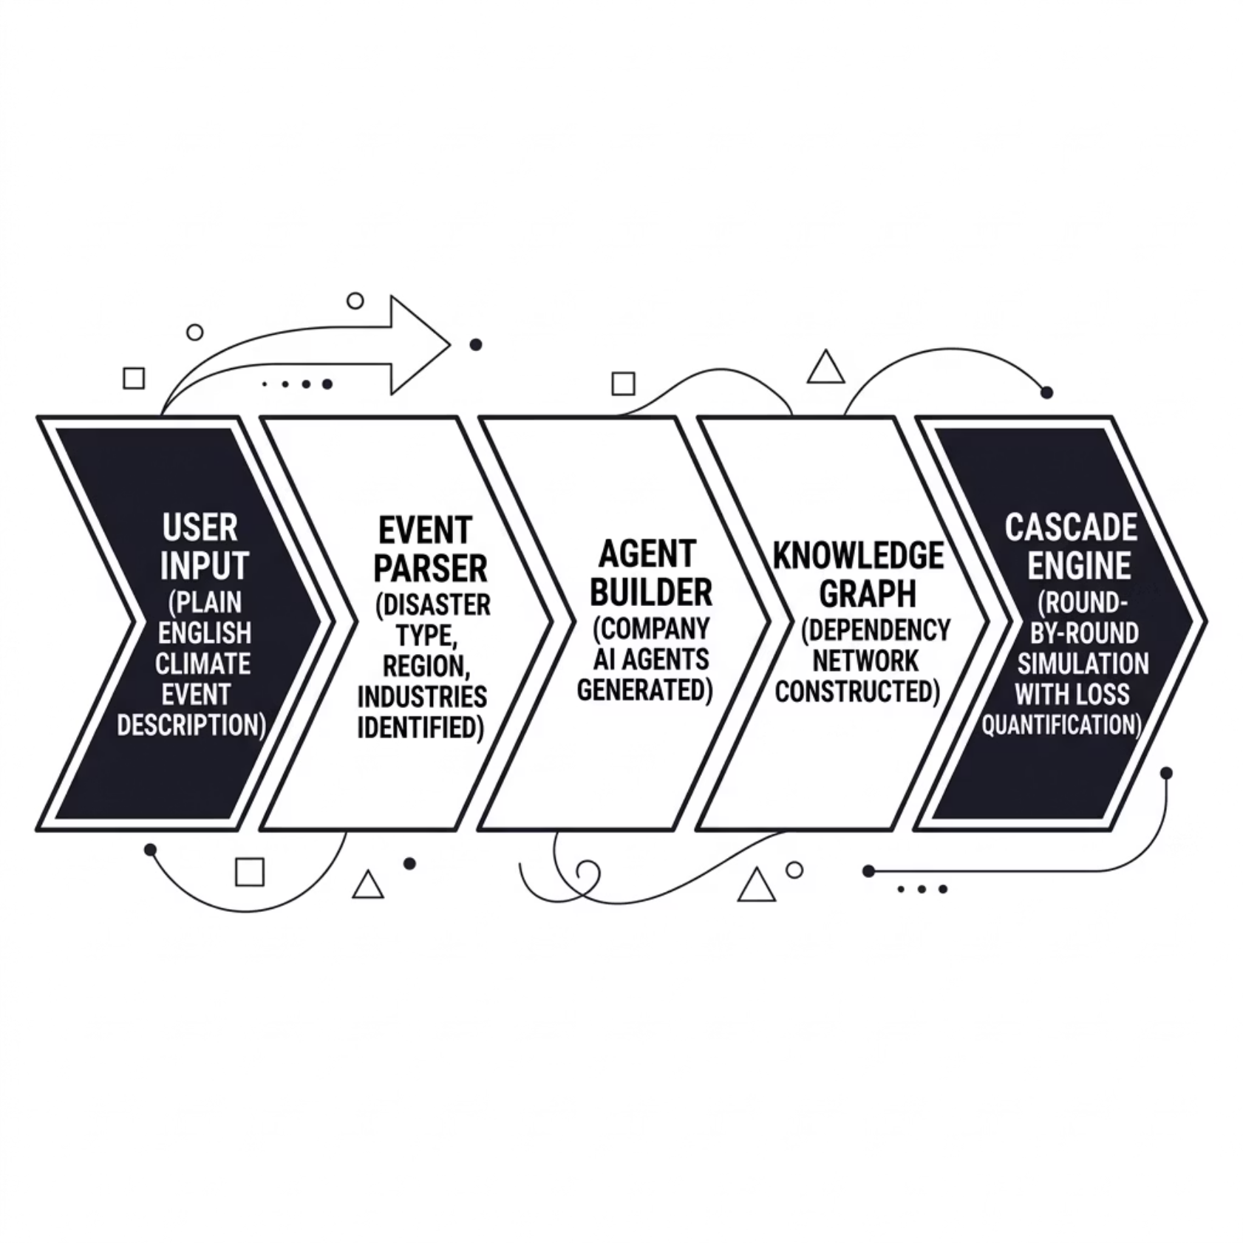

ARCHITECTURE
Full-Stack Platform with AI-Powered Simulation Engine
The platform is engineered for performance, resilience, and real-time interactivity — from the Next.js frontend through the LLM-powered cascade engine. Every layer is designed to handle complex, multi-agent simulations at scale.
Frontend
Backend
AI Engine
Next.js 15 · TypeScript · Tailwind CSS · Canvas API · Framer Motion · Zustand
FastAPI · Python 3.11+ · PostgreSQL · Redis · NetworkX · Pydantic · RESTful API
Gemini / OpenAI LLM · Graph RAG · Per-agent reasoning · Rule-based fallback

Slide 6
AI AGENTS & GRAPH RAG
Every Company Thinks for Itself
Inspired by MiroFish — each company becomes an autonomous AI agent reasoning about its situation using its neighborhood in the dependency graph.
Agent Anatomy
Graph RAG Pattern
Identity
Financials
01
Name, sector, region, type
Market value, carbon intensity
Build Knowledge Graph
Companies become nodes; dependencies become edges.
Dependencies
Reasoning
02
Supply chain, grid, insurance links
LLM-powered or rule-based logic
Walk the Neighborhood
Retrieve 2-hop neighbors and damage state per agent.
Graph Context
Social Feed
03
2-hop neighborhood + damage state
Other agents' reactions this round
Augment the Prompt
Inject graph context into the LLM system prompt.
04
Agent Reasons
LLM sees damaged dependencies and estimates its own loss.
05
Interactive Cascade
Agent A's reaction feeds into Agent B's reasoning.
06
Emergent Behavior
Complex cascade patterns emerge from simple agent rules.

Slide 7
EXAMPLE WALKTHROUGH
"Category 5 Hurricane Hits the Texas Gulf Coast"
Round 0 — Direct Impact
Round 1 — First Cascade
Round 2+ — Deep Cascade
ExxonMobil, CenterPoint Energy, Valero Energy, ERCOT, Southwest Airlines, Camden Property
Phillips 66, Chubb Insurance, BNSF Railway, LyondellBasell, Dell Technologies
FedEx, JPMorgan, Tyson Foods, Tenet Healthcare — losses amplify 2–5×
Simulation Results
$67.5M
$142.3M
Direct Loss
Cascade Loss
$209.8M
211%
Total Loss
Amplification
15 companies affected. Cascade effects account for 68% of total losses — critical systemic exposure data.

Slide 8
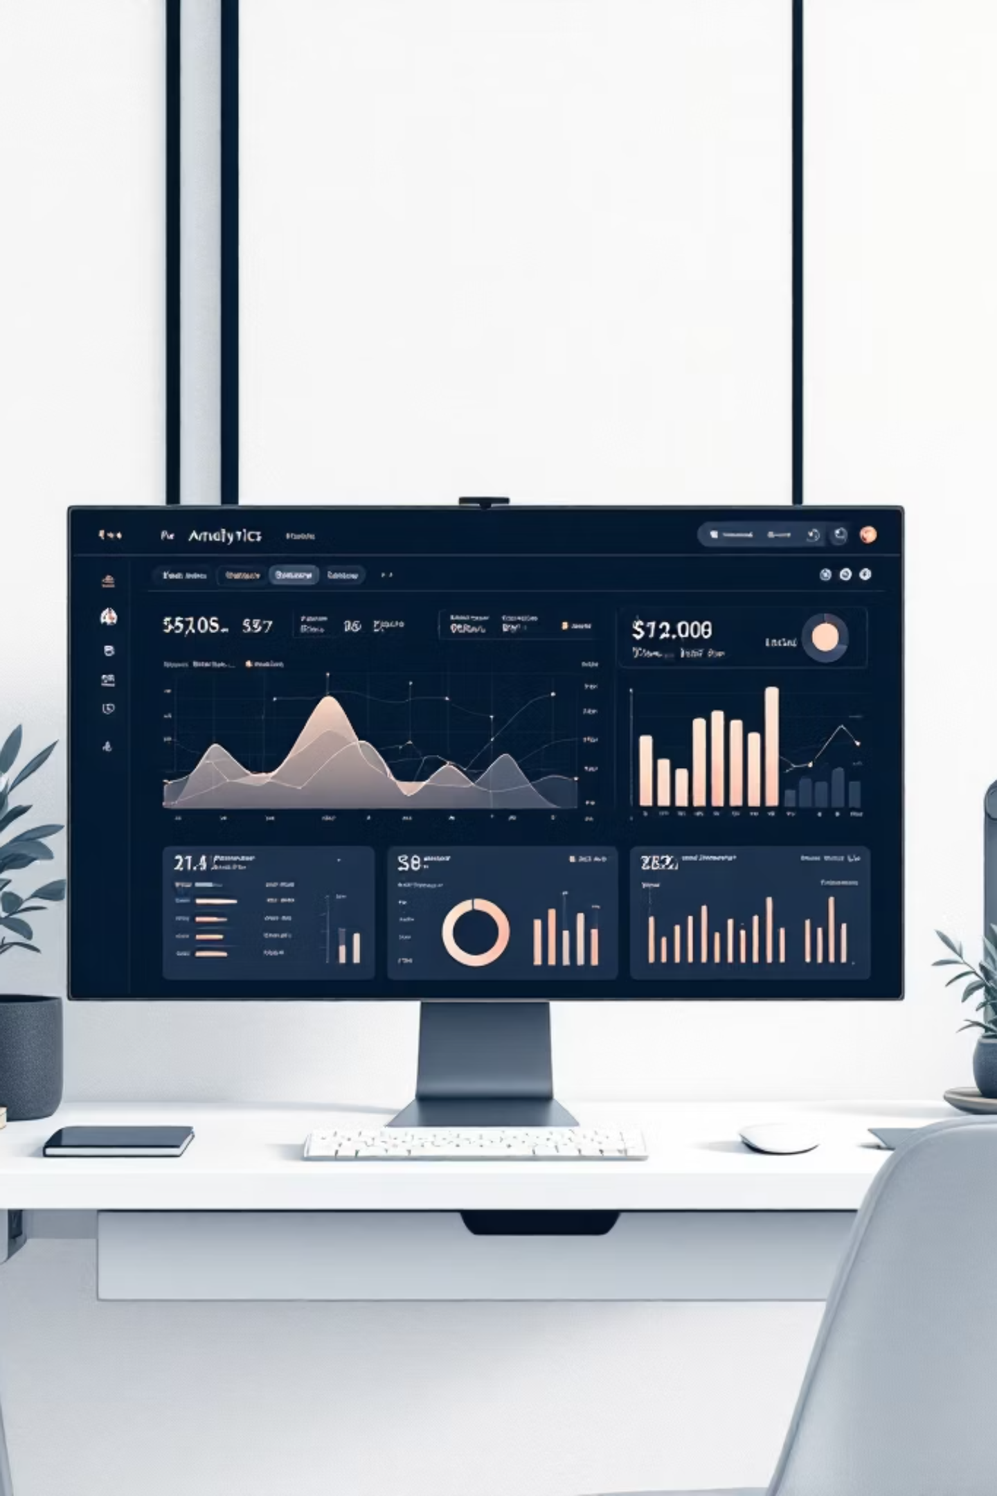
USER EXPERIENCE
Premium Interactive Dashboard
Dark-themed, responsive interface with real-time simulation feedback and rich visualizations.
Agent Network Graph
Canvas-based force-directed graph. Nodes sized by loss, color-coded by sector. Dashed rings mark portfolio holdings.
Cascade Timeline
Events grouped by round with source → target loss flows. Animated particles highlight active edges.
Affected Entities Table
Sortable by loss, sector, region. Portfolio vs. dependency tagging with risk score filtering.
Recommendations Panel
Categorized actions — rebalance, hedge, exit — with priority levels and affected entities.

Slide 9
SMART FEATURES
Built to Be Resilient, Just Like Your Portfolio Should Be
Dynamic Agent Generation
Graceful Degradation
Generates relevant companies even outside your portfolio — they're part of the dependency chain affecting your holdings.
No API key? Rule-based fallback runs parsing, cascade math, and narratives. Rate-limited? Auto-switches mid-simulation.
200+ Real Company Registry
Cascade Amplification Tracking
Curated companies by sector and US region with realistic market values and dependency profiles.
Quantifies how cascade effects multiply losses — a 211% amplification means indirect losses more than double direct damage.

Slide 10
SCENARIOS & USE CASES
Any Climate Event You Can Describe, We Can Simulate
🌀 Hurricane
🔥 Wildfire
Texas Gulf Coast
Energy → Utilities → Transportation
🌊 Flood
🌡️ Extreme Heat
Midwest River Basins
Utilities → Healthcare → Consumer
💰 Carbon Tax
🏜️ Drought
Energy → Materials → All high-carbon
Agriculture → Water → Real Estate
💻 Supply Shock
❄️ Winter Storm
Tech → Consumer → Manufacturing
Northeast US

