Slide 1
A History of Feminism in 20 minutes!
By Dr. Elisa Beshero-Bondar
Presentation for La Cultura Panel on the “F” word: 9/15/2011

Slide 2
When did “feminism” begin?
1850s dictionary definition of “feminism”: the qualities of females.
1880s – 90s: “feminism”: advocacy for equality of the sexes. Connected with women’s movements for voting rights and legal reform in France, Germany, England, and the U.S.
Roots of “feminism” are much earlier. . .identifications of common problems experienced by women within society

Slide 3
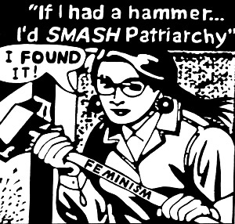
Patriarchal Tradition and Her “Lot in Life”
Patriarchy: society in which authority, value, and social order are consolidated in male lineage: Fathers pass authority, property to sons.
Not universal, but widely prevalent in the world’s cultures—social hierachies
Modern pattern: “Patriarchal tendencies” have replaced ancient egalitarian tendencies:
Feminists experience varying degrees of tension with “patriarchal tendencies or expectations.”
Women in Patriarchy: family property, exchanged in marriage (dowry / bridewealth)
Marriage: for proper order of society. Having sons = blessing to women in patriarchal systems. Increases woman’s social importance and rank.
Independent women? Exiles? Aging unmarried women, widows—outsiders, no reliable financial support from patriarchal family.

Slide 4
When Patriarchy is Law. . .
English / US common law and custom (~1600s – 1800s) treated husbands as “heads” of families, and wives as “hearts”
Laws of “coverture”: wife is “covered” by husband who speaks for her, for entire household.
No voting for women, because their views are supposed to be “covered” by male relatives or husband.
Married women and widows: no rights to own property, to their own money. Might be represented by their husbands or male children if called as court witnesses.

Slide 5
Deep Roots of 19th-c Western Feminism
Subcultures with women as religious authorities (Medieval convents, Protestant Quakers)
Age of Reason and Revolution
Rights of Man, AND Rights of Woman: first feminist tracts (1770s – 1790s)
Protesting patriarchal laws and customs, advocating for women as equal citizens
Notes:
Abigail Adams to John Adams: “Remember the ladies” as you’re planning the new U.S. constitution. . .
Judith Sargent Murray “On the Equality of the Sexes” (1790) (US: equal education)
Olympe de Gouges: Declaration of the Rights of Woman and the Female Citizen (1791) (Revolutionary France)
Guillotined during Robespierre’s Reign of Terror
Vindication of the Rights of Woman –Mary Wollstonecraft (published in England, 1792)

Slide 6
The Revolution Era and the “Rights of Woman”
American and French Revolutions: 1770s – 1790s
Thomas Paine: The Rights of Man (1790)
Revolutionary calls for intellectual and social equality of the sexes: (US, France, England)
Abigail Adams to John Adams: “Remember the ladies” as you’re planning the new U.S. constitution. . .
Judith Sargent Murray “On the Equality of the Sexes” (1790) (US: equal education)
Olympe de Gouges: Declaration of the Rights of Woman and the Female Citizen (1791) (Revolutionary France)
Guillotined during Robespierre’s Reign of Terror
Vindication of the Rights of Woman –Mary Wollstonecraft (published in England, 1792)

Slide 7

Mary Wollstonecraft: “the mother of modern feminism”
Wollstonecraft’s Vindication of the Rights of Woman
Public letter to Charles Talleyrand (Education Minister, Revolutionary France—1792) to debate the role of education for women in a revolutionary “free” society:
Talleyrand had argued that the state should only educate boys. Girls should be educated at home.
Wollstonecraft retorts that no society is free until girls and boys are educated with equal expectations
To educate the sexes unequally is to perpetuate tyranny—to corrupt the morals of children: prepares boys to be tyrants, and girls for bondage as dependent captives in life.
Read (quietly) by future generations of feminists in England and America. Not taught until 1970s

Slide 8
First, Second, and Third Waves: feminism → feminisms
FIRST WAVE: 1800s – 1920s SECOND WAVE: 1960s – 80s THIRD WAVE: 1990s – present

Slide 9
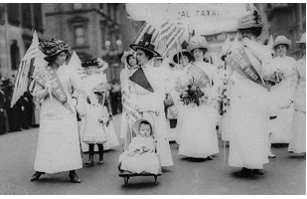
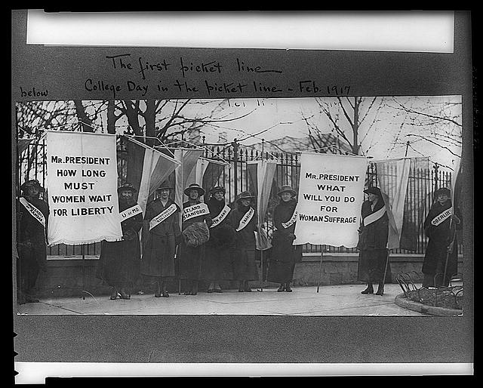

“First Wave” Feminism

Slide 10
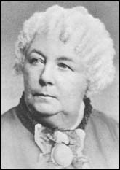
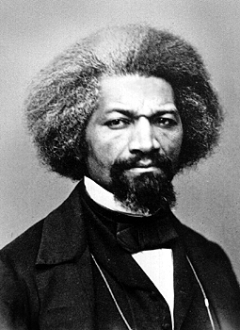
USA: “First Wave” Feminism
Seneca Falls Convention, 1848 (NY)—organized by Elizabeth Cady Stanton and Lucretia Mott
Beginning of national-scale organizing for women’s rights in the US
Declaration of Sentiments (style of Declaration of Independence)
Frederick Douglass signs
Allegiance of abolitionists with early women’s rights movements: Remove all forms of bondage from society
Temperance vs. Abolitionist emphases:
Temperance unions: women advocating laws for prohibition of alcohol: protect women and children from abuse in their homes.
Abolitionist movements: women leaders protesting slavery first and foremost, and all forms of bondage / oppression in American homes
BIG SPLIT in 1869:
National Women Suffrage Association (Susan B. Anthony and Elizabeth Cady Stanton): Women’s suffrage first and foremost.
vs.
American Women Suffrage Association (Frederick Douglass and Lucy Stone): Suffrage for former slaves (males) first—then turn to women.

Slide 11
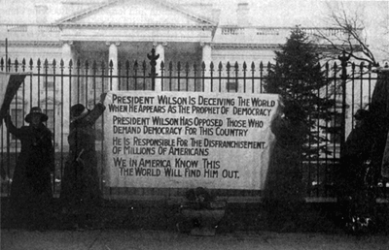
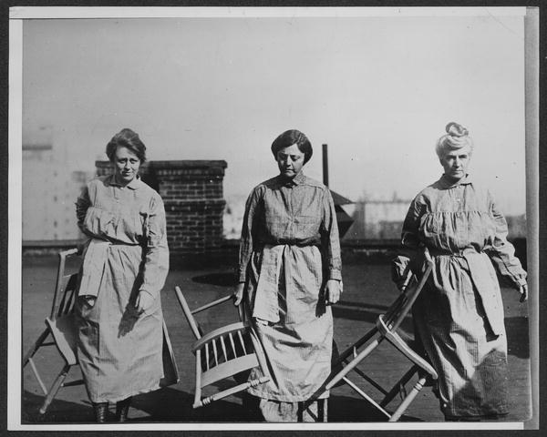
Voting rights (USA)
1870: 15th Amendment (ALL MEN regardless of race / color)
Women’s Suffrage: rights to vote (first granted in Wyoming / Western frontier territories—late 1800s
1900s – 1910s: feminist protests, picketing in front of White House, govt buildings → arrested / jailed. Hunger strikes. Torture by force feeding.
1920: 19th Amendment passes “The right of citizens of the United States to vote shall not be denied or abridged by the United States or by any State on account of sex. Congress shall have power to enforce this article by appropriate legislation.”
Prisoners Doris Stevens, Allison Turnbull Hopkins, Eunice Dana Brannan. Associated Press Photos. 1919

Slide 12
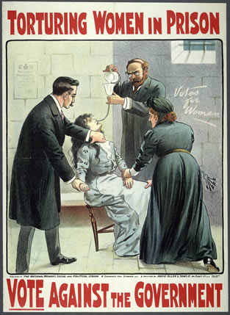
Alice Paul and other first wave feminist leaders were force fed by doctors and prison guards to stop their hunger strike→prevent martyrdom

Slide 13
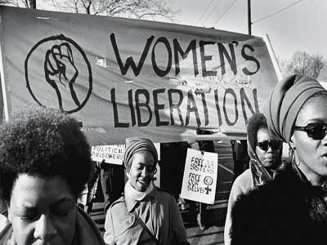
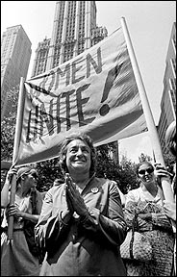
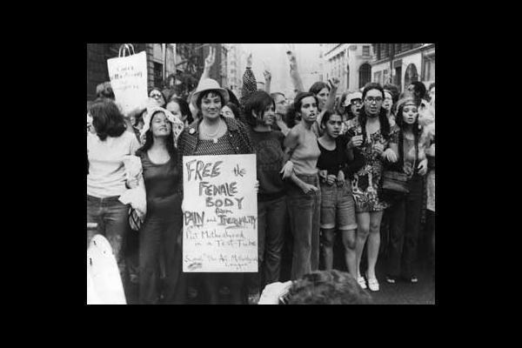
Second Wave Feminisms

Slide 14

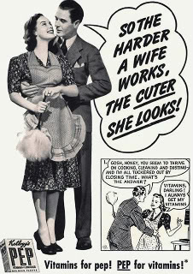
A “Second Wave” Ignites!
Betty Friedan, “The Feminine Mystique” (1963)
Criticized the Post- World War II culture of the 1950s for setting women back
“feminine mystique” = ideal of womanhood projected in 1950s women’s zines as completely fulfilled in the life of a wife and mother, always giving generously to others
STARK CONTRAST with the 1930s – 40s media images of “career women”: What happened to those images of independence and workplace assertiveness?
Women of the 1950s-60s: unhappy and unfulfilled at home—need more in their lives
self-actualization outside marriage / family unit

Slide 15
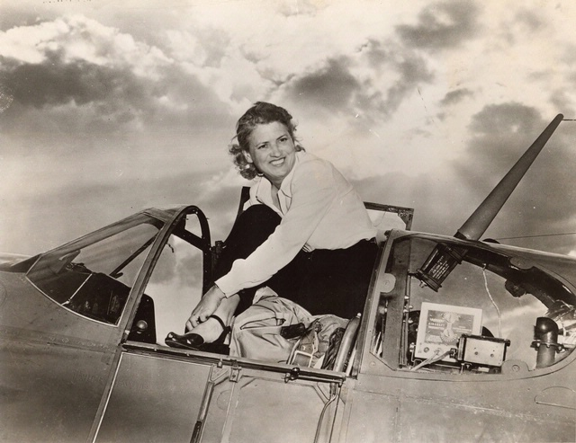
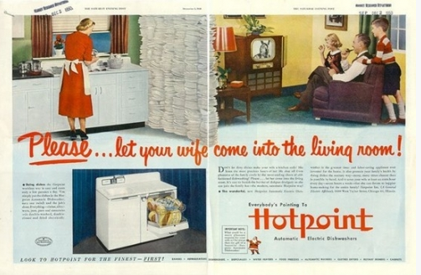
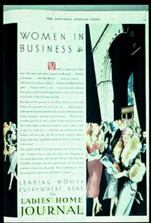
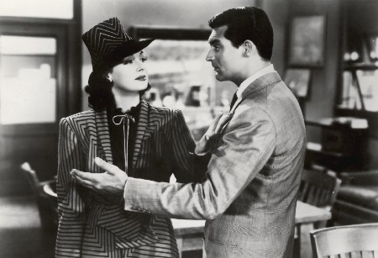
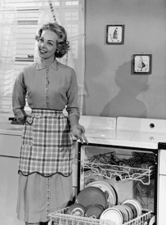
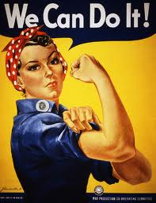
1930s vs 1950s: feminism vs. mystique
Notes:
Ladies Home Journal of 1930: celebrating emancipated women woman aviator—1930s – 40s office scene from “His Gal Friday”

Slide 16
Second Wave: Workplace, Law, Education
Hiring and promoting women to the same ranks as men (fighting “the glass ceiling” and sexual harassment)
NOW (National Organization of Women): Activist Organization
“equal pay for equal work”
Equal Rights Amendment
Maternity and paternity leaves / child care so moms can work
Women seek power positions in male-dominated professions: CEOs, lawyers, scientists, doctorates, professions
Introduce “Women’s Studies” and “Gender Studies”: learn from women’s experiences, women’s traditions in art, literature: CHANGE THE CULTURAL MAP OF OUR PAST
Notes:
9 to 5 Helen Gurley Brown: editor of Cosmopolitan

Slide 17
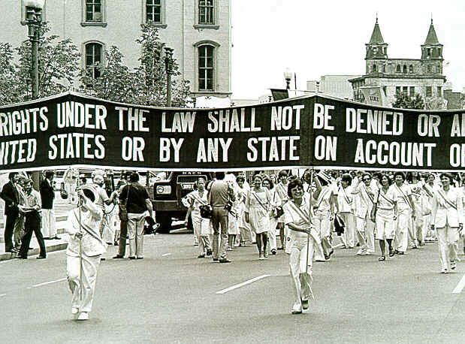
Equal Rights Amendment (ERA) in USA
The ERA: proposed amendment to the US Constitution
First proposed in 1923, passed by US Congress in 1972, repealed in 1982 when it fell short of ratification by three states)

Slide 18
Full Text of the ERA
Section 1. Equality of rights under the law shall not be denied or abridged by the United States or by any state on account of sex.
Section 2. The Congress shall have the power to enforce, by appropriate legislation, the provisions of this article.
Section 3. This amendment shall take effect two years after the date of ratification.

Slide 19
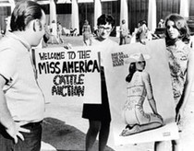

Second Wave Sexual Revolution
“The personal is political” –resist patriarchy’s customs / expectations over your personal life!
Protest beauty pageants: Patriarchy’s cattle auction
Women should seek sexual pleasure for themselves, not serve the pleasure of others
Don’t put up with rape. No means no!
Don’t be ashamed of female desire. Orgasmic liberation!
Women should have deciding power over their bodies—over sex and pregnancy
Limit family size and protect life opportunities for women:
Availability of birth control pill: affordable, convenient (“The pill”: first manufactured in 1950s)
Legalize abortion (Roe vs. Wade Supreme Court decision, 1973)

Slide 20

Tensions within Second Wave
Over gender definition
Essentialism! Are there *essential* differences between males and females?
Are heterosexual relationships dangerous to women? Is heterosexual sex a fundamentally violent act—a conquest?
“A woman needs a man like a fish needs a bicycle.” --Irina Dunn, U of Sydney, 1970
Over sexual expression
Serving male gazes, or taking power over people through sex? Taking advantage?
Porn stars / sex workers→ oppressed or empowered?
Over race and culture:
“Feminism”: too much about white women!
White women achieving in white men’s world--become like white men in taking power and pleasure for themselves? Oppressors!
Alice Walker proposes “womanism”: black women as strong supporters, pillars of reliability needed by black community. Supportive of men and women both, regardless of race and social class.

Slide 21
“Postfeminist” Perspectives (since 1980s)
Feminism is now in the past; equality has been achieved. The fight is over.
Or…
Feminism broke apart and no one can agree on what it’s for. There’s no central platform—nothing worth fighting for now.
Or. . .
Feminism was too extreme / asked too much. Feminism was about women hating men and having unreal expectations for themselves.
But maybe…
“BACKLASH!” (Susan Faludi , early 1990s): “Postfeminism”is a cultural backlash against the serious work of 2nd wave feminism.
Third Wave Feminism emerges in 1990s as reaction against “postfeminism.”

Slide 22
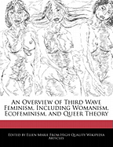
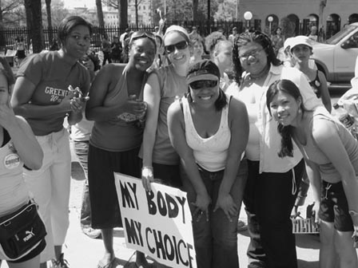

Third Wave Feminisms
“choice is the power of feminism”
–Ali P. Crown at Emory U. (1996)

Slide 23
Third Wave: Generation Gap
Led by Rebecca Walker (daughter of Alice Walker), early 1990s.
Calls attention to generation gap in feminist expectations
Sees Second Wave Feminism as too rigid and combative—alienating.
For many of us it seems that to be a feminist in the way that we have seen or understood feminism is to conform to an identity and way of living that doesn't allow for individuality, complexity, or less than perfect personal histories. We fear that the identity will dictate and regulate our lives, instantaneously pitting us against someone, forcing us to choose inflexible and unchanging sides, female against male, black against white, oppressed against oppressor, good against bad." (Rebecca Walker,1995)

Slide 24
Third Wave Feminism: Goals
End Sexual Harassment—recognize and resolve ongoing problems (link to work of Second Wave)
Motivated by Anita Hill / Clarence Thomas hearings, early 1990s
Emphasis on local diversity of women’s experiences around the world
Advocacy for women absolutely needed—but not just one kind of advocacy!
Not so centralized a movement. Instead--localized networks of women within their own communities
Don’t fight men as the enemy. (Men can be feminists too!)
Instead fight essentialism!
Develop, challenge, complicate ideas about gender and sexuality
Transgender, gay identities
Dispute “essentialism” in understanding of sex and gender.
Many ways to be happy in self-definition!
“grrrrrl power”: sexual assertiveness
“lipstick feminism” – embrace materialism as means to power—don’t feel guilty about physical attractiveness—play to it.

Slide 25
Third Wave Feminisms
Not just about women in Western cultures—Europe, Americas.
Is second-wave feminism applicable to women in Afghanistan? Iraq? Ethiopia?
Is there a more inclusive, plural, culturally sensitive way to be a feminist?
Many possibilities for liberation in women, depending on local / cultural contexts!

Slide 26
Tensions between “Third Wave” and “Second Wave”
“Third wavers” question Second Wave standards for feminist liberation:
Perceived 2nd-wave drive to “have it all”: career and family→ Why not simplify?
Does it really make one less of a “feminist” to put parenting first…or to devote oneself entirely to career? Can we respect each other’s choices?
“Third wavers”: wary of imposing Western feminist standards on Nonwestern cultures: (Example: Respect the veil / chador in Islamic culture: can be a liberating personal decision for women.)
BUT. . .
“Second Wavers” think “Third Wavers” devalue their efforts: (You call yourself a “feminist”? You don’t understand the uphill battles we fought for you!)
Some “Second Wavers” see “Third Wavers” as defending cultures in which women are not given the same rights as men.
Second Wavers don’t see Third Wavers rallying for women’s rights the way they did. No unifying center—too relativist, too happy with sexist fashion trends
Second Wavers (and some Third Wavers) worry that feminism has been hijacked by a vacuous “girl power” commercial culture! Susan Faludi calls this an invasive, regressive “pod feminism” (fake feminism)

Slide 27
Not one feminism but many!
Ecofeminism (protect our environment / preserve water and food resources for women’s health and well being)
Cyberfeminism / technofeminism (make technology work for women’s interests)
Queer feminists (reclaim and redefine abusive terms, support gay communities)
Womanism (respect how women around the world support communities)
Radical feminism (fight patriarchy)
Guerilla Girls (expose gender issues in the art world)
Women’s shelters, women’s networks, ALLIES

