Slide 1
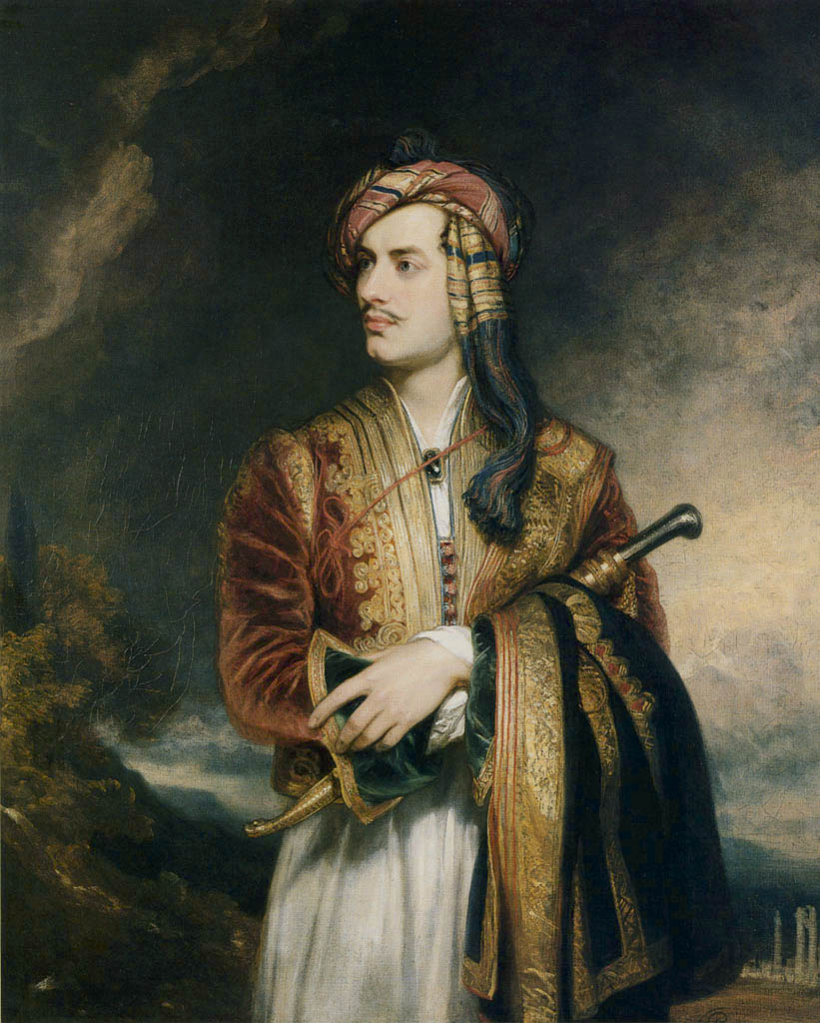
Lord Byron in Albanian Costume, first painted 1814…repainted 1835 (Thomas Phillips, artist)

Slide 2
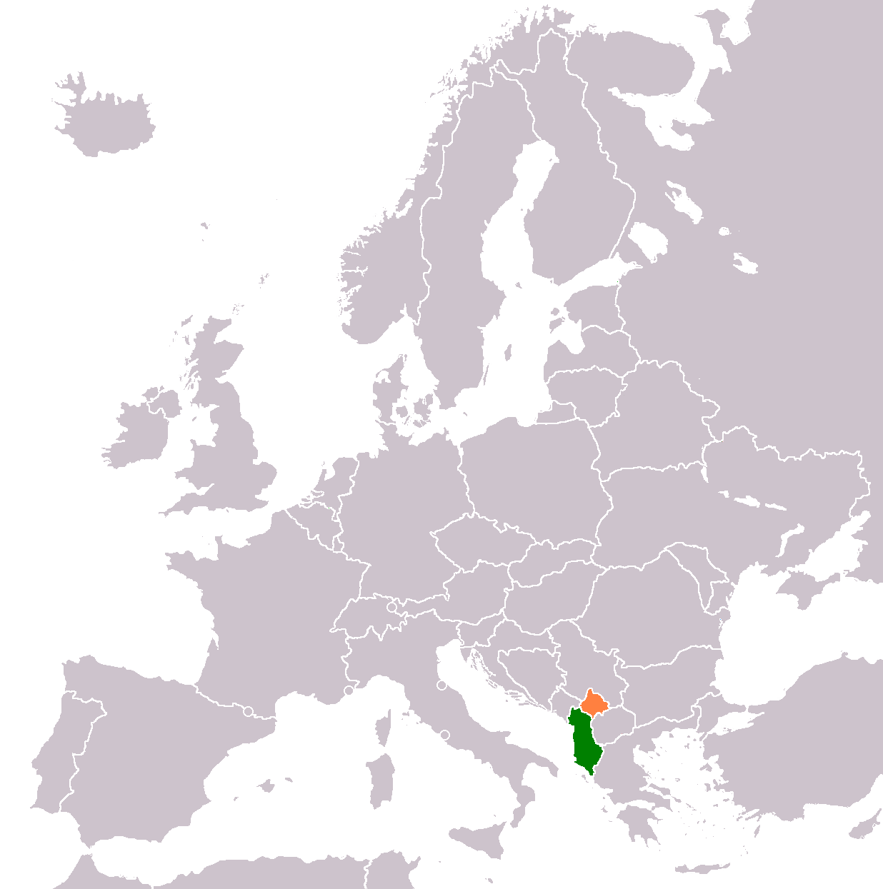

Slide 3
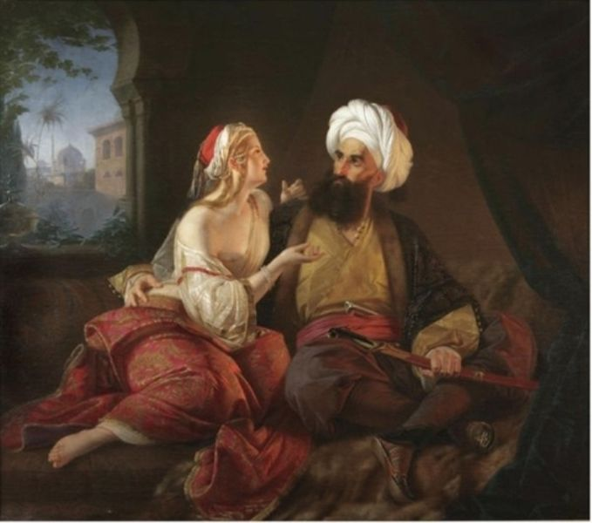
“The Ali Pasha and his favorite mistress”
Paul Emil Jacobs (German artist, 1842)

