Slide 1
Sublime Places of Frankenstein
Maps and Images

Slide 2
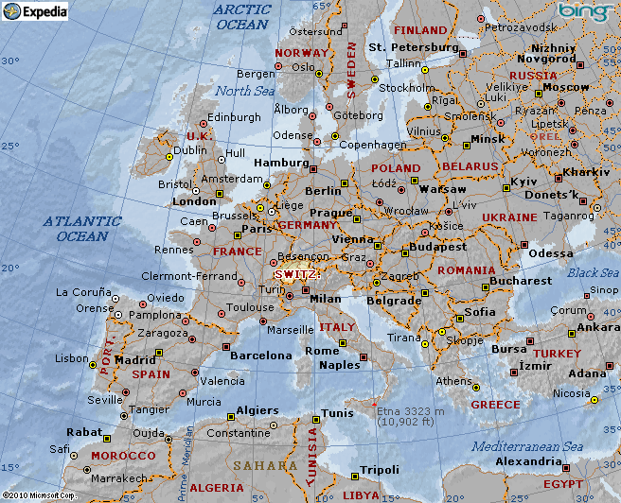

Slide 3
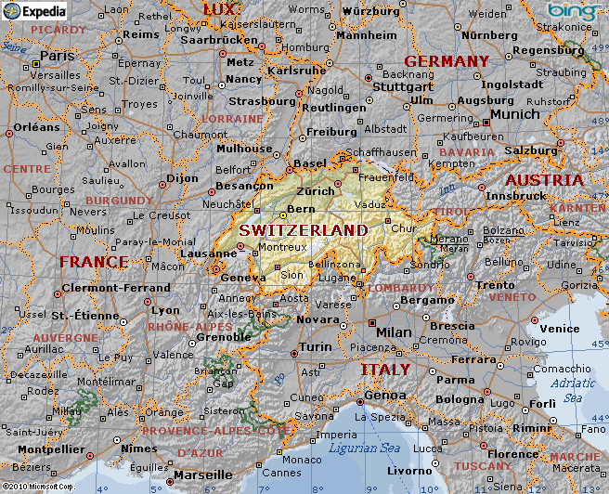

Slide 4

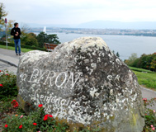
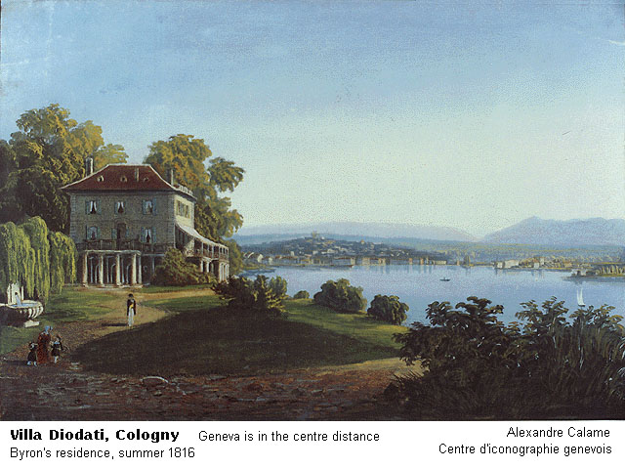

Slide 5
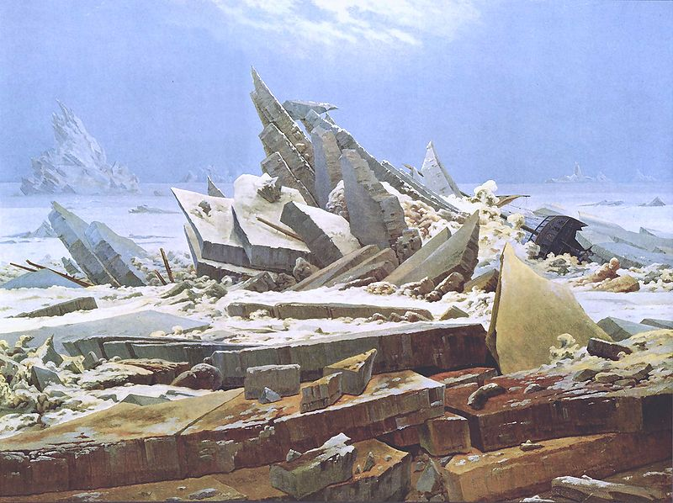
Das Eismeer (The Sea of Ice), by Caspar David Friedrich (1824) inspired by William Parry's Journal of a Voyage for the Discovery of the North-west Passage…1819–1820. Arctic Ocean scene

Slide 6
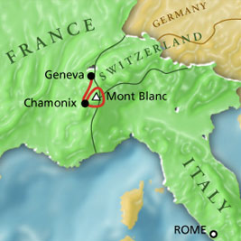
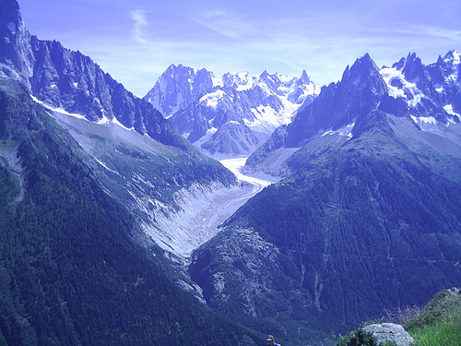

Slide 7
