Slide 1
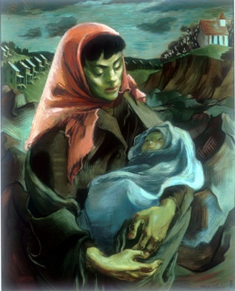
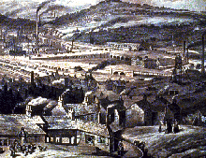
Industrial Revolution and “the Hungry Forties”
Above: Mildred Olmes, “Madonna of the Mines” (1949)
(PA artist)

Slide 2
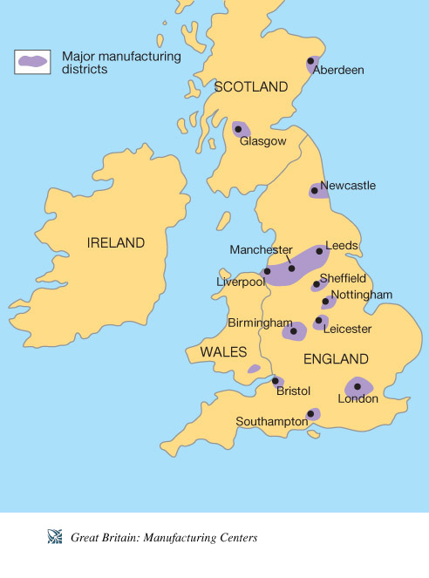

Slide 3
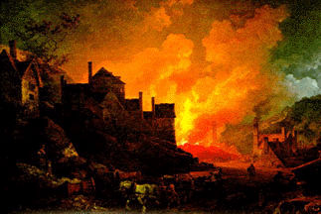
Industrial Revolution:
Begins in England, mid 1700s, with new machine inventions to increase speed and efficiency of cloth weaving (cotton and wool)
Connected with history of African slavery in British colonies and new U.S.→cotton from the American Deep South
First waterwheels, then steam engines power enormous mechanical looms
Makes possible a higher standard of productivity than ever before

Slide 4
INDUSTRIAL REVOLUTION:
High Productivity: transforms agriculture to keep pace (cotton gin, plantations supply raw materials)
Factory workers drawn from agricultural regions—farming roots
Transforms landscape and everyday life:
  Nights bright and fiery, Days darkened—smoke and pollution
  Work shifts in factories: night and day—long hours/hourly wages
  Industrialized lifestyle—unlike farming: not tied to daily/seasonal cycles
  Instead: subject to economic peaks and depressions: Work and unemployment directly hinges on world trade!

Slide 5
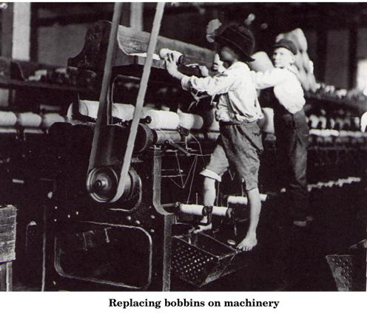
Child labor: 19th – early 20th c. factories. Here: two kids setting new bobbins on a power loom

Slide 6
Population and Poverty:
Great numbers of people seeking work move from rural areas to factory cities, like Manchester, Birmingham, and Liverpool
Working class: Lousy living conditions / High population density
New extremes in wealth AND poverty
  Wealth: rising class of industrial capitalists, eclipses “old money” landed nobility in England (plutocrats)
  Poverty: “working class” experience: unpredictable life! extreme swings between relative comfort and starvation with economic changes.
Family life: new expectations/forms of work for women and children
  See Elizabeth Barrett Browning’s “The Cry of the Children” (pp. 1140-44)

Slide 7
“Every great city has one or more slums, where the working-class is crowded together. True, poverty often dwells in hidden alleys close to the palaces of the rich; but, in general, a separate territory has been assigned to it, where, removed from the sight of the happier classes, it may struggle along as it can. These slums are pretty equally arranged in all the great towns of England, the worst houses in the worst quarters of the towns; usually one- or two-storied cottages in long rows, perhaps with cellars used as dwellings, almost always irregularly built. These houses of three or four rooms and a kitchens form, throughout England, some parts of London excepted, the general dwellings of the working-class. The streets are generally unpaved, rough, dirty, filled with vegetable and animal refuse, without sewers or gutters, but supplied with foul, stagnant pools instead. Moreover, ventilation is impeded by the bad, confused method of building of the whole quarter, and since many human beings here live crowded into a small space, the atmosphere that prevails in these working-men's quarters may readily be imagined. Further, the streets serve as drying grounds in fine weather; lines are stretched across from house to house, and hung with wet clothing.”
--Friedrich Engels, from The Condition of the Working Class in England, 1845

Slide 8
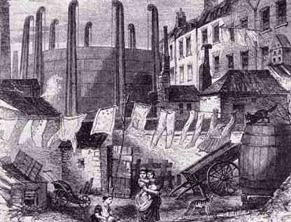

Slide 9
Education:
Industrial Revolution leads to Public Schooling: need for skilled, literate labor force.
First “public schools” established by factory owners
  practical education in the 3 r’s
  theories of society and economics supporting industrial systems (often the POV of the owners!)
  workers sought expertise in Math, Statistics, Sciences, engineering/mechanical skills
Education→new inventions/new, more efficient machinery
Education→possibility of rising from working class to management to mill owner

Slide 10
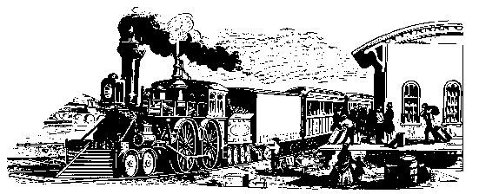
Big Changes for Nineteenth-century Britain:
SPEEDY CONNECTIONS between cities (1830): Manchester and Liverpool Railway begins operations. Trains move at giddy speeds of 30 mph!
GRADUAL LEGAL / SOCIAL REFORMS:
  MORE REPRESENTATIONAL GOVERNMENT:
  1832: First Reform Bill Passed: Eliminates 56 “rotten boroughs” in Britain (see Note to Peterloo Massacre above), adds 143 new Parliament seats for urban areas. Grants right to vote (franchise) to small landholders—essentially upper-middle-class men.
  ABOLITION OF SLAVERY + FACTORY ACT (1833): Slavery abolished throughout the British colonies around the world. Factory Act: Restricts working hours for children under age 12 to 48 hours/week, 9 hours/day, and teens under 18 to 12 hours/day. Kids must be allowed to leave work for 2 hours/day for school.
  WORKHOUSES (1834): Poor Law Amendment: Established workhouses for the unemployed. Men and women kept in separate facilities, food strictly rationed. Idea: Make the workhouse less attractive than employment.

Slide 11
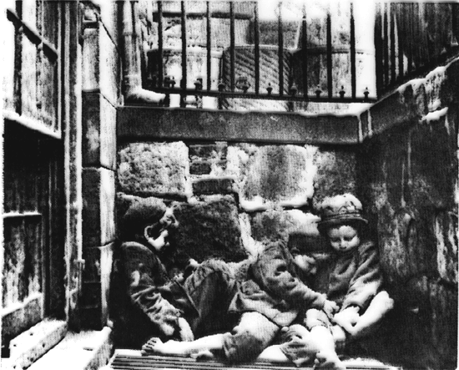
1841-42: “Hungry Forties” severe economic depression.
Crime at an all time high in 1842, particularly high in the industrial north (Manchester, Birmingham, Leeds).
Labor Laws—attempt to limit exploitation of “cheap” labor: Ten Hours Act (1847) limits women and children to 10 hours/day of work.
Chartist Movements: “The People’s Charter”: demands for legal and social reforms—govt that cares about all citizens
Mobilizes British writers:
Elizabeth Barrett Browning, Charles Dickens, Elizabeth Gaskell
(Also in England and Europe: Karl Mark and Friedrich Engels)
Victorian era street kids

Slide 12
General Overview of Social Issues (1840s)
Overcrowding in cities, increasing population and poor sanitation leads to cholera epidemics
Employer exploitation of women and children, as well as immigrants—lower wages, fewer full-time jobs
Laws drafted to protect mill owners’ interests: At first, govt. laws passed to STOP workers from protesting exploitation and wage cuts
Trade Unions once illegal by British law in the 1790s-1810s. Legalized in 1820s. Workers rally to improve their condition—Strikes and conflicts

Slide 13
"It is a community of purpose that constitutes society," continued the younger stranger; "without that, men may be drawn into contiguity, but they still continue virtually isolated."
"And is that their condition in cities?"
"It is their condition everywhere; but in cities that condition is aggravated. A density of population implies a severer struggle for existence, and a consequent repulsion of elements brought into too close contact. In great cities men are brought together by the desire of gain. They are not in a state of co-operation, but of isolation, as to the making of fortunes; and for all the rest they are careless of neighbours. Christianity teaches us to love our neighbour as ourself; modern society acknowledges no neighbour."
"Well, we live in strange times," said Egremont, struck by the observation of his companion, and relieving a perplexed spirit by an ordinary exclamation, which often denotes that the mind is more stirring than it cares to acknowledge, or at the moment is capable to express.
"When the infant begins to walk, it also thinks that it lives in strange times," said his companion.
"Your inference?" asked Egremont.
"That society, still in its infancy, is beginning to feel its way."
"This is a new reign," said Egremont, "perhaps it is a new era."
"I think so," said the younger stranger.
"I hope so," said the elder one.
"Well, society may be in its infancy," said Egremont slightly smiling; "but, say what you like, our Queen reigns over the greatest nation that ever existed."
"Which nation?" asked the younger stranger, "for she reigns over two."
The stranger paused; Egremont was silent, but looked inquiringly.
"Yes," resumed the younger stranger after a moment's interval. "Two nations; between whom there is no intercourse and no sympathy; who are as ignorant of each other's habits, thoughts, and feelings, as if they were dwellers in different zones, or inhabitants of different planets; who are formed by a different breeding, are fed by a different food, are ordered by different manners, and are not governed by the same laws."
"You speak of—" said Egremont, hesitatingly.
"THE RICH AND THE POOR.“ --from Benjamin Disraeli’s novel, The Sibyl (1845)

