Slide 1
The Man Who Would Be King (1888)
Rudyard Kipling

Slide 2
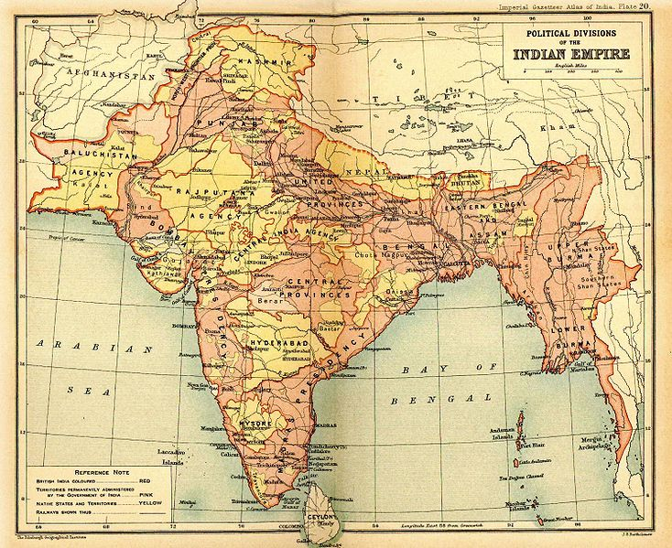
Map of British Raj in 1909

Slide 3
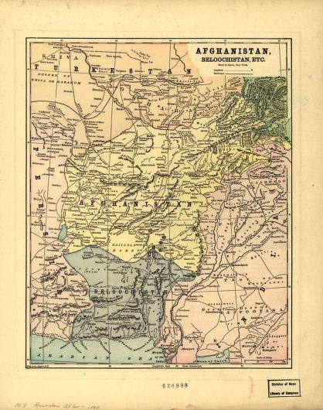
Power of Maps:
Empire Definition
  Create/Draw Political Boundaries
  Provide Ruling Overview
    Mythic or Realistic?
  Terrain, Roads
  British army surveying Indian subcontinent, starting in 1750s

Slide 4
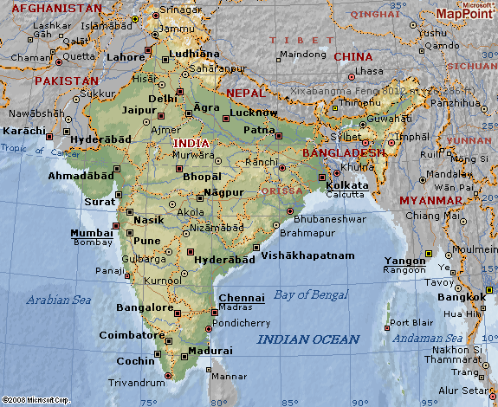
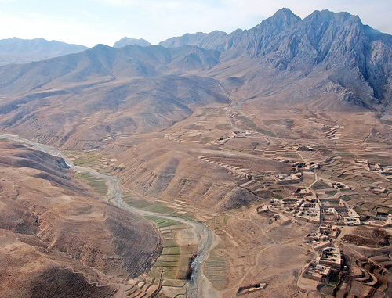
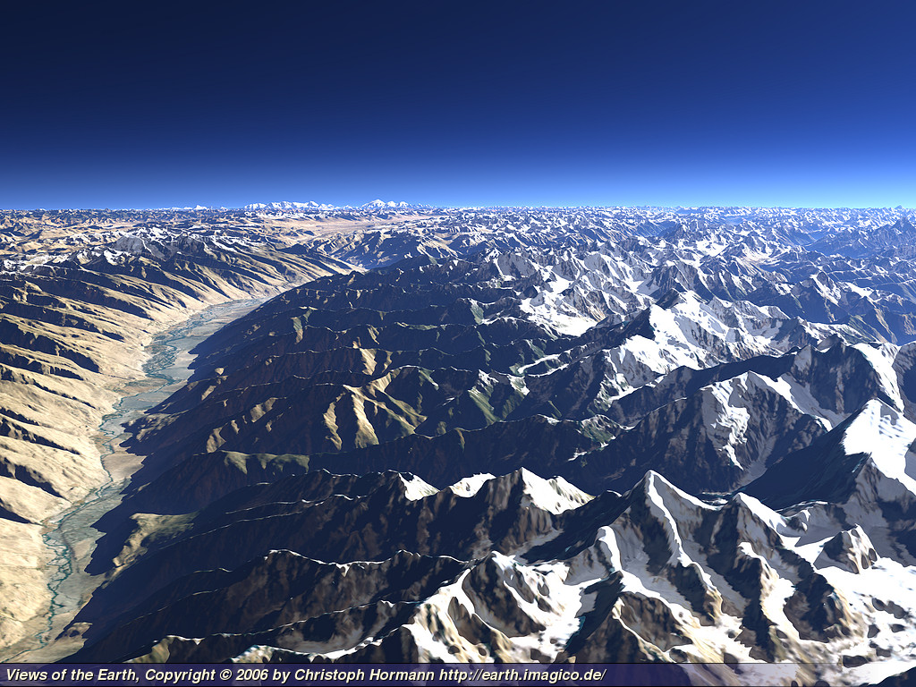
See Google Earth Afghanistan Map
See http://wikitravel.org/en/Kabul

Slide 5
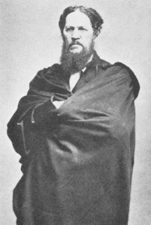
Josiah Harlan (1799-1871)
Kipling’s real-life “man who would be king”
American (from Chester, PA), sailor on cargo ships to India and China
offers to serve the Maharaja of Punjab…involvement with local rulers
Quaker, anti-slavery
  admires the absence of slavery in local Afghan groups, as well as gender equality—strong women
  Sees Afghanis as basis of an ideal egalitarian society
Offers Afghan leaders to train them as a modern army
In return: He becomes a Prince of Ghor..an “emir” (1820s and 30s)
Doesn’t like increasing British involvement…leaves Afghanistan to return to US

Slide 6
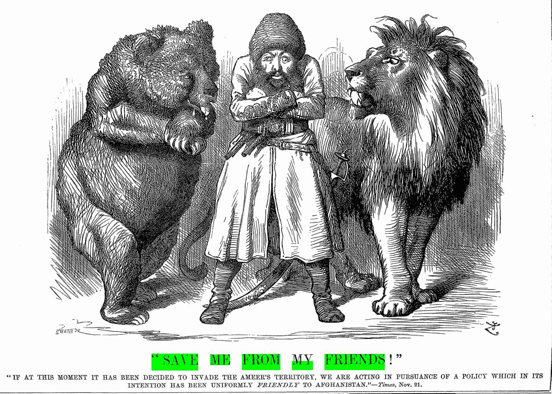
“The Great Game” (1838 – 1900s)
British and Russians vie for control over Afghanistan
(Russian Bear and British Lion surround the Afghan Emir)—Punch cartoon, Nov. 30, 1878
Anglo-Afghan Wars: 1838 through 1920s
  Alarm of 1878
Notes:
Re FIRST Anglo-Afghan War– Brits suffer EXTREME loss– (1839-1842)—lost 4,500 soldiers and 12,000 civilians and children who followd them into Afghanistan
Re Alarm of 1878: Russia and England struggling over Persia and Turkey as well as Afghanistan. Position of Afghan, right on BORDER with Russia—Brit concern is that Russians might use it to get at their “Jewel in the Crown,” India.
--Afghan leaders entertain Russian visitors, and Brits get wind of it. Neville Chamberlain (future prime minister) sent with a treaty group over the Khyber Pass (from India), but they were told to leave! Brits then send military force against the Afghans—force them to make a place in Kabul for a British envoy, Sir Louis Cavagnari…Cavagnari arrives and the Afghanis riot—and kill Cavagnari and the peace enjoy. Brits respond with military force: 2nd Afghan War.
See Longman Conrad / Kipling cultural ed: pp. 106-107.

Slide 7
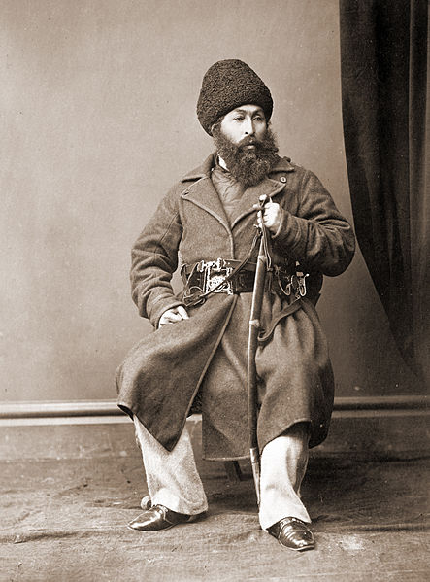
Afghanis—past centuries in conflict between Persia and India
  Hard fought Afghan independence in 1700s
Afghan Emir Shir Ali Khan tries to keep both Russia AND Britain out (2nd Afghan War)
Conflicted leadership: civil wars / family struggles for power, aggravated by British
  Shir Ali Khan (1860s-70s), fought British and lost, fled to Russian territories
  His son, Ya’qub Khan, as new Emir, signs peace treaty with Britain—allowing them power to control foreign affairs (May 1779), but…
  …uprising! Riots! (Sept. 1779…)
Shir Ali Khan, 1869

Slide 8
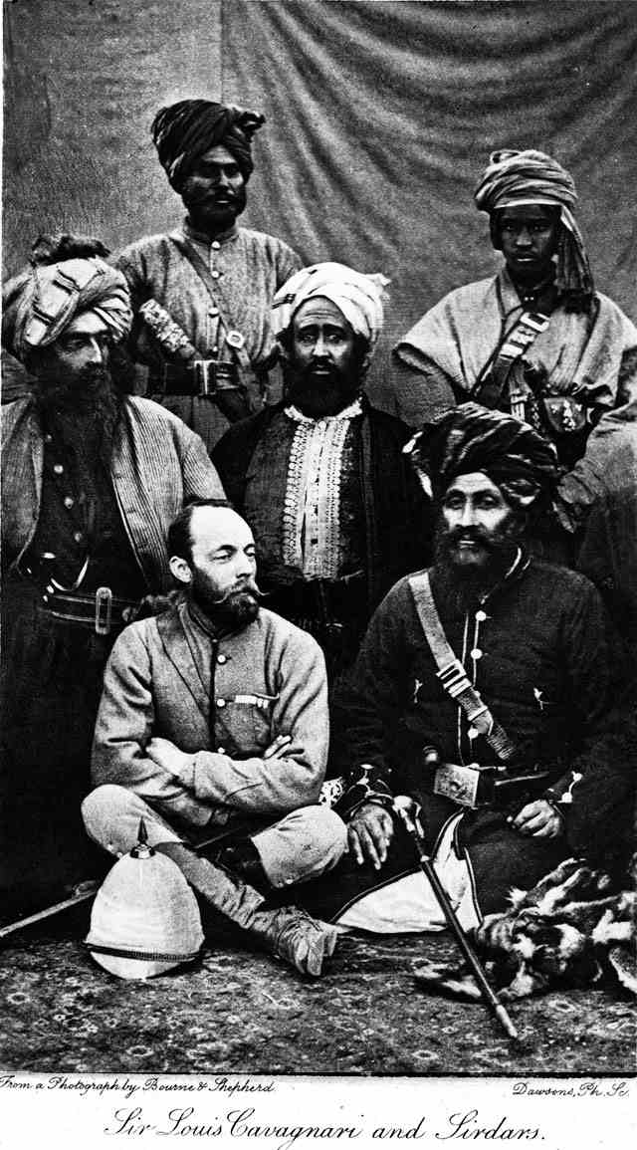
Louis Cavagnari, leader of the ill-fated British “peace” mission, among a group of Sirdars—powerful Afghan group.
  Negotiates with new Afghan emir, Ya’qub Khan
  killed in Afghan uprising in Kabul, Sept. 1879
Brits respond aggressively
  Drive emirs from power, replace them with members of rival factions
  Assert Brit control of Afghan territories…cultivate Afghan emirs with pay and promise of military protection…
  See p. 1859—Peachey and Dravot, past involvement.

Slide 9

Perspective on British Empire in
“The Man Who Would Be King”
Roads, Trains, Telegraphs: circulation of big network (see pp. 1854-55)
  Ability to coordinate meeting times (travelling in subcontinent)
Media: maps, encyclopedias, newspapers
  waiting for newswire: death of “a real King” in Europe
  Context for meeting with Daniel Dravot (red beard) and Peachey Carnahan
Guns: Martini-Henry (1870s-80s)—cheap to mass produce or convert from older models

Slide 10
Tale Structure
Frame narrative: our narrator’s changing positions (see pp. 1855-1856)
  Newspaper office (pp. 1856-1857)
Connection with Daniel Dravot and Peachy Carnehan (p. 1858)….Contract (p. 1860)…the Serai (p. 1861)
Tale of three summers’ reign of two kings
  Peachey Carnehan returns to tell the tale (p. 1863)
    Or is it him anymore? (See p. 1864)
  Boundary between Madness and Opportunism?
  Empire and Frontier territories

Slide 11
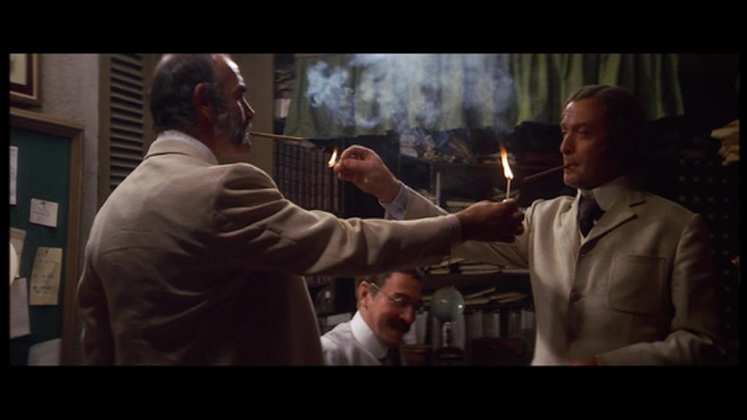
Loafers’ (Tricksters’) Plan (see pp. 1858-1860)
Goal: to be Kings in Kafiristan!
Hybrid abilities: speaking native languages, taking on roles
    Mad priest
    King/God
    String-talk letter (p. 1867)
Perspective on Afghanis…as English?

Slide 12
Being Kings, Building Empire
How Carnehan and Dravot gain power (pp. 1864-65)
  Disconnected mountain terrain, rope bridges
  Bows and arrows vs. guns
Dravot’s Kingship and Godhood (pp. 1865-66)
  Attracts attention of neighboring chiefdoms (“a new God kicking about”)
  Freemasonry: mysterious rituals and nation-building (p. 1868)
    Stone of Imbra Chair and the Missing Mark (p. 1869)
    Deciding the Afghanis are “Lost Tribes,” become English (p. 1870)

Slide 13
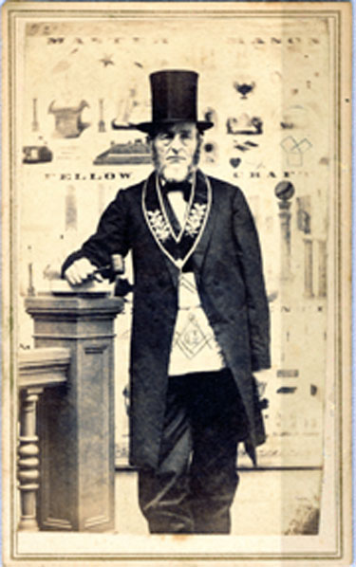
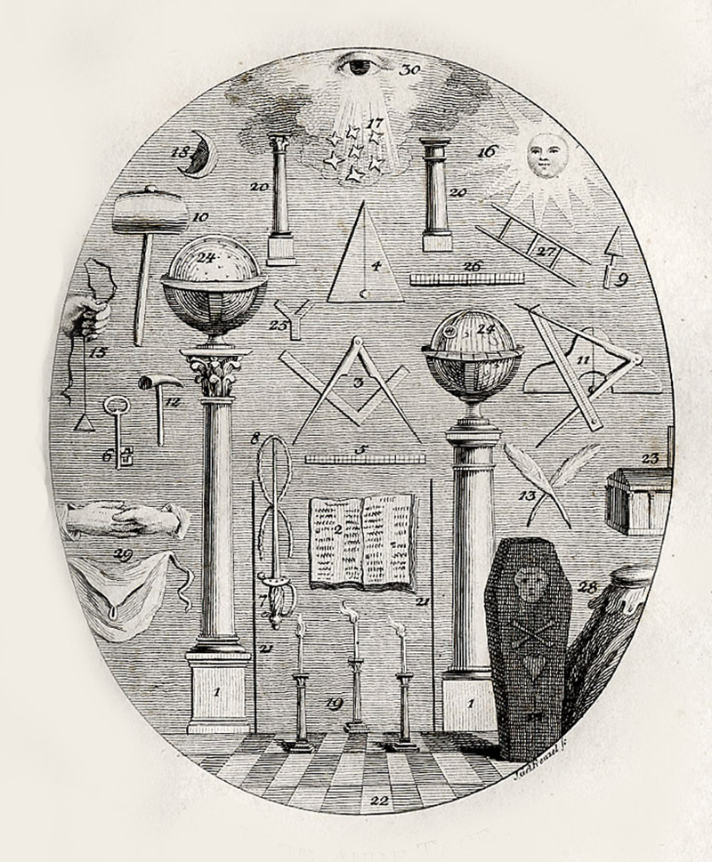
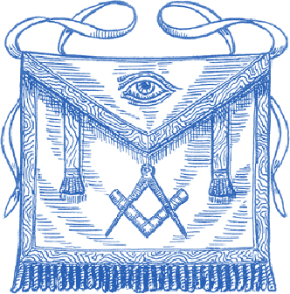
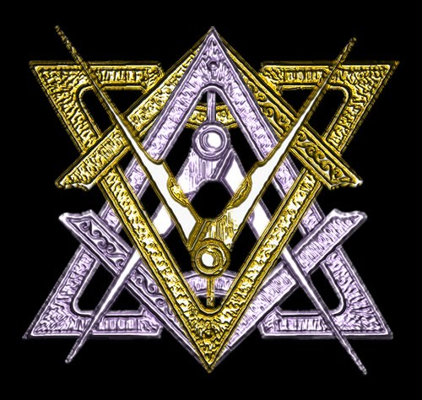
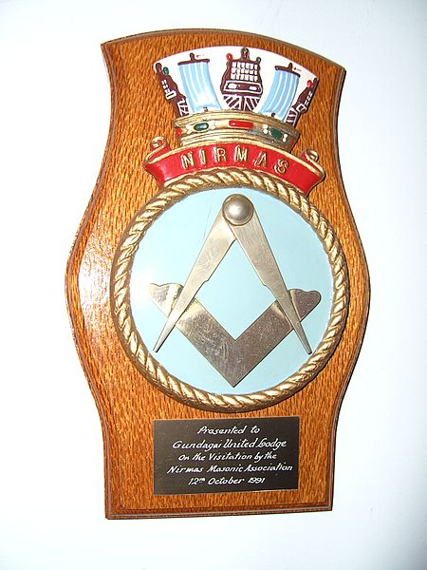
Freemasonry: brotherhood (men’s organization)
--league of men of importance, some wealthy and powerful
--organized in “lodges” or “temples” with elected leaders
--secret rituals, symbolic costumes
--members relate as equals within their lodges
--organized in 1600s / early 1700s: (England and colonial America)
A lodge master (1865)
Notes:
Freemasonry: brotherhood (men’s organization)
--league of men of importance, some wealthy and powerful
--organized in “lodges” or “temples” with elected leaders
--secret rituals, symoblic costumes
--members relate as equals within their lodges
--organized in 1600s / early 1700s

Slide 14
“Ruin and Mutiny”
Breaking the Contract (p. 1871)
marriage issue with a god or devil (p. 1873)
Biting mortality… (p. 1874)
“This business is our Fifty-Seven”
  Like 1857 Revolt—near overthrow of British India (p. 1874)
English capacity to dethrone a King? (p. 1875)
  Dravot’s end
  torture (why this form??)
  Dravot’s head! (P. 1876)
Madness induced by Empire… Tone of this story?

