Slide 1
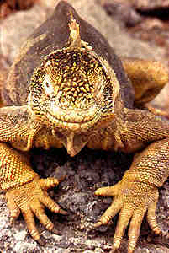
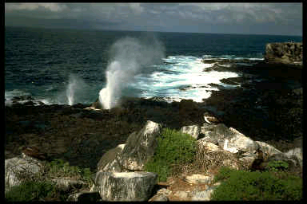

Science vs. Religion
Darwin and the Victorians

Slide 2
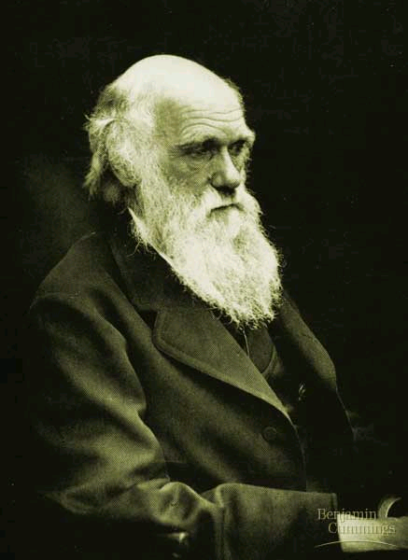
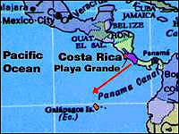
Charles Darwin the great shocker of the Victorian Age…
On the Origin of Species by Means of Natural Selection (1859)
based on research in Galapagos Islands, 1830s
theory of evolution based on “struggle for existence”: (p. 1563)
  competition between and within species in a “state of Nature”
  Most species produce far more offspring than can survive
  Nature via climate, food availability
    ”checks” survival
    shapes species (“species variation”)

Slide 3
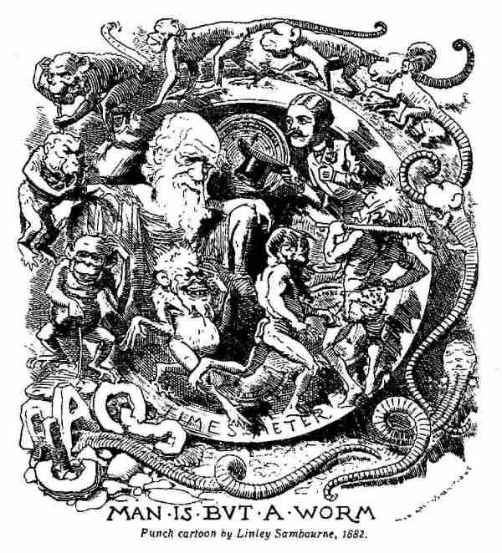

Slide 4
Evolution—not so new
Grandpa: Erasmus Darwin: The Loves of Plants (1789) / The Botanic Garden , and The Temple of Nature (1803)
Hence without parent by spontaneous birth
Rise the first specks of animated earth;
From Nature's womb the plant or insect swims,
And buds or breathes, with microscopic limbs.
ORGANIC LIFE beneath the shoreless waves
Was born and nurs'd in Ocean's pearly caves
First forms minute, unseen by spheric glass,
Move on the mud, or pierce the watery mass;
These, as successive generations bloom,
New powers acquire, and larger limbs assume;
Whence countless groups of vegetation spring,
And breathing realms of fin, and feet, and wing.

Slide 5
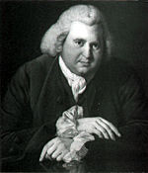

Erasmus Darwin’s motto (made for his carriage and bookplate in 1770): E conchis omnia
Everything from shells

Slide 6
19th-c. Contexts for “natural selection” and “struggle for existence”
Thomas Malthus, Essay on the Principle of Population (1798 / 1803): Human populations limited by available energy/food resources
Geology (“imperfect record”): Charles Lyell’s Principles of Geology (1830-33)--present contains secrets of past
Charles Darwin’s 1830s Voyage on The Beagle→Galapagos islands (near S. America)
1850s: Other naturalists (Alfred Russel Wallace) also arriving at Darwin’s conclusions independently
  Darwin had delayed publication—to avoid controversy
  Now (1859) finally publishes his findings

Slide 7
New methods: “scientist” (new word in the 1840s)
New views on Religion: (John Ruskin on hearing clink of geology hammers every time he hears Bible verses)
All these scientific activities anticipate the big Victorian-era shocker: Darwin’s Descent of Man, published 1872

Slide 8
Threats to Religious Faith: Victorian sense of lost foundations
Before Darwin: (Charles Lyell) geological evidence of earth’s age (“old earth” vs. “young earth”)
  Fossil records pose problem for literal interpretation of the Book of Genesis
  Philip Gosse (naturalist) tries to reconcile science with faith: The geological record is deceptive!
  (Did God hide the fossils in the rocks?) (p. 1579)
Bible as myth or history?
  “higher criticism”: Bible as historically inaccurate
  (David Strauss, The Life of Jesus Critically Examined, translated from German by George Eliot--1830s-40s

Slide 9
“All round us, the intellectual lightships had broken from their moorings….The present generation…will never know what it was to find the lights all drifting, the compasses all awry, and nothing left to steer by except the stars”
--J. A. Froude (Victorian-era historian on the 1840s). (see p. 1291: Perspectives: Religion and Science)

Slide 10
“War of Nature” / Consolation?
Origin of Species: See p. 1568
Descent of Man. See p. 1572

Slide 11
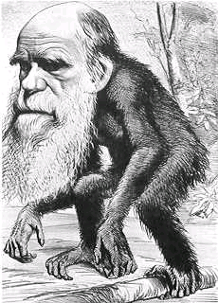
Darwin’s Descent of Man (1871)
the big shocker: HUMAN evolution!
Humanity “descends” from “less organized forms”
  Evidence in human embryos (1569)
shaped by
  “sexual selection”
  “state of nature”
Human morality—not so distinctive
(related to social instinct) (1572)
high respect for animals
  Morals and intellect reflected in “state of nature”: social instincts→survival
  Female Argus pheasants→taste/aesthetics (p. 1571)
Descent or Ascent? (last paragraph, p. 1572-73)

Slide 12
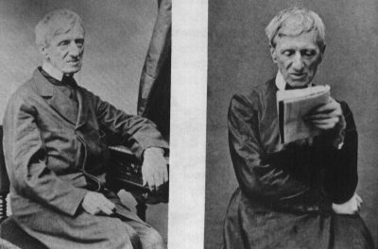
Cardinal Newman
Converts from Church of England to Catholicism
Part of larger spiritual movement reacting against science and reason: Oxford Movement
Catholicism superior to Protestantism: no questioning of mysteries and phenomena: no urges to doubt
Down with conflict and questioning—we need to be more humble
”The Church must denounce rebellion as of all possible evils the greatest. She must have no terms with it.” (p. 1397)
“When…a flood of facts…comes pouring in upon us…all believers in Revelation, be they Catholic or not, are roused to consider their bearing upon themselves…[and] are in danger of being led away into a bottomless liberalism of thought....” (1397)

Slide 13
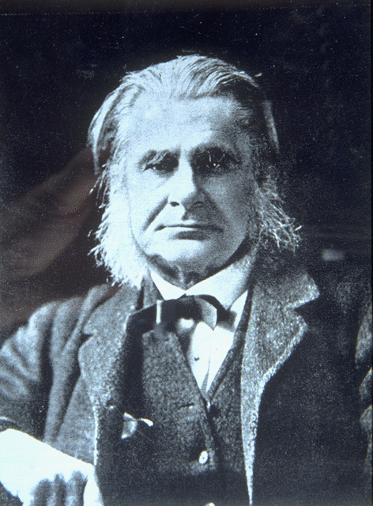
Thomas Huxley
“Darwin’s bulldog”
Takes opposite perspective from Cardinal Newman: Darwin’s theories have disproved accounts of creation:
  p. 1399: “As a natural process. . . evolution excludes creation and all other kinds of supernatural intervention.”)
But our civilization has intervened against the natural struggle for existence.
  Darwin doesn’t apply in civilized contexts!
We need to be gardeners to promote civilization
  A view easily adapted to support British Empire and its expansion around the world (without anxiety over consequent loss of lives)
“What would become of the garden if the gardener treated all weeds and slugs and birds and trespassers as he would like to be treated, if he were in their place?”
Instead, we need to tend our gardens of civilization around the world, and selectively promote what we value.

Slide 14
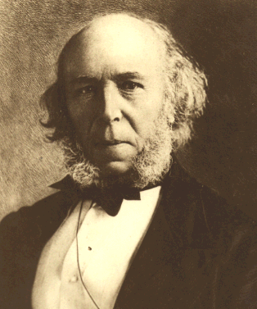
Herbert Spencer
(not in your textbook)
British philosopher promoting laissez-faire (let be) capitalism without government regulation.
He actually coined the phrase “survival of the fittest” seven years before Darwin’s Origin of Species.
Philosopher of Social Darwinism.
Darwin’s theory inspires Spencer to apply ideas of evolution to society based on individual competition. Spencer applies this in particular to Industrial societies.
“Society advances where its fittest members are allowed to assert their fitness with the least hindrance.” Government should NOT regulate this process or protect the poor and weak members of society, because that interferes with the natural process of society’s evolution.
Eventually, the poor and weak and “unfit” will decline in population, because they can’t compete. We see this happening most markedly in industry towns, where the struggle for existence is keenest!

Slide 15
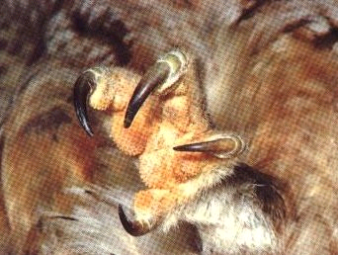
Literature and the Crisis of Faith:
Tennyson, In Memoriam:
see pp. 1187-1189, and pp. 1206-07:
“Nature, red in tooth and claw”
Some themes to watch for:
Higher divine purpose conflicts with physical nature
Savage elements within humanity:
  the poor and the uncivilized/uncolonized—struggles for existence, expression of “primal” impulses
Women and sexual selection?
Perversions of animal nature: (Rossetti’s Goblin Market)

