Slide 1
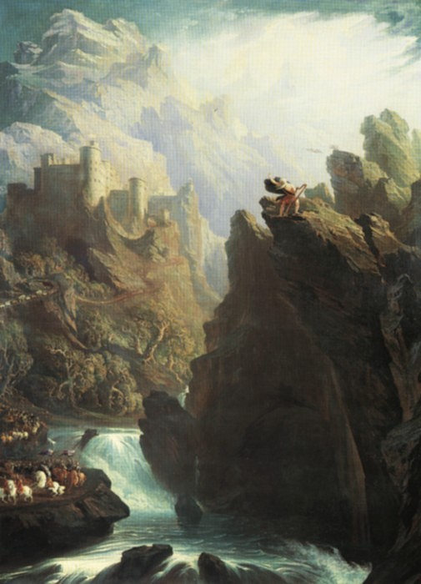
Sublime, Beautiful, and Picturesque
Philosophy, Art, and Literature

Slide 2
The Sublime vs. The Beautiful
Mid-to-late 18th-c. philosophical discussion
  Lays groundwork for content of poetry, theories of art, language, and poetry at the turn of the 19th-c.
  Helps to define “Romantic” era in in Brit Lit

Slide 3
Edmund Burke’s Philosophical Enquiry re Sublime and Beautiful (1757)
“Sublime”
  Anything that excites emotions of terror, pain, danger, astonishment
    “productive of the strongest emotion the mind is capable of feeling” (37) (Pain more powerful than pleasure)
    Fills the mind entirely, and “hurries us on by an irresistible force” (39)
  Emotions related to fear of death
  Associated with obscurity/mystery, as well as power, huge dimensions, infinity
  At safe distance, can produce delight
    Stripped of means of power, can produce contempt!

Slide 4
Edmund Burke’s Philosophical Enquiry re Sublime and Beautiful (1757)
“Beautiful”
  Inspires soothing emotions: physical pleasure, melting languor, love
  Associated with small, smooth, polished, gradual variation in women’s bodies—drawing/moving the eye
  Imperfection, women’s feigning weakness
  Non-threatening
  “beauty acts by relaxing the solids of the whole system”(42)

Slide 5
Edmund Burke’s Philosophical Enquiry re Sublime and Beautiful (1757)
  “Sublime” and “Beautiful”
    Applied to both the object that we respond to, and the emotion we produce
    Words—can produce ideas (and sublime / beautiful impressions) not found in natural objects

Slide 6
Immanuel Kant’s Critique of Judgment (1790)
Basic distinction between Sublime and Beautiful based on Burke
  Disagrees with Burke’s emphasis on physical objects in nature as sublime/beautiful
Nature is NOT sublime or beautiful in and of itself
Mind/Imagination exceeds Nature: Ideas, not objects, are sublime

Slide 7
Immanuel Kant’s Critique of Judgment (1790)
“Sublime”
  absolute greatness, exceeding what we see and know from Nature
  Imagination’s inability to make its ideas fit a reasonable, known standard
  Reason is “inadequate”
  Moves/Disturbs/Elevates the mind to new ideas, new perspectives
  Again, from a safe position, this is pleasurable

Slide 8
Immanuel Kant’s Critique of Judgment (1790)
“Beautiful”
  Idea within known limits and standards, fits, harmonizes
  Mind in a state of “restful contemplation”
Note attention to emotion and reason, as triggered by sensory experience of the outside world (“Nature” and the Senses)
Imagination: as synthesizer, categorizer, above and beyond sensory perception, emotional reaction, or reasonable limits
Moving, overflowing power of the Sublime, Resting, calming capacity of Beautiful

Slide 9
William Gilpin: picturesque
See William Gilpin, from Observations on the River Wye https://www.wwnorton.com/college/english/nael/romantic/topic_1/riverwye.htm
What is the picturesque?
NOT like the smoothness of beauty: “roughness” and “ruggedness”
In landscapes, faces— “force of expression”
  Present pursuit of the picturesque give us delight!
  “agreeable suspense”—seeking a view, comprehension
Recollection of the past—drawing/recording
  See his description of Tintern Abbey (the place, not the poem)
  Transmission to others via art:
  Creating an impression of “composition” (composite whole)
  “visions of fancy” (imagination): “sublime arrangements”

Slide 10
SONNETS
Sonnet form:
typically 14 lines, divided into units of thought: often 2 quatrains (octave) + 1 sestet.
Typically contains a “turn” of thought: Sets up an idea and responds to it, reacts to it, twists it in a new direction
Make a concise statement—tightly constructed form shapes ideas in a vivid, memorable way.
19th-c: In short form, create a comprehensive/ “composite” impression?
  Sublime, beautiful, picturesque

Slide 11
Charlotte Turner Smith
Charlotte Turner Smith helped to popularize the sonnet form at the end of the 18th c.
Poet of beaches—verges/limits (“Beachy Head”)
Influxes/Refluxes of Mind and Nature: a theme she helps to introduce to poets like Wordsworth and Coleridge
Notice Smith’s interest in the Sublime!

Slide 12
Smith vs. Wordsworth: SONNETS
Flip to these sonnets in your texts: What do you see of the sublime and the beautiful, and of the pictureseque in the language and imagery here?
Smith: “Written in the church-yard at Middlesex” and “The Sea View” (55-56)
Wordsworth: “Composed upon Westminster Bridge” (344)
“It is a beauteous evening” (345)
“The world is too much with us” (347),

Slide 13
Wordsworth’s Preface to Lyrical Ballads (2nd ed., 1800)
“I have said that each of these poems has a purpose. . .namely to illustrate the manner in which our feelings and ideas are associated in a state of excitement. . .it is to follow the fluxes and refluxes of the mind when agitated by the great and simple affections of our nature.” (p. 296)

Slide 14
Wordsworth’s Preface to Lyrical Ballads
Poet: has capacity to feel what others do—and conjure up (imagine) feelings not induced by real experience
“to let himself slip into an entire delusion”
“What then does the Poet? He considers man and the objects that surround him as acting and re-acting upon each other, so as to produce an infinite complexity of pain and pleasure.” (p. 301)

Slide 15
WW’s Preface to Lyrical Ballads
“I have said that Poetry is the spontaneous overflow of powerful feelings:
it takes its origin from emotion recollected in tranquillity:
the emotion is contemplated till by a species of reaction the tranquillity gradually disappears,
and an emotion, kindred to that which was before the subject of contemplation, is gradually produced, and does itself actually exist in the mind.
In this mood, successful composition generally begins” (p. 303)

Slide 16
WW, “Tintern Abbey”
“. . .And I have felt
A presence that disturbs me with the joy
Of elevated thoughts; a sense sublime
Of something far more deeply interfused,
Whose dwelling is the light of setting suns,
And the round ocean, and the living air,
And the blue sky, and in the mind of man,
A motion and a spirit that impels
All thinking things, all objects of all thought,
And rolls through all things” (p. 354)

